Slide 1
Plant and Animal Biotechnology
Faculty: Ach

Slide 3
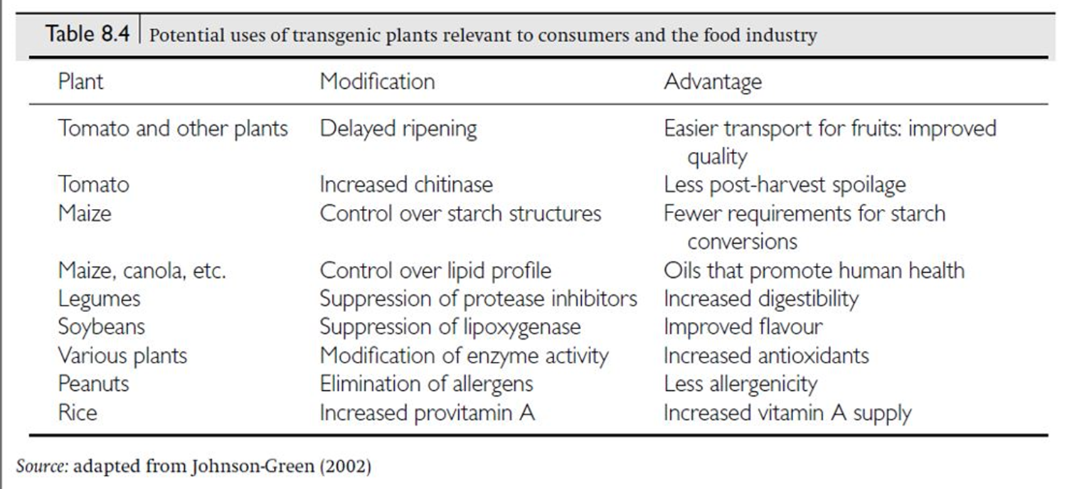

Slide 10
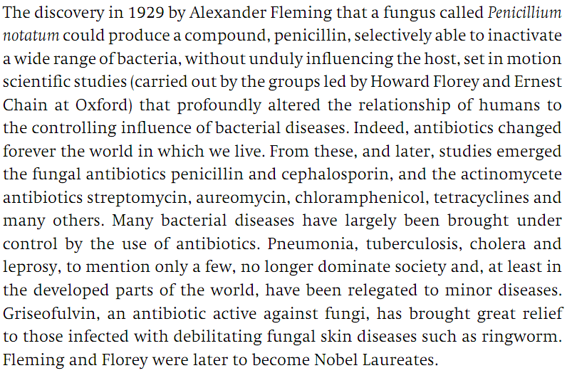
Biotechnology and Medicine
Antibiotics
Q1. Who discovered penicillin? From which organism penicillin was isolated?
Q2. Name three bacterial diseases that were prevalent in the past but they were successfully controlled by antibiotics.
Q3. Which disease can be treated by the fungal antiobiotic, griseofulvin?

Slide 11
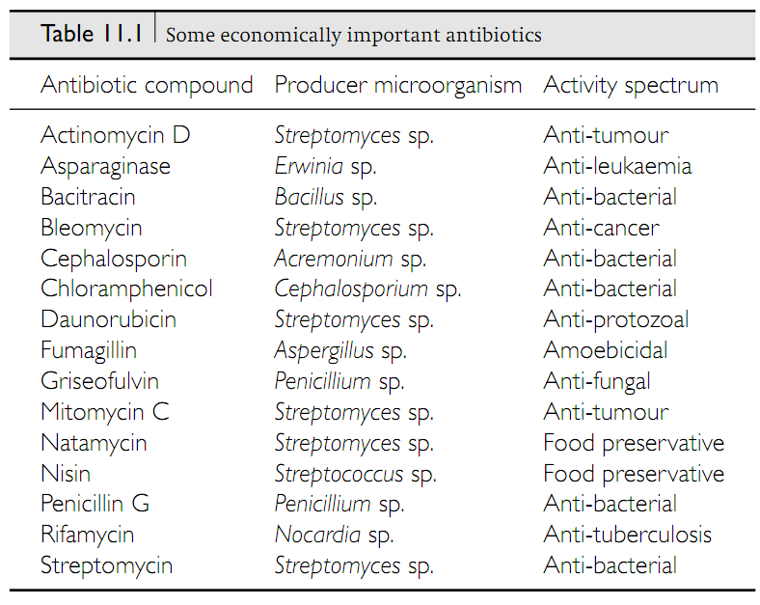
Biotechnology and Medicine
Antibiotics
Q1. Write the name, producer organism, and activity spectrum of four economically important antibiotics.

Slide 12
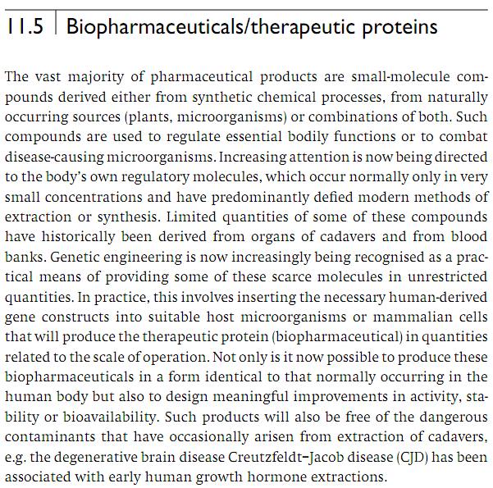
Biotechnology and Medicine
Biopharmaceuticals
Biopharmaceutical is a pharmaceutical derived from biological sources and especially one produced by biotechnology.
Q1. What is a biopharmaceutical?
Q2. Which technology is promoting production of therapeutic proteins (biopharmaceuticals)?
Q3. Apart from synthesizing larger amount of proteins, what other improvements can be done on biopharmaceuticals by genetic engineering?

Slide 13
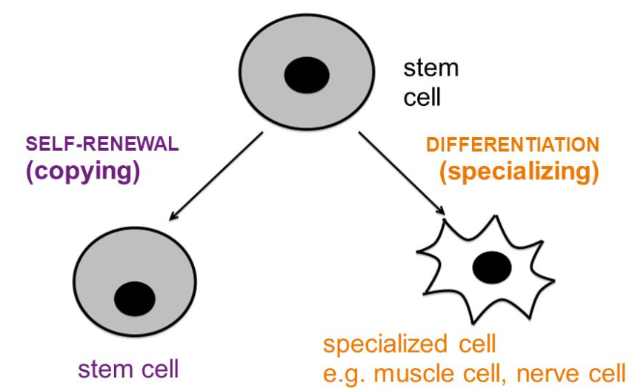
Stem Cell Biotechnology
The Nature of Stem Cells
Q1. What are stem cells?
Q2. Do stem cells have any specialized function?
Q3. In how many ways stem cells can be characterized?
http://slideplayer.com/slide/5868575/

Slide 14
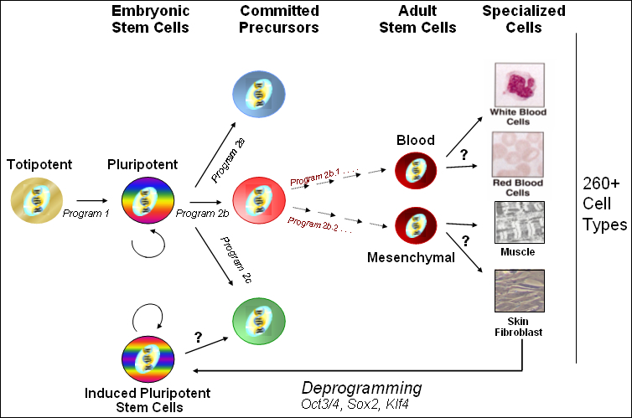
Stem Cell Biotechnology
Totipotent, Pluripotent, and Multipotent Stem Cells
https://stemcell.ny.gov/faqs/what-difference-between-totipotent-pluripotent-and-multipotent
Q1. What is the difference between totipotent, pluripotent and multipotent stem cells?
No question in exam from the image of this slide.
http://imgur.com/X1kP64Z

Slide 15
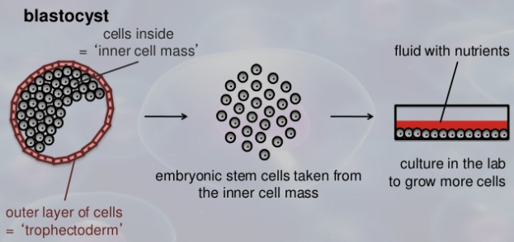
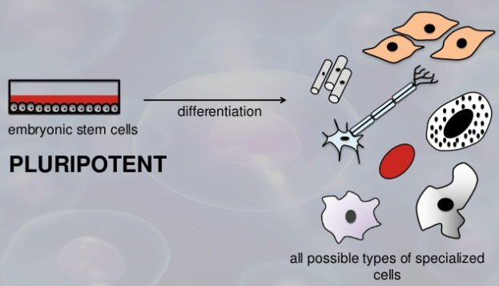
Stem Cell Biotechnology
Embryonic Stem (ES) Cells
Q1. Diagrammatically show how embryonic stem cells can be harvested from an embryo to develop specialized cells like muscle cells, liver cells etc.

Slide 16
Stem Cell Biotechnology
Advantages of Embryonic Stem Cells over Adult Stem cells
Q1. Write three comparisons between the embryonic stem cells over adult stem cells in treating human diseases.

Slide 17
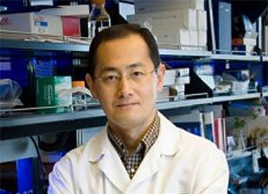
Stem Cell Biotechnology
Induced Pluripotent Stem (iPS) Cells can be generated from adult cells
Induced pluripotent stem cells (iPSCs) are adult cells that have been genetically reprogrammed to an embryonic stem cell–like state by being forced to express genes and factors important for maintaining the defining properties of embryonic stem (ES) cells.
Shinya Yamanaka of the Kyoto University, Japan developed the method of preparing iPS cells from adult cells. This procedure opens up a field of treating human diseases by stem cell therapy.
https://www.slideshare.net/drashutoshtiwari/stem-cell-therapy-36963348
Q1. What are induced pluripotent stem (iPS) cells? How one can get them? Who developed it?
Q2. What is the advantage of using the iPS cells over ES cells?

Slide 18
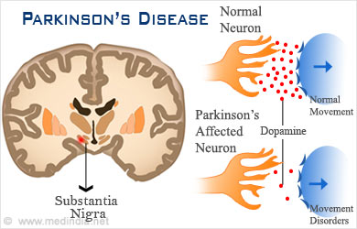
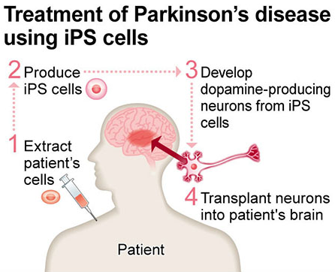
Stem Cell Biotechnology
Example of the use of iPS cells to treat disease
Parkinson’s disease is a brain disorder and a progressive disease that leads to persistent movement disorder and worsens over time.
http://www.medindia.net/patients/patientinfo/parkinsonsdisease.htm
http://ourparkinsonsplace.blogspot.com/2015_05_10_archive.html
Q1. Name a disease that can be treated with iPS cells.
No other questions from this slide.

Slide 19
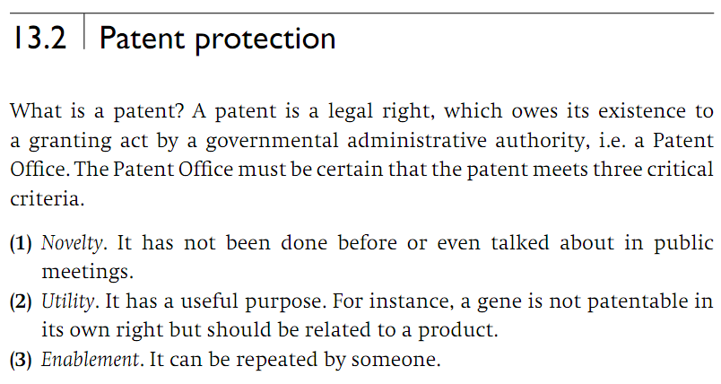
Protection of Biotechnological Invention
Patent
Q1. What is a patent?
Q2. What are three criteria that a patent must meet?

