Slide 1
BIO 201
ACh
Introduction to Biotechnology

Slide 4
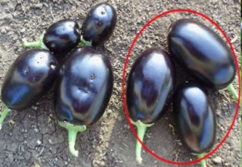
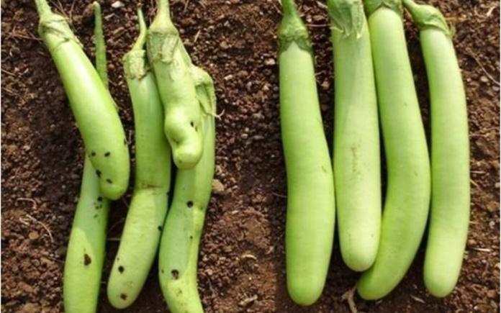
Introduction to Biotechnology
Example of application of biotechnology in modern times
In 2013, Bangladesh commercialized Bt eggplant, becoming the first developing country in the world to take a public sector genetically modified food crop to benefit smallholder farmers.
Bt eggplant (or brinjal) carries a gene that makes it resistant to the main crop pest, fruit and shoot borer. This serious pest otherwise destroys over half the crop and forces farmers to spray toxic insecticides.
Bt brinjal enables farmers to dramatically reduce their use of insecticides, by 80% or more, and thereby protect their health and the local environment.
https://www.slideshare.net/reja1310/eggplant-production-overview-by-reja
Q1. What is Bt brinjal?
Q2. How Bt brinjal was established?
Q2. What is the major benefit of using it?
http://www.smartindianagriculture.in/bangladesh-minister-takes-on-ngos-politically-shows-an-example-for-india/

Slide 5
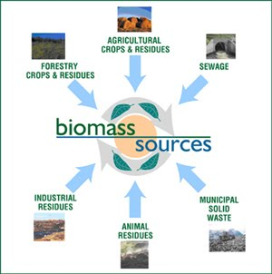
Biomass in Biotechnology
Biomass
Biomass: Renewable organic materials, such as wood, agricultural crops or wastes, and municipal wastes, especially when used as a source of fuel or energy.
Biomass can be burned directly or processed into biofuels such as ethanol and methane.
https://sites.google.com/site/bioenergyeas2/home/definition
Q1. What is biomass?
Q2. Can biomass be burnt directly?

Slide 6
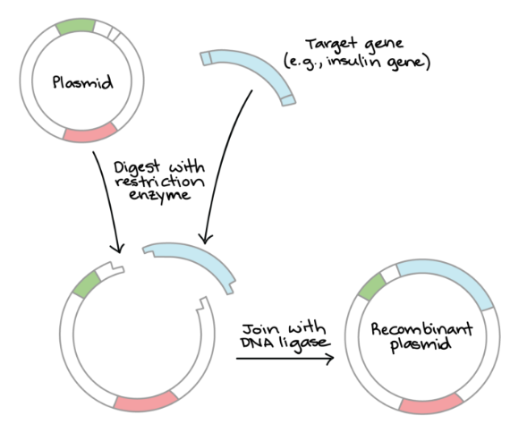
Genetics & Biotechnology
Steps of Genetic Engineering
Genetic engineering is the modern modification and subspecialty of the branch of science called biotechnology.
It deals with the specific and targeted modifications of the genetic material of bacteria, plants or animals to stimulate them biosynthesize the desired products.
https://www.khanacademy.org/science/biology/biotech-dna-technology/dna-cloning-tutorial/a/overview-dna-cloning
Q1. What is genetic engineering? What is its usefulness?
Q2. Diagrammatically show the key steps of cloning a foreign DNA into a plasmid.

Slide 7
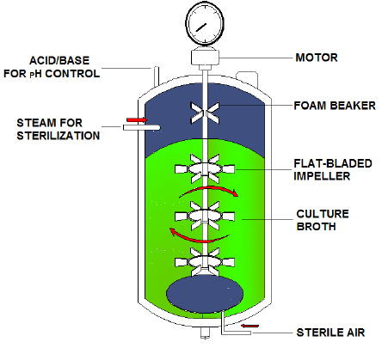
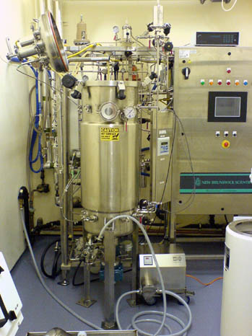
Fermentation Biotechnology
Fermentation
Fermentation is an energy-yielding anaerobic metabolic process in which organisms convert nutrients (typically carbohydrates) to alcohols and acids (lactic acid and acetic acid).
Q1. What is fermentation? Give an example.

Slide 8
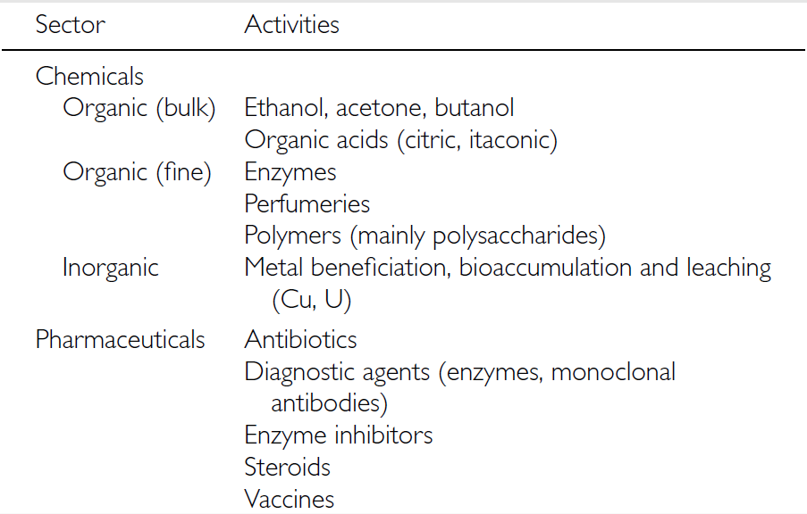
Fermentation Biotechnology
Fermentation products
Q1. Mention the industrial sectors that produce fermentation products with one example.

Slide 9
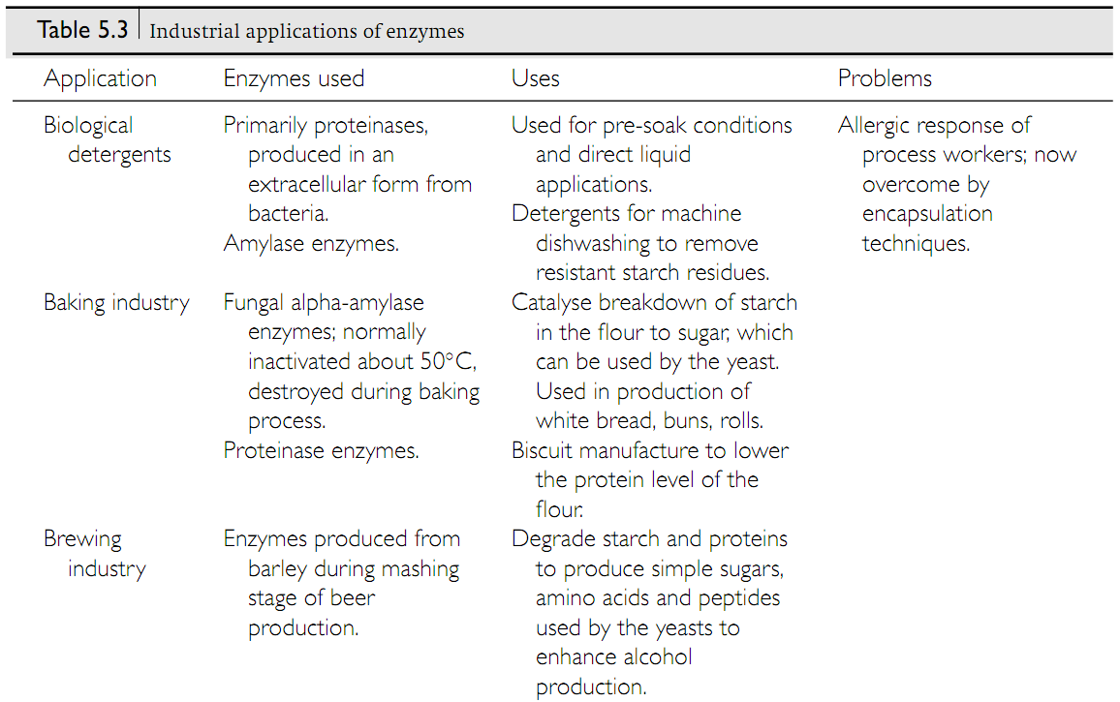
Enzyme Technology
The application of enzymes

Slide 10
Biological Fuel Generation
Bioethanol
https://www.slideshare.net/SmritiTikoo/bioethanol-production-64568557
Q1. What is bioethanol?

Slide 11
Biological Fuel Generation
Biodiesel
Q1. Mention three advantages of biodiesel over fossil fuel-derived diesel.

Slide 12
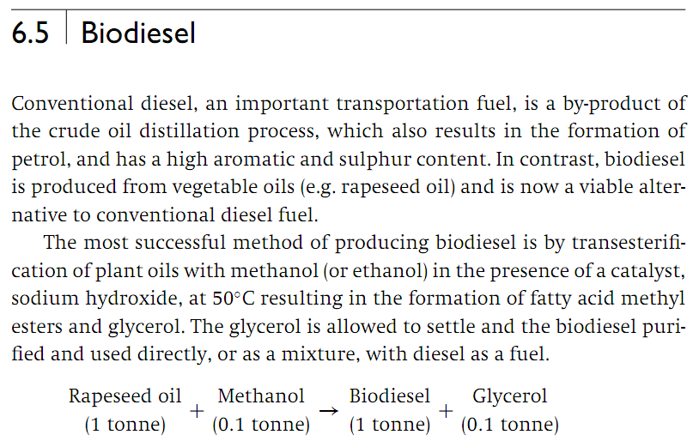
Biological Fuel Generation
Biodiesel
Q1. What is biodiesel? How can it be made from the rapeseed oil?

Slide 13
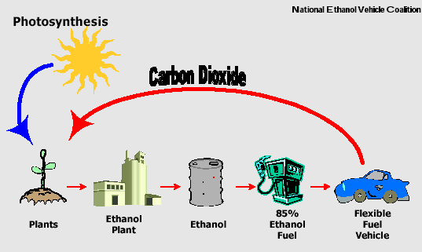
Biological Fuel Generation
Bioethanol
http://www.engineerspathshala.in/2016/04/green-technology-as-alternative-fuel-in.html
No question in the exam from this slide.

Slide 14
Environmental Biotechnology
Biodegradation
Biodegradation can be defined as the decomposition of substances by microbial activities either by single organisms but most often by microbial community.
https://link.springer.com/chapter/10.1007/978-981-287-110-7_4/fulltext.html
Q1. Schematically show how organic molecules can undergo biodegradation by natural microbes.

Slide 15
Reference Textbook: Smith Biotechnology
5th Edition
Cambridge University Press,
Cambridge, UK

