Slide 1
Reduction-Oxidation (Redox) Reaction

Slide 2
Reduction-Oxidation (Redox) Reactions
Oxidation is the loss of electrons while reduction is the gain of electrons.
Alternatively, oxidation refers to the increase in oxidation number while reduction refers to the decrease in oxidation number.
Simple mnemonic: OIL RIG
OIL → Oxidation Is Loss
RIG → Reduction Is Gain
A reducing agent loses electrons and gets oxidized.
An oxidizing agent gains electrons and gets reduced.
A redox reaction involves electron transfer. Oxidation and reduction occur together.
2Mg(s) + O₂(g) → 2MgO(s)

Slide 3
Rules for Assigning an Oxidation Number (O.N.)
General rules
1. For an atom in its elemental form (Na, O₂, Cl₂, etc.): O.N. = 0
2. For a monoatomic ion: O.N. = ion charge
3. The sum of O.N. values for the atoms in a compound equals zero. The sum of O.N. values for the atoms in a polyatomic ion equals the ion’s charge.
Rules for Specific Atoms or Periodic Table Groups
1. For Group 1A(1):
O.N. = +1 in all compounds
2. For Group 2A(2):
O.N. = +2 in all compounds
3. For hydrogen:
O.N. = +1 in combination with nonmetals
O.N. = -1 in combination with metals and boron
4. For fluorine:
O.N. = -1 in all compounds
5. For oxygen:
O.N. = -1 in peroxides
O.N. = -2 in all other compounds(except with F)
6. For Group 7A(17):
O.N. = -1 in combination with metals, nonmetals (except O), and other halogens lower in the group

Slide 4
Sample Problem 4.17
Determine the oxidation number of each element in these species:
(a) zinc chloride (b) sulfur trioxide (c) nitric acid (d) dichromate ion
SOLUTION

Slide 5
Sample Problem 4.18
Use oxidation numbers to decide whether the following is a redox reaction. If so, then identify the oxidizing agent and the reducing agent.
a) 2Al(s) + 3H₂SO₄(aq) → Al₂(SO₄)₃(aq) + 3H₂(g)

Slide 6
Sample Problem 4.18
Use oxidation numbers to decide whether the following is a redox reaction. If so, then identify the oxidizing agent and the reducing agent.
b) H₂SO₄(aq) + 2NaOH(aq) → Na₂(SO₄)(aq) + 2H₂O(l)

Slide 7
Sample Problem 4.18
Use oxidation numbers to decide whether the following is a redox reaction. If so, then identify the oxidizing agent and the reducing agent.
c) PbO(s) + CO(g) → Pb(s) + CO₂(g)

Slide 8
Types of Redox Reactions
Combination Reaction
Two or more reactants combine to form a new compound: X + Y → Z
Decomposition Reaction
A single compound decomposes to form two or more products: Z → X + Y
Displacement Reaction
metathesis or double displacement: AB + CD → AD + CB
single displacement: X + YZ → XZ + Y
Combustion Reaction
the process of burning in O₂

Slide 9
Sample Problem 4.20
Classify the following redox reaction as a combination, decomposition, or displacement reaction. Write a balanced molecular equation, and identify the oxidizing and reducing agents.
hydrogen peroxide(l) → water(l) + oxygen gas
SOLUTION
Decomposition Reaction

Slide 10
Sample Problem 4.20
Classify the following redox reaction as a combination, decomposition, or displacement reaction. Write a balanced molecular equation, and identify the oxidizing and reducing agents.
aluminum(s) + lead(II) nitrate(aq) → aluminum nitrate(aq) + lead(s)
SOLUTION
Displacement Reaction

Slide 11
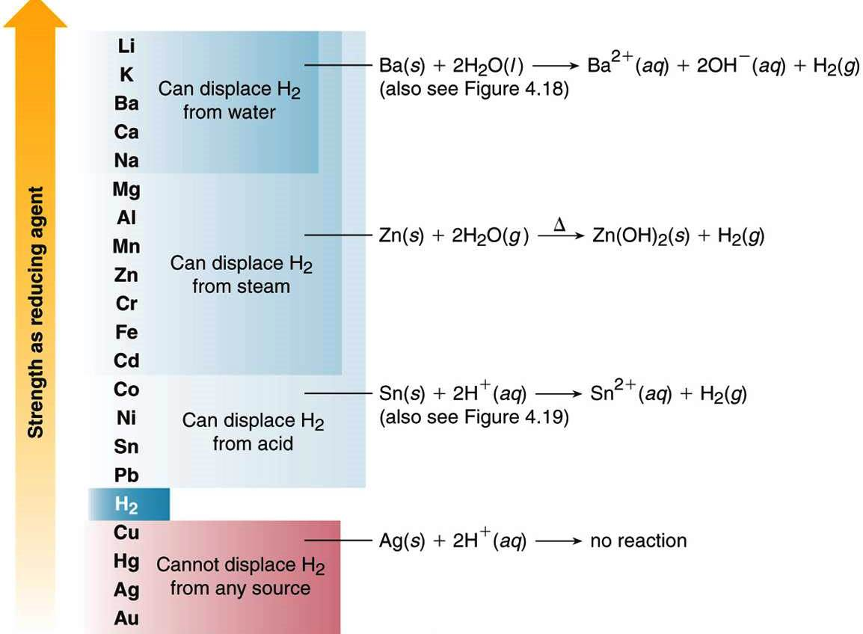
Reactivity Series of Metals

Slide 12
po → Potassium (K)
ca → Calcium (Ca)
so → Sodium (Na)
m → Magnesium (Mg)
al → Aluminum (Al)
z → Zinc (Zn)
i → Iron (Fe)
l → Lead (Pb)
hy → Hydrogen (H)
co → Copper (Cu)
m → Mercury (Hg)
si → Silver (Ag)
A Trick to Remember the Reactivity Series
po-ca-so-m-al-z-i-l-hy-co-m-si
Examples of displacement reactions

