Slide 1
The Periodic Table

Slide 2
The Periodic Table
The most popular version of the periodic table shows the elements arranged in order of increasing atomic number and grouped into periods and groups.
Each group contains elements with similar chemical properties.
In most cases, the elements in a column also have similar electronic configuration.
The two most important exceptions are hydrogen and helium.

Slide 3
The Periodic Table
Provides a basis for predicting general trends in a number of physical properties, including
the relative size of atoms and the ions they form, and
the relative ease with which atoms either gain or lose electrons.
These properties, such as:
the size of the atoms or the ions,
ionization energies,
electron affinity,
electronegativities etc.
profoundly influence the chemical behavior of elements.

Slide 4
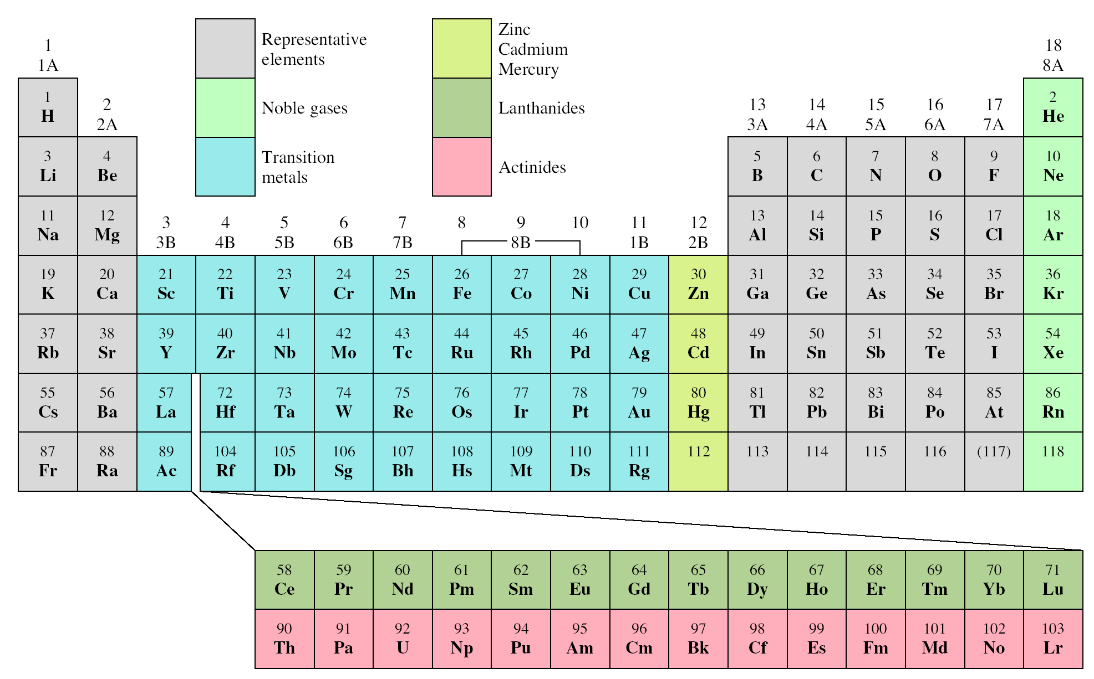
Classification of the Elements

Slide 5
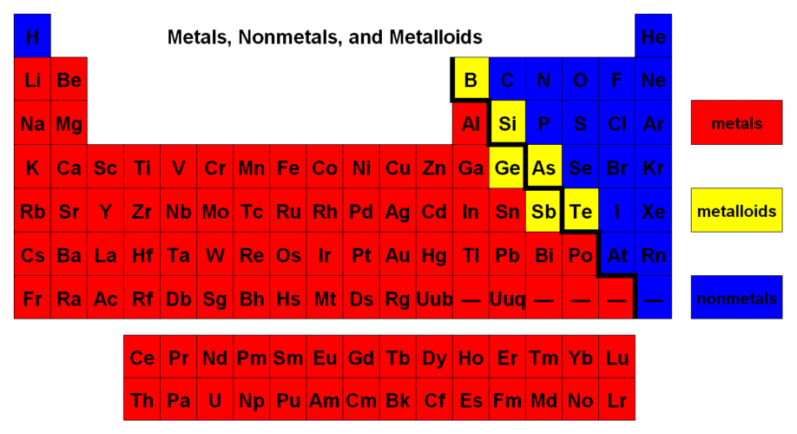

Slide 6
Metals | Metalloids | Non metals
Readily lose electrons Usually solid at room temperature (mercury is an exception) High luster (shiny) metallic appearance Good conductors of heat and electricity Malleable (can be bent and pounded into thin sheets) Ductile (can be drawn into wire) Corrode or oxidize in air and sea water Usually dense (exceptions include lithium, potassium, and sodium) May have very high melting point | Metalloids have some of the properties of metals and some nonmetallic characteristic. Dull or shiny Usually conduct heat and electricity, though not as well as metals Often make good semiconductors Often ductile & malleable May gain or lose electrons in reactions | Nonmetals exhibit very different properties from metals. Dull appearance usually brittle Poor conductors of heat and electricity Usually less dense, compared to metals Usually low melting point of solids, compared with metals Tend to gain electrons in chemical reactions

Slide 7
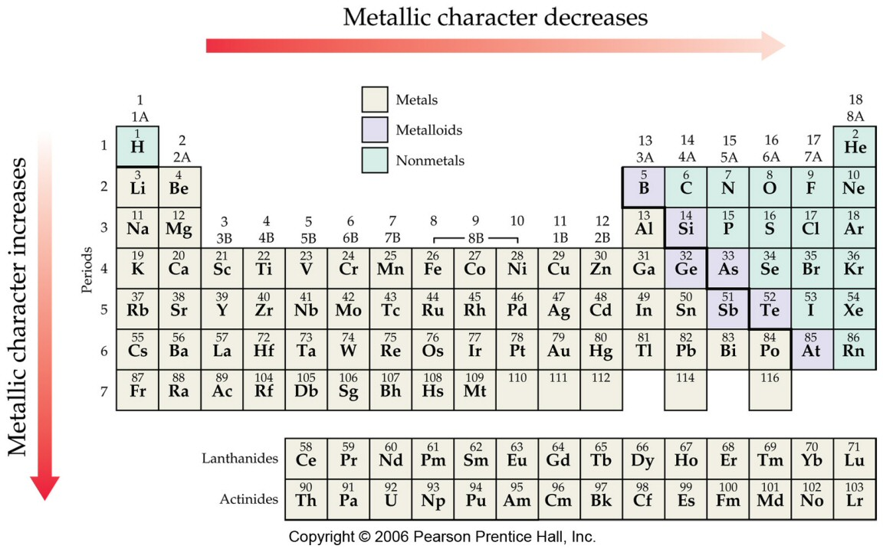
Trends in Metallic Character

Slide 8
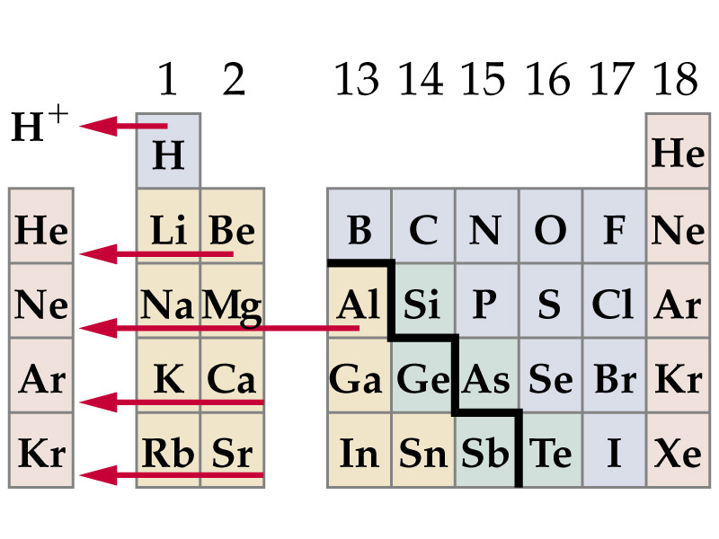
Metals Tend to Lose Electrons

Slide 9
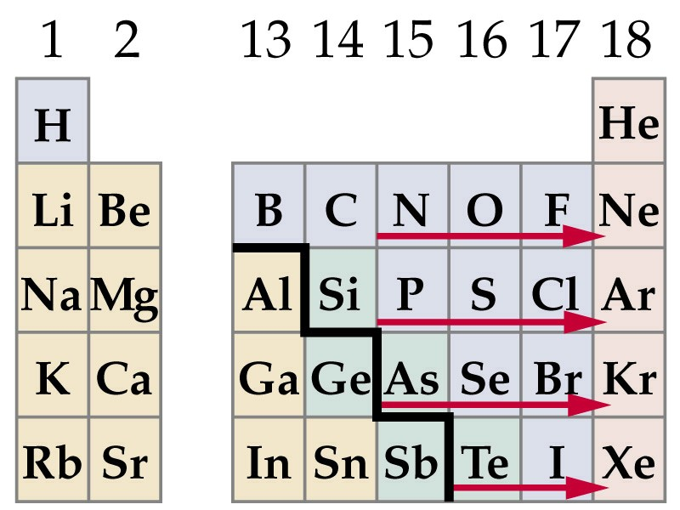
Nonmetals Tend to Gain Electrons

Slide 10
Electron Configurations of Cations and Anions of Representative Elements
Na [Ne]3s¹
Na⁺ [Ne]
Atoms lose electrons so that cation has a noble-gas outer electron configuration.
Ca [Ar]4s²
Ca²⁺ [Ar]
Al [Ne]3s²3p¹
Al³⁺ [Ne]
H 1s¹
H⁻ 1s² or [He]
Atoms gain electrons so that anion has a noble-gas outer electron configuration.
F 1s²2s²2p⁵
F⁻ 1s²2s²2p⁶ or [Ne]
O 1s²2s²2p⁴
O²⁻ 1s²2s²2p⁶ or [Ne]
N 1s²2s²2p³
N³⁻ 1s²2s²2p⁶ or [Ne]

Slide 11
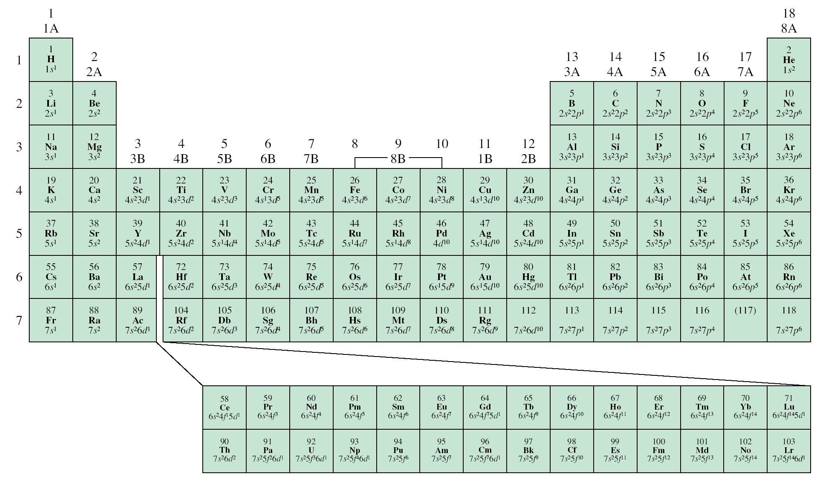
Cations and Anions of Representative Elements
+1
+2
+3
-3
-2
-1

Slide 12
Effective Nuclear Charge (Z_{eff})
Effective nuclear charge (Z_{eff}) is the “positive charge” felt by an electron.
Z_{eff} = Z - σ
0 < σ < Z (σ = shielding constant)
Z_{eff} ≈ Z – number of inner or core electrons
Z
Core
Z_{eff}
Radius (pm)
Na
11
10
1
186
Mg
12
10
2
160
Al
13
10
3
143
Si
14
10
4
132

Slide 13
Effective Nuclear Charge (Z_{eff})
Z_{eff} = Z_{actual} – No. of Core Electrons or Electron shielding

Slide 14
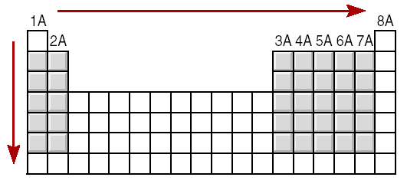
Effective Nuclear Charge (Z_{eff})
increasing Z_{eff}
decreasing Z_{eff}

Slide 15
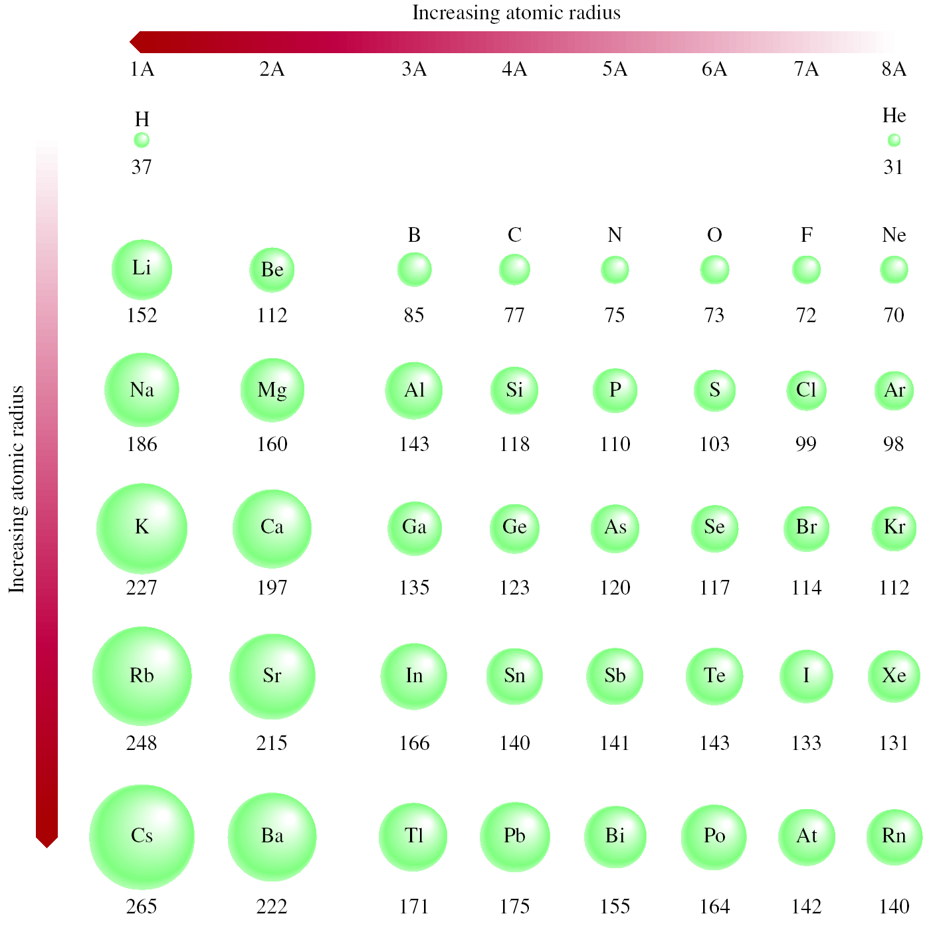

Slide 16
Atomic Radii Increases Down the Group
Group IIA
2e⁻
2e⁻
Be
Mg
Ca
Sr
Ba
Ra
Be (4p⁺ & 4e⁻)
4 p⁺
2e⁻
8e⁻
2e⁻
Mg (12p⁺ & 12e⁻)
12 p⁺
2e⁻
8e⁻
8e⁻
Ca (20p⁺ & 20e⁻)
2e⁻
20 p⁺

Slide 17
Atomic Radii Decreases Across the Period
Period 2
Li | Be | B | C | N | O
1e⁻
2e⁻
3e⁻
2e⁻
2e⁻
2e⁻
3 p⁺
4 p⁺
5 p⁺
Li (3p⁺ & 3e⁻)
Be (4p⁺ & 4e⁻)
B (5p⁺ & 5e⁻)
4e⁻
6e⁻
8e⁻
2e⁻
2e⁻
2e⁻
6 p⁺
8 p⁺
10 p⁺
C (6p⁺ & 6e⁻)
O (8p⁺ & 8e⁻)
Ne (10p⁺ & 10e⁻)

Slide 18
Atomic Radii & Ionic Radii
Cation is always smaller than atom from which it is formed.
Anion is always larger than atom from which it is formed.

Slide 19
Isoelectronic: have the same number of electrons, and hence the same ground-state electron configuration
Na⁺: [Ne]
Al³⁺: [Ne]
F⁻: 1s²2s²2p⁶ or [Ne]
O²⁻: 1s²2s²2p⁶ or [Ne]
N³⁻: 1s²2s²2p⁶ or [Ne]
Na⁺, Al³⁺, F⁻, O²⁻, and N³⁻ are all isoelectronic with Ne
What neutral atom is isoelectronic with H⁻ ?
H⁻: 1s²
same electron configuration as He

Slide 20
Radii for Isoelectronic atoms or ions
Atom or Ion Radius (nm) Electron config.
C⁴⁻ 0.260 1s²2s²2p⁶
N³⁻ 0.171 1s²2s²2p⁶
O⁻² 0.140 1s²2s²2p⁶
F⁻ 0.136 1s²2s²2p⁶
Ne 0.112 1s²2s²2p⁶
Na⁺ 0.095 1s²2s²2p⁶
Mg²⁺ 0.065 1s²2s²2p⁶
Al³⁺ 0.050 1s²2s²2p⁶

Slide 21
Ionization Energy
Ionization energy is the minimum energy (kJ/mol) required to remove an electron from a gaseous atom in its ground state.
I₁ + X _{(g)} X⁺_{(g)} + e⁻
I₁ first ionization energy
I₂ + X⁺_{(g)} X²⁺_{(g)} + e⁻
I₂ second ionization energy
I₃ + X²⁺_{(g)} X³⁺_{(g)} + e⁻
I₃ third ionization energy
I₁ < I₂ < I₃

Slide 22
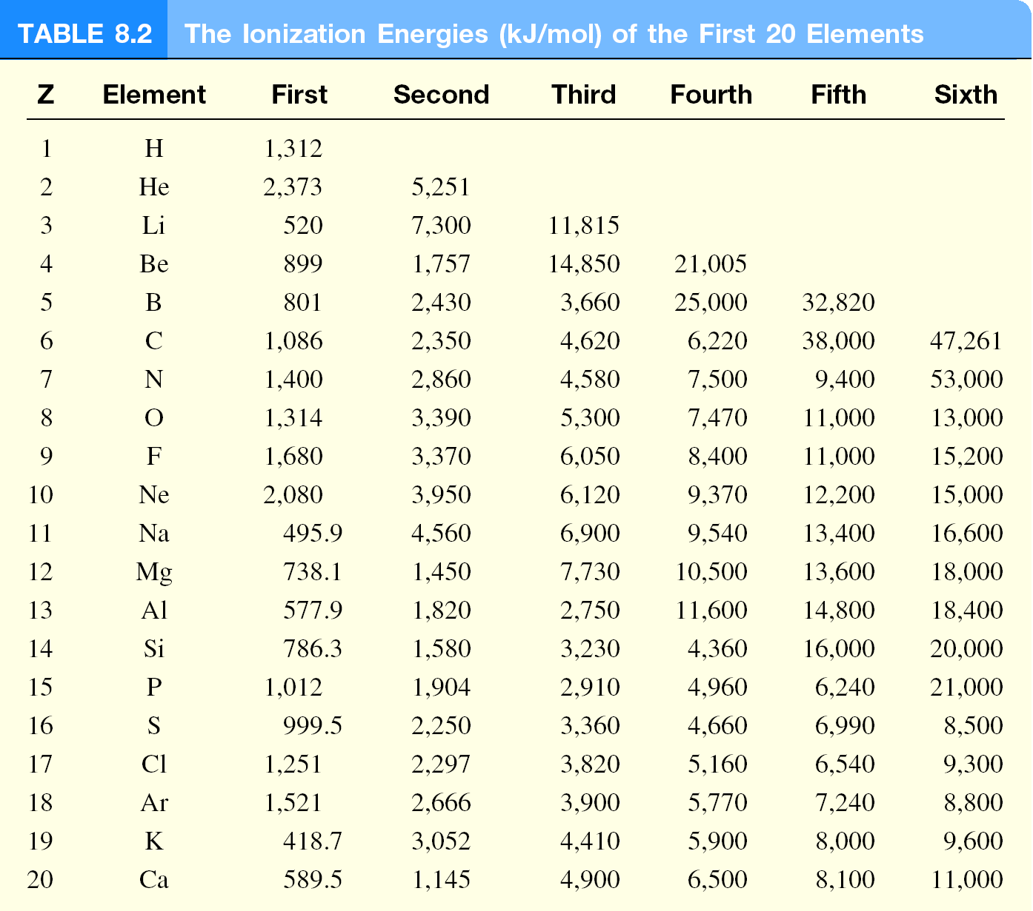

Slide 23
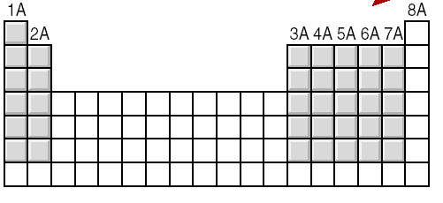
General Trends in First Ionization Energies
Increasing First Ionization Energy
Increasing First Ionization Energy

Slide 24
Electron Affinity
Electron affinity is defined as the change in energy (in kJ/mole) of a neutral atom (in the gaseous phase) when an electron is added to the atom to form a negative ion. In other words, the neutral atom's likelihood of gaining an electron.
X _{(g)} + e⁻ X⁻_{(g)}
F _{(g)} + e⁻ F⁻_{(g)}
ΔH = −328 kJ/mol
EA = +328 kJ/mol
O _{(g)} + e⁻ O⁻_{(g)}
ΔH = −141 kJ/mol
EA = +141 kJ/mol
O⁻ _{(g)} + e⁻ O²⁻_{(g)}
ΔH = +780 kJ/mol
EA = −780 kJ/mol
?
EA of O⁻ is highly –ve; i.e. O²⁻ formation is unfavorable,
electron-electron repulsion (g) > stability from noble gas configuration;
O²⁻ ion stabilized by neighboring cation, e.g. Li₂O, Mg₂O

Slide 25
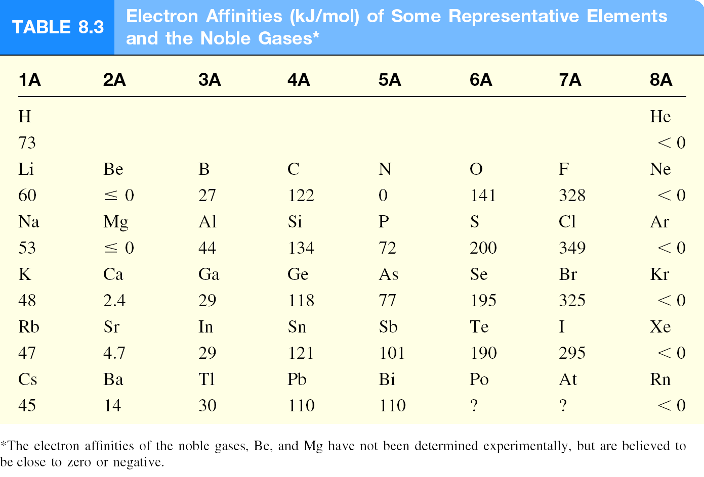

Slide 26
Periodic Properties of the Elements
Notes:
Metallic character corresponds to conductance of heat and electricity.

Slide 27
Variation in Chemical Properties of the Representative Elements
Ionization energy (IE) and electron affinity (EA) help us to understand:
the types of reactions an element undergo
the nature of the elements’ compounds formed
IE measures the attraction of an atom for its own electrons
EA expresses the attraction of an atom for additional electrons
IE and EA together gives the insight into the general attraction of an atom for electron
With these concepts we can survey the chemical behavior of the elements systematically.

Slide 28
Variation in Chemical Properties of the Representative Elements
The metallic character of the elements
decreases from left to right across a period, and
increases from top to bottom within a group
Metals usually have low ionization energies, and Nonmetals usually have high electron affinity
On the basis of these trends we can predict the outcome of a reaction involving some of these elements

Slide 29
Hydrogen (1s¹)
No suitable position for hydrogen in the periodic table, it really could be a class by itself
Like alkali metals, has a single s electron and forms H⁺ ion, which is hydrated in solution (H₃O⁺)
Also forms hydride ion H⁻ in ionic compounds, NaH, CaH₂
Hydrides reacts with water:
2NaH(s) + 2H₂O(l) → 2NaOH(aq) + H₂(g)
CaH₂(s) + 2H₂O(l) → Ca(OH)₂(s) + 2H₂(g)
Most important compound of hydrogen is water,
2H₂(g) + O₂(g) → 2H₂O(l)

Slide 30
Summary
Periodic law: When the elements are arranged in order of increasing atomic mass, certain sets of properties recur periodically.
Elements having similar physical and chemical properties fall within a column.
The elements are arranged from left to right in increasing ATOMIC NUMBER (number of protons an element has).
Rows in the periodic table are referred to as PERIODS.
Columns within the periodic table are sometimes referred to as families.
Families because the elements within the column have similar physical and chemical properties
The elements, their names, and symbols are given on the PERIODIC TABLE.

Slide 31
Group Names
Group 0 is known as noble gases
Group 1 is called alkali metal
Group 2 metals are known as alkaline earth metals
Group 7 is called Halogens

Slide 32
Group I; Properties
Soft silvery metals
Very reactive
Form ions with single positive charge
Down the group melting point decreases and reactivity increases
All their compounds are soluble in water
Nearly all compounds are stable when heated

Slide 33
Group II; Properties
Soft but not as much as Group I and slivery
Reactive but less than G I
Form ions with double positive charge
Reactivity increases down the group
Many group 2 compounds are insoluble in water as well as unstable when heated

Slide 34
Transition elements
Has high melting and boiling point
Elements and their compounds often work as catalyst
They form colored compounds
They can react with another element to form more than one compound

Slide 35
Group VII; Properties
Reactive but reactivity decreases down the group
Colored non-metals and exist as diatomic molecule
Melting point and boiling point increase down the group
React to form anions with single negative charge

Slide 36
Group VIII; Properties
Colorless gases and found in small amounts in the air
Very uncreative
Down the group, b.p increases and elements get more dense

Slide 37
