Slide 1
Ach

Slide 2
Food
Any materials that provides the nutritive requirements of an organism to maintain growth and well being.
Foods are those chemical substances which an individual takes, digests, assimilates and that provides the nutritive requirements of an individual to maintain growth and physical well being.

Slide 3
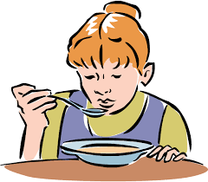

Slide 4
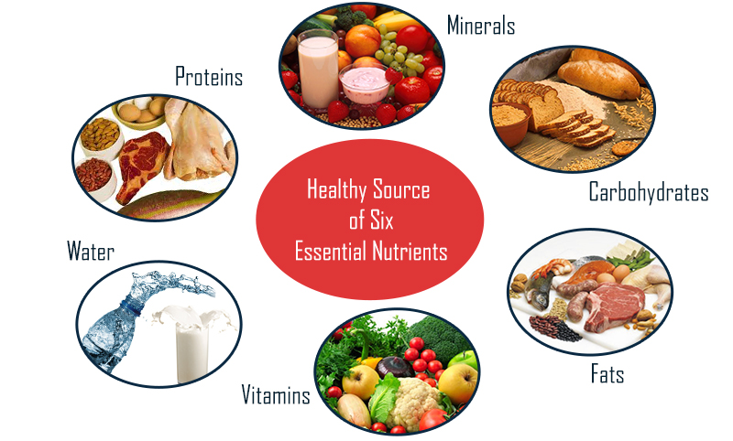

Slide 5
Calorie value of food :
a) Carbohydrate - 4.4 k.cal/g.
b) Fat - 9.3 k.cal/g.
c) Protein - 4.0 k.cal/g.
Classification of foods: (with example)
According to the source of origin | According to the calorigenicity | According to the main function
Animal foods 2. Plant foods | 1. Calorigenic foods 2. Non- Calorigenic foods | 1. Energy yielding foods 2. Body building food 3. Protective foods

Slide 6
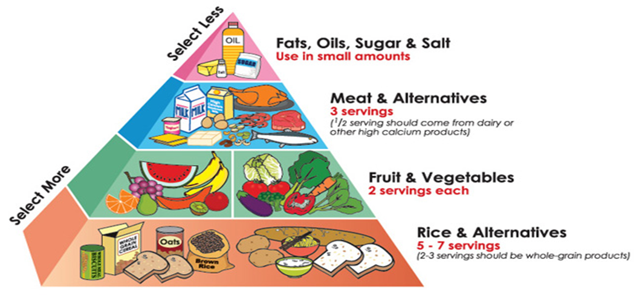
What Is a Balanced Diet?
A balanced diet is one that gives your body the nutrients it needs to function correctly. In order to get the proper nutrition from your diet, you should obtain adequate and proportionate amounts majority of your daily calories from:
fresh fruits
fresh vegetables
whole grains
legumes
nuts
lean proteins

Slide 7
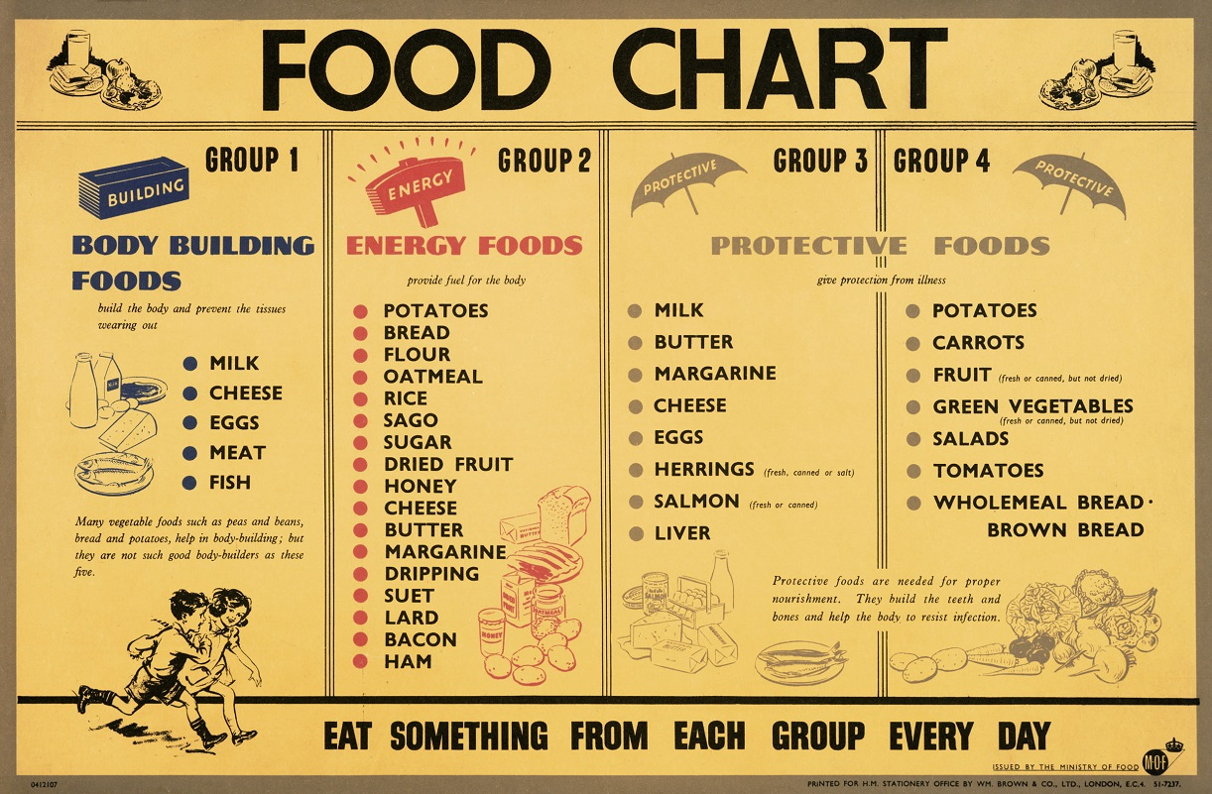

Slide 8
Criteria of a balanced diet :
It should contain all the proximate principles of food in adequate and proportionate amount.
One third to half of protein
And fat should come from animal sources.
It should contain sufficient fruits and vegetables.
It should be easily digestible , absorbable and assailable.
It should be easily available.
It should contain certain amount of cellulose to promote peristalsis.
Factors considered to
formulate a balanced diet:
Age
Sex, height, weight
Quality and quantity of food.
Socio-economical value
Seasonal factor
Geographical
Allergic condition

Slide 9
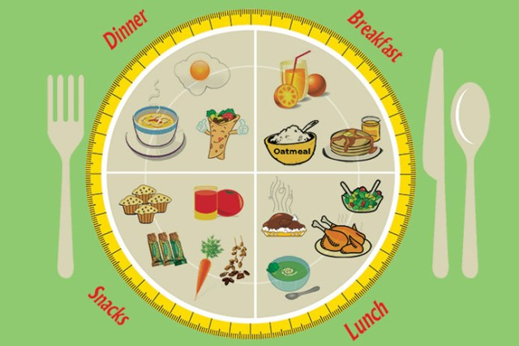
Balanced diet chart :
=> Protein 50 gm 200 k cal.
=> Fat 40 gm 360 k cal.
=> Carbohydrate 310 gm 1364 k cal.
=> Green leafy vegetables 100 gm 25 k cal.
=> Fruits 30 gm 15 k cal .
=> Others vegetable 75 gm 45 k cal.
= 2000 kcal for females and 2500Kcal for males per day

Slide 10
What foods do for you
Proteins
Although the expected amount of protein is 100 g per day, less amount can also maintain health
Larger amounts are necessary for growth, pregnancy and lactation
Protein gives 4 of energy
FATS:
Fats are high fuel value (9.3 Kcal/g)
Has got high capacity to be stored as energy in the body
Fats provide the essential fatty acids such as linoleic acid, linolenic acid etc.
Fats are essential for the absorption of fat soluble protein
The consumption of fat usually is over 80 g per day
Fat provide fat soluble vitamins i.e. A and D
Excess fat result to coronary heart disease, obesity. Cancer of bowel and breast
Carbohydrate:
Cheapest source of food.
Easily be digested, absorbed and utilized for producing energy
Carbohydrate provides 4.4 Kcal/g energy
Carbohydrates are almost entirely derived from vagetables

Slide 11
Lipid profile

Slide 12
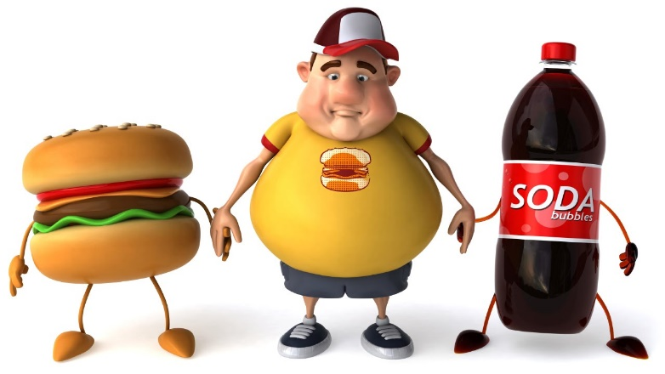
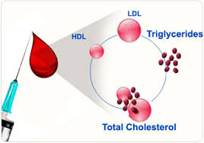
What is a lipid profile?
The lipid profile is a group of tests that are often
ordered together to determine risk of coronary heart
disease. The tests that make up a lipid profile are
tests that have been shown to be good indicators
of whether someone is likely to have a heart attack
or stroke caused by blockage of blood vessels
(hardening of the arteries).

Slide 13
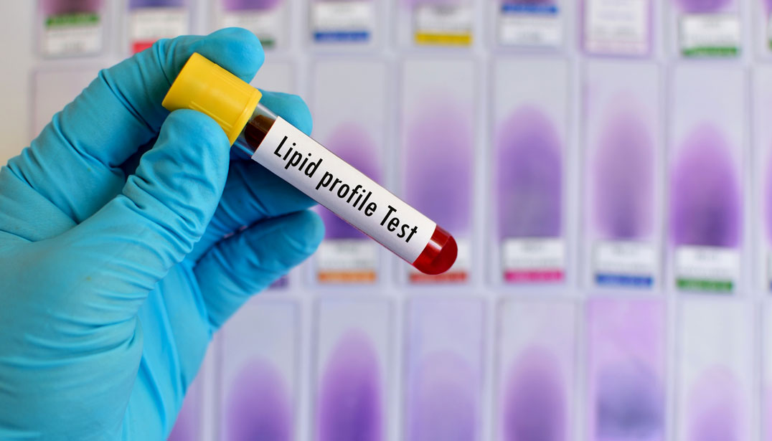
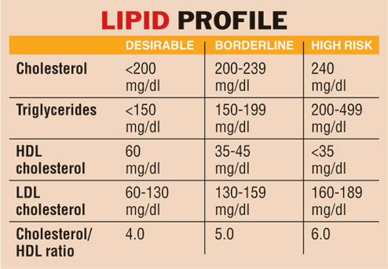
Your Lipid Profile
When doctors order a lab test called a lipid profile (sometimes called a lipid panel), they are looking for information about the amounts of four types of fats in the blood.
You will be asked to give a small sample of blood from your arm. The results can help your doctor evaluate your risk for heart disease.
What tests are included in a lipid profile?
The lipid profile includes total cholesterol,
HDL-cholesterol (often called good cholesterol),
LDL-cholesterol (often called bad cholesterol),
Triglycerides.
Sometimes the report will include additional calculated values such as the Cholesterol/HDL ratio or a risk score based on lipid profile results, age, sex, and other risk factors.

Slide 14
Cholesterol helps the body form hormones, vitamin D and other important substances, but too much of it in the blood can clog and damage the blood vessels. Because it is a fat-like substance that doesn't mix with blood, cholesterol has to combine with proteins to form lipoproteins. Lipoproteins can travel in the blood to all the organs and tissues of the body.
Low-density lipoproteins (LDLs, or "bad" cholesterol) build up in the blood and increase your risk of heart disease.
High-density lipoproteins (HDLs, or "good" cholesterol) carry cholesterol to the liver, where it is removed from the body.
Triglycerides
Stores energy for your body to use when it is needed. If there is too much, it can block blood vessels and cause other health problems such as abdominal pain and pancreatitis.

Slide 15
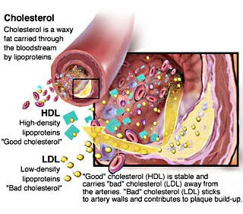

Slide 16
How is a lipid profile used?
The lipid profile is used to guide providers in deciding how a person at risk should be treated. The results of the lipid profile are considered along with other known risk factors of heart disease to develop a plan of treatment and follow-up.
Total Cholesterol (lower is better)
Best = <200 mg/dL Borderline high = 200-239 mg/dL High = 240 mg/dL or higher
Triglycerides (lower is better)
Best = <150 mg/dL Borderline high = 150-199 mg/dL High = 200-499 mg/dL Very high = 500 mg/dl or higher
LDL Cholesterol (lower is better)
Best = <100 mg/dL Good = 100-129 mg/dL Borderline high = 130-159 mg/dL High = 160-189 mg/dL Very high = 190 mg/dL or higher
HDL Cholesterol (higher is better)
Low = <40 mg/dL Best = 60 mg/dL or higher

Slide 17
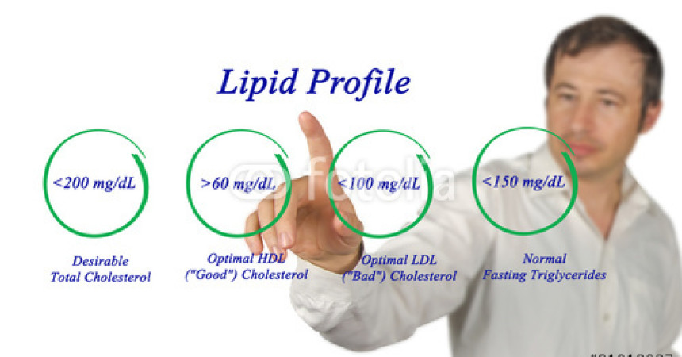

Slide 18
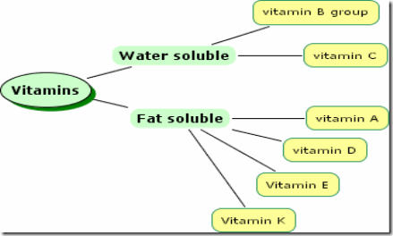
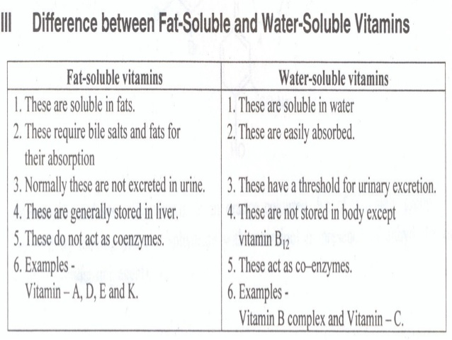

Slide 20
Vitamin, Sources and Deficiency

Slide 21
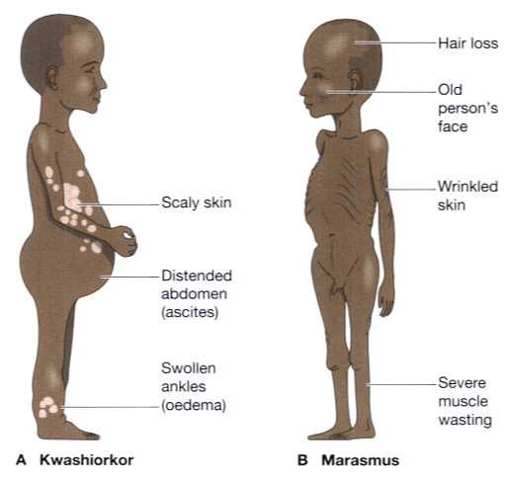
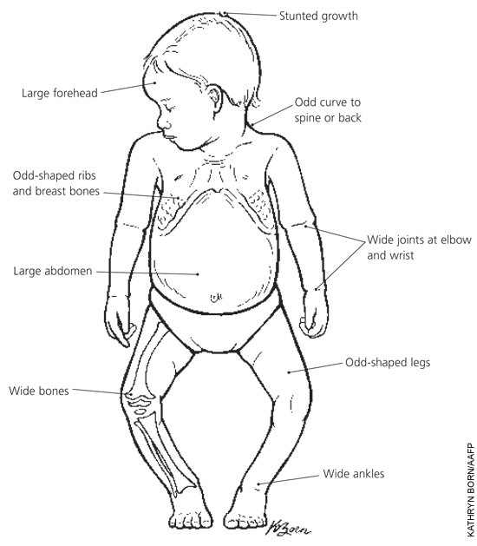
Micro Nutrient Deficiency

Slide 22
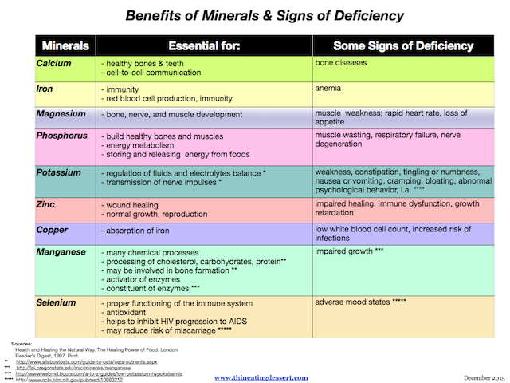

Slide 23
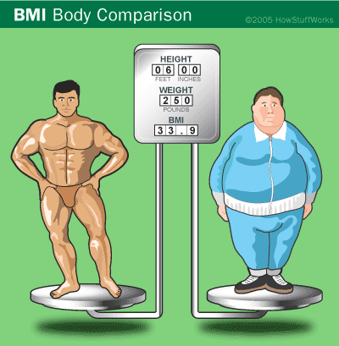
Body Mass Index

Slide 24
Introduction
The body mass index (BMI) is a statistical measurement using a person’s height and weight to determine their “healthy” body weight.

Slide 25
Introduction
BMI is controversial, because it does not actually measure a person’s percentage body fat.
It just displays what a healthy weight range would be for a person’s height.

Slide 26
Introduction
It is so easy to determine, which makes it so widespread in use.
Mathematically it is figured out by the equation on the right.
Most people, however, just use a BMI chart which are widely published.

Slide 27
International BMI Categories
Unfortunately our world is one of have and have not and consequently the WHO has added the categories of “Starvation” to anyone who has a BMI under 15 and “morbidly obese” to anyone who has a BMI over 40.
Category | BMI range – kg/m²
Starvation | less than 14.9
Underweight | from 15 to 18.4
Normal | from 18.5 to 22.9
Overweight | from 23 to 27.5
Obese | from 27.6 to 40
Morbidly Obese | greater than 40

Slide 28
Conclusion
While BMI is fast and easy to calculate, it should not be the be all end all of determining whether or not someone is at a healthy weight.
However, if someone has a low BMI or a really high BMI, that should signal the potential for health problems and that person should see their doctor to discuss this.

Slide 29
Homework
What does BMI stand for? What does it calculate?
What does BMI take into consideration in its calculation?
What are three limitations of the BMI calculation? Another way of saying this is what are three things BMI does not take into consideration.
Calculate your BMI using the BMI index and compare the category you are in with the percentile you are in on the BMI for the U20s. Are you in the same category on both charts?

