Slide 1
Molarity or Concentration

Slide 2
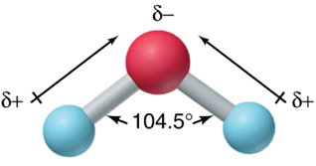
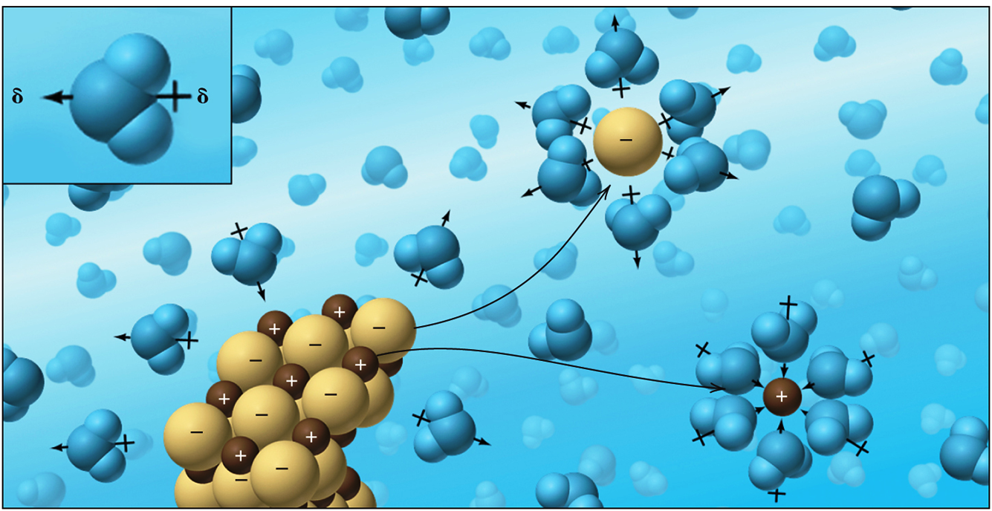
Water as a Polar Solvent
Water is a polar molecule
since it has uneven electron distribution
and a bent molecular shape.
Due to its polar nature, water interacts strongly with its solutes and often plays an active role in aqueous reactions.
Polar H₂O molecule
Cl⁻ ion surrounded by H₂O
NaCl crystal
Na⁺ ion surrounded by H₂O
Notes:
2

Slide 3
Molarity or Concentration
The concentration of a solution is given by the quantity of solute present in a given quantity of solution.
Molarity (M) is often used to express concentration. It is the number of moles of solute dissolved per liter of solution.
moles of solute
mol
Molarity =
M =
liters of solution
L

Slide 4
Sample Problem 4.5
What amount (mol) of each ion is in 35 mL of 0.84 M zinc chloride?
SOLUTION

Slide 5
Sample Problem 4.6
“Isotonic saline” is a 0.15 M aqueous solution of NaCl. How many liters of 6.0 M stock solution would you need to prepare 0.80 L of isotonic saline?
SOLUTION

Slide 6
Total and Net Ionic Equations

Slide 7
Total and Net Ionic Equations
2AgNO₃(aq) + Na₂CrO₄(aq) → Ag₂CrO₄(s) + 2NaNO₃(aq)
The total ionic equation shows all soluble ionic substances dissociated into ions.
2Ag⁺(aq) + 2NO₃–(aq) + 2Na⁺(aq) + CrO₄^{2–}(aq) → Ag₂CrO₄(s) + 2Na⁺(aq) + 2NO₃–(aq)
Spectator ions are not involved in the actual chemical change. Spectator ions appear unchanged on both sides of the total ionic equation.
2Ag⁺(aq) + 2NO₃–(aq) + 2Na⁺(aq) + CrO₄^{2–}(aq) → Ag₂CrO₄(s) + 2Na⁺(aq) + 2NO₃–(aq)
The net ionic equation eliminates the spectator ions and shows only the actual chemical change.
2Ag⁺(aq) + CrO₄^{2–}(aq) → Ag₂CrO₄(s)
Note: Solid, liquid and gas remain in their same form. They can not be broken down into ions. e.g. CaCO₃(s), H₂O(l), CO₂(g), etc.

Slide 8
Precipitation Reaction

Slide 9
Precipitation Reaction
In a precipitation reaction two soluble ionic compounds react to give an insoluble product, called a precipitate.
2AgNO₃(aq) + Na₂CrO₄(aq) → Ag₂CrO₄(s) + 2NaNO₃(aq)
A precipitation reaction is also known as a metathesis or double displacement reaction.

Slide 10
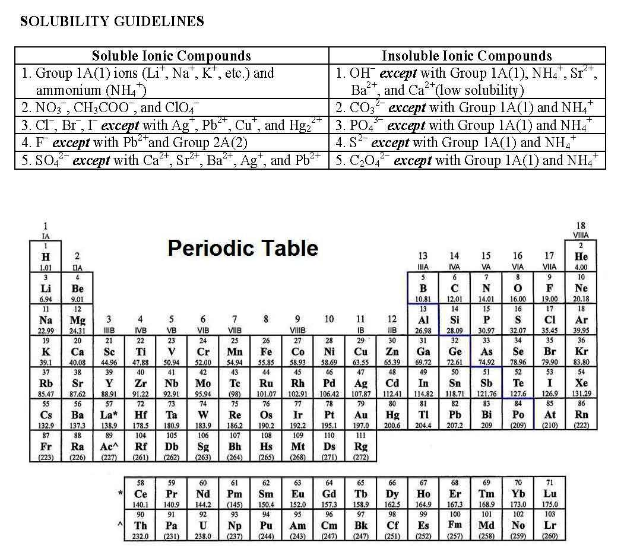

Slide 11
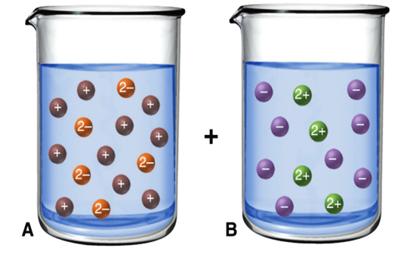
Sample Problem 4.9
The following molecular views show reactant solutions for a precipitation reaction (with H₂O molecules omitted for clarity).
a) Which compound is dissolved in beaker A: KCl, Ag₂SO₄, MgBr₂, or Na₂SO₄?
b) Which compound is dissolved in beaker B: NH₄NO₃, MgSO₄, Ba(NO₃)₂, or CaF₂?
c) Name the precipitate and spectator ions when solutions A and B are mixed, and write balanced molecular, total ionic, and net ionic equations for this process.
SOLUTION

Slide 12
Acid-Base Neutralization

Slide 13
Acid-Base Neutralization
An acid is a substance that produces H⁺ ions when dissolved in H₂O.
H₂O
→
HX H⁺(aq) + X⁻(aq)
A base is a substance that produces OH⁻ ions when dissolved in H₂O.
H₂O
→
MOH M⁺(aq) + OH⁻(aq)
An acid-base reaction is also called a neutralization reaction. A salt and water are produced.

Slide 14
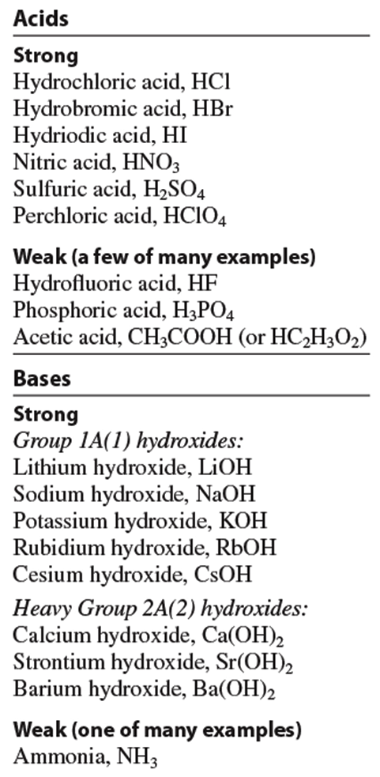
Strong Acid or Strong Base: Dissociates completely into ions
Weak Acid or Weak Base: Does NOT dissociate completely

Slide 15
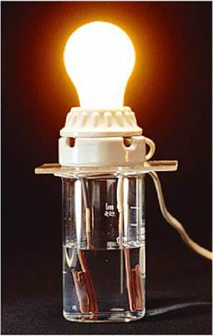
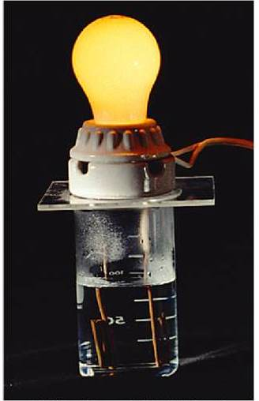
Acids and Bases as Electrolytes
Strong acids and strong bases dissociate completely into ions in aqueous solution. They are strong electrolytes and conduct well in solution.
Weak acids and weak bases dissociate very little into ions in aqueous solution. They are weak electrolytes and conduct poorly in solution.

Slide 16
Sample Problem 4.14
Write balanced, total and net ionic equations for the following reactions:
a) hydriodic acid (aq) + calcium hydroxide (aq) →
b) potassium hydroxide (aq) + propanoic acid (aq) →
SOLUTION

Slide 17
Acid-Base Titrations
In a titration, the concentration of one solution is used to determine the concentration of another.
An acid-base indicator has different colors in acid and base, and is used to monitor the progress of a titration experiment.
At the equivalence point, the mol of H⁺ from the acid equals the mol of OH⁻ ion produced by the base. i.e. pH of the solution = 7
The end point occurs when there is a slight excess of base and the indicator changes color permanently. i.e. pH is slightly greater than 7

Slide 18
Sample Problem 4.16
A 50.00 mL sample of HCl is titrated with 0.1524 M NaOH. The buret containing NaOH reads 0.55 mL at the beginning and 33.87 mL at the end point. Find the molarity of the HCl solution.
Ans: 0.102 M

Slide 19
CLASS ACTIVITY
Problem 4.37
Barium nitrate solution reacts with aqueous sodium carbonate to form a solid precipitate of barium carbonate and aqueous sodium nitrate. Write down (a) the balanced chemical equation, (b) total ionic equation, and (c) net ionic equation.
Problem 4.44 a)
Potassium carbonate solution reacts with aqueous barium hydroxide to form a solid precipitate of barium carbonate and aqueous potassium hydroxide. Write down (a) the balanced chemical equation, (b) total ionic equation, and (c) net ionic equation.
Problem 4.45 b)
Ammonium sulfate solution reacts with aqueous barium chloride to form a solid precipitate of barium sulfate and aqueous ammonium chloride. Write down (a) the balanced chemical equation, (b) total ionic equation, and (c) net ionic equation.

