Slide 1
BIO201 Introduction to Biochemistry & Biotechnology
Lecture #9

Slide 2
Lehninger
Principles of Biochemistry
Chapter 9
DNA-based information technologies

Slide 3
DNA-Based Information Technologies
Genomics & Proteomics
Genome: A genome is the complete set of genetic information in an organism.
Genomics: Genomics is an area within genetics that concerns the sequencing and analysis of an organism's genome.
Proteome: A proteome is the complete set of proteins expressed by an organism.
Proteomics: Proteomics is the large-scale study of proteomes.
Q1. Define genome and genomics.
Q2. Define proteome and proteomics.

Slide 4
DNA-Based Information Technologies
DNA is the major source of molecular insights
Q1. What is the major source of molecular insights of cells?

Slide 5
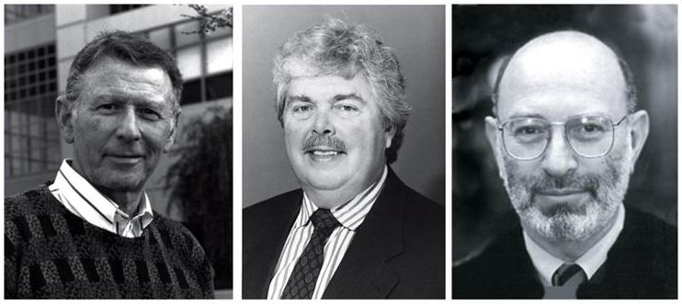
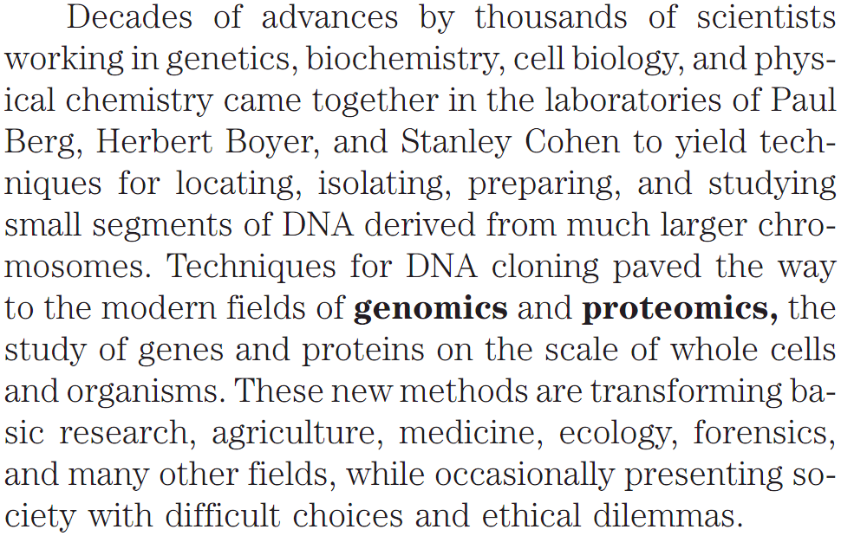
DNA-Based Information Technologies
The Pioneers of DNA Cloning
Q1. Name the three scientists who are the pioneers of DNA cloning.

Slide 6
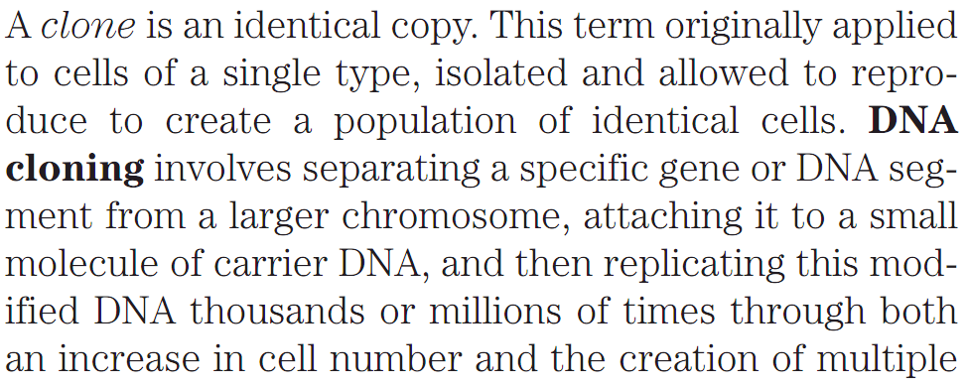
DNA-Based Information Technologies
DNA Cloning
Q1. What is a clone?
Q2. What are the three stages of DNA cloning?

Slide 7
DNA-Based Information Technologies
Five General Procedures/Steps of DNA Cloning
Cloning of DNA from any organism entails five general procedures:
1. Cutting DNA at precise locations. Sequence-specific endonucleases (restriction endonucleases) provide the necessary molecular scissors.
2. Selecting a small molecule of DNA capable of self-replication. These DNAs are called cloning vectors (a vector is a delivery agent). They are typically plasmids or viral DNAs.
3. Joining two DNA fragments covalently. The enzyme DNA ligase links the cloning vector and DNA to be cloned. Composite DNA molecules comprising covalently linked segments from two or more sources are called recombinant DNAs.
4. Moving recombinant DNA from the test tube to a host cell that will provide the enzymatic machinery for DNA replication.
5. Selecting or identifying host cells that contain recombinant DNA.
The methods used to accomplish these and related tasks are collectively referred to as recombinant DNA technology or, more informally, genetic engineering.
Genetic Engineering: Genetic engineering, also called genetic modification, is the direct manipulation of an organism's genome using biotechnology.
Q1. What are the five general steps of DNA cloning?
Q2. What is genetic engineering?

Slide 8
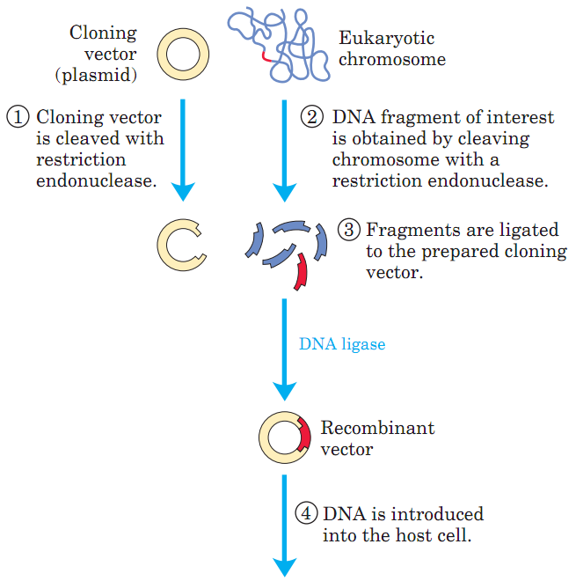
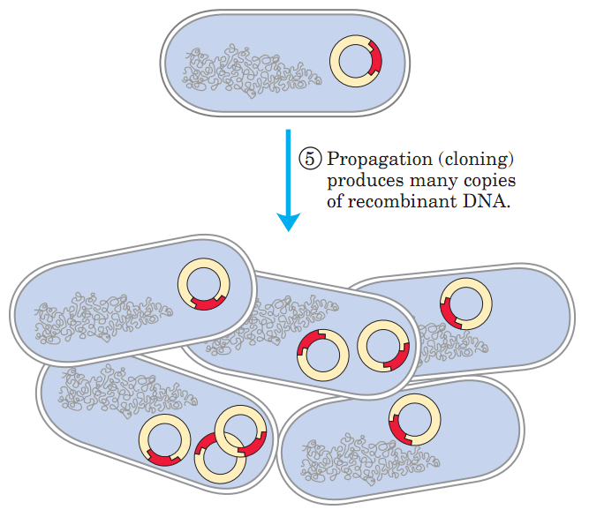
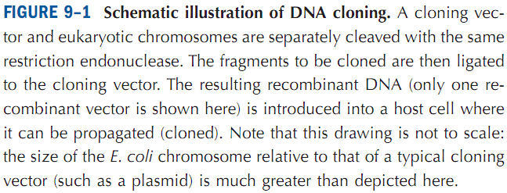
DNA-Based Information Technologies
Five General Procedures/Steps of DNA Cloning
Q1. Schematically show the five general steps of DNA cloning.

Slide 9
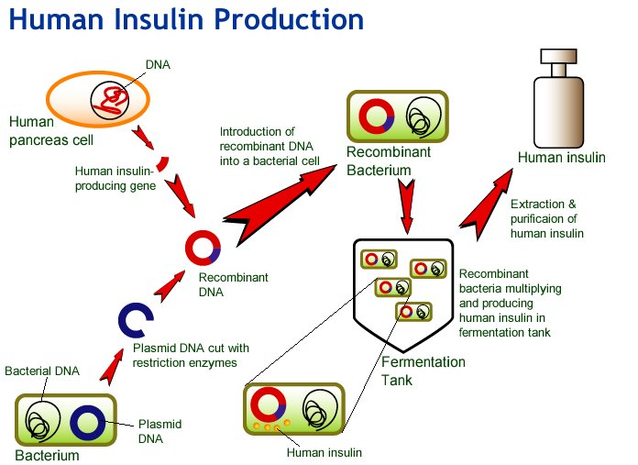
DNA Cloning
Genetic methods in Biotechnology
The biotechnology industry employs genetic techniques to develop and mass-produce substances of commercial value.
Growth hormone, insulin, and clotting factor are now produced commercially by genetically engineered bacteria.
http://biotech4you.com/biotech-notes/recombinant-dna-technology/83-human-insulin-production-by-genetic-engineering
Q1. Give an example of the successful use of genetically engineered bacteria in biotechnology.

Slide 10
DNA cloning
Plasmids
Plasmids: A plasmid is a small, circular, double-stranded DNA molecule that is distinct from a cell's chromosomal DNA. Plasmids naturally exist in bacterial cells, and they also occur in some eukaryotes. Often, the genes carried in plasmids provide bacteria with genetic advantages, such as antibiotic resistance.
Q1. What are plasmids?
Q2. What is the benefit of bacteria in nature to keep plasmids?
Q3. Why plasmids are important in molecular biology?

Slide 11
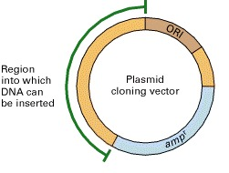
DNA Cloning
Cloning plasmids or Cloning vectors
Cloning plasmids: A vector that is used for cloning of a DNA fragment is called a cloning plasmid.
It has three major parts:
An origin for replication;
A selection marker (for example, an antibiotic-resistance gene like amp^{r});
Multi-cloning site for inserting the gene-of-interest.
A cloning vector
https://www.ncbi.nlm.nih.gov/books/NBK21498/
Q1. What is cloning plasmid or cloning vector?
Q2. Show the essential parts of a cloning plasmid.

Slide 12
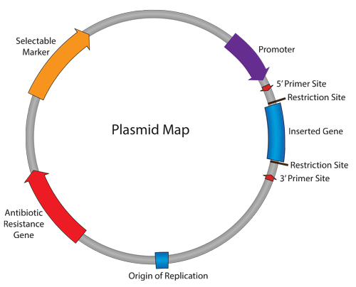
DNA Cloning
Producing large amounts of a protein using Expression plasmid
Expression plasmids or vectors not only allow the isolation and purification of a plasmid DNA but also drives the expression of gene within the insert DNA resulting in the production of the gene-product or protein.
An Example of Expression Plasmid Map
http://blog.addgene.org/plasmid-101-origin-of-replication
http://slideplayer.com/slide/5673384/
Q1. What is an expression plasmid?
Q2. What is the key difference between a cloning and an expression vector?
No question on the image of the expression plasmid.

Slide 13
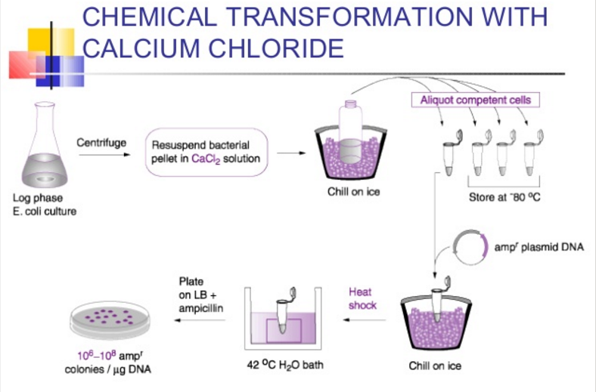
DNA Cloning
Transforming bacteria with plasmid DNA
Bacterial transformation: The process of transferring exogenous DNA into cells is called bacterial transformation. Various commercially available E. coli strains are used for this purpose.
E. coli cells have cell wall and they do not take up DNA molecules from solution readily.
Two methods to transform E. coli with plasmid DNA:
heat-shock transformation (chemical transformation with CaCl₂);
electroporation.
http://www.slideshare.net/TapeshwarYadav1/dna-cloning-49765396
Q1. What is bacterial transformation?
Q2. What are the two methods to transform E. coli with plasmid DNA?

Slide 14
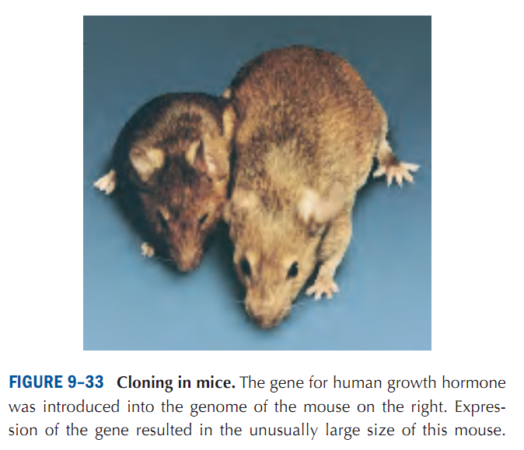
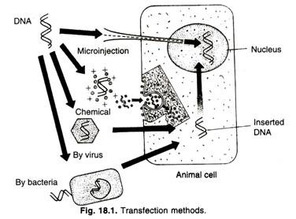
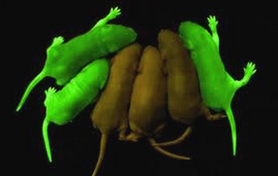
DNA Cloning
Transfecting animal cells with plasmid DNA
Transfection: The process of transferring exogenous DNA into animal cells is called transfection. In animals, the word “transformation” means progression of animal cells into a cancerous state, and this why the word “transfection” is used when exogenous DNA is introduced into an animal cell.
Electroporation
http://www.biologydiscussion.com/animals-2/transgenic-animals/methods-used-for-creation-of-transgenic-animals/12123
http://www.biology4friends.org/bacterial-transformation-lab1.html
Q1. What is transfection of animal cells?
Q2. Mention at least five methods of transferring exogenous DNA into animal cells.
No question on Figure 9-33 of this slide in exam.

Slide 15
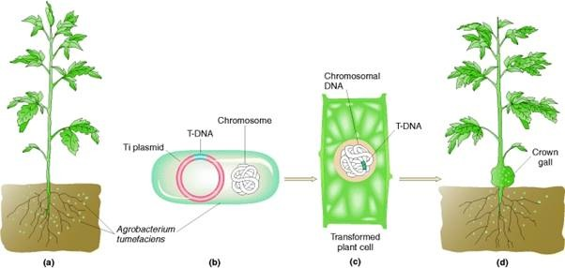
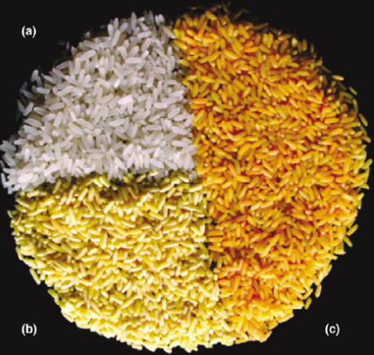
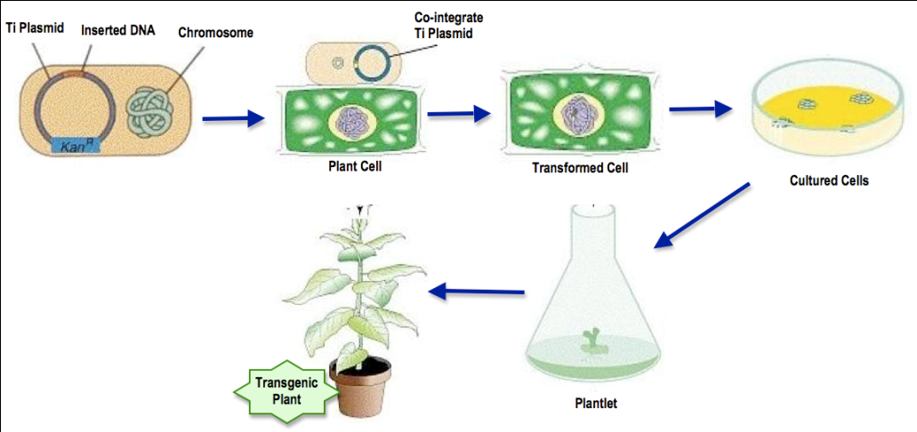
DNA Cloning
Transforming plant cells with plasmid DNA
The most-widely used method to create transgenic (genetically modified) plants is to use the bacterium, Agrobacterium tumefaciens.
The Ti (tumor-inducing) plasmid of A. tumefaciens is modified so that it carries the “gene-of-interest”. The bacterium then delivers the gene-of-interest to the target plant.
http://www.biologyexams4u.com/2012/12/steps-involved-in-agrobacterium.html
Golden Rice colors. (a) Wild-type rice; (b) Golden Rice 1 (GR1); (c) GR2.
https://www.researchgate.net/figure/7470279_fig2_Figure-3-Golden-Rice-colors-a-Wild-tape-rice-b-GR1-expressing-the-phytoene
Q1. Which bacterium is used to create transgenic plants? What is Ti plasmid?
No question on the images of this slide in exam.
http://2010.igem.org/Team:Nevada/Agrobacterium_Transformations

Slide 16
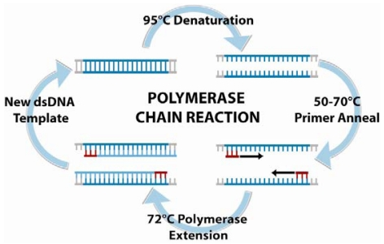
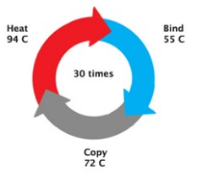
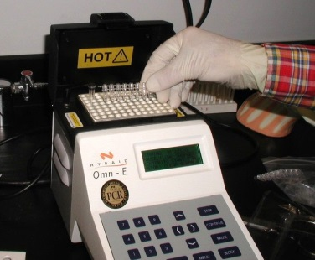
Amplification of DNA
Polymerase Chain Reaction
PCR: The polymerase chain reaction (PCR) is a process used in molecular biology to amplify a single copy or a few copies of a piece of DNA across several orders of magnitude, generating thousands to millions of copies of a particular DNA sequence.
Steps in PCR: There are three steps in PCR.
Heat denaturation step at 90-95°C.
Primer annealing step at 40-60°C.
Extension step at 70-75°C by Taq or Pfu polymerase.
The PCR machine repeats the denaturing, annealing and elongating temperatures ~ 30 times.
https://www.researchgate.net/figure/223138442_fig5_Polymerase-chain-reaction-PCR-is-an-amplification-based-technique-for-DNA-detection
A typical thermal cycler
or PCR machine
http://slideplayer.com/slide/7463460/
http://www.paulvanouse.com/dwpcr.html
Q1. What is PCR? How many steps are there in a PCR?
No question on the images of this slide in exam.

Slide 17
Amplification of DNA
Applications of PCR
http://www.slideshare.net/giumtell_2000/polymerase-chain-reaction-yazd1011
http://www.slideshare.net/saurabh784/different-pcr-techniques-and-their-application-38000297
Q1. Who invented PCR?
Q2. Write any three applications of PCR.

Slide 18
Next Lecture: Biological Membranes
Reference Textbook: Lehninger Principles of Biochemistry
4th or 5th Edition
Chapter 11
David L. Nelson, Michael M. Cox WH Freeman & Company,
New York, USA

