Slide 1
BIO201 FALL 2017 Introduction to Biochemistry & Biotechnology
Lecture #8
2017-10-22

Slide 2
Lehninger
Principles of Biochemistry
Chapter 8
Nucleic Acids

Slide 3
Nucleic Acids

Slide 4
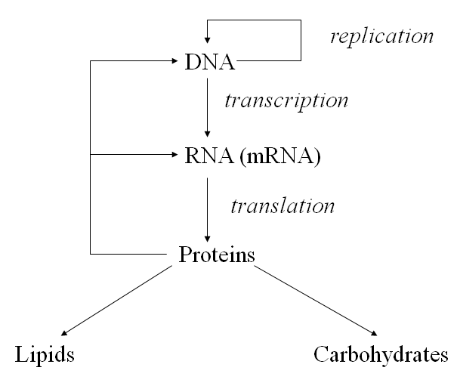
Nucleic Acids store all the information for biological processes
Cellular Processes
Q1. Which biomolecules store all the information to carry out all biological processes?

Slide 5
Nucleic Acids store all the information for biological processes
Gene
A segment of a DNA molecule that contains the information required for the synthesis of a functional biological product, whether protein or RNA, is referred to as a gene.
A cell typically has many thousands of genes, and DNA molecules, not surprisingly, tend to be very large. The storage and transmission of biological information are the only known functions of DNA.
Q1. What is a gene?
Q2. What are the only known biological functions of DNA?

Slide 6
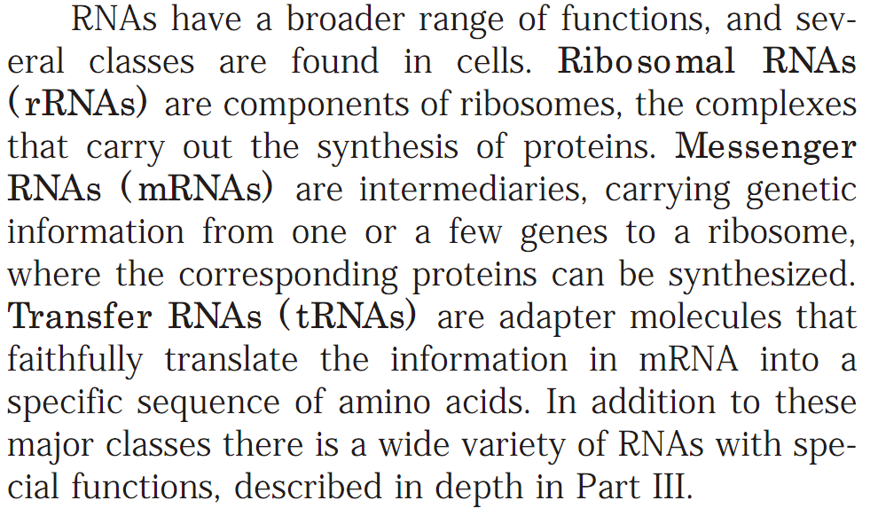
Nucleic Acids store all the information for biological processes
Types of RNAs
Q1. What is a gene?
Q2. What is the only known biological functions of DNA?

Slide 7
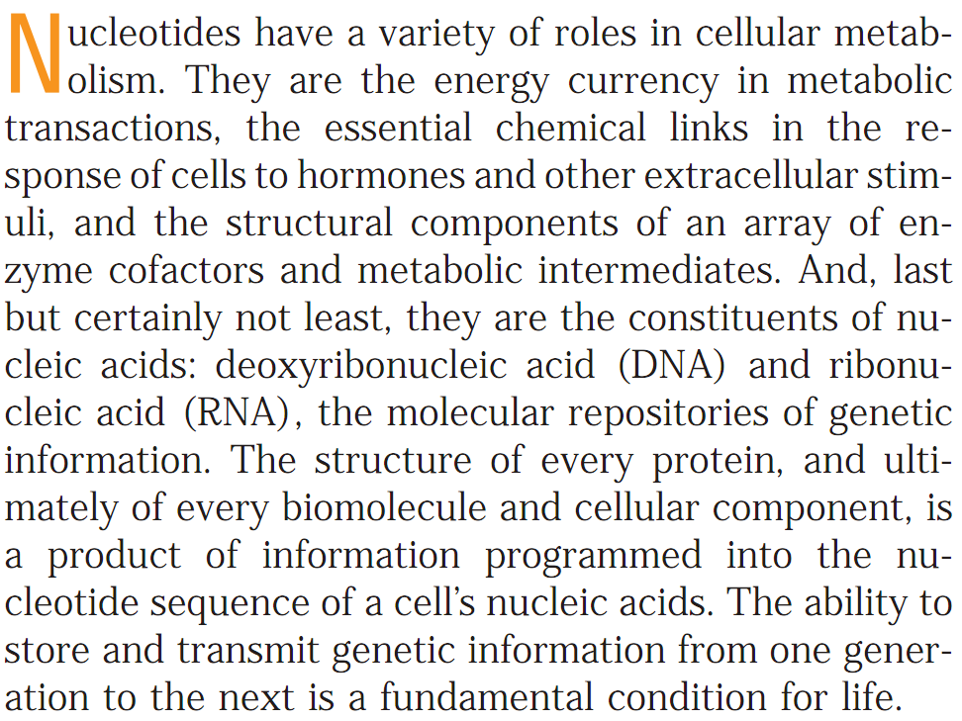
Nucleic Acids
Nucleotides are the constituents of Nucleic Acids
Q1. What is the most important function of nucleotides in cells?

Slide 8
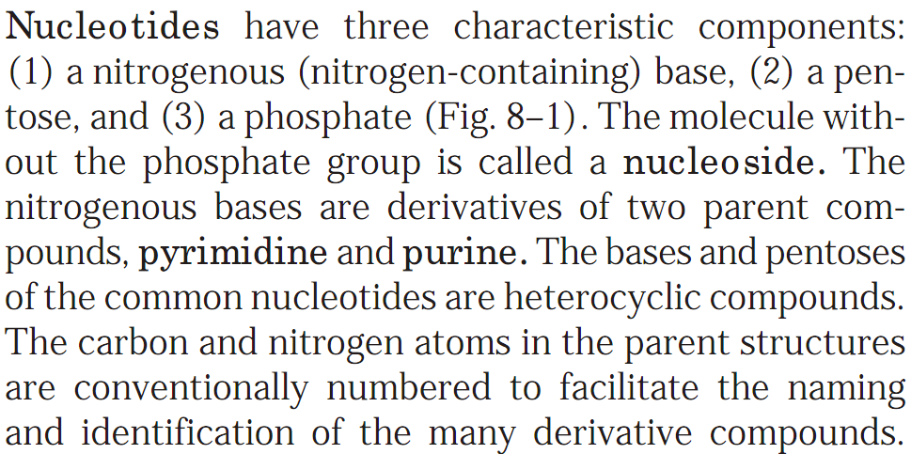
Nucleic Acids
Nucleotides
Q1. What are the three components of nucleotides?
Q2. What is a nucleoside?
Q3. Name the two parent compounds from which the nucleotide bases are derived.

Slide 9
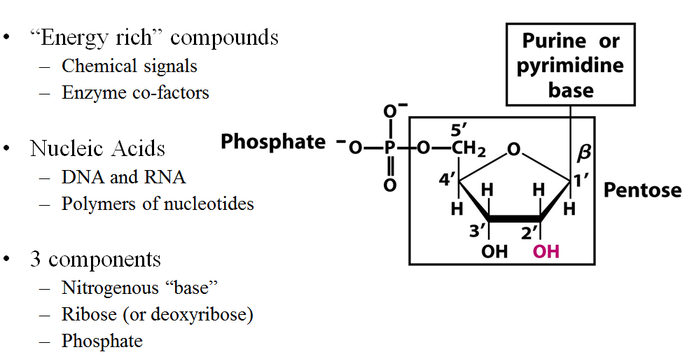
Nucleic Acids
Nucleotides
Q1. Draw the general structure of nucleotides.
Q2. What are the two different types of nucleic acids present in cells?

Slide 10
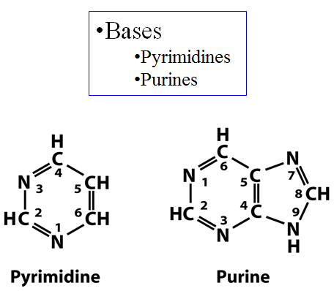
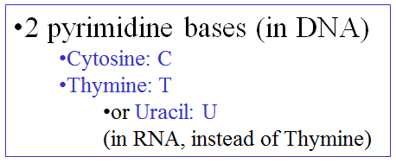
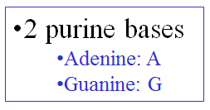
Nucleic Acids
The Bases of Nucleotides
Q1. Draw the structures of pyrimidine and purine.
Q2. What are the pyrimidine bases in cells?
Q3. What are the purine bases in cells?

Slide 11
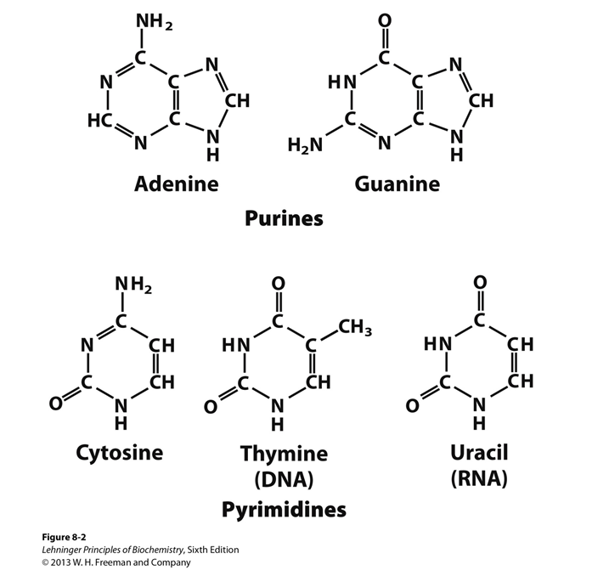
Nucleic Acids
Structures of the Bases of Nucleotides
Q1. Draw the structures of the purine bases of cells.
Q2. Draw the structures of pyrimidine bases of cells.

Slide 12
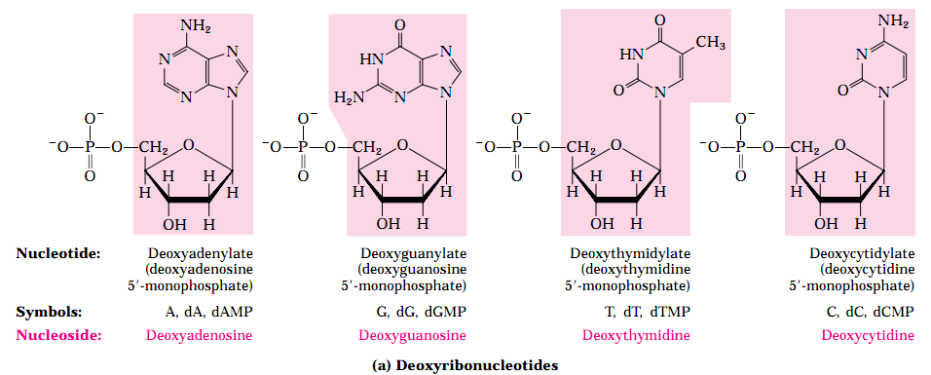
Nucleic Acids
Structures of the Deoxyribonucleotides
Q1. Draw the structures of deoxyribonucleotides.

Slide 13
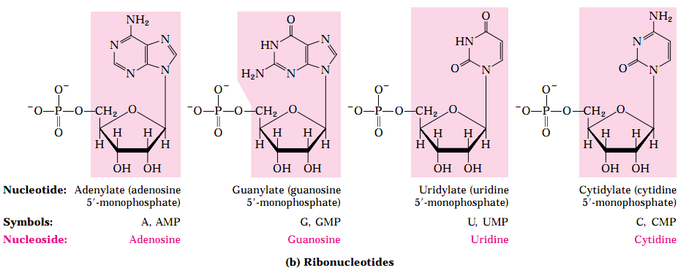
Nucleic Acids
Structures of the Ribonucleotides
Q1. Draw the structures of ribonucleotides.

Slide 14
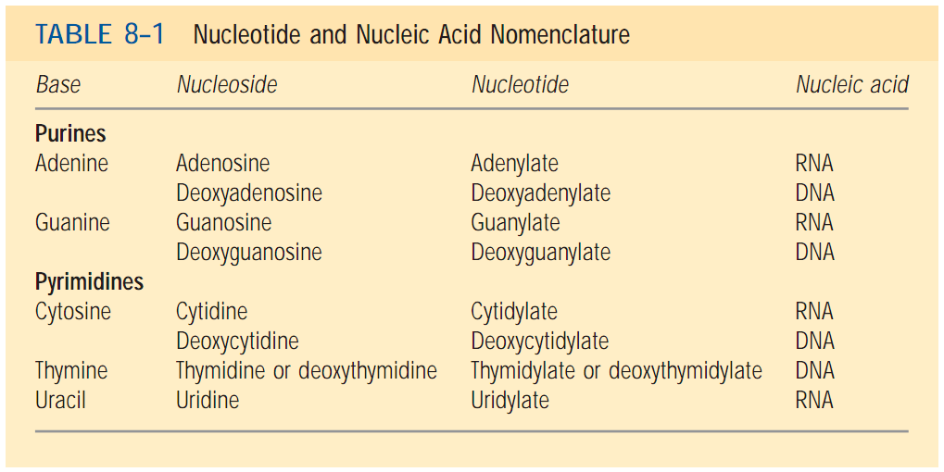
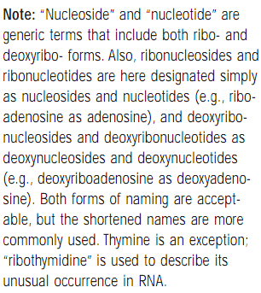
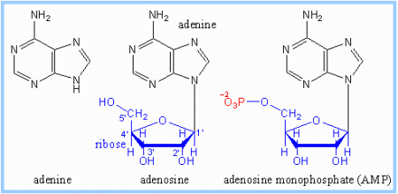
Nucleic Acids
Structures of the Ribonucleotides
Example:
A Base
A Nucleoside
A Nucleotide
Q1. Draw the structures of a base, a nucleoside, a nucleotide.
https://selfhacked.com/2015/10/06/about-adenosine-and-the-adenosine-deaminase-gene-rs73598374/

Slide 15
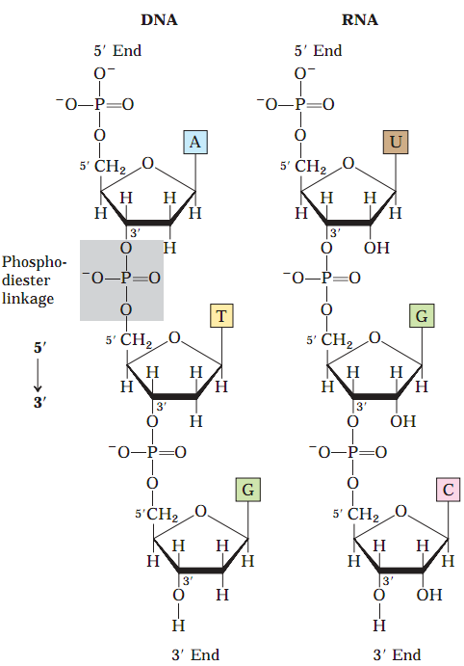
Nucleic Acids
Structures of the Ribonucleotides
Q1. Diagrammatically show the phosphodiester linkages in the covalent backbone of DNA and RNA.

Slide 16
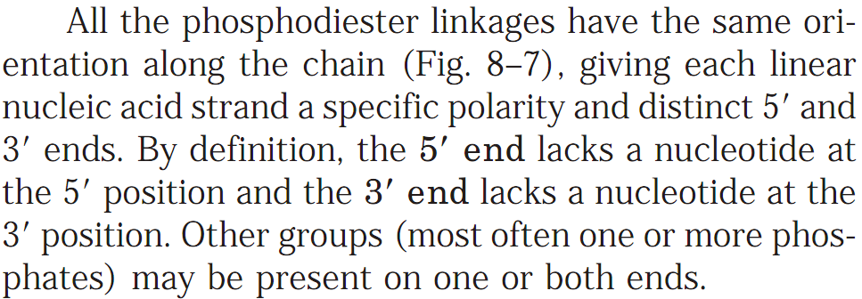
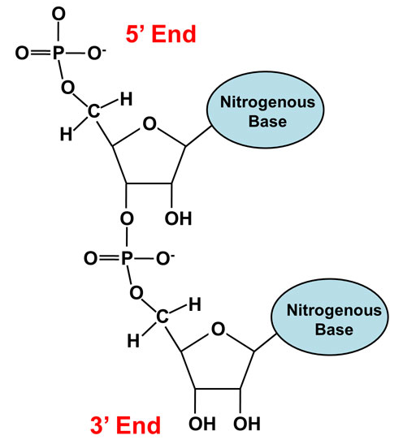
Nucleic Acids
Structures of the Ribonucleotides
https://dlc.dcccd.edu/biology1-3/nucleic-acid
Q1. Diagrammatically show the 5’-end and 3’-end of nucleic acids.

Slide 17
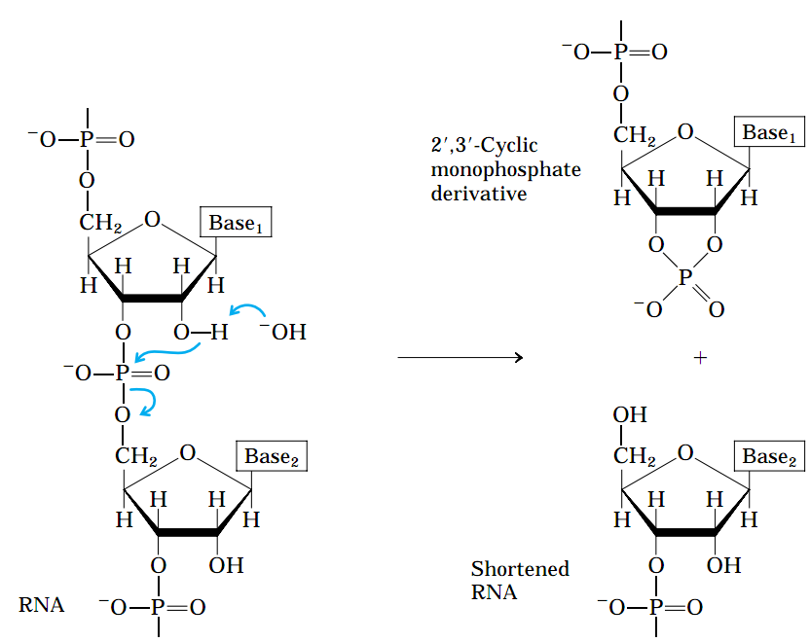
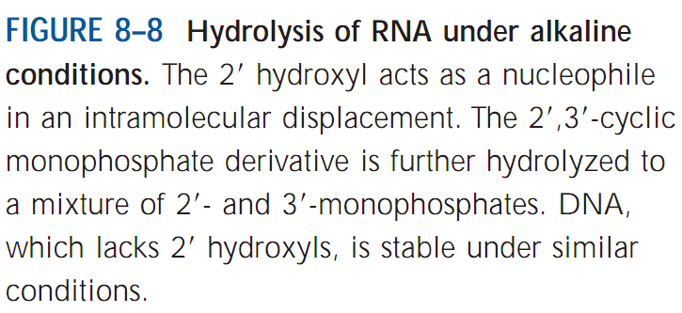
Nucleic Acids
Hydrolysis of RNA
Q1. Diagrammatically show the hydrolysis of RNA in an alkaline condition.

Slide 18
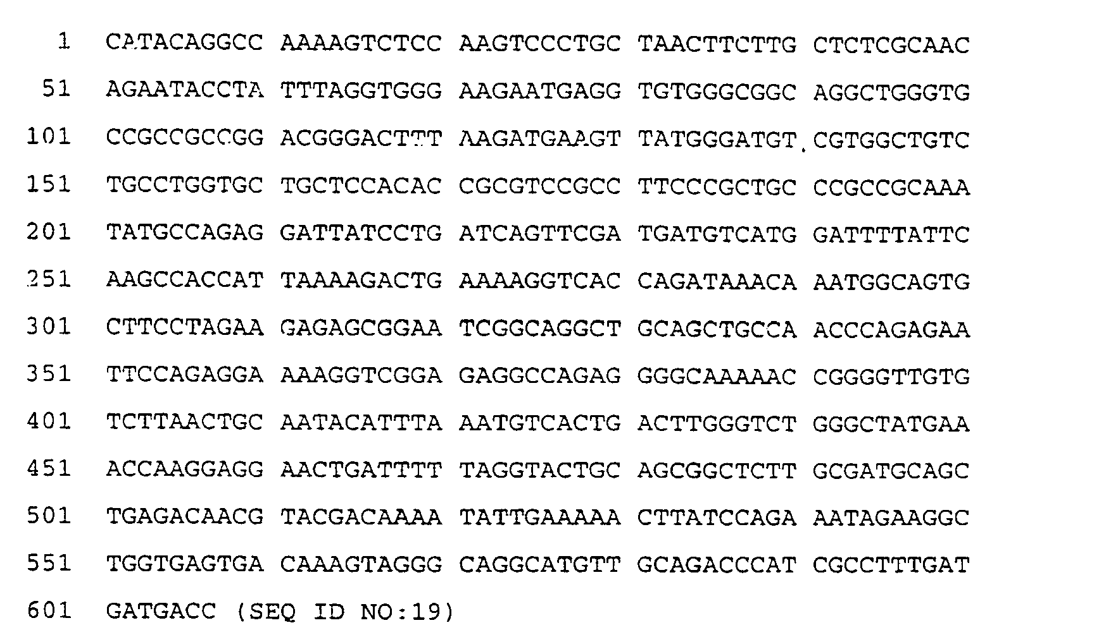
Nucleic Acids
Oligonucleotides and Polynucleotides
Example of an oligonucleotide:
Example of a polynucleotide:
Q1. What are oligonucleotides and polynucleotides?
No question about the examples in the exam.

Slide 19
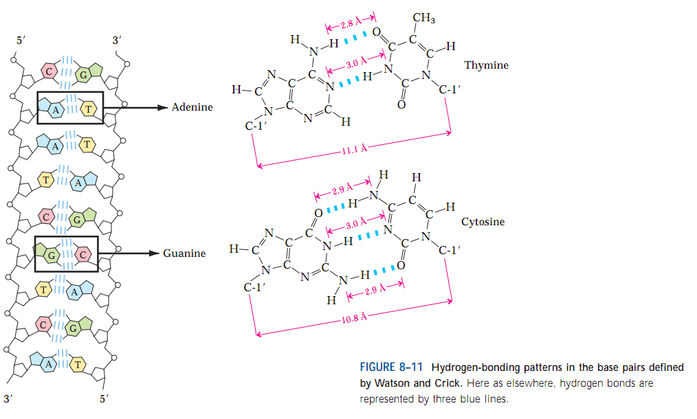
Nucleic Acids
Hydrogen bonding patterns in base pairs of DNA
In DNA, adenine and thymine bases make two hydrogen bonds, whereas guanine and cytosine make three hydrogen bonds.
Q1. How many H bonds between A & T, G & C in DNA?
No question on the images of this slide in exam.

Slide 20
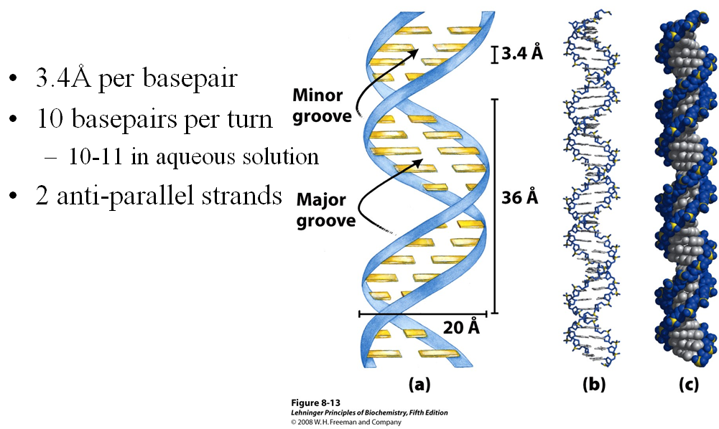
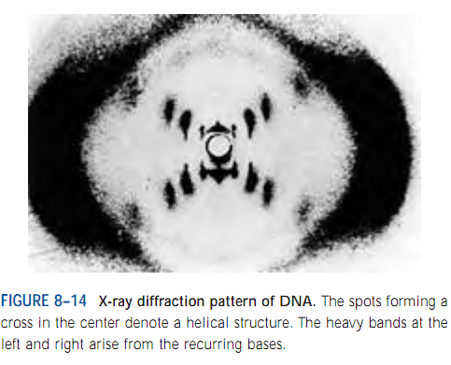
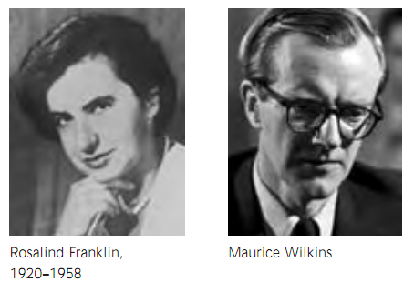
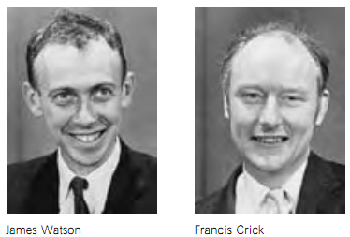
Nucleic Acids
DNA is a double helix
Rosalind Franklin, while working in the lab of Maurice Wilkins, took the first X-ray diffraction image of DNA.
Q1. Who took the first X-ray diffraction image of DNA?
Q2. What type of helix is present in DNA?
No question on the images of this slide in exam.

Slide 21
Nucleic Acids
DNA strands are complementary
Q1. Are the two strands of DNA complementary?
Q2. Are the two strands of DNA differ in sequence?
No question on the images of this slide in exam.

Slide 22
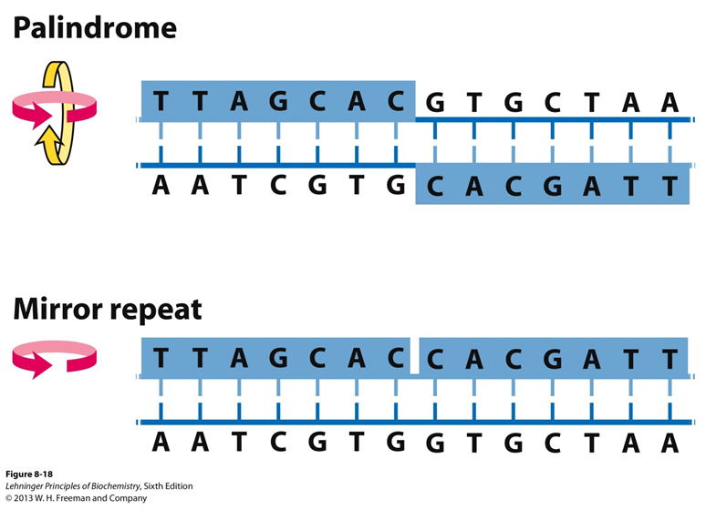
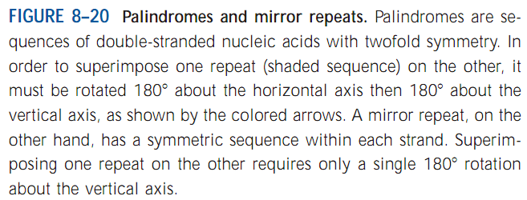
Nucleic Acids
Certain DNA sequences adopt unusual structure: Palindromes, Mirror repeats
A rather common type of DNA sequence is a palindrome. A palindrome is a word, phrase, or sentence that is spelled identically read either forward or backward; two examples are ROTATOR and NURSES RUN.
The term is applied to regions of DNA with inverted repeats of base sequence having twofold symmetry over two strands of DNA (Fig. 8–20).
When the inverted repeat occurs within each individual strand of the DNA, the sequence is called a mirror repeat.
Q1. What is palindrome and mirror repeat of DNA?

Slide 23
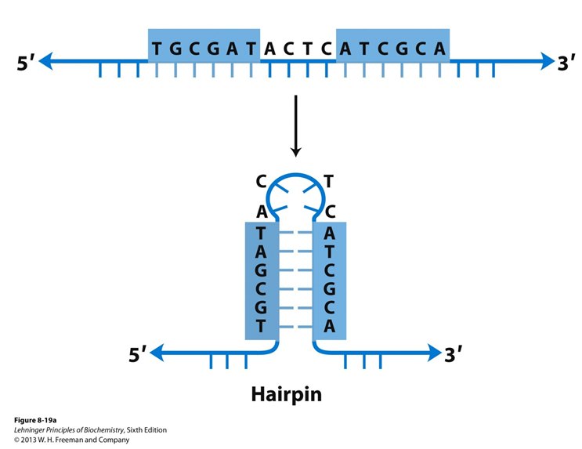
Nucleic Acids
Certain DNA sequences adopt unusual structure: Hairpin structure
A single DNA strand with a self-complementary sequences can form a hairpin structure.
Q1. What is hairpin structure of DNA?

Slide 24
Nucleic Acids
Certain DNA sequences adopt unusual structure: Cruciform structure
Q1. What is cruciform structure of DNA?

Slide 25
Nucleic Acids
Messenger RNAs (mRNAs) code for polypeptide chains
Q1. What is the difference between monocistronic and polycistronic mRNAs?

Slide 26
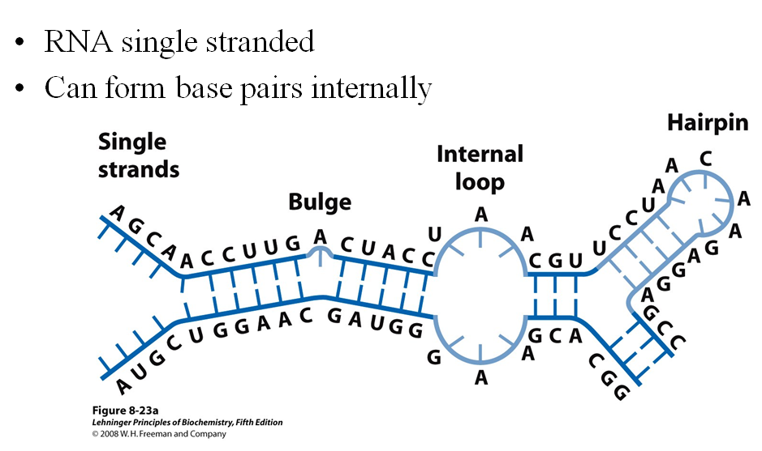
Nucleic Acids
RNAs can form secondary structures
Q1. Are RNAs single-stranded?
Q2. Can RNAs form base pairs internally?

Slide 27
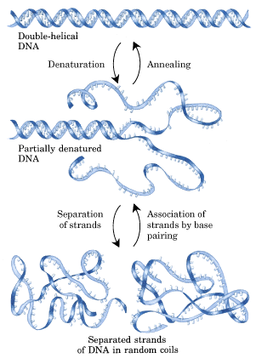
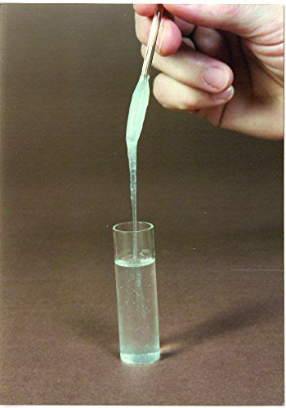
Nucleic Acids
Reversible physical changes in DNA by extreme pH or high temperature
Native DNA at 25°C and pH 7.0 is highly viscous.
https://www.pinterest.com/pin/343469909060304814/
Extreme pH or high temperature (80°C) reduces the viscosity indicating DNA has undergone physical changes.
Q1. Schematically show denaturation and renaturation of DNA.

Slide 28
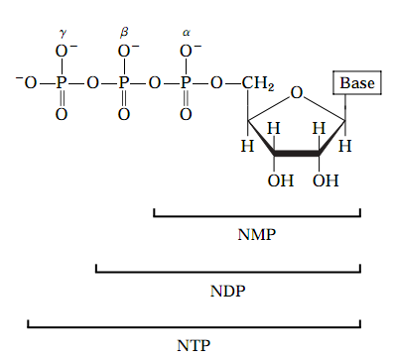
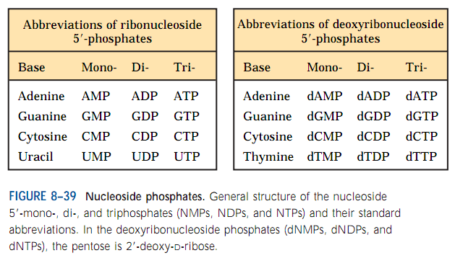
Nucleic Acids
Abbreviation of Nucleotides
Q1. What are the abbreviations of deoxyadenosine-5’-mono-, di-, and tri-phosphates?

Slide 29
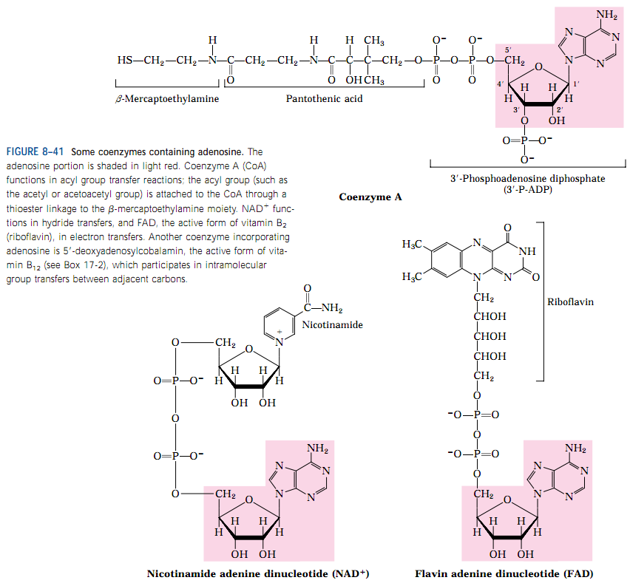
Nucleic Acids
Adenine is present in some coenzymes that are important for biological functions
Q1. Draw the structure of a coenzyme that contains adenine.

Slide 30
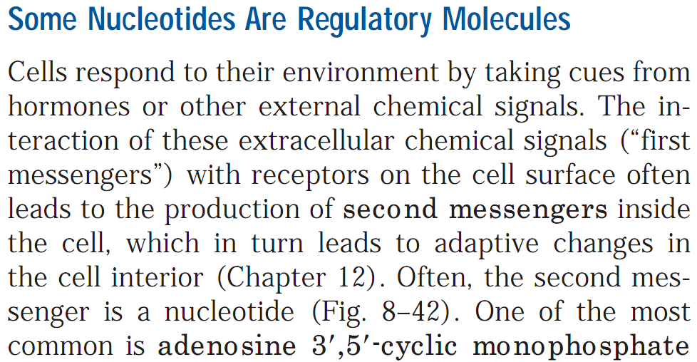
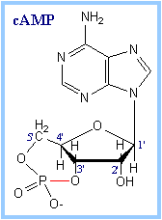
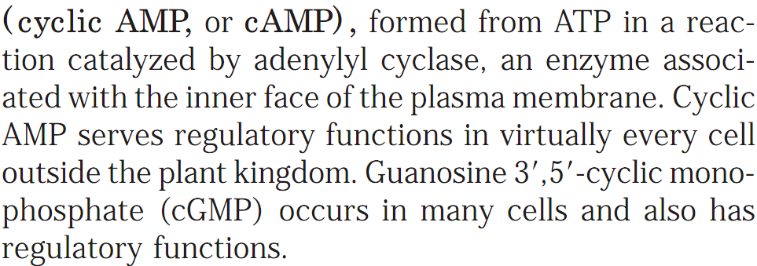
Nucleic Acids
Some Nucleotides are Regulatory Molecules
https://www.rpi.edu/dept/bcbp/molbiochem/MBWeb/mb1/part2/signals.htm
Q1. What are second messengers? Give an example.
Q2. What is cyclic AMP? Is it found in plant kingdom?
Q3. Give an example of a nucleotide that is a regulatory molecule.
Q4. Does cyclic GMP have regulatory functions in cells?

Slide 31
Next Lecture: DNA-based Information Technologies
Reference Textbook: Lehninger Principles of Biochemistry
4th or 5th Edition
Chapter 9, 11
David L. Nelson, Michael M. Cox WH Freeman & Company,
New York, USA

