Slide 1
BIO201 SPRING 2018 Introduction to Biochemistry & Biotechnology
Lecture #7

Slide 2
Lehninger
Principles of Biochemistry
Chapter 10
Lipids

Slide 3
Lipids
Types of Lipids
The lipids are a large and diverse group of naturally occurring organic compounds that are generally insoluble in water, but soluble in nonpolar organic solvents (e.g. ether, chloroform, acetone & benzene). The biological functions of lipids are as diverse as their chemistry.
Lipids
Storage
Lipids
(example,
triacylglycerol)
Structural
Lipids
(example,
phospholipids
of membranes)
Other Lipids as signals, co-factors, electron-carriers, pigments
(example, ubiquinone as electron carrier)
Q1. What are lipids?
Q2. Classify lipids according to their biological functions.

Slide 4
Storage Lipids

Slide 5
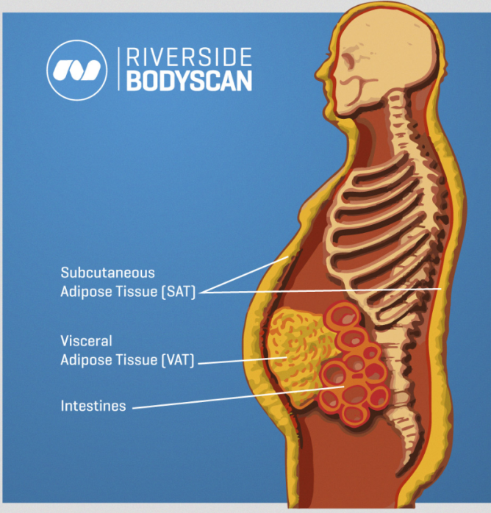
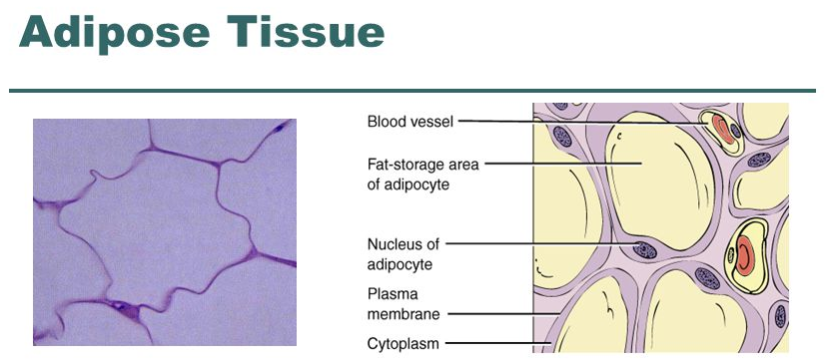
Storage Lipids
Storage Lipids
Lipids such as cholesterol, cholesteryl esters and triacylglycerols are stored in our body primarily in specialized fat cells called adipocytes, which comprise a specialized fatty tissue called adipose tissue.
http://slideplayer.com/slide/4556564/
Q1. Name two lipids that humans stored in body.
Q2. Which cells store lipids?
Q3. Which tissues store fats in human body?
No question in the exam on the SAT/VAT of the image of human body.
No question in the exam on the image of adipocytes/adipose tissue.

Slide 6
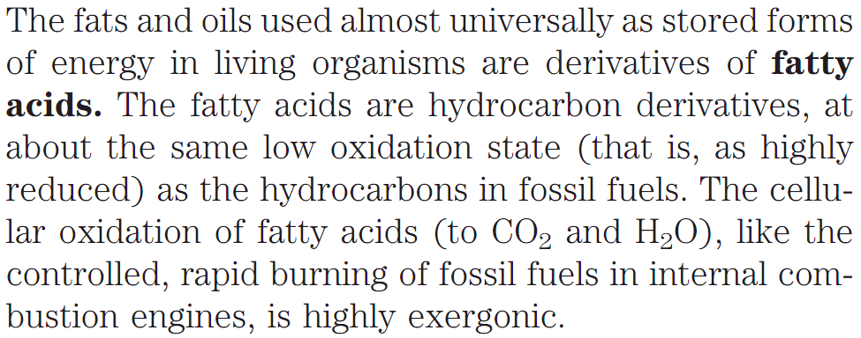
Storage Lipids
Fatty acids
The fatty acid-containing compounds that are most commonly found in living organisms include triacylglycerols and waxes.
Q1. What type of compounds are fatty acids? What is their major function in living organisms?
Q2. Name two fatty acid-containing compounds that are very common in living organisms.

Slide 7
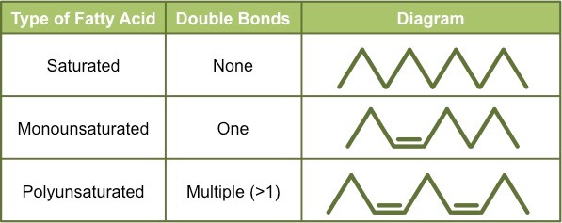
Storage Lipids
Fatty acids can be saturated or unsaturated
Fatty acids: Fatty acids are carboxylic acids with hydrocarbon chains ranging from 4 to 36 carbons long (C₄ to C₃₆). Fatty acids are long hydrocarbon chains that are found in certain types of lipids (triglycerides & phospholipids).
Q1. What are fatty acids? Where do fatty acids exist in nature?
Q2. How many different types of fatty acids exist?
Q3. What are saturated and unsaturated fatty acids?
Q4. What are mono-unsaturated fatty acids?
Q5. What are poly-unsaturated fatty acids?
Q6. Show the differences among saturated-, mono-unsaturated-, and poly-unsaturated fatty acids using a table.
http://ib.bioninja.com.au/standard-level/topic-2-molecular-biology/23-carbohydrates-and-lipids/types-of-fatty-acids.html

Slide 8
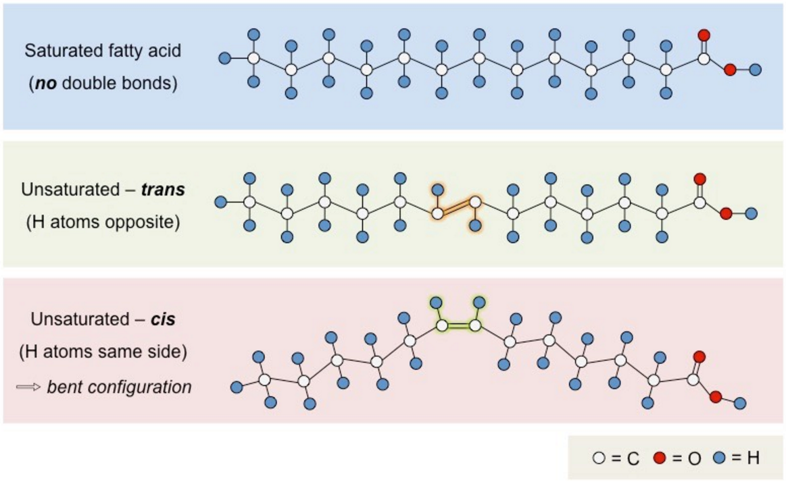
Storage Lipids
Unsaturated Fatty acids can be cis- or trans isomer
Trans fatty acids do not commonly occur in nature and are typically produced by an industrial process called hydrogenation.
Trans fatty acids are generally linear in structure (despite being unsaturated) and are usually solid at room temperature.
Q1. What are cis- and trans isomers of unsaturated fatty acids?
Q2. How trans-fatty acids are produced?
Q3. Are trans-fatty acids linear in structure? Are they solid at room temperature?
No question in the exam from the image of this slide.
http://ib.bioninja.com.au/standard-level/topic-2-molecular-biology/23-carbohydrates-and-lipids/types-of-fatty-acids.html

Slide 9
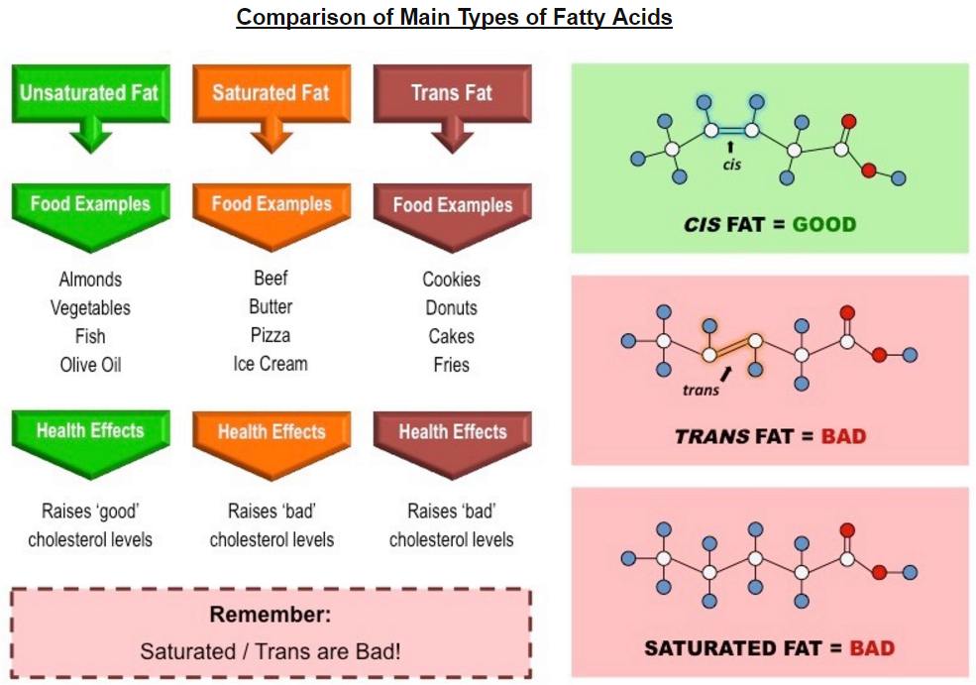
Storage Lipids
Saturated- and Trans-unsaturated fatty acids are bad for health
Q1. Which type(s) of fats is(are) bad for health?
Q2. What type of fatty foods are good for health? Give examples.
Q3. Which fatty foods you should avoid? Give three examples.
http://ib.bioninja.com.au/standard-level/topic-2-molecular-biology/23-carbohydrates-and-lipids/types-of-fatty-acids.html

Slide 10
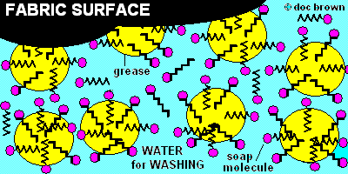
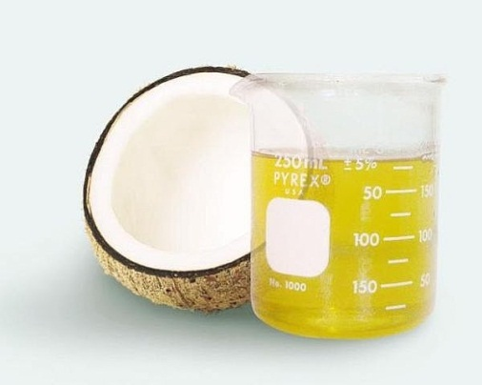
Storage Lipids
Examples of saturated- and unsaturated fatty acids
Example of saturated fatty acid: stearic acid, sodium stearate (used in soap).
How detergents work?
http://www.docbrown.info/page04/OilProducts14.htm
Example of unsaturated fatty acid: cis-oleic acid.
Oleic acid is a fatty acid that occurs naturally in various animal and vegetable oils. It is an odorless, colorless oil, although commercial samples may be yellowish. In chemical terms, oleic acid is classified as a monounsaturated omega-9 fatty acid, abbreviated with a lipid number of 18:1 cis-9.
http://www.naturalfattyacids.com/Natural-fatty-acid/Coconut-oil-oleic-acid/
Q1. Give an example of a saturated- and an unsaturated fatty acid.

Slide 11
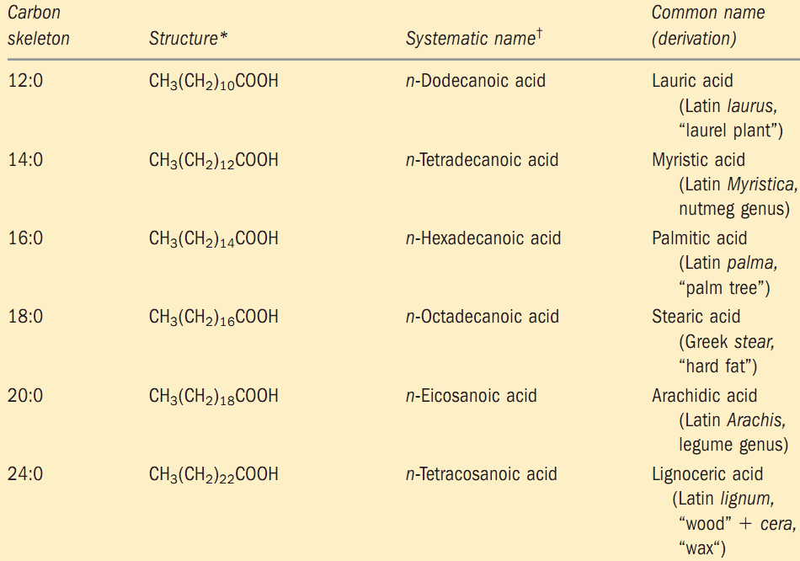
Storage Lipids
Name of some naturally occurring saturated fatty acids
Q1. Draw the structure of an unsaturated fatty acid.
Q2. What kind of fatty acid is palmitic acid? Draw its structure.

Slide 12
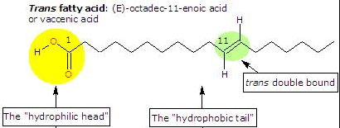
Storage Lipids
Name of some naturally occurring unsaturated fatty acids
Example of an industrially produced trans-fatty acid
Q1. Draw the structure of a mono-unsaturated fatty acid.
Q2. Draw the structure of a poly-unsaturated fatty acid.
Q3. Give an example of trans-fatty acid. (Answer: Vaccenic acid).
No question in the exam from the structure of trans-fatty acid.
http://www.tuscany-diet.net/tag/trans-fatty-acids/

Slide 13
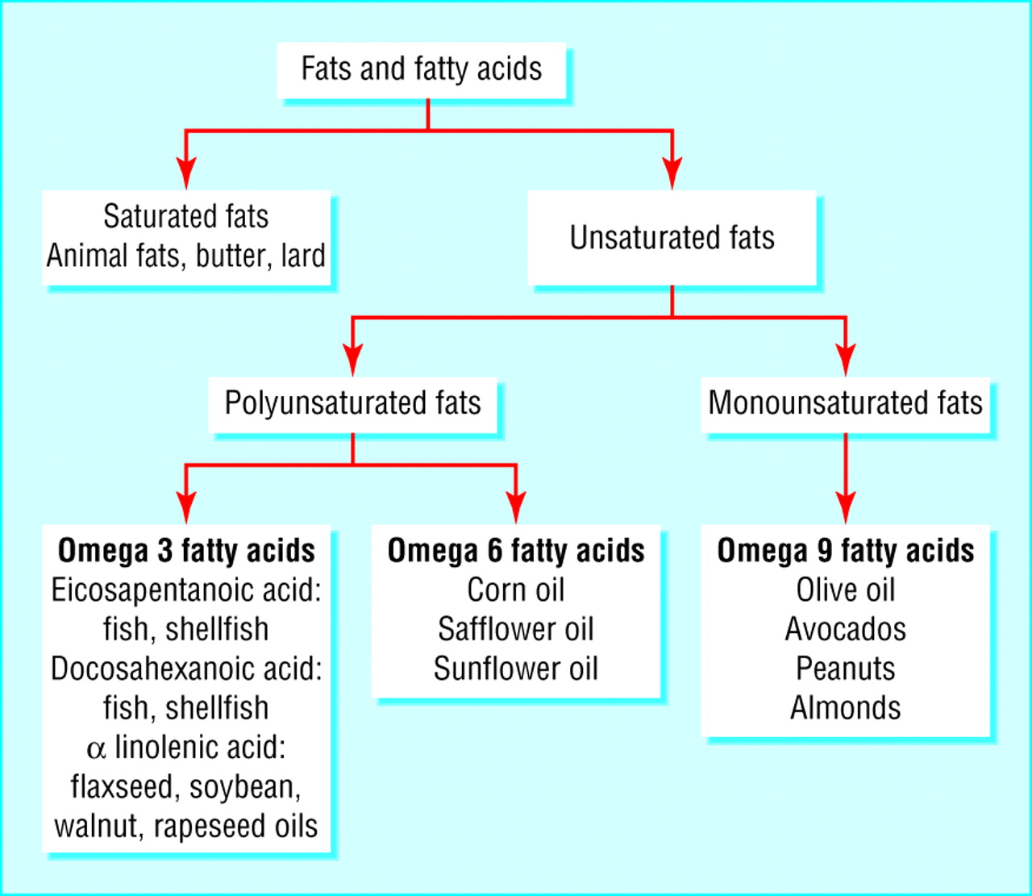
Storage Lipids
Classification of fatty acids
Examples:
Linoleic acid,
Arachidonic acid
Examples:
Oleic acid,
Erucic acid
Q1. Schematically show the classification of fatty acids with one example for each class.

Slide 14
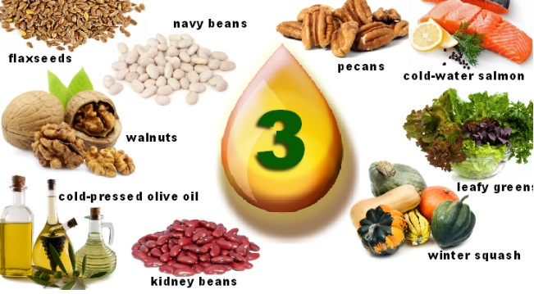
Storage Lipids
Some food sources of ω-3 (omega-3) fatty acids
http://keywordsuggest.org/gallery/1326318.html
Q1. Name three food sources for omega-3 fatty acids.
No question in the exam on DHA and EPA structures.

Slide 15
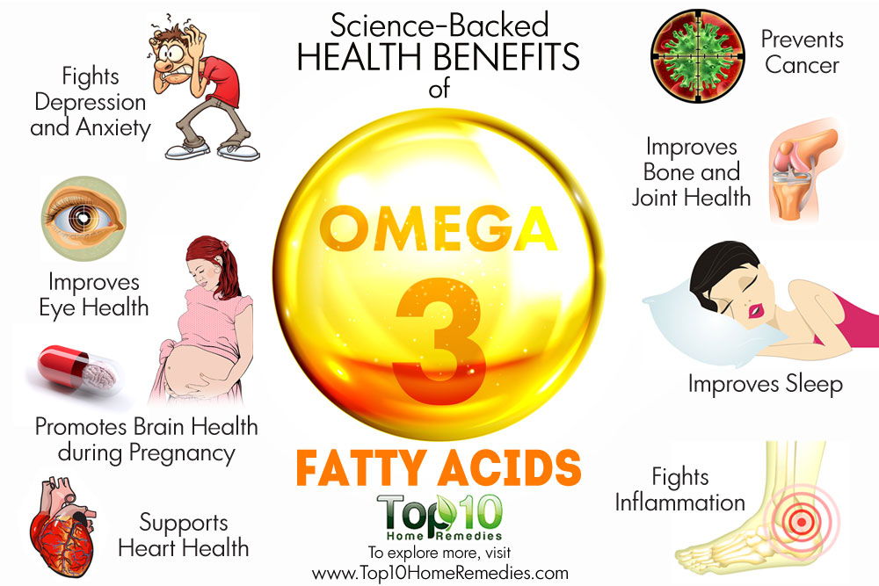
Storage Lipids
Benefits of ω-3 fatty acids
http://www.top10homeremedies.com/news-facts/10-science-backed-health-benefits-omega-3-fatty-acids.html
Q1. Name three health benefits of omega-3 fatty acids.

Slide 16
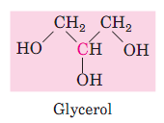
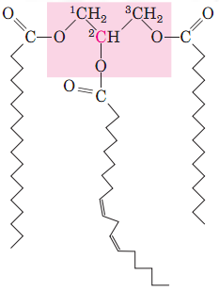
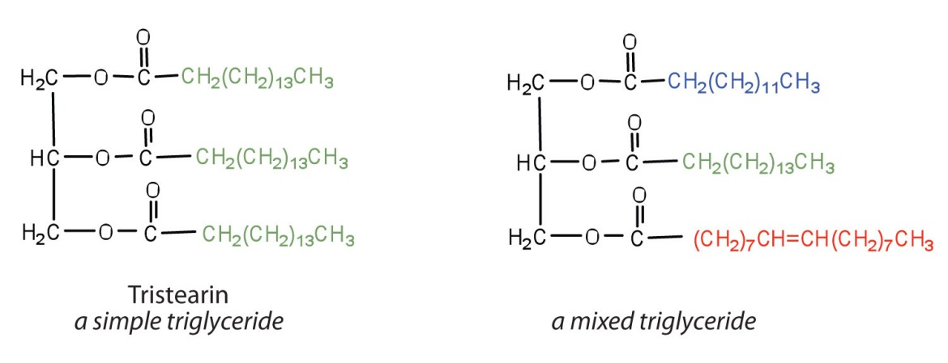
Storage Lipids
Triacylglycerols or Triglycerides are Fatty Acid esters of Glycerol
The simplest lipids constructed from fatty acids are the triacylglycerols, also referred to as triglycerides, fats, or neutral fats. Triacylglycerols are composed of three fatty acids each in ester linkage with a single glycerol (Fig. 10–2).
Triacylglycerols contain three fatty acid molecules esterified to the three hydroxyl groups of glycerol. Simple triacylglycerols contain only one type of fatty acid; mixed triacylglycerols, two or three types. Triacylglycerols are primarily storage fats; they are present in many foods.
Q1. What are triacylglycerols?
Q2. Draw the structures of a simple- and a mixed triacylglycerol.
Q3. What is the primary function of triacylglycerols?

Slide 17
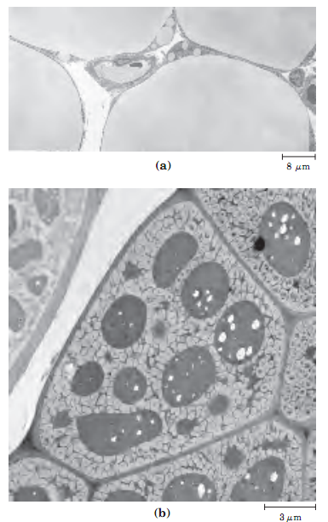
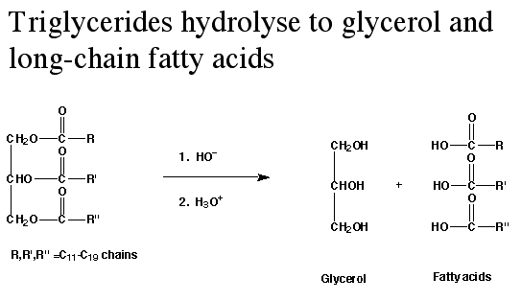
Storage Lipids
Triacylglycerols provide stored energy and insulation
In most eukaryotic cells, triacylglycerols form a separate phase of microscopic, oily droplets in the aqueous cytosol, serving as depots of metabolic fuel. In vertebrates, specialized cells called adipocytes, or fat cells, store large amounts of triacylglycerols as fat droplets that nearly fill the cell (Fig. 10–3a). Triacylglycerols are also stored as oils in the seeds of many types of plants, providing energy and biosynthetic precursors during seed germination (Fig. 10–3b).
Adipocytes and germinating seeds contain lipases, enzymes that catalyze the hydrolysis of stored triacylglycerols, releasing fatty
acids for export to sites where they are required as fuel.
or, Lipases
The fatty acids released from triacylglycerol are oxidized to produce ATP to carry out energy-requiring biological processes.
Q1. What type of cells store triacylglycerols in animals?
Q2. What is the significance of storing triacylglycerols in the seeds of plants?
Q3. Which class of enzymes hydrolyse triacylglycerols?
Q4. What is the ultimate purpose of the hydrolysis of triacylglycerols in nature?

Slide 18
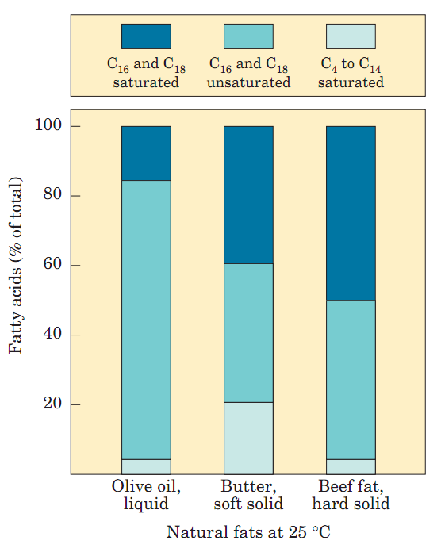
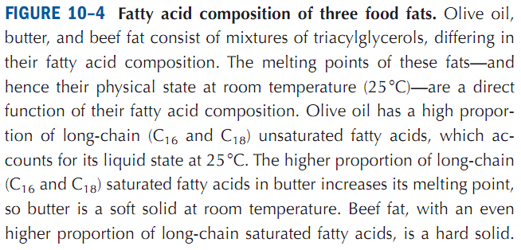
Storage Lipids
Many Foods contain Triacylglycerols
Q1. Explain why olive oil is liquid, butter is soft solid and beef fat is hard solid at room temperature.

Slide 19
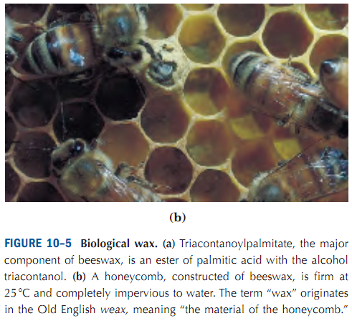
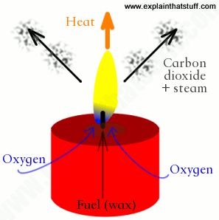
Storage Lipids
Waxes serve as energy sources and water repellant
Biological waxes are esters of long-chain (C14 to C36) saturated and unsaturated fatty acids with long-chain (C16 to C30) alcohols (Fig. 10–5). Their melting points (60 to 100 degree C) are generally higher than those of triacylglycerols. In plankton, the free-floating microorganisms at the bottom of the food chain for marine animals, waxes are the chief storage form of metabolic fuel.
Waxes also serve a diversity of other functions related to their water-repellent properties and their firm consistency. Certain skin glands of vertebrates secrete waxes to protect hair and skin and keep it pliable, lubricated, and waterproof. Birds, particularly waterfowl, secrete waxes from their preen glands to keep their feathers water-repellent. The shiny leaves of holly, rhododendrons, poison ivy, and many tropical plants are coated with a thick layer of waxes, which prevents excessive evaporation of water and protects against parasites.
Triacontanoyl palmitate (the major component of beeswax)
Waxes in candle
(Beeswax, soy wax, palm wax, gels, and synthesized waxesare also used in candle-making for the U.S. market)
Q1. What are waxes? Give one example.
Q2. Draw the structure of a biological wax.
http://www.explainthatstuff.com/candles.html

Slide 20
Structural Lipids

Slide 21
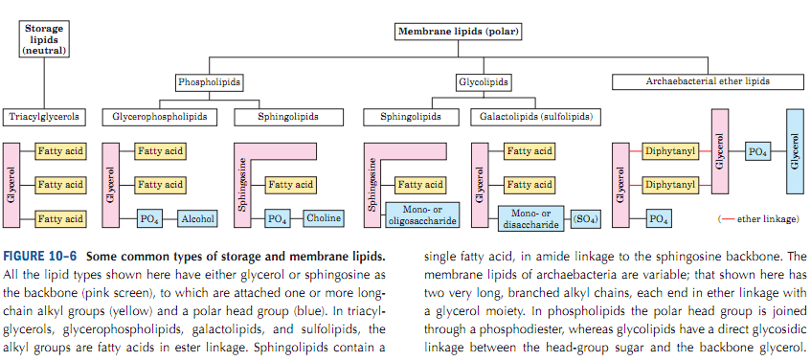
Structural Lipids
Membrane Lipids
The central architectural feature of biological membranes is a double layer of lipids, which acts as a barrier to the passage of polar molecules and ions.
Membrane lipids are amphipathic: one end of the molecule is hydrophobic, the other hydrophilic.
In glycerophospholipids and some sphingolipids, a polar head group is joined to the hydrophobic moiety by a phosphodiester linkage; these are the phospholipids. Other sphingolipids lack phosphate but have a simple sugar or complex oligosaccharide at their polar ends; these are the glycolipids (Fig. 10–6).
Q1. What are structural lipids?
Q2. Classify membrane lipids.

Slide 22
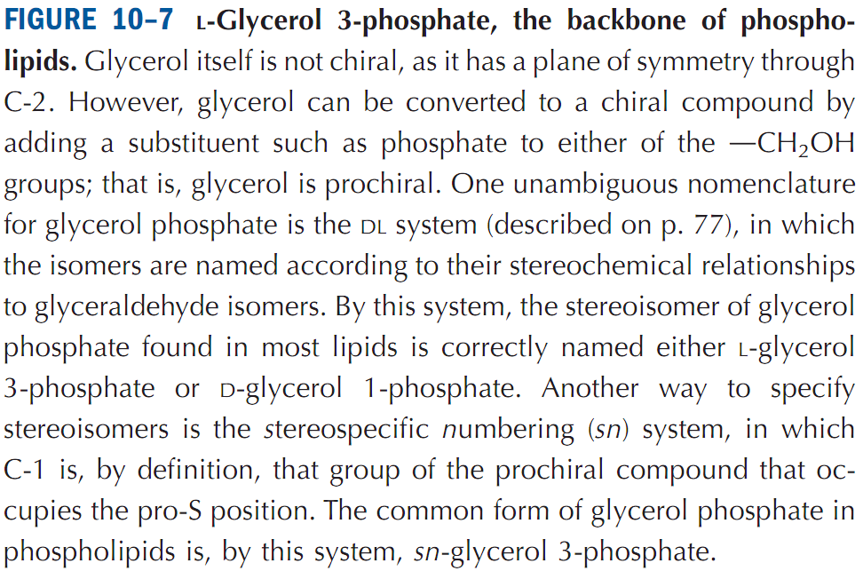
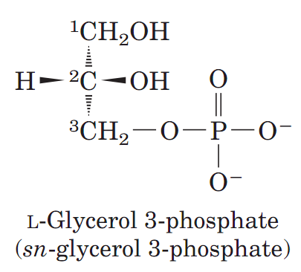
Structural Lipids
Glycerophospholipids are derivatives of Phosphatidic Acid
Phospholipids are a class of lipids that are a major component of all cell membranes. They can form lipid bilayers because of their amphiphilic characteristic. The structure of the phospholipid molecule generally consists of two hydrophobic fatty acid "tails" and a hydrophilic "head" consisting of a phosphate group.
Glycerophospholipids, also called phosphoglycerides, are membrane lipids in which two fatty acids are attached in ester linkage to the first and second carbons of glycerol, and a highly polar or charged group is attached through a phosphodiester linkage to the third carbon. Glycerol is prochiral; it has no asymmetric carbons, but attachment of phosphate at one end converts it into a chiral compound, which can be correctly named either L-glycerol 3-phosphate, D-glycerol 1-phosphate, or sn-
glycerol 3-phosphate (Fig. 10–7).
Q1. What are glycerophospholipids?
Q2. Which compound is the backbone of phospholipid?

Slide 23
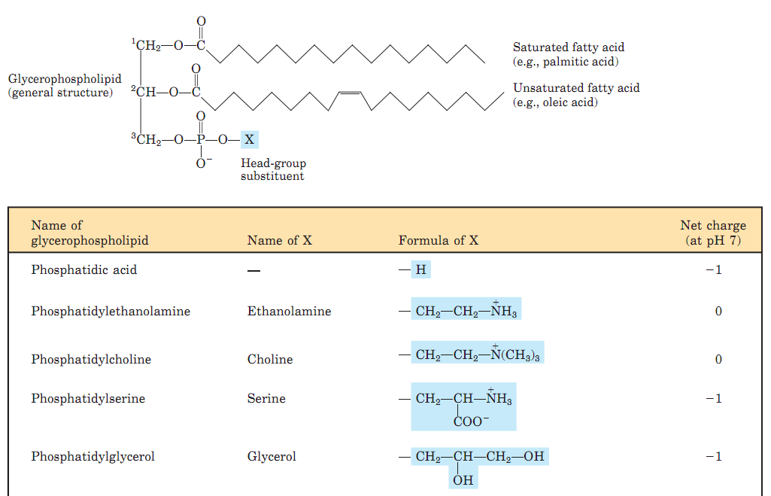
Structural Lipids
Examples of Glycerophospholipids
Glycerophospholipids are named as derivatives of the parent compound, phosphatidic acid (Fig. 10–8), according to the polar alcohol in the head group. For example, phosphatidylcholine and phosphatidylethanolamine have choline and ethanolamine in their polar head groups.
Q1. Give two examples of glycerophospholipids.

Slide 24
Structural Lipids
Sphingolipids are derivatives of sphingosine
Sphingolipids, the fourth large class of membrane lipids, also have a polar head group and two nonpolar tails, but unlike glycerophospholipids and galactolipids they contain no glycerol. Sphingolipids are composed of one molecule of the long-chain amino alcohol sphingosine (also called 4-sphingenine) or one of its derivatives, one molecule of a long-chain fatty acid, and a polar head group that is joined by a glycosidic linkage in some cases and by a phosphodiester in others (Fig. 10–12).
Q1. What are sphingolipids? Draw the general structure of sphingolipids.

Slide 25
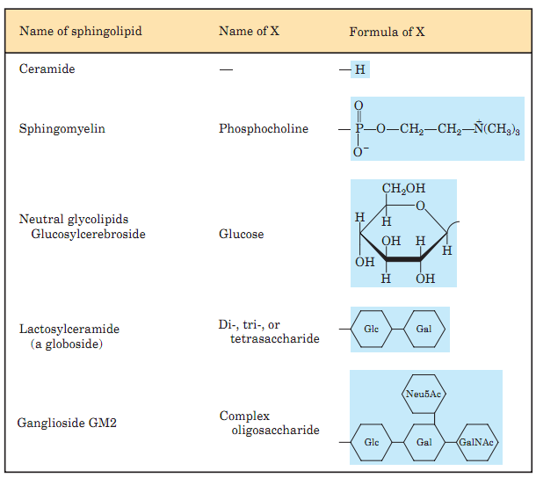
Structural Lipids
Sphingolipids are derivatives of sphingosine
Q1. Draw the structures of two sphingolipids.

Slide 26
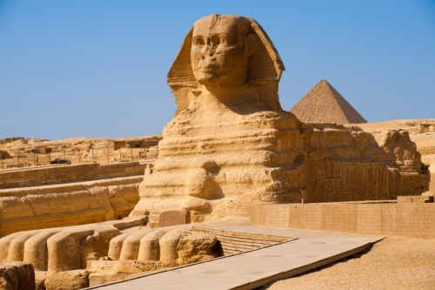
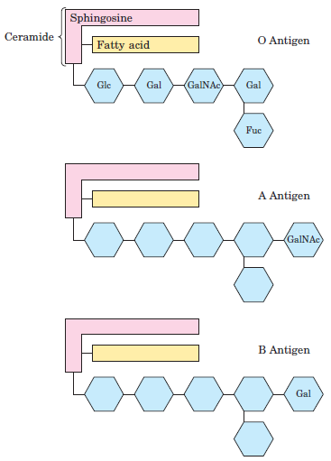
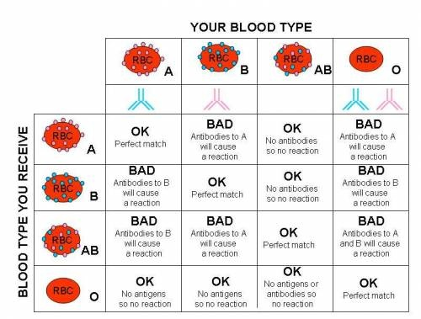
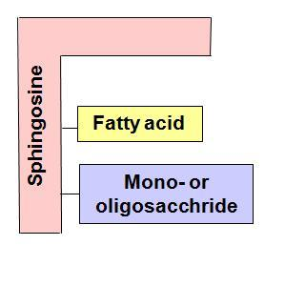
Structural Lipids
Structural Lipids: Sphingolipids at cell surfaces
When sphingolipids were discovered a century ago by the physician-chemist Johann Thudichum, their biological role seemed as enigmatic as the Sphinx, for which he therefore named them.
Sphinx: The Great Sphinx of Giza is a limestone statue of a reclining sphinx, a mythical creature with the body of a lion and the head of a human.
In humans, at least 60 different sphingolipids have been identified in cellular membranes.
http://www.alexandrina.nl/?p=3414
Glycosphingolipids determine blood groups: The carbohydrate moieties of certain sphingolipids define the human blood groups and therefore determine the type of blood that individuals can safely receive in blood transfusions (Fig. 10–14).
Glycosphingolipids are lipids that contain carbohydrate residues with sphingosine as the alcohol and a very long chain fatty acid.
General structure of
glycosphingolipids
https://s-media-cache-ak0.pinimg.com/736x/8b/7e/73/8b7e731f26117243896885032b3590bc.jpg
Q1. What are glycosphingolipids?
Q2. What is the basis of ABO blood grouping?
No question from the table on this slide in any BIO201 exam.

Slide 27
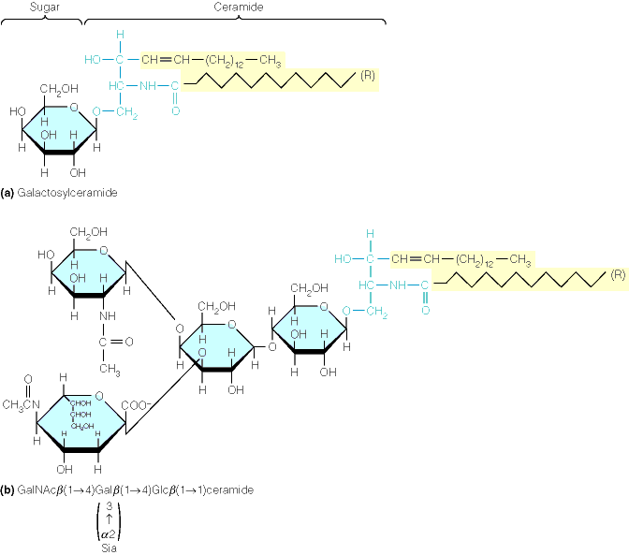
Structural Lipids
Structural Lipids: Structure of Glycosphingolipids
http://oregonstate.edu/dept/biochem/hhmi/hhmiclasses/bb450/winter2002/ch10/fi10p8.htm
No question in exam from this slide.

Slide 28
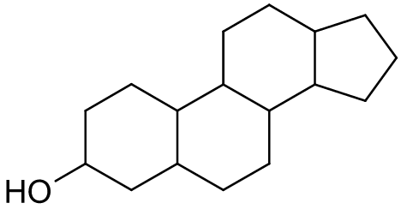
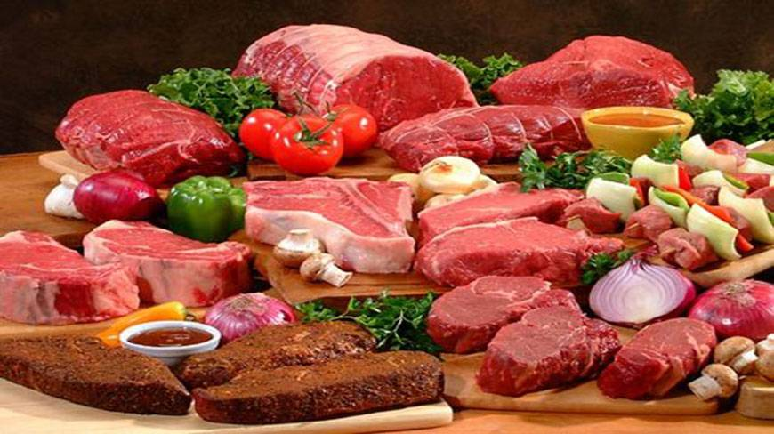
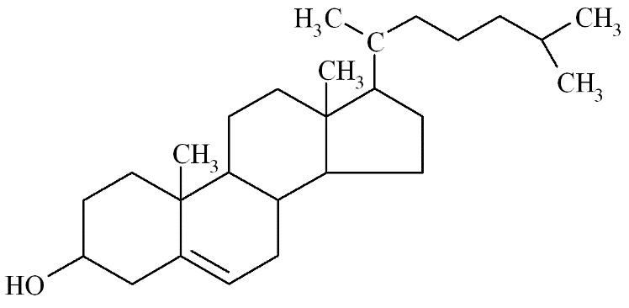
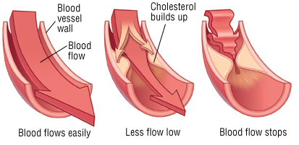
Structural Lipids
Structural Lipids: Sterols with four fused carbon rings
Sterols are structural lipids present in the membranes of most eukaryotic cells.
General structure of sterols
Red meat is a rich source of cholesterol
Cholesterol, the major sterol in animal tissues, is amphipathic, with a polar head group (the hydroxyl group at C-3) and a nonpolar hydrocarbon body (the steroid nucleus and the hydrocarbon side chain at C-17), about as long as a 16-carbon fatty acid in its extended form.
Cholesterol accumulation in blood vessels can block blood flow resulting in heart attacks.
Cholesterol: major sterol in animal tissues
Major sterols in plant tissues: stigmasterol, β-sitosterol.
Major sterols in fungi: ergosterol.
Sterols made by bacteria: none.
Q1. What is the major sterol in animals? Draw its structure.
Q2. Write the names of plants, fungal and bacterial sterols.

Slide 29
Structural Lipids
Structural Lipids: Cholesterol and other lipids in membranes
Structural Lipids in eukaryotic plasma membrane
http://slideplayer.com/slide/2455885/
Q1. Draw a diagram to show different structural lipids in a eukaryotic cell membrane.
Q2. Which structural lipids are always on the outside face of a cell membrane?

Slide 30
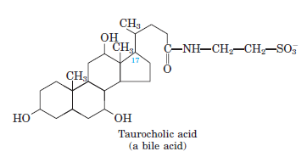
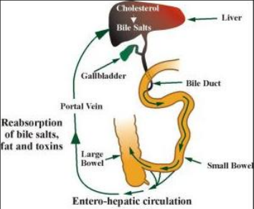
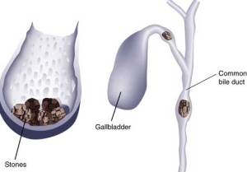
Structural Lipids
Sterols as precursors: Bile acids are derivatives of cholesterol
In addition to their roles as membrane constituents, the sterols serve as precursors for a variety of products with specific biological activities.
Bile helps with digestion. It breaks down fats into fatty acids, which can be taken into the body by the digestive tract. Bile contains mostly cholesterol, bile acids (also called bile salts), and bilirubin (a breakdown product of red blood cells).
Bile acids are polar derivatives of cholesterol that act as detergents in the intestine, emulsifying dietary fats to make them more readily accessible to digestive lipases.
https://www.studyblue.com/notes/note/n/blood-lipid-altering-drugs/deck/8316986
Gallstones:
https://www.slideshare.net/nixpolking/understanding-gallstones-causes-is-important-to-prevent-stone-formation-in-future
Q1. What are bile acids?
Q2. Draw the structure of a bile acid.
Q3. Why gallstones are formed?

Slide 31
Other Lipids

Slide 32
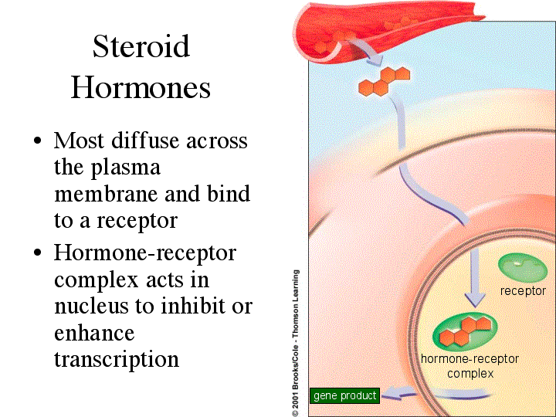
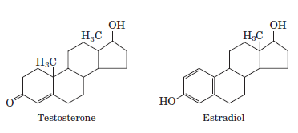
Other Lipids
Lipids as Signals, Cofactors, Energy carriers and Pigments
Lipids with passive roles:
Storage Lipids (example: triacylglycerol);
Structural Lipids in membranes (example: cholesterol).
These lipids are abundant.
Some types of lipids, although present in relatively small quantities, play critical roles as cofactors or signals and these are included in the classification of lipids as “other lipids”.
Lipids as Signals: Steroid hormones carry messages between tissues
Steroid hormones are any of a group of hormones that belong to the class of chemical compounds known as steroids. They are secreted by the adrenal cortex, testes, and ovaries (and during pregnancy by the placenta). All steroid hormones are derived from cholesterol. Examples include testosterone (male sex hormone produced in testis) and estradiol (a female sex hormone produced in ovaries and placenta).
Sex hormones
http://www231.pair.com/fzwester/courses/bis10v/week10/12steroid.html
Q1. What are lipids with passive roles?
Q2. Give an example of lipids acting as a signaling molecule.
Q3. Draw the chemical structures of male and female sex hormones.
No question on the image of this slide.

Slide 33
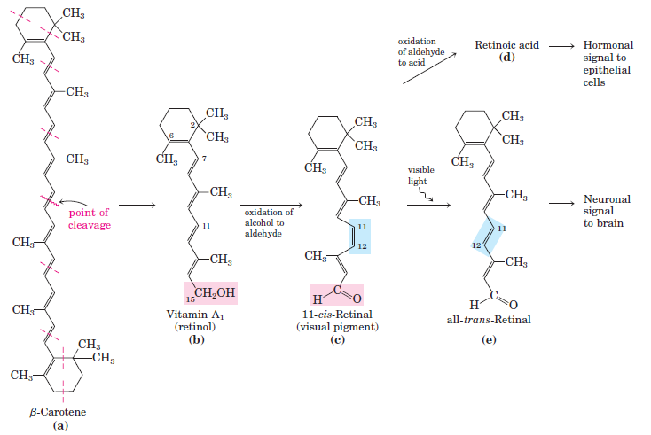
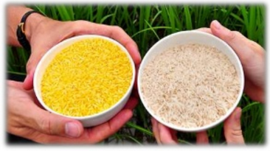
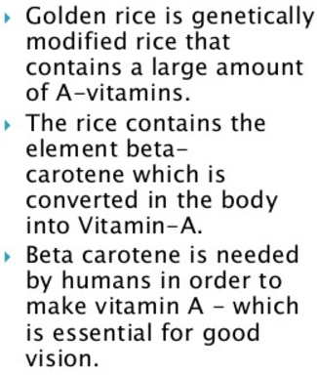
Other Lipids
Lipids as Pigments: The visual pigment of vertebrate eye can be derived from vitamin A
Vitamin A (retinol) serves as the precursor for the visual pigment, 11-cis-retinal in vertebrate eyes (Fig. 10–21).
Supplying vitamin A through transgenic rice can eradicate night blindness in Bangladesh
https://www.slideshare.net/zakiasayed3/golden-rice-57244860
Q1. Give example of a lipid acting as a pigment.
Q2. Discuss how 11-cis-retinal is formed from β-carotene.
Q3. What is golden rice? How can it prevent night-blindness in Bangladesh?

Slide 34
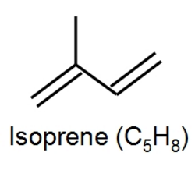
Other Lipids
Lipids as Co-factors: Lipid Quinones can act oxidation-reduction co-factors
Isoprene (2-methyl-1,3-butadiene) is a branched-chain unsaturated hydrocarbon. Isoprenoids contain from two to many thousands of isoprene units.
There are many isoprenoid compounds in nature.
Ubiquinone (also called coenzyme Q) and plastoquinone (Fig. 10–22d, e) are isoprenoids that function as lipophilic electron carriers in the oxidation-reduction reactions that drive ATP synthesis in mitochondria and chloroplasts, respectively.
Ubiquinone (Coenzyme Q) (n=4 to 8)
[involved in mitochondrial ATP synthesis]
Plastoquinone ((n=4 to 8)
[involved in chloroplast ATP synthesis]
Ubiquinone is part of a chain of proteins and lipids in mitochondrial inner membrane that is collectively called as the Electron transport chain (ETC) that produces ATP.
Most of the usable energy obtained from the breakdown of carbohydrates or fats is derived by oxidative phosphorylation, which takes place within mitochondria. For example, the breakdown of glucose by glycolysis and the citric acid cycle yields a total of four molecules of ATP, ten molecules of NADH, and two molecules of FADH₂ (see Chapter 2). Electrons from NADH and FADH₂ are then transferred to ubiquinone and finally to molecular oxygen, coupled to the formation of an additional 32 to 34 ATP molecules by oxidative phosphorylation. Electron transport and oxidative phosphorylation are critical activities of protein complexes in the inner mitochondrial membrane, which ultimately serve as the major source of cellular energy.
Q1. What are isoprenoids? What are they made up of?
Q2. Draw structures of two quinones that are involved in oxidation-reduction reactions to carry out ATP synthesis.

Slide 35
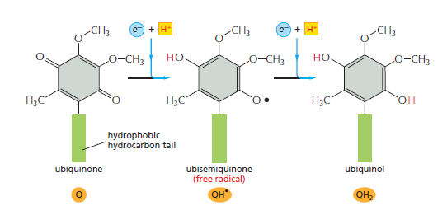
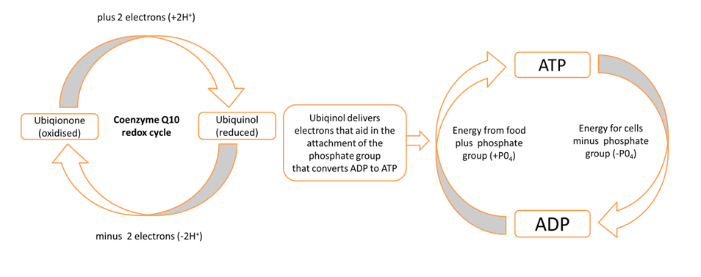
Other Lipids
Lipid co-factors: Ubiquinone in mitochondrial ATP synthesis
Oxidative phosphorylation is the metabolic pathway in which cells use enzymes to oxidize nutrients, thereby releasing energy which is used to reform ATP. In most eukaryotes, this takes place inside mitochondria.
During oxidative phosphorylation, transfer of electrons are accompanied by expulsion of protons to the outside of the inner membrane followed by re-entry of the proton through an ATP synthase that converts ADP to ATP.
https://www.slideshare.net/macrock707/coenzyme-q10-ubiquinone
The quinone group allows ubiquinone to function as an electron-carrier, while the highly hydrophobic tail of isoprene units helps to confine ubiquinone to lipid-rich areas of cells.
https://igennus.com/nutrition-blog/fatigue-and-mitochondrial-function-ubiquinols-therapeutic-benefits/
Q1. What is the role of ubiquinone during oxidative phosphorylation?
Q2. What is the role of ubiquinone in producing energy for cells?

Slide 36
Comparison between carbohydrates and lipids as the stored forms of energy

Slide 37
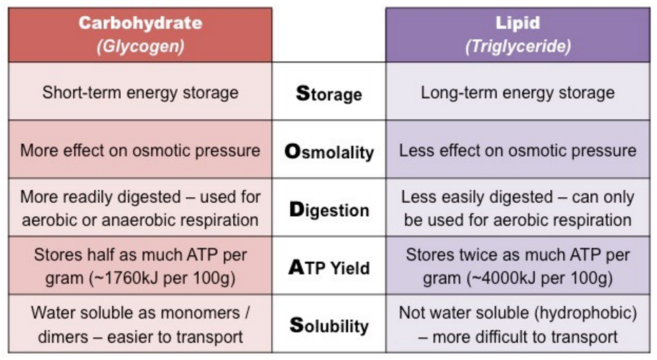
Carbohydrates and Lipids
Energy storage comparison between Carbohydrates & Lipids
http://ib.bioninja.com.au/standard-level/topic-2-molecular-biology/23-carbohydrates-and-lipids/types-of-fatty-acids.html
Q1. Compare between carbohydrates and lipids with respect to energy storage.

Slide 38
Next Lecture: Nucleotides & Nucleic Acids
Reference Textbook: Lehninger Principles of Biochemistry
4th or 5th Edition
Chapter 8
David L. Nelson, Michael M. Cox WH Freeman & Company,
New York, USA

