Slide 1
BIO201 SPRING 2018 Introduction to Biochemistry & Biotechnology
Lecture #6

Slide 2
Lehninger
Principles of Biochemistry
Chapter 7
Carbohydrates

Slide 3
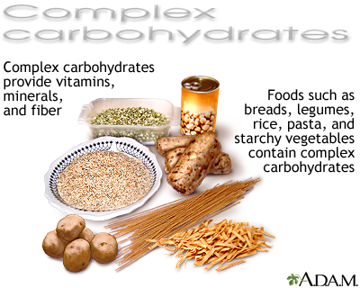
Carbohydrates
Carbohydrates are the most abundant biomolecules on earth
Carbohydrates: These are polyhydroxyaldehydes or ketones. These are any of various neutral compounds of carbon, hydrogen, and oxygen (as sugars, starches, and celluloses) most of which are formed by green plants and which constitute a major class of animal foods.
Carbohydrates are found in a wide array of both healthy and unhealthy foods—bread, beans, milk, popcorn, potatoes, cookies, spaghetti, soft-drinks, corn, and cherry pie. They also come in a variety of forms. The most common and abundant forms are sugars, fibers, and starches.
Q1. What are carbohydrates?
Q2. Name two sources of carbohydrates.

Slide 4
Carbohydrates
Carbohydrates are the most abundant biomolecules on earth
The four primary functions of carbohydrates in the body are to
(i) provide energy,
(ii) store energy,
(iii) build macromolecules, and
(iv) spare protein and fat for other uses.
Q1. What are the primary functions of carbohydrates?

Slide 5
Carbohydrates
Classification of Carbohydrates
Major Classes of Carbohydrates:
1. monosaccharides,
2. oligosaccharides,
3. polysaccharides.
Q1. What are sugars?
Q2. What are the major classes of carbohydrates?

Slide 6
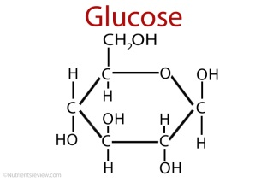
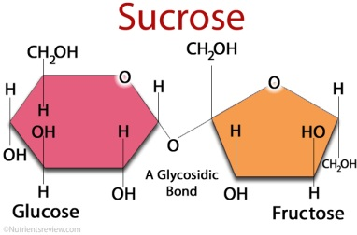
Carbohydrates
Classification of Carbohydrates
Monosaccharides: These are consist of a single polyhydroxy aldehyde or ketone unit, for example glucose.
Oligosaccharides: These are consist of short chains of monosaccharide units joined by characteristic linkages called glycosidic bonds. The most abundant are the disaccharides, with two monosaccharide units, for example, sucrose.
Polysaccharides: These are consist of more than 20 or so monosaccharide units, and some have hundreds or thousands of units. Examples include cellulose and starch (linear chain) and glycogen (branched chain) which are composed of D-glucose.
Q1. What are monosaccharides? Give example.
Q2. What are disaccharides? Give example.
Q3. What are polysaccharides? Give example.

Slide 7
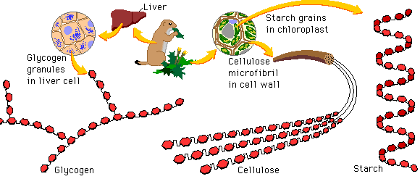
Carbohydrates
Examples of Polysaccharides
http://www.phschool.com/science/biology_place/biocoach/bioprop/polysac.html
Q1. Give three examples of polysaccharides.
No question in the exam from the images of this slide.

Slide 8
Carbohydrates
Digestion and Absorption of Carbohydrates
https://www.slideshare.net/namarta28/digestion-and-absorption-of-carbohydrates
Q1. Schematically show how different types of carbohydrates are digested by the gastrointestinal tract (GIT).

Slide 9
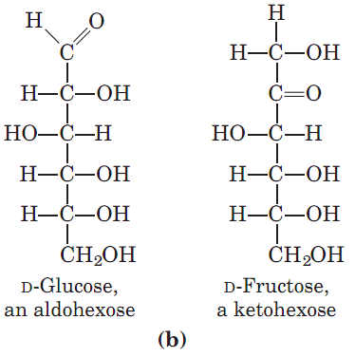
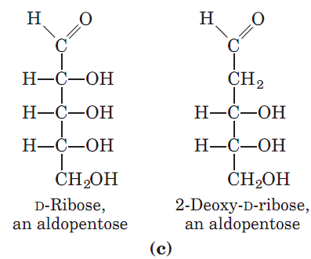
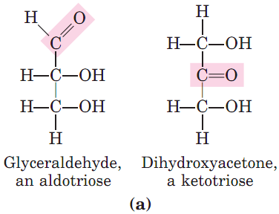
Monosaccharides
Representative Monosaccharides
Q1. Draw structures of two monosaccharides.
Q2. Draw the structure of a triose.
Q3. Draw the structure of a hexose.
Q4. Draw the structure of a pentose.

Slide 10
Monosaccharides
Characteristics of Monosaccharides
Monosaccharides:
Freely soluble in water but insoluble in nonpolar solvents;
Most have a sweet taste;
Two families: aldoses and ketoses;
If the carbonyl group is at the end of the carbon chain (if an aldehyde), it is called aldose, whereas if the carbonyl group is at any other position, it is called a ketose.
Q1. Are monosaccharides water-soluble?
Q2. Write the four major characteristics of monosaccharides.

Slide 11
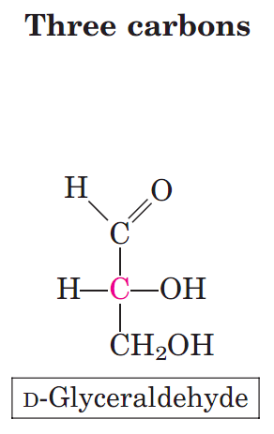
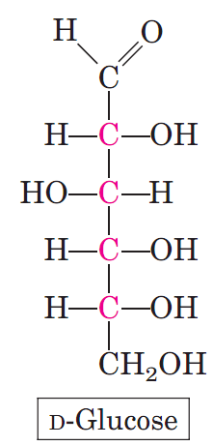
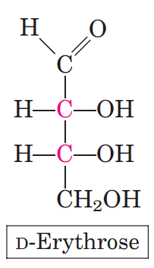
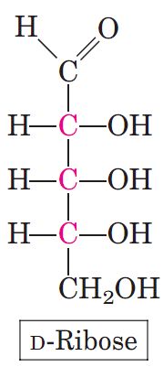
Monosaccharides
Monosaccharides: Examples of Aldoses
Q1. Give an example of (i) 3-carbon, (ii) 4-carbon, (iii) 5-carbon, (iv) 6-carbon aldose.

Slide 12
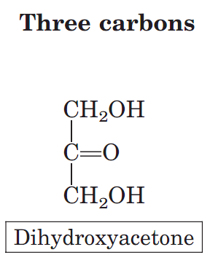
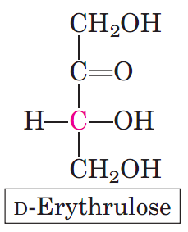
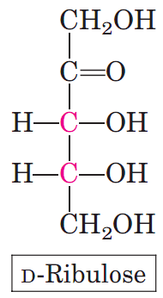
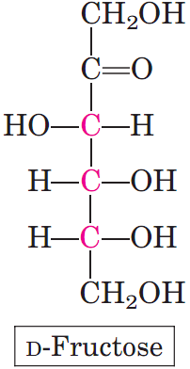
Monosaccharides
Monosaccharides: Examples of Ketoses
Q1. Give an example of (i) 3-carbon, (ii) 4-carbon, (iii) 5-carbon, (iv) 6-carbon ketose.

Slide 13
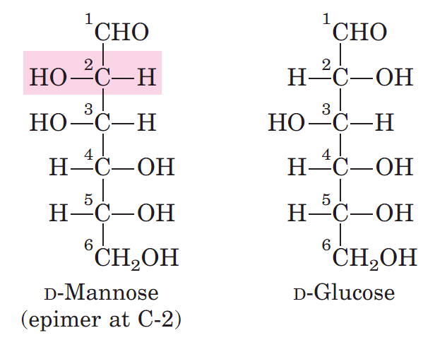
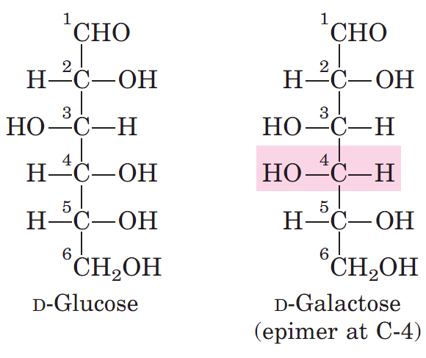
Monosaccharides
Epimers
Epimers: Two sugars that differ only in the configuration of one carbon atom are called epimers.
Q1. What are epimers? Give an example.
Q2. Draw the structures and names of C-2 and C-4 epimers of D-glucose.

Slide 14
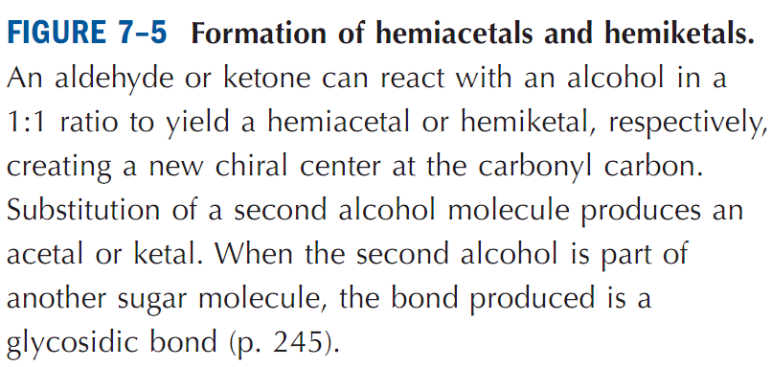
Monosaccharides
Hemiacetals and hemiketals
Hemiacetals & Hemiketals: Hemiacetals and hemiketals are compounds that are derived from aldehydes and ketones respectively. The Greek word hèmi means half. These compounds are formed by formal addition of an alcohol to the carbonyl group.
Q1. What are hemiacetals & hemiketals? Give example.

Slide 15
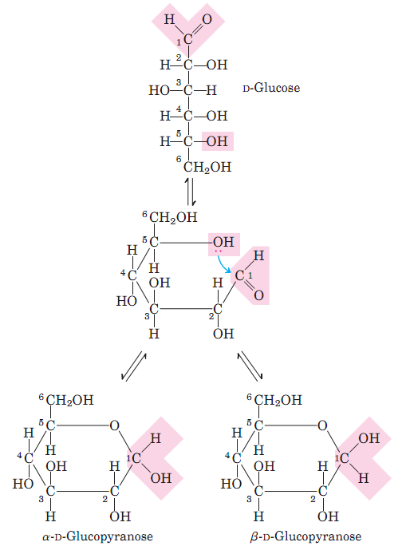
Monosaccharides
Anomers
Anomers: Isomeric forms of monosaccharides that differ only in their configuration about the hemiacetal or hemiketal carbon atoms are called anomers. The hemiacetal (or carbonyl) carbon atom is called anomeric carbon.
For example, α-D-Glucopyranose and β-D-Glucopyranose are anomers of each other.
Q1. What are anomers? Give example.

Slide 16
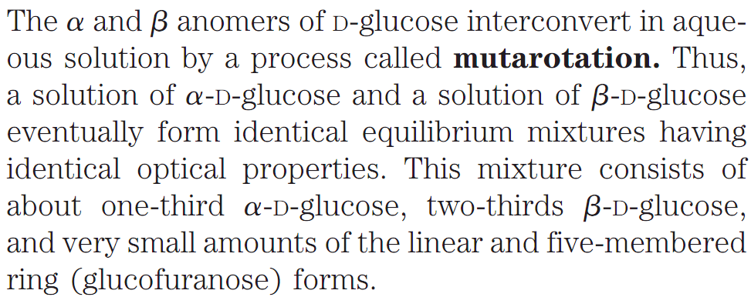
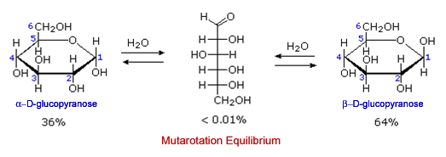
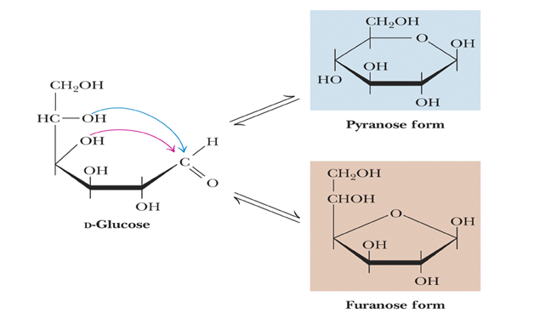
Monosaccharides
Mutarotation
http://www.namrata.co/chemistry-of-carbohydrates-lecture-3-ring-structures-and-mutarotation/
Q1. What is mutarotation? Explain with an example.
No question in the exam on the formation of pyranose and furanose from D-Glucose.

Slide 17
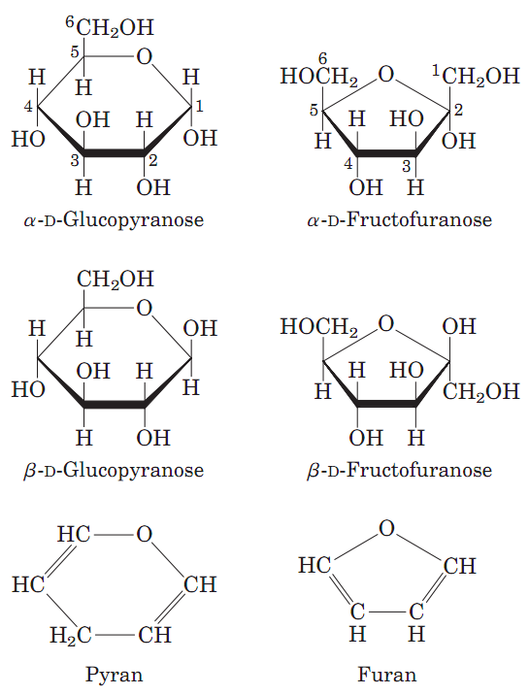
Monosaccharides
Pyranoses & Furanoses drawn by Haworth perspective formulas
Q1. Draw the structures of D-glucose and D-fructose in Haworth perspective formulas.

Slide 18
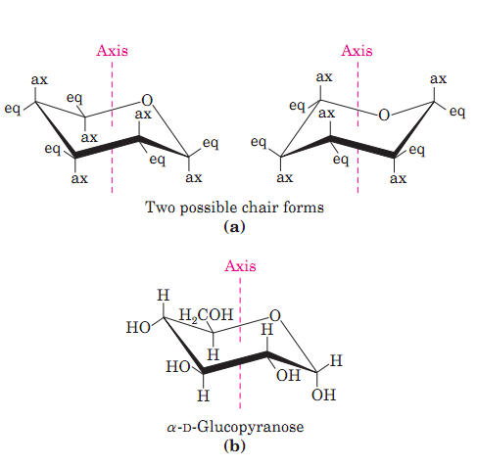
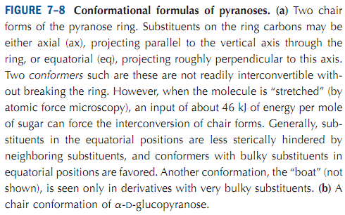
Monosaccharides
Chair conformation of six-membered pyranose ring
The six-membered pyranose ring is not planar, as Haworth perspectives suggest, but tends to assume either of two “chair” conformations (Fig. 7–8).
The specific three-dimensional conformations of the monosaccharide units are important in determining the biological properties and functions of some polysaccharides.
Q1. Draw the chair conformation of α-D-Glucopyranose.
Q2. Why the specific 3D conformations of the monosaccharide units are important?

Slide 19
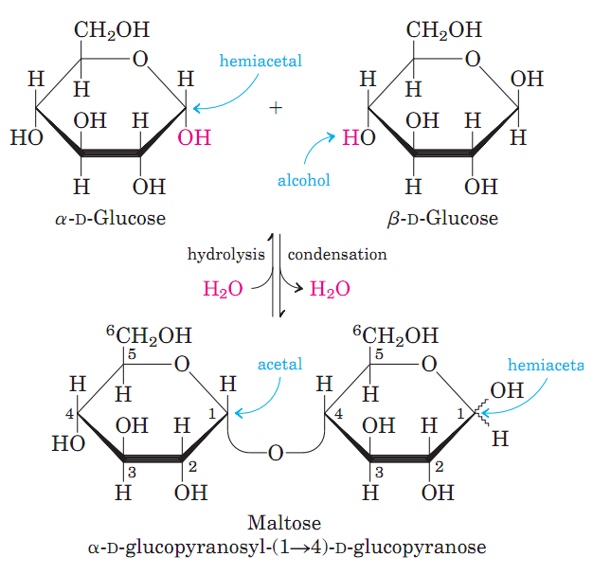
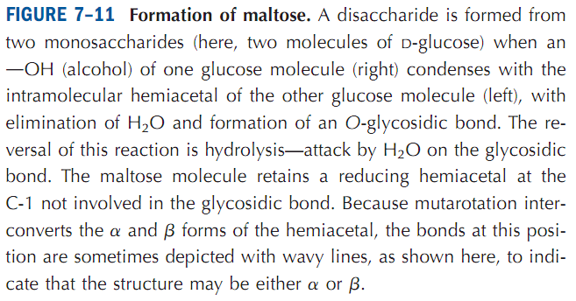
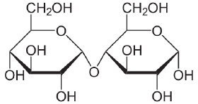
Disaccharides
Disaccharides contain a glycosidic bond
O-glycosidic bond: These bonds are formed when a hydroxyl group from sugar reacts with the anomeric carbon of the other.
Maltose
http://www.newworldencyclopedia.org/entry/Maltose
Q1. Explain O-glycosidic bond formation with example.
Q2. Draw the structure of a disaccharide.

Slide 20
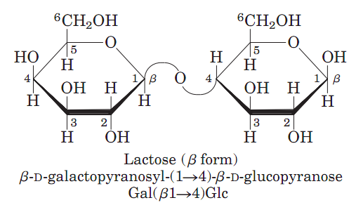
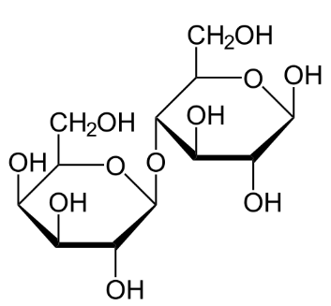
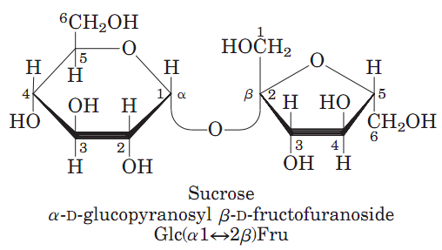
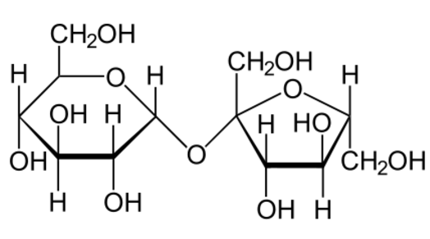
Disaccharides
Some common Disaccharides
Lactose
Sucrose
Q1. Draw the structure of sucrose.
Q2. Draw the structure of a disaccharide.

Slide 21
Polysaccharides
Homo and Heteropolysaccharides
Most carbohydrates found in nature occur as polysaccharides.
Polysaccharides are also known as glycans.
Polysaccharides differ from each other
in the identity of their recurring monosaccharide units,
in the length of their chains,
in the types of bonds linking the units, and
in the degree of branching.
Q1. Which types of carbohydrates are most abundant in nature?
Q2. What are glycans?
Q3. Name the four characteristics in which polysaccharides differ from each other.

Slide 22
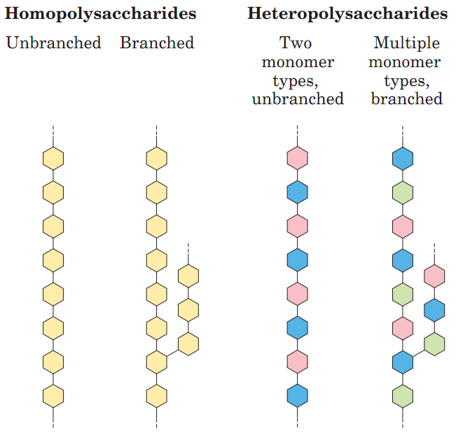
Polysaccharides
Homo and Heteropolysaccharides
Homo-polysaccharides contain only a single type of monomeric units.
Hetero-polysaccharides contain two or more different kinds of monomeric units.
Examples of Homo-polysaccharides: glycogen in animals; starch and cellulose in plants.
Starch and glycogen serve as stored forms of fuel. Cellulose serves structural roles.
Example of Hetero-polysaccharides: peptidoglycan of bacterial cell wall.
Q1. What are homo- and heteropolysaccharides? Give examples.

Slide 23
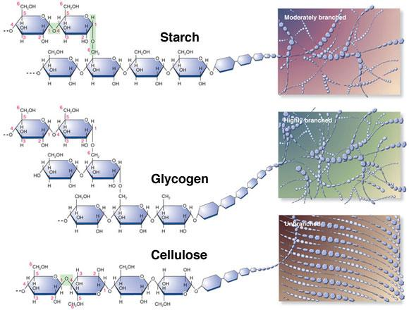
Homopolysaccharides
Differences in branching of Polysaccharides
Moderately Branched Homopolysaccharide: Starch
Highly Branched
Homopolysaccharide: Glycogen
Unbranched
Homopolysaccharide: Cellulose
Q1. Give one example for each of moderately-branched, highly-branched and unbranched homopolysaccharides.
No question in the exam on the image of this slide.
http://www.namrata.co/reaction-catalyzed-by-amylase/

Slide 24
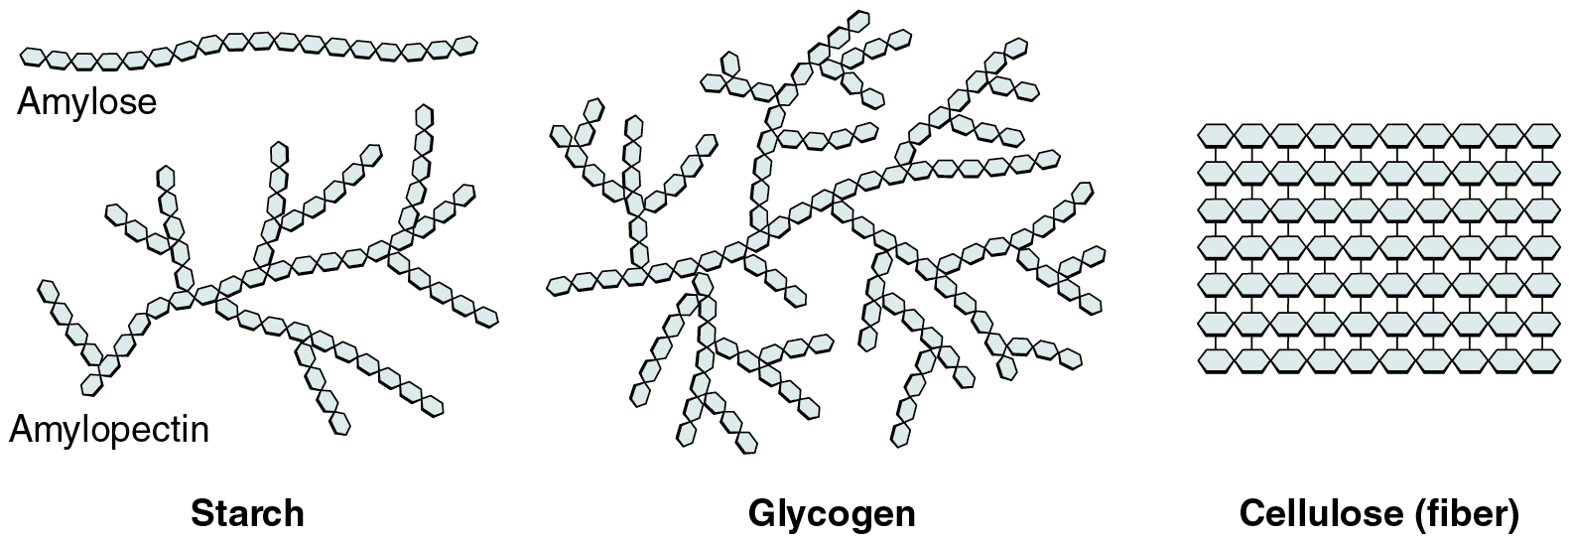
Homopolysaccharides
Differences in branching of Polysaccharides
-Starch contains two types of glucose polymer: amylose and amylopectin.
-Glycogen is similar in structure with the amylopectin of starch.
-Cellulose has no branching, although it is different from amylose.
https://polizeiberichte.info/starch-vs-glycogen-structure
Q1. What are the two different polysaccharides found in starch?

Slide 25
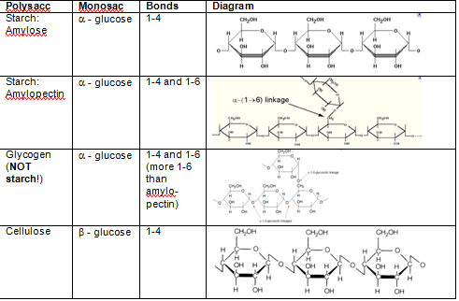
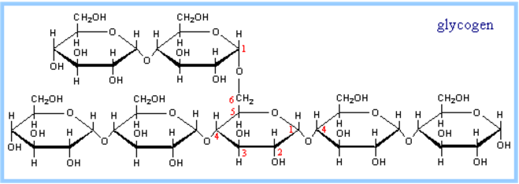
Homopolysaccharides
Comparison among starch, glycogen, cellulose
Q1. Explain the differences in bonding among starch, glycogen and cellulose.
No question in the exam on the structures/diagrams of the table.

Slide 26
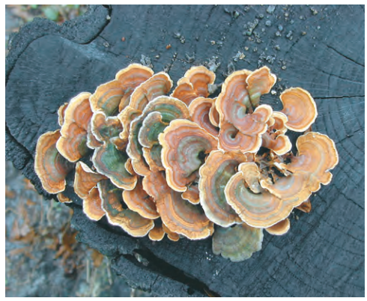
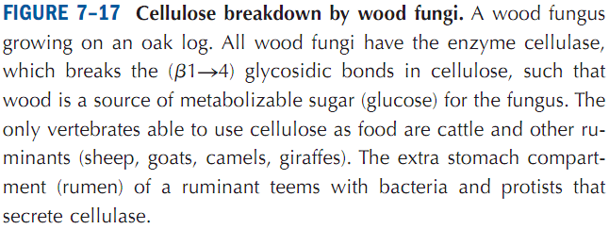
Homopolysaccharides
Humans can digest starch, glycogen but not cellulose
Q1. Can humans digest cellulose?
Q2. Which vertebrates can digest cellulose?

Slide 27
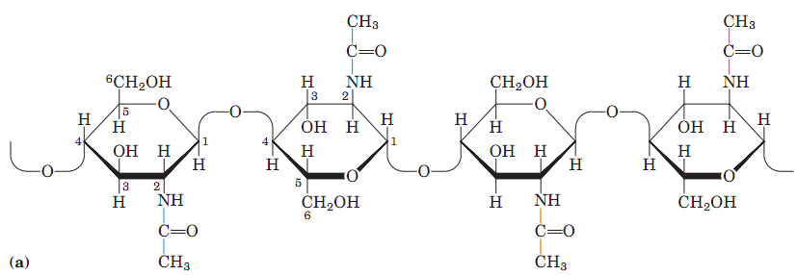
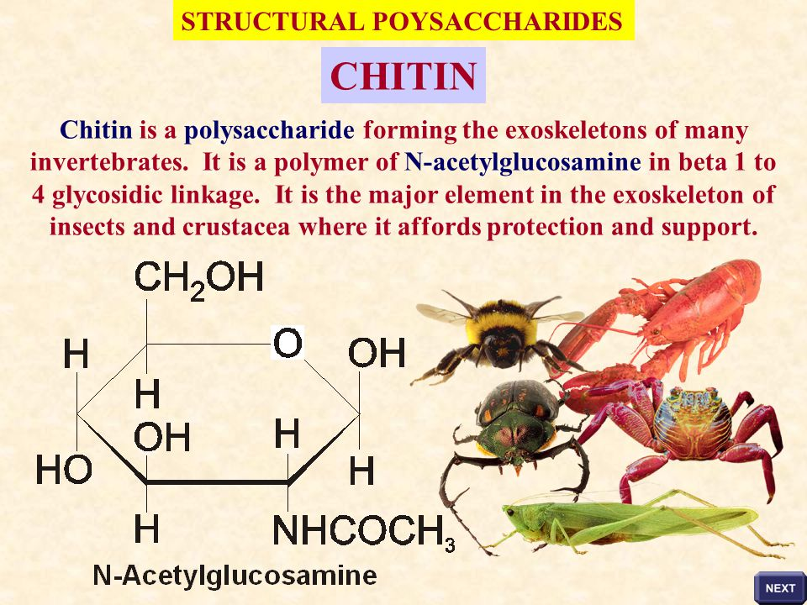
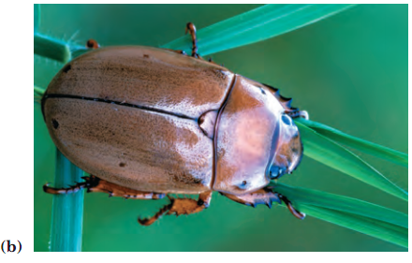
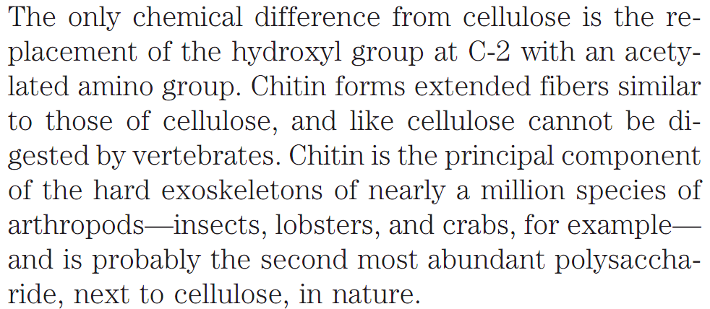
Homopolysaccharides
Chitin
Chitin: Chitin is a linear homo-polysaccharide composed of N-acetylglucosamine residues in β linkage.
Q1. What is chitin? Why is it important?
Q2. What is the composition of chitin?
Q3. Draw the chemical structure of the monomeric unit of chitin.
Q4. Which is the most abundant polysaccharide in nature?
Q5. Which is the second most abundant polysaccharide in nature?
No question in the exam on the polymeric structure of chitin.

Slide 28
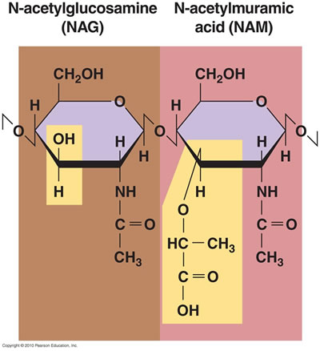
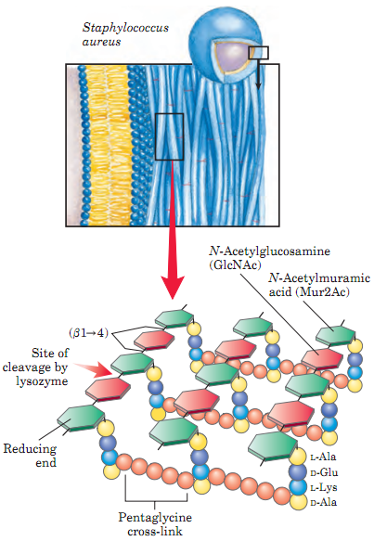
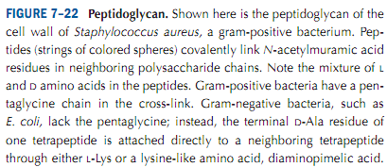
Heteropolysaccharides
Peptidoglycans
Bacterial and algal cell walls contain structural heteropolysaccharides.
Peptidoglycan is a polymer consisting of sugars and amino acids that forms a mesh-like layer outside the plasma membrane of most bacteria, forming the cell wall.
The sugar component consists of alternating residues of β-(1,4) linked N-acetylglucosamine and N-acetylmuramic acid.
Q1. What is peptidoglycan?
Q2. What is the composition of peptidoglycan?
No question on the images of this slide in exams.

Slide 29
Carbohydrates
Glycoconjugates
Glycoconjugates: Glycoconjugates is the general classification for carbohydrates covalently linked with other chemical species such as proteins, peptides, lipids.
Types of glycoconjugates: Proteoglycans, Glycoproteins, Glycolipids.
Proteoglycans: These are macromolecules of the cell surface or extracellular matrix in which one or more glycosaminoglycan chains are joined covalently to membrane protein or a secreted protein. They are the major components of connective tissue such as cartilage. Aggrecan is the most abundant proteoglycan in cartilage.
Glycoproteins: They have one or several oligosaccharides of varying complexity joined covalently to a protein. For example, mucin that is secreted in the mucus of respiratory and digestive tracts. Another example is collagen, the most abundant protein in animal kingdom, that is found in connective tissue and bone.
Glycolipids: Glycolipids are lipids with a carbohydrate attached by a glycosidic bond. Their role is to maintain stability of cell membrane and facilitate cellular recognition. For example, gangliosides in cell membrane.
Q1. What are glycoconjugates?
Q2. What are proteoglycans? Give an example.
Q3. What are glycoproteins? Give an example.
Q4. What are glycolipids? Give an example.
Q5. Give examples of proteoglycans, glycoproteins, glycolipids.

Slide 30
Next Lecture: Lipids
Reference Textbook: Lehninger Principles of Biochemistry
4th or 5th Edition
David L. Nelson, Michael M. Cox WH Freeman & Company,
New York, USA

