Slide 1
BIO201 SPRING 2018 Introduction to Biochemistry & Biotechnology
Lecture #5

Slide 2
Lehninger
Principles of Biochemistry
Chapter 4, 5, 6
Three Dimensional Structure of Proteins;
Protein Function;
Enzymes

Slide 3
The Three Dimensional Structure of Proteins

Slide 4
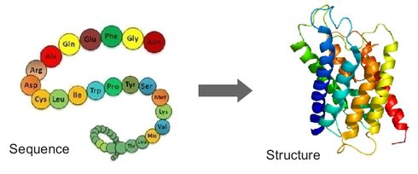
Overview of protein structure
Protein Conformation
Conformation: The spatial or three-dimensional arrangement of atoms in a protein is called its conformation.
A protein can have more than one conformations and the conformations existing under a given set of conditions are usually the ones that are thermodynamically the most stable, having the lowest Gibbs free energy.
http://www.robotics.tu-berlin.de/menue/research/protein_structure_prediction/
The native protein is folded through weak interactions:
Hydrophobic interactions;
Hydrogen bonds;
Ionic interactions;
van der Waals interactions.
Q1. Explain protein conformation.
No questions about the image on this ppt slide in exam.
Notes:
r

Slide 5
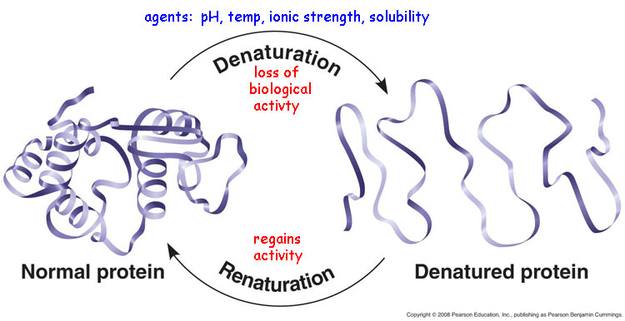
Overview of protein structure
Native and Denatured forms of protein
Proteins in any of their functional, folded conformations are called native proteins.
Denaturation of proteins involves the disruption and possible destruction of both the secondary and tertiary structures. Since denaturation reactions are not strong enough to break the peptide bonds, the primary structure (sequence of amino acids) remains the same after a denaturation process.
Renaturation is a process by which a denatured protein regained the native form.
Q1. What are native and denatured forms of proteins?
Notes:
r

Slide 6
Protein Function

Slide 7
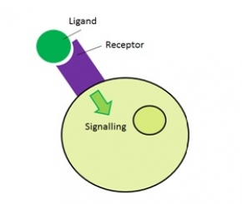
How Proteins Interact with other molecules?
Ligands
Ligand: A molecule bound reversibly by a protein is called a ligand.
The functions of many proteins involve the reversible binding of other molecules.
https://www.fastbleep.com/biology-notes/40/1175
Insulin is a ligand of its receptor known as insulin receptor.
Q1. Define ligand. Give example.
Notes:
r

Slide 8
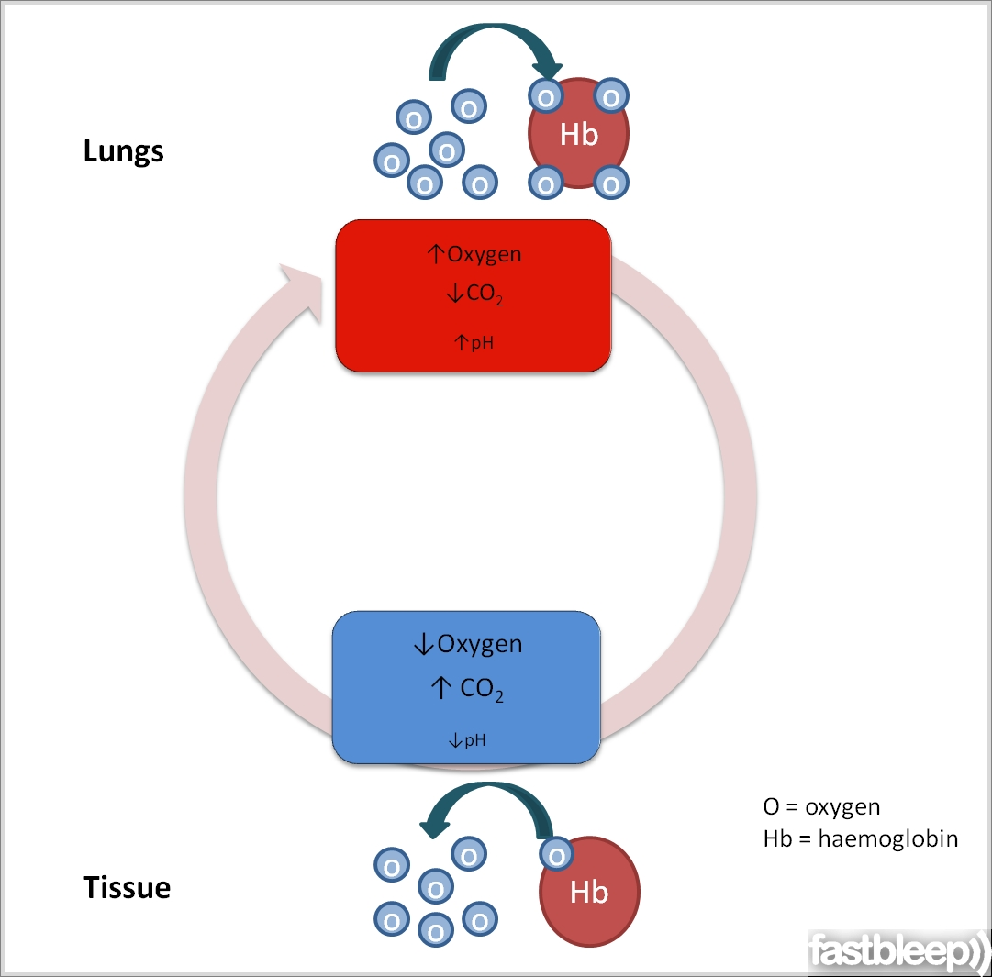
How Proteins Interact with other molecules?
Ligands
For example, oxygen is a ligand for hemoglobin.
https://www.fastbleep.com/biology-notes/32/846
Q1. What is the ligand for hemoglobin? What is the importance of the ligand?
Notes:
r

Slide 9
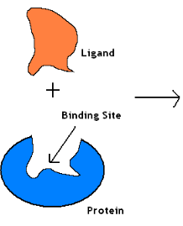
How Proteins Interact with other molecules?
Binding site of Proteins
A ligand binds at a site on the protein called the binding site.
This interaction is specific: the protein can discriminate among the thousands of different molecules in its environment and selectively bind only one or a few.
Protein with bound ligand
https://en.wikibooks.org/wiki/Structural_Biochemistry/Enzyme_Catalytic_Mechanism/Binding
Q1. Explain the meaning of the binding site of a protein.
Notes:
r

Slide 10
Hemoglobin and its function
Hemoglobin
Oxygen is transported through blood from lungs to peripheral tissues by hemoglobin of red blood cells.
https://www.slideshare.net/angellal2010/haemoglobin-61293008
Q1. How oxygen is transported through blood from lungs to peripheral tissues?
Notes:
r

Slide 11
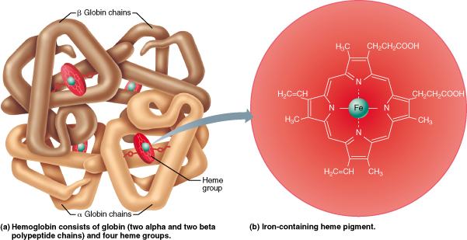
Hemoglobin and its function
Structure of hemoglobin
http://www.easynotecards.com/notecard_set/24151
No question in the exam from this slide.
Notes:
r

Slide 12
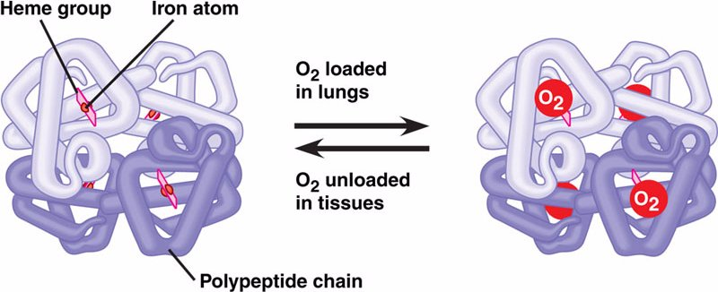
Hemoglobin and its function
Binding of oxygen with hemoglobin
One hemoglobin molecule can bind four oxygen molecules.
https://sites.google.com/site/atidbiology/cellbiology/biochemistry/proteins/hemoglobin
Q1. How many oxygen molecules can be bound by one hemoglobin molecule?
Notes:
r

Slide 13
Enzymes

Slide 14
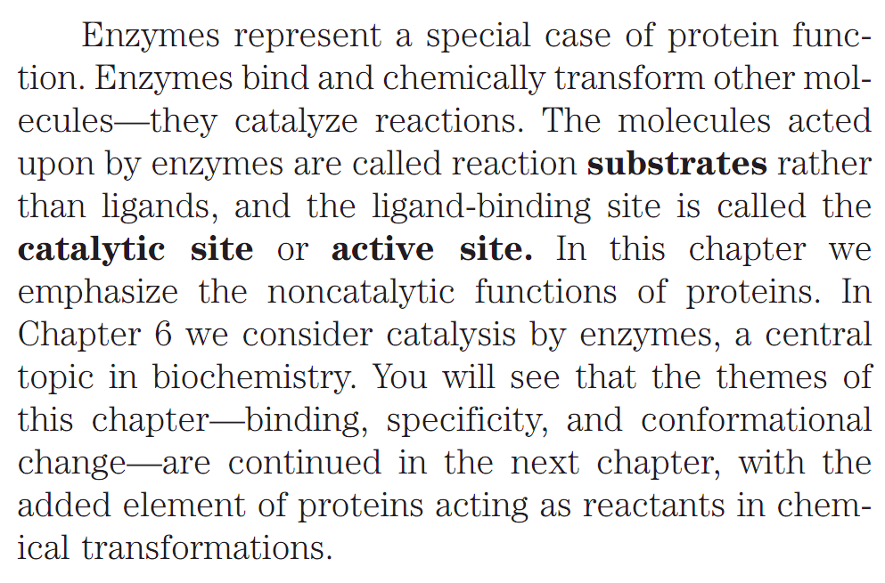
Catalysts of biological systems
Most Enzymes are Proteins
Q1. What is the difference between ligand and substrate?
Q2. What is the difference between binding site and catalytic or active site of a protein?
Notes:
r

Slide 15
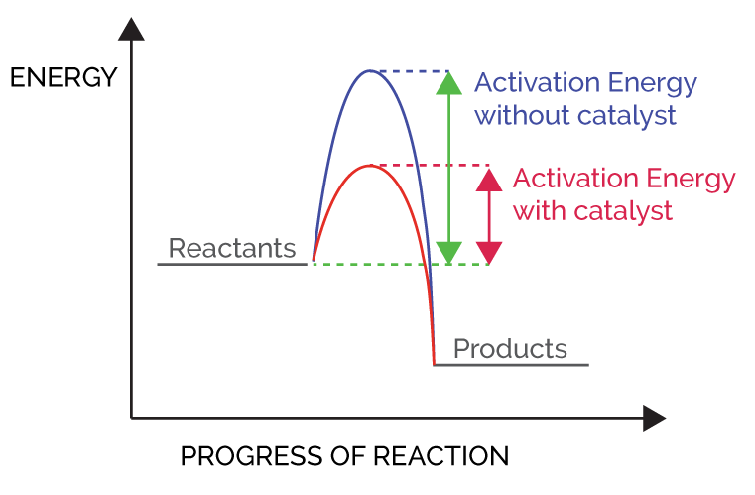
Catalysts of biological systems
Enzymes are biological catalysts
Catalyst: A catalyst is a substance which speeds up a reaction, but is chemically unchanged at the end of the reaction.
http://gcylinder.com/how-it-works/
Q1. Define catalyst.
Notes:
r

Slide 16
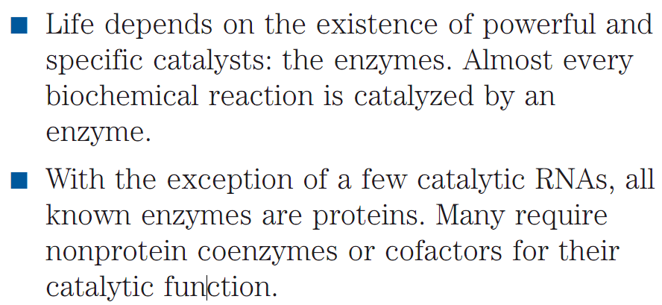
Catalysts of biological systems
Enzymes are biological catalysts
Q1. What is the significance of the enzymes in living organisms?
Q2. Are all enzymes proteins?
Notes:
r

Slide 17
Catalysts of biological systems
Enzymes and their classification
Enzymes: Enzymes are macromolecular biological catalysts that accelerate, or catalyze, chemical reactions. The molecules at the beginning of the process upon which enzymes may act are called substrates and the enzyme converts these into different molecules, called products.
Q1. Define enzymes.
Q2. What are substrates and products?
Q3. What is the basis of enzyme classification? Write the names of the classes of enzymes according to international classification.
Notes:
r

Slide 18
Catalysts of biological systems
Enzymes and their classification
Q1. Give an example of each classes of enzymes.
Notes:
r

Slide 19
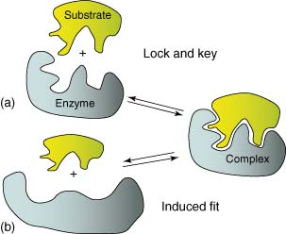
Catalysts of biological systems
Enzymes are highly specific
Enzyme specificity: Enzyme specificity refers to the tendency for enzymes to catalyze a specific set of chemical reactions.
Some enzymes are absolutely specific and only catalyze one chemical reaction.
http://slideplayer.com/slide/2424931/
https://www.researchgate.net/figure/277701347_fig2_Figure-2-Rigid-lock-and-key-and-b-induced-fit-models-of-enzyme-substrate-and-hence
Q1. What is enzyme specificity?
Q2. Compare between “lock-and-key” and “induced fit” models of enzyme function.
Notes:
r

Slide 20
Catalysts of biological systems
Cofactors
Cofactor: A substance (other than the substrate) whose presence is essential for the activity of an enzyme.
http://slideplayer.com/slide/9345920/
Q1. What is a cofactor?
Q2. How many types of cofactors exist?
Notes:
r

Slide 21
Catalysts of biological systems
Examples of Co-factors
http://slideplayer.com/slide/5779139/
Q1. Give examples of cofactors.
Q2. What are prosthetic groups of enzymes? Give example.
Notes:
r

Slide 22
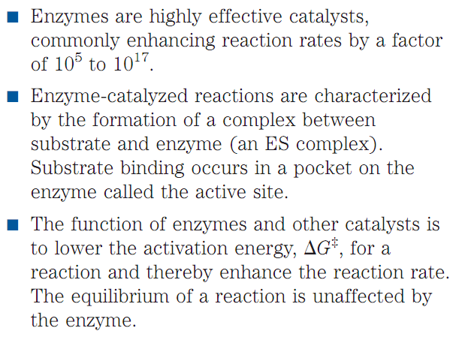
Catalysts of biological systems
Enzymes are highly effective catalysts
Q1. Are enzymes effective catalysts?
Q2. What is the primary function of enzymes with respect to activation energy of a chemical reaction?
Notes:
r

Slide 23
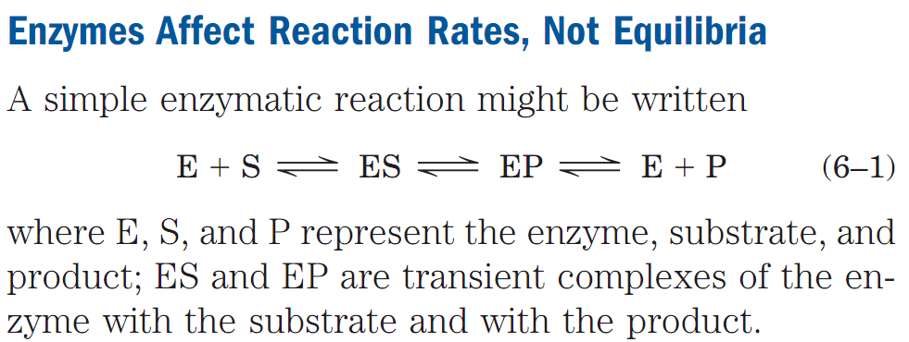
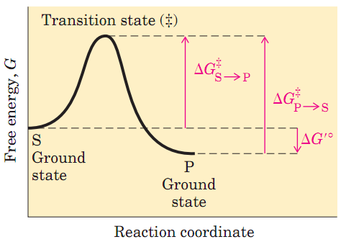
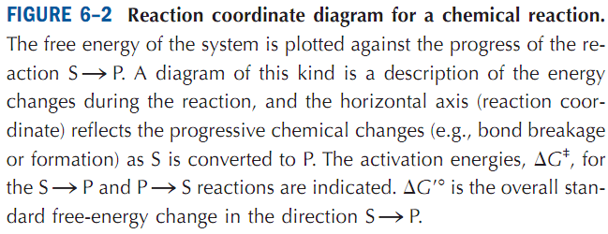
Catalysts of biological systems
Catalysts affect reaction rates
To understand catalysis, we must first appreciate the important distinction between reaction equilibria and reaction rates. The function of a catalyst is to increase the rate of a reaction. Catalysts do not affect reaction equilibria. Any reaction, such as S P, can be described by a reaction coordinate diagram (Fig. 6–2), a picture of the energy changes during the reaction.
Q1. What is the common function of catalysts?
Q2. Draw the reaction coordinate diagram for a chemical reaction.
Notes:
r

Slide 24
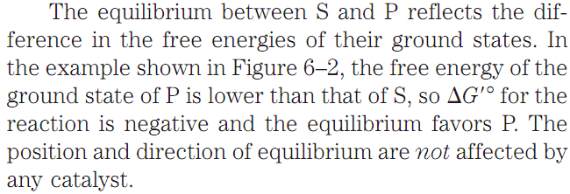
Catalysts of biological systems
Biochemical Standard Free-Energy Change
To describe the free-energy changes for reactions, chemists define a standard set of conditions (temperature 298 K; partial pressure of each gas 1 atm, or 101.3 kPa; concentration of each solute 1 M) and express the free-energy change for this reacting system as ∆G°, the standard free-energy change.
Because biochemical systems commonly involve H⁺ concentrations far below 1 M, biochemists define a biochemical standard free-energy change, ∆G´°, the biochemical standard free-energy change.
The starting point for either the forward or the reverse reaction is called the ground state, the contribution to the free energy of the system by an average molecule (S or P) under a given set of conditions.
Q1. What is the difference between ∆G° and ∆G´°?
Notes:
r

Slide 25
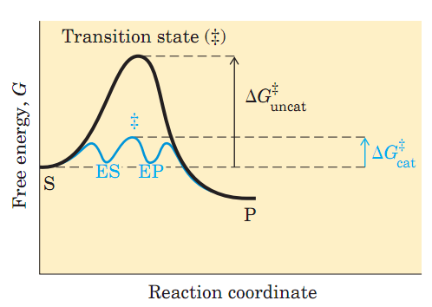
Catalysts of biological systems
Catalysts do not affect reaction equilibrium
Transition state: At the top of the energy hill is a point at which decay to the S or P state is equally probable (it is down-hill either way). This is called the transition state.
The transition state is not a chemical species with any significant stability and should not be confused with a reaction intermediate (such as ES or EP). It is simply a fleeting molecular moment in which events such as bond breakage, bond formation, and charge development
have proceeded to the precise point at which decay to either substrate or product is equally likely.
The difference between the energy levels of the ground state and the transition state is the activation energy, ∆G‡. The rate of a reaction reflects this activation energy: a higher
activation energy corresponds to a slower reaction. Reaction rates can be increased by raising the temperature, thereby increasing the number of molecules with sufficient energy to overcome the energy barrier. Alternatively, the activation energy can be lowered by adding a catalyst (Fig. 6–3). Catalysts enhance reaction rates by lowering activation energies.
Q1. What is transition state?
Q2. How does activation energy affect the rate of a reaction?
Q3. “Catalysts enhance reaction rates by lowering activation energies”. Explain.
Notes:
r

Slide 26
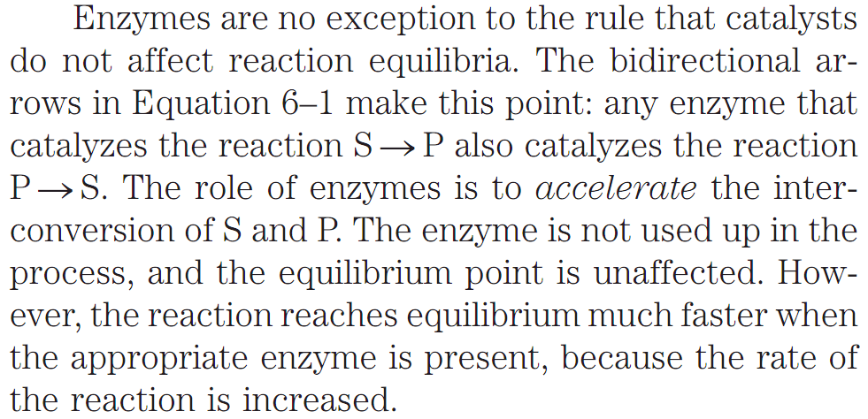
Catalysts of biological systems
Catalysts do not affect reaction equilibrium
Q1. Explain how enzymes do not affect reaction equilibria.
Notes:
r

Slide 27
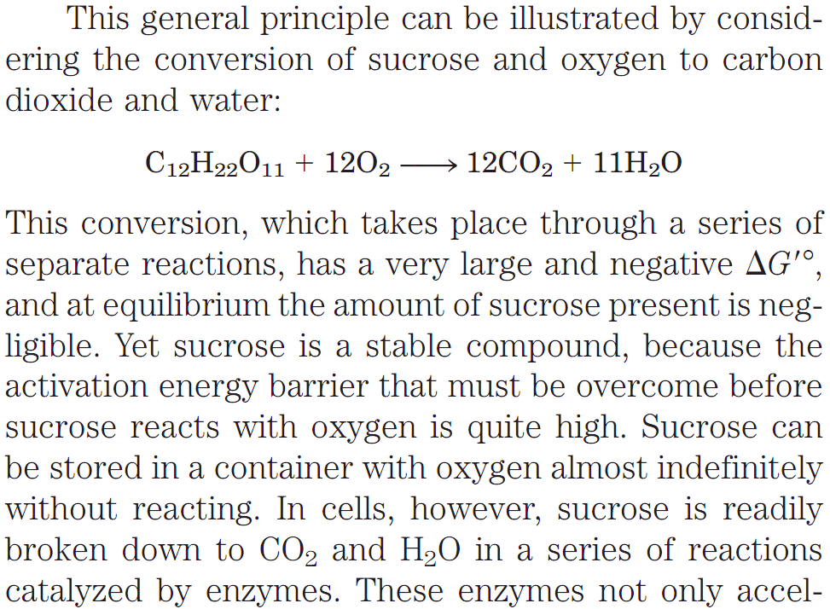
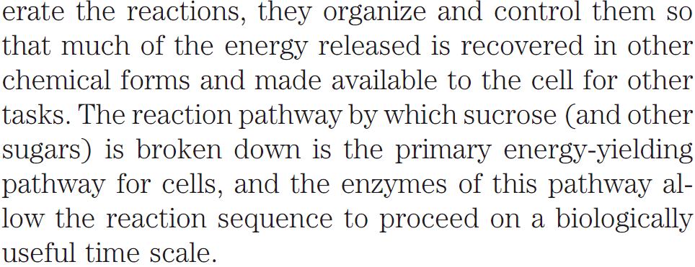
Catalysts of biological systems
Catalysts do not affect reaction equilibrium
Q1. Discuss the rates of oxidation of sucrose by oxygen without and with enzymes.
Notes:
r

Slide 28
Catalysts of biological systems
Reaction intermediates
Any reaction may have several steps, involving the formation and decay of transient chemical species called reaction intermediates. A reaction intermediate is
any species on the reaction pathway that has a finite chemical lifetime (longer than a molecular vibration, ~10⁻¹³ seconds). When the S P reaction is catalyzed by an enzyme, the ES and EP complexes can be considered intermediates, even though S and P are stable chemical species (Eqn 6–1); the ES and EP complexes occupy valleys in the reaction coordinate diagram (Fig.6–3).
Additional, less stable chemical intermediates often exist in the course of an enzyme-catalyzed reaction.
Q1. What is reaction intermediate?
Notes:
r

Slide 29
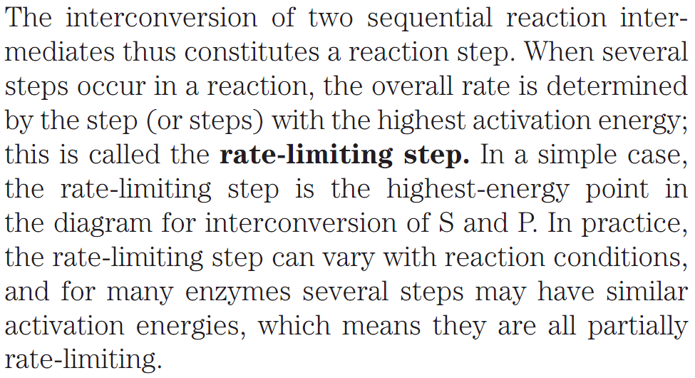
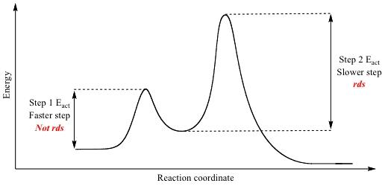
Catalysts of biological systems
Rate-limiting step of metabolic pathways
Q1. What is rate-limiting step of metabolic pathways? Draw diagram to explain.
https://www.studyblue.com/notes/note/n/sn1/deck/11644061
Notes:
r

Slide 30
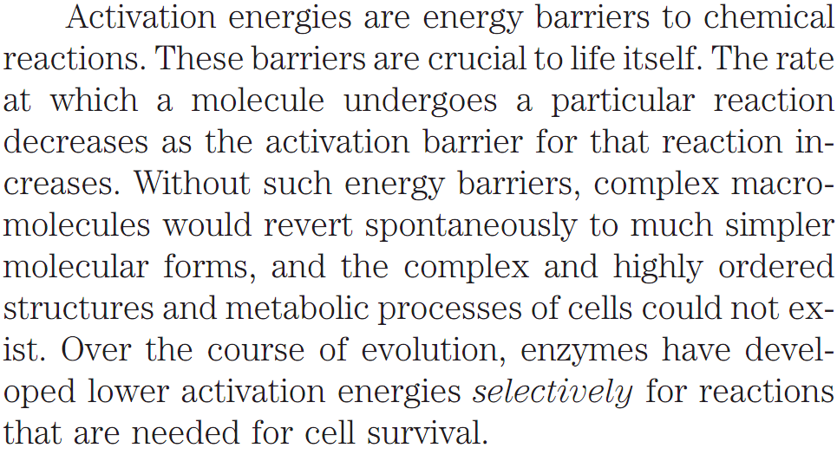
Catalysts of biological systems
Biologic Significance of Activation Energy
Q1. What is the significance of activation energy of biological reactions?
Q2. What is the role of enzymes with respect to lowering activation energies of biological reactions during evolution?
Notes:
r

Slide 31
Next Lecture: Carbohydrates
Reference Textbook: Lehninger Principles of Biochemistry
4th or 5th Edition
David L. Nelson, Michael M. Cox WH Freeman & Company,
New York, USA

