Slide 1
BIO201/BBT101 SPRING 2018 Introduction to Biochemistry & Biotechnology
Lecture #4

Slide 2
Lehninger
Principles of Biochemistry
Chapter 3
Amino Acids

Slide 3
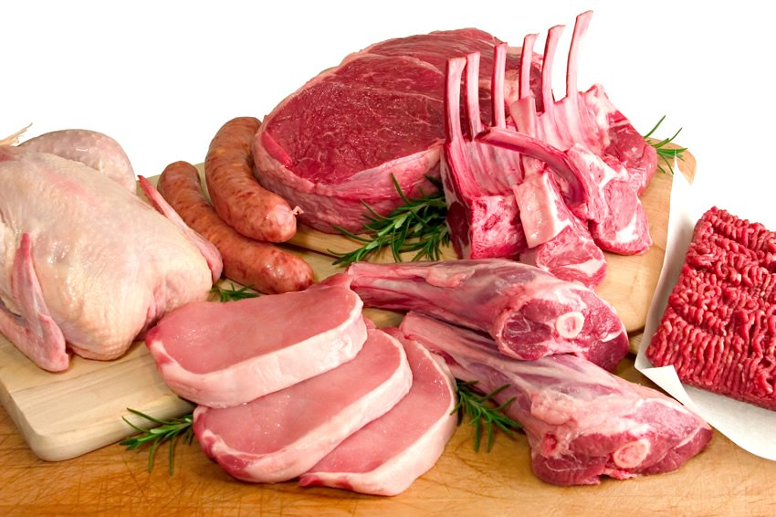
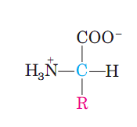
Amino Acids
What are the building blocks of proteins?
Proteins play crucial roles in almost all biological processes and amino acids are the building blocks of it. A large proportion of our cells, muscles and tissue is made up of amino acids.
Proteins are made up of amino acids.
http://www.building-muscle101.com/food-high-in-protein.html
Q1. What makes proteins?
Q2. Draw the general structure of amino acids.

Slide 4
Amino Acids
Some Functions of Proteins
Q1. Give an example of protein function in biological systems.

Slide 5
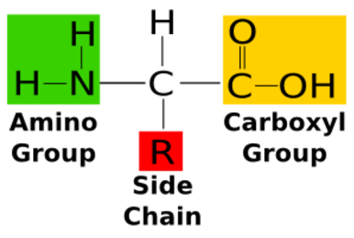
Amino Acids
What are amino acids?
An amino acid is a type of organic acid that contains a carboxyl functional group (-COOH) and an amine functional group (-NH₂) as well as a side chain (designated as R) that is specific to the individual amino acid.
Q1. Define amino acids.

Slide 6
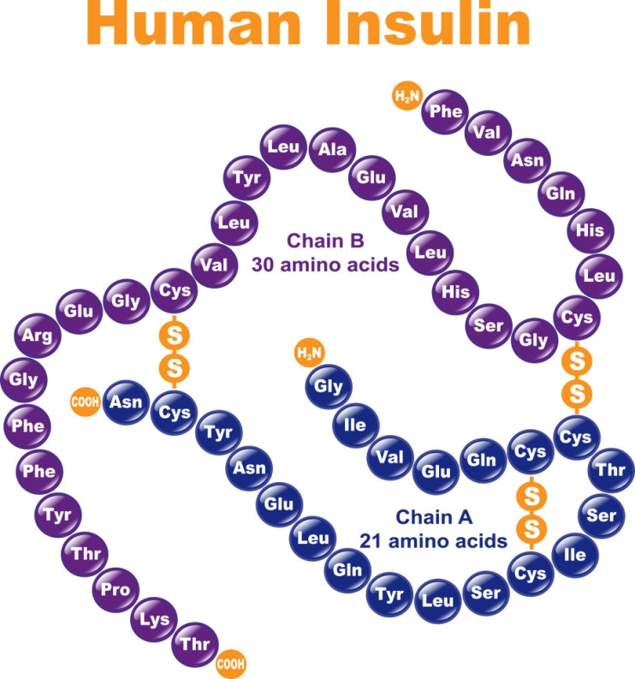
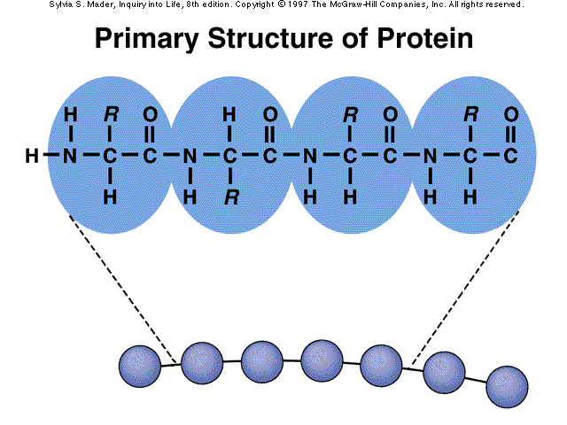
Amino Acids
How amino acids are linked together in proteins?
Proteins are made up of hundreds of smaller units called amino acids that are attached to one another by peptide bonds, forming a long chain.
http://www.interactive-biology.com/6711/the-basics-of-protein-structure-and-function/
Q1. What is the monomeric unit of proteins?

Slide 7
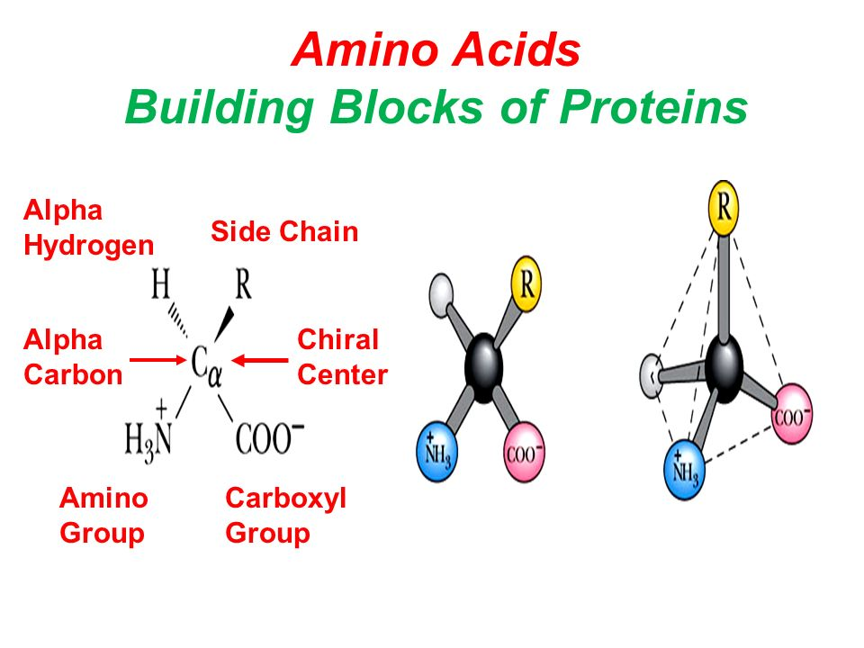
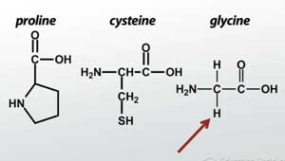
Amino Acids
Chiral Center
Chiral center: Chiral molecules contain at least one carbon atom with four non-identical substituents. Such a carbon atom is called a chiral center.
Except glycine, all other amino acids are chiral. Glycine is achiral.
http://slideplayer.com/slide/6990130/
Q1. What is chiral center?
Q2. Show the chiral center in an amino acid.
Q3. Draw the structure of amino acid that is not chiral.
Notes:
r

Slide 8
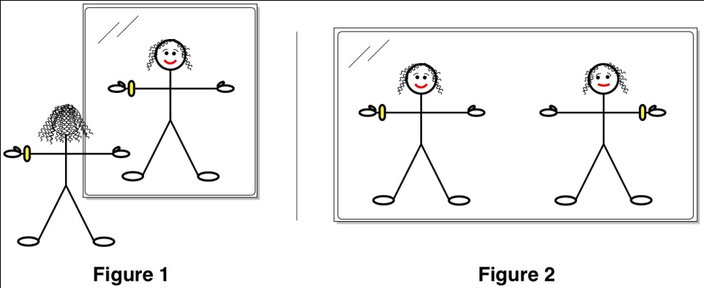
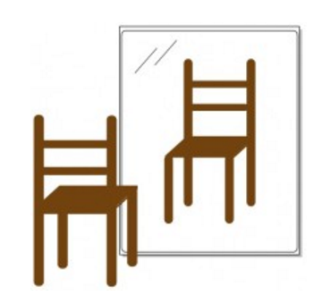
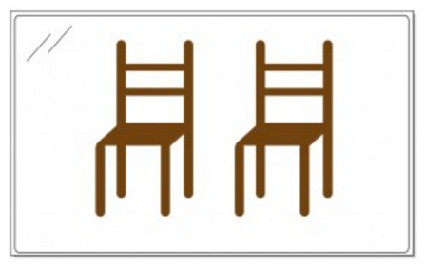
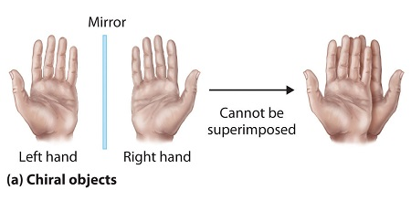
Amino Acids
Chiral & Achiral Molecules
http://icanhasscience.com/chemistry/through-the-looking-glass/
http://jinavie.tumblr.com/post/42210918094/mirror#.WI76QdJ97cs
A chiral molecule can’t be superimposed on its mirror image, no matter how you rotate it. One could say that his or her body is chiral.
An achiral molecule cannot be distinguished from its mirror image. The chair in the picture above is achiral.
Q1. Define chiral and achiral molecules.
Notes:
r

Slide 9
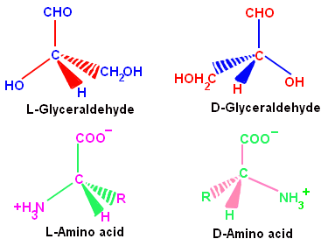
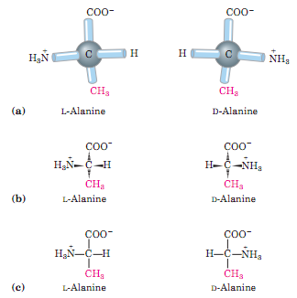
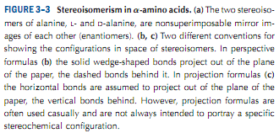
Amino Acids
Enantiomers
Stereoisomers: Stereoisomers are compounds with the same structural formula but with a different arrangement in space.
Enantiomers: Enantiomers are chiral molecules that are mirror images of each other.
An enantiomer is one of two stereoisomers that are mirror images of each other which means they are non-superimposable. For all chiral compounds, stereoisomers having a configuration related to that of L-glyceraldehyde are designated L, and stereoisomers related to D-glyceraldehyde are designated D.
Racemic mixture: In chemistry, a racemic mixture, or racemate is one that has equal amounts of left- and right-handed enantiomers of a chiral molecule.
Q1. Define enantiomers.
Q2. What is racemic mixture?
Q3. Draw structures of the enantiomers of alanine.
Notes:
r

Slide 10
Amino Acids
Amino acids in proteins are L stereoisomers
The amino acids in protein molecules are exclusively L stereoisomers.
D-Amino acids have been found only in a few, relatively small peptides of bacterial cell walls and certain peptide antibiotics.
Cells are able to specifically synthesize the L isomers of amino acids because the active sites of enzymes are asymmetric, causing the reactions they catalyze to be stereospecific.
Not in proteins;
only in some bacterial peptides
In proteins
There are no scientific explanation why proteins are primarily made up of only
L-amino acids.
Q1. Which stereoisomer of amino acids exist in proteins?
Notes:
r

Slide 11
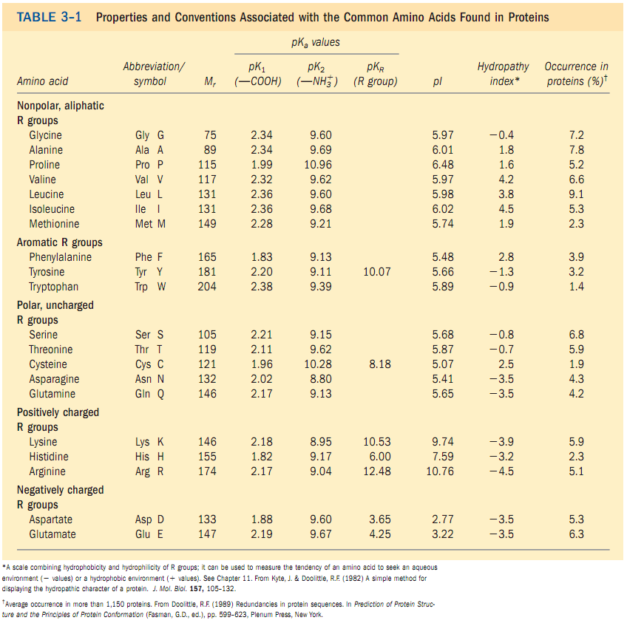
Classification of Amino Acids
Amino acids can be classified by R group
Amino acids are grouped into five classes based on their tendency to interact with water at biological pH (7.0).
Q1. What is the basis of amino acid classification?
Q2. Name the five different classes of common amino acids.
Notes:
r

Slide 12
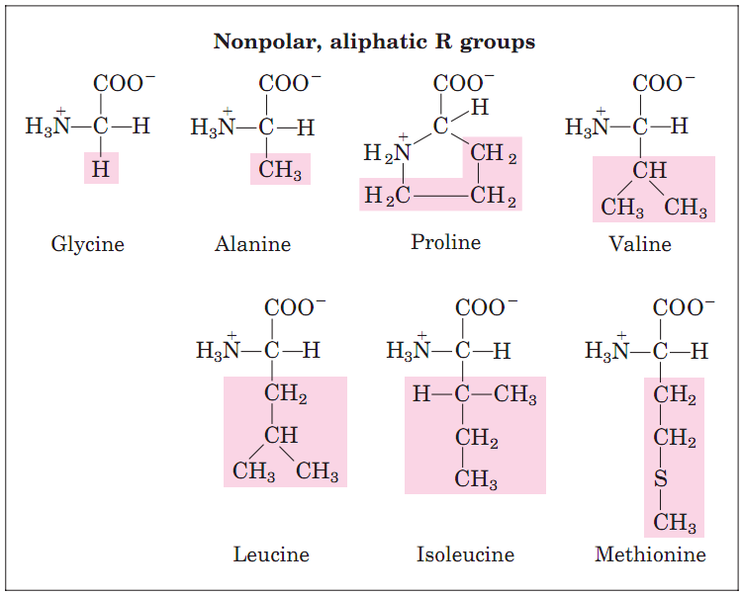
Classification of Amino Acids
Amino acids can be classified by R group
Q1. Draw the structure of an amino acid with non-polar, aliphatic R groups.
Notes:
r

Slide 13
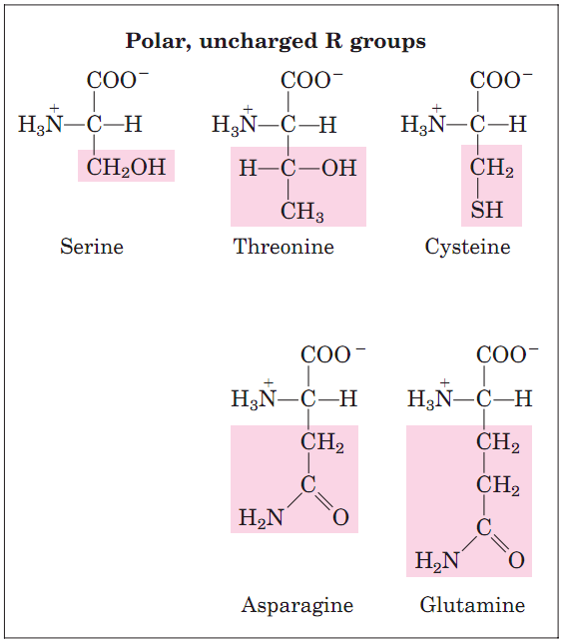
Classification of Amino Acids
Amino acids can be classified by R group
Q1. Draw the structure of an amino acid with polar, uncharged R group.
Notes:
r

Slide 14
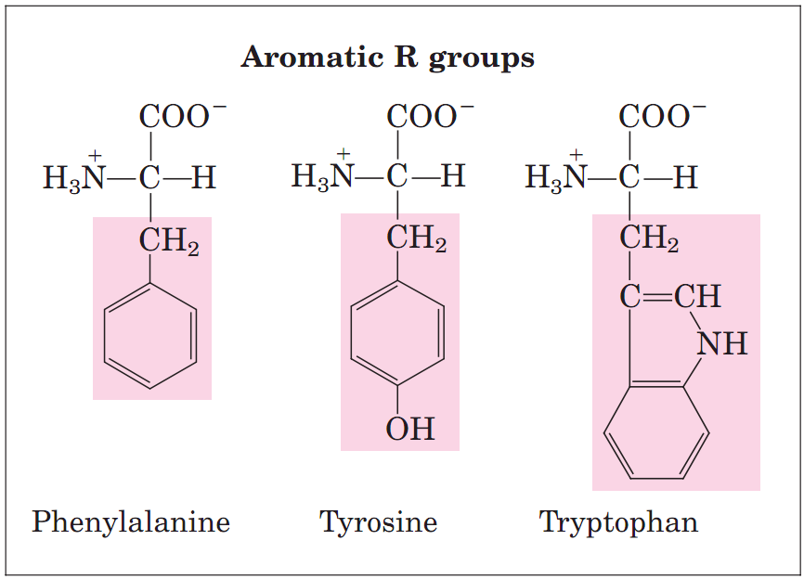
Classification of Amino Acids
Amino acids can be classified by R group
Q1. Draw the structure of an amino acid with aromatic R group.
Notes:
r

Slide 15
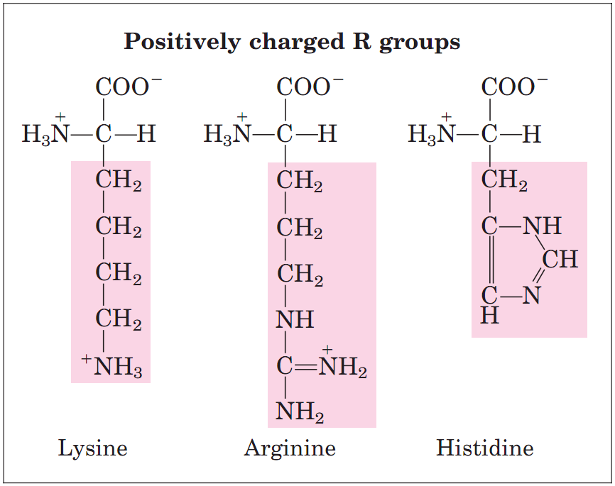
Classification of Amino Acids
Amino acids can be classified by R group
Q1. Draw the structure of an amino acid with positively charged R group.
Notes:
r

Slide 16
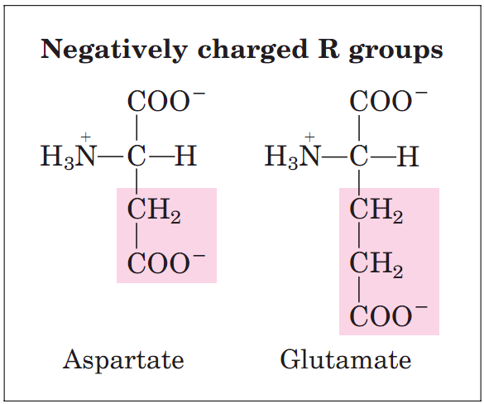
Classification of Amino Acids
Amino acids can be classified by R group
Q1. Draw the structure of an amino acid with negatively charged R group.
Notes:
r

Slide 17
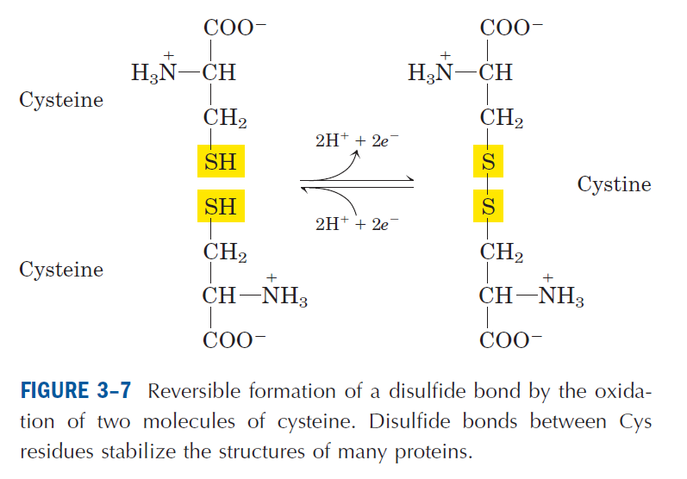
Classification of Amino Acids
Disulfide bonds
Cysteine is readily oxidized to form a covalently linked dimeric amino acid called cystine, in which two cysteine molecules are joined together by disulfide bonds.
http://www.interactive-biology.com/6711/the-basics-of-protein-structure-and-function/
Q1. Show how disulfide bonds are formed.
Q2. Why some hair are curly whereas some are straight?
http://positivemed.com/2012/12/09/why-is-some-hair-curly-and-some-hair-straight/
Notes:
r

Slide 18
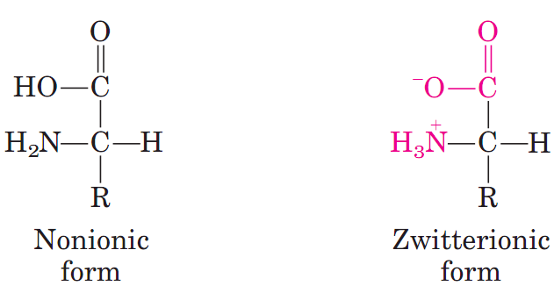
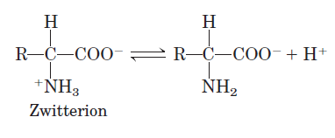
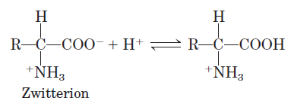
Classification of Amino Acids
Amino acids can act as Acids and Bases
Zwitterion: A molecule or ion having separate positively and negatively charged groups.
Amino acids as Zwitterions: When an amino acid is dissolved in water (pH 7.0), it exists in solution as dipolar ion, or zwitterion.
A zwitterion can act as either an acid (proton donor) or a base (proton acceptor).
Amino acid as an acid (proton donor)
Amino acid as a base (proton acceptor)
Q1. What is a zwitterion? Draw diagrams to show how amino acids can act as zwitterions.
Q2. Show how amino acids can act as both proton-donor and proton-acceptor.
Notes:
r

Slide 19
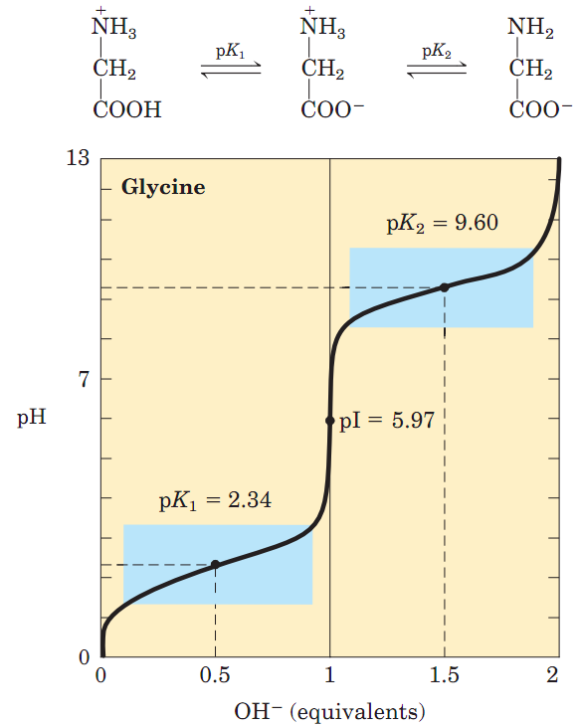
Amino acids have characteristic titration curves
Isoelectric point (pI) of amino acids
Isoelectric pH or point: The isoelectric pH or point (pI), is the pH at which a particular molecule carries no net electrical charge.
Q1. What is isoelectric point?
No questions about values of isoelectric points of glycine in exam.
Notes:
r

Slide 20
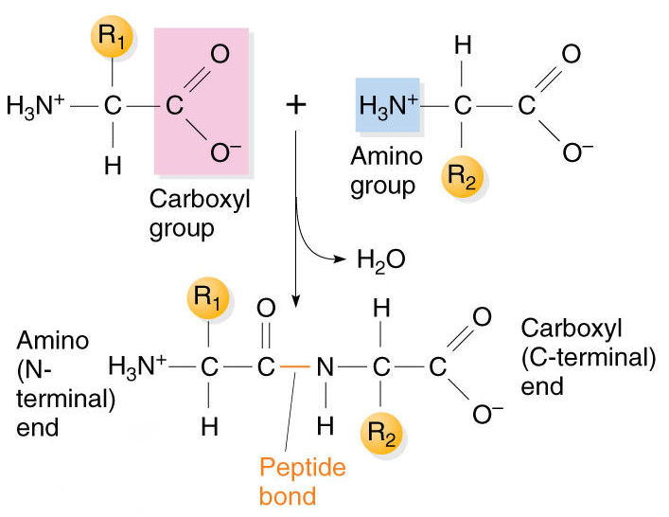
Amino Acids
How a peptide bond is formed?
A peptide bond is a chemical bond formed between two molecules when the carboxyl group of one molecule reacts with the amino group of the other molecule, releasing a molecule of water (H₂O).
This is a dehydration synthesis reaction (also known as a condensation reaction), and usually occurs between amino acids.
https://drgpinstitute.wordpress.com/2014/12/27/protein/
Q1. How a peptide bond is formed?
Q2. Show the chemical reaction of peptide bond formation.

Slide 21
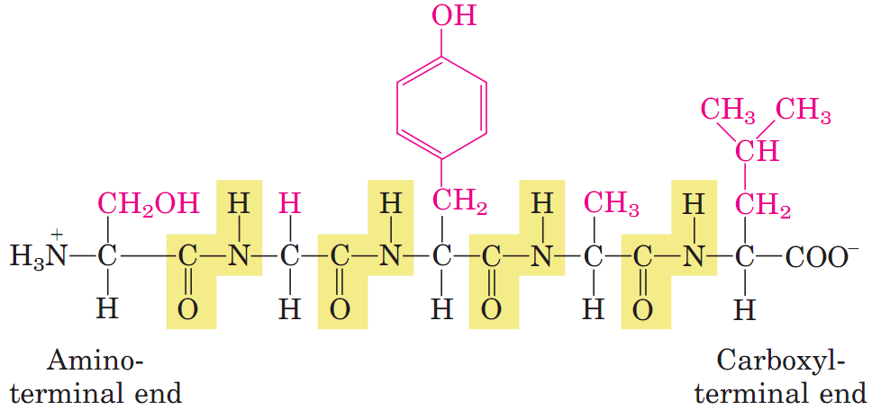
Amino Acids
What is a peptide bond?
Amino acids are joined to its neighbor by covalent bonds in proteins.
A peptide bond (amide bond) is a covalent chemical bond linking two consecutive amino acid monomers along a polypeptide or protein chain.
http://www.interactive-biology.com/6711/the-basics-of-protein-structure-and-function/
Q1. What is a peptide bond?
Q2. Draw a diagram to show peptide bonds in a polypeptide.

Slide 22
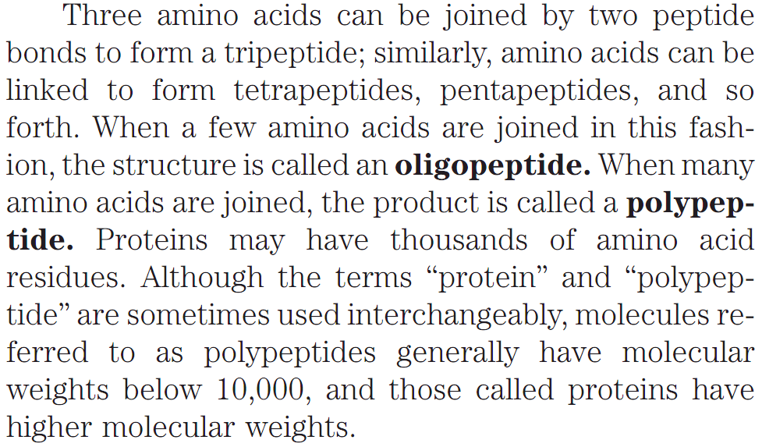
Amino Acids
What is a peptide bond?
Oligopeptides: 10 or less; Polypeptides: 50 or less; Proteins: More than 50 amino acids.
Q1. What are oligopeptides, polypeptides, and proteins?

Slide 23
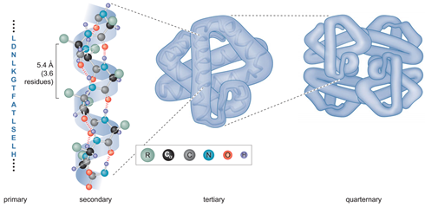
How many levels of protein structure exist?
There are several levels of protein structure
There are four levels of protein structure: Primary, secondary, tertiary, quaternary.
Secondary structure: Within the long protein chains there are regions in which the chains are organized into regular structures known as alpha-helices (alpha-helixes) and beta-pleated sheets. These are the secondary structures in proteins. These secondary structures are held together by hydrogen bonds.
Tertiary structure: The overall three dimensional arrangement of all atoms in a protein is referred to as the protein’s tertiary structure.
Quaternary structure: Protein quaternary structure is the number and arrangement of multiple folded protein subunits in a multi-subunit complex.
Q1. Explain the four levels of protein structure.
Notes:
r

Slide 24
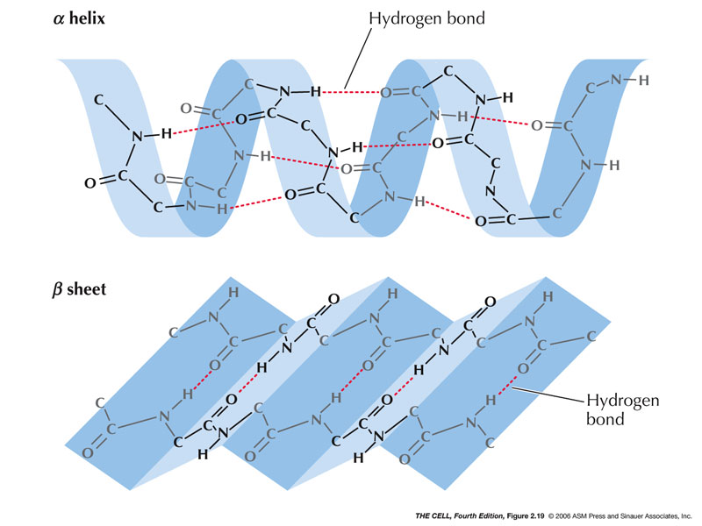
Protein secondary structure
α helix & β sheets are examples of secondary structures
Q1. What kind of bonding stabilizes both α helix and β sheet in proteins?
Notes:
r

Slide 25
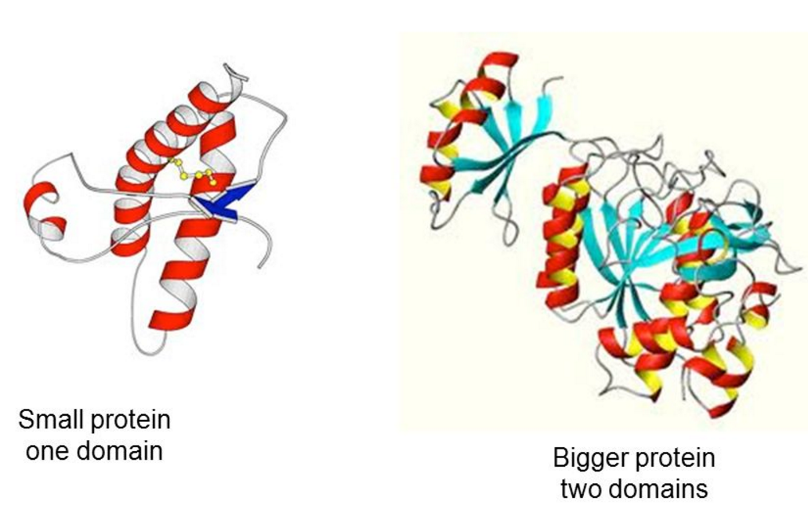
Proteins
Domains
Domain: A part of a polypeptide chain with a folded structure that does not depend for its stability on any of the remaining parts of the protein.
http://slideplayer.com/slide/8430672/
Q1. What is domain of a protein?
No question in exam on the images of this slide.

Slide 26
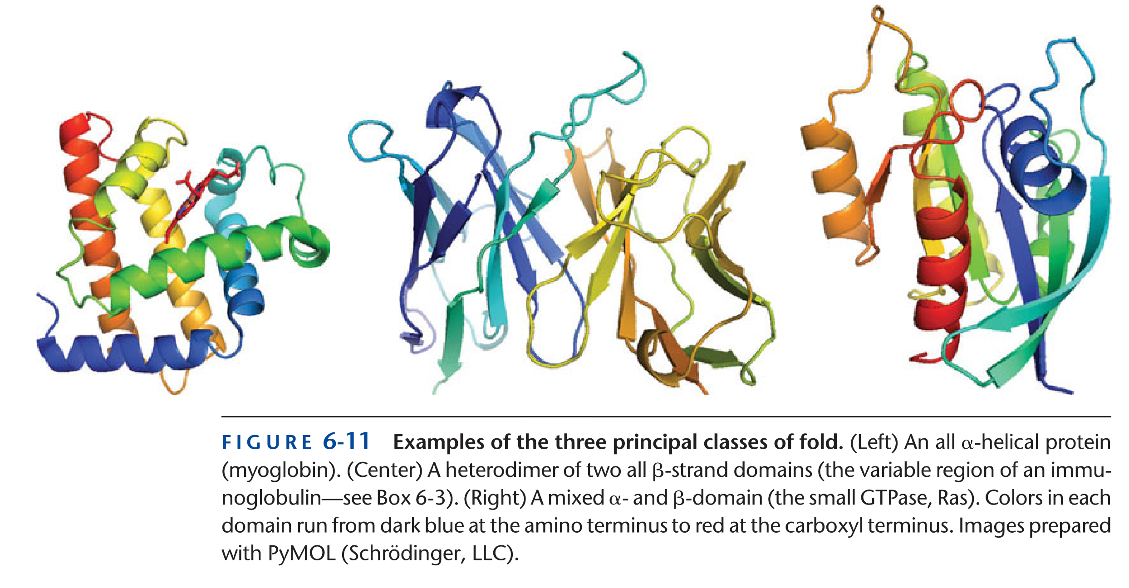
Proteins
Examples of principal classes of fold
Protein with α helix: Myoglobin.
Protein with β strand: The variable region of an immunoglobulin (antibody).
Protein with mixed α helix and β strand domains: Small GTPase, Ras.
Some proteins contain small domains with very little secondary structure.
Q1. Give an example of protein with (i) α helix, (ii) β strand, (iii) both α helix and β strand.
No question in the exam about the images on this slide.

Slide 27
Next Lecture: Proteins
Reference Textbook: Lehninger Principles of Biochemistry
4th or 5th Edition
David L. Nelson, Michael M. Cox WH Freeman & Company,
New York, USA

