Slide 1
BIO201/BBT101 SPRING 2018 Introduction to Biochemistry & Biotechnology
Lecture #3

Slide 2
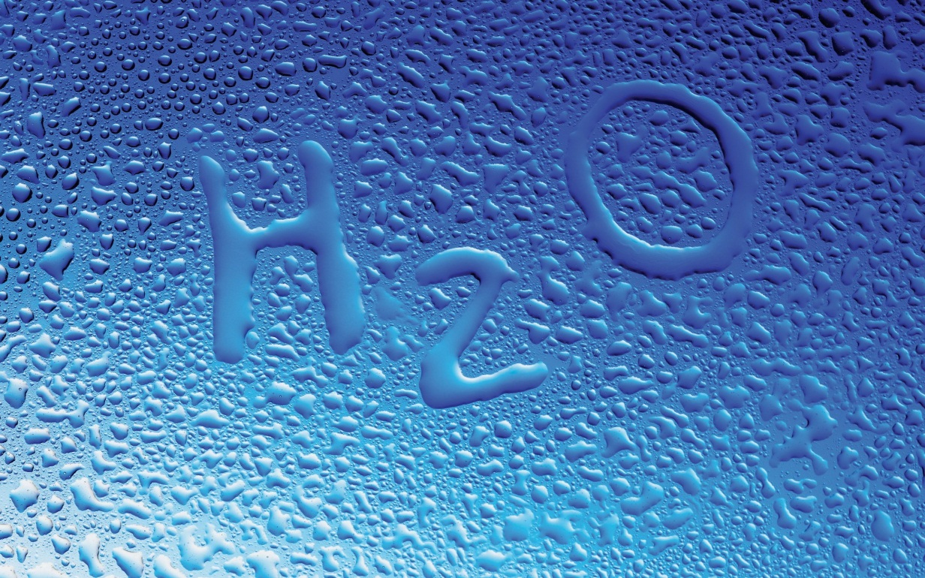
Lehninger
Principles of Biochemistry
Chapter 3
Water

Slide 3
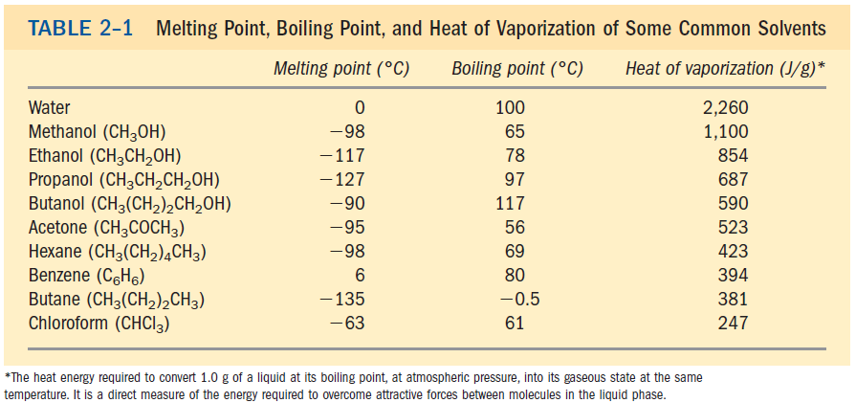
Water: Weak Interactions in Aqueous System
Water has high melting point, boiling point than some other common solvents
Water has a higher melting point, boiling point, and heat of vaporization than most other common solvents. These unusual properties are a consequence of attractions between adjacent water molecules that gives liquid water great internal cohesion.
Q1. Why water has higher melting point and boiling point than other common solvents?
No question in exam from the table.

Slide 4
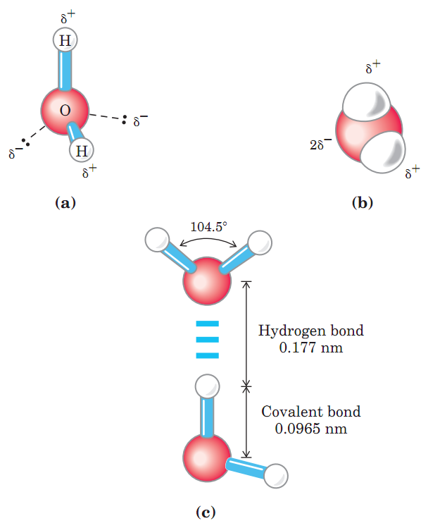
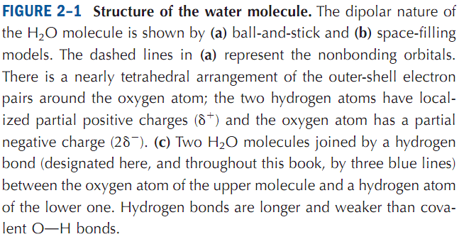
Water: Weak Interactions in Aqueous System
Hydrogen bonding in water
Hydrogen bonds are electrostatic forces of attraction between molecules which contain these highly polar bonds. A hydrogen bond is weaker than a covalent bond.
Q1. What is hydrogen bond? Draw the structure of a water molecule.
No question in the exam from the image of this slide.

Slide 5
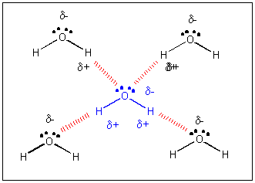
Water: Weak Interactions in Aqueous System
Hydrogen bonding in water
The hydrogen bond is about 10% covalent due to overlap of the bonding orbitals, and ~90% electrostatic. The lifetime of each hydrogen bond is just 1-20 picoseconds and within 0.1 ps of the destruction of one hydrogen bond, a new bond is formed.
Hydrogen bonds among water molecules
Q1. Discuss hydrogen bonding in water.

Slide 6
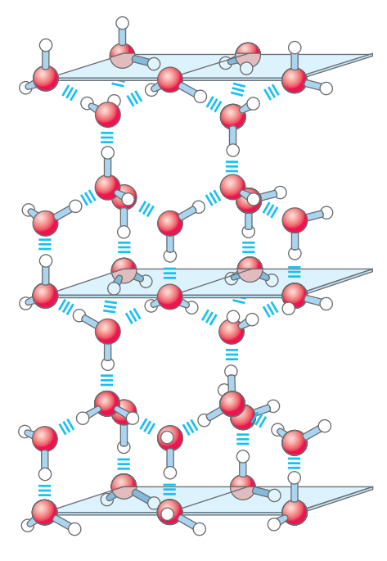
Water: Weak Interactions in Aqueous System
Why Ice floats on liquid water?
The nearly tetrahedral arrangement of the orbitals about the oxygen atom allows each water molecule to form H bonds with as many as four neighboring water molecules.
Due to disorganized and continuous motion at 25°C and atmospheric pressure, each water molecule interacts with 3.4 other water molecules on average.
In ice, each water molecule forms the maximum of four H bonds, creating a regular crystal lattice. This crystal lattice of ice makes it less dense than liquid water, and thus ice floats on liquid water.
Q1. Why ice floats on water?

Slide 7
Water: Weak Interactions in Aqueous System
Shapes of Ice Crystals
http://slideplayer.com/slide/9155931/
No question in exam on the images of this slide.

Slide 8
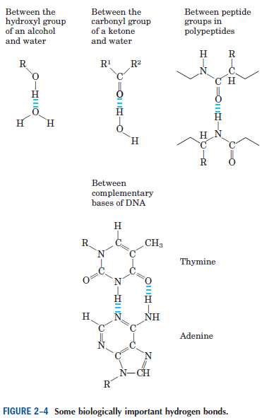
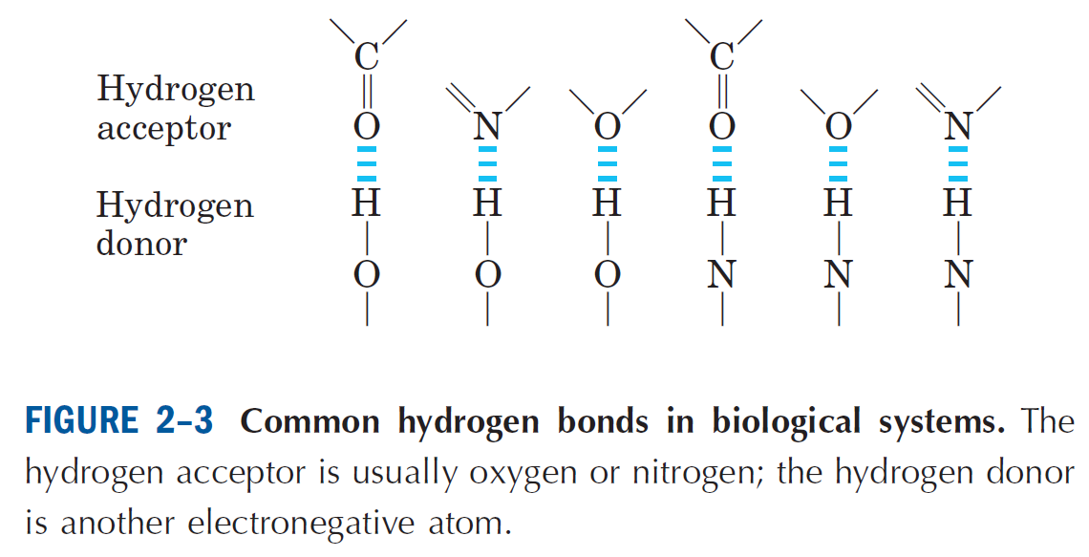
Water: Weak Interactions in Aqueous System
Hydrogen bonding in biological systems
Q1. Are hydrogen bonds important in biological systems? Give an example.

Slide 9
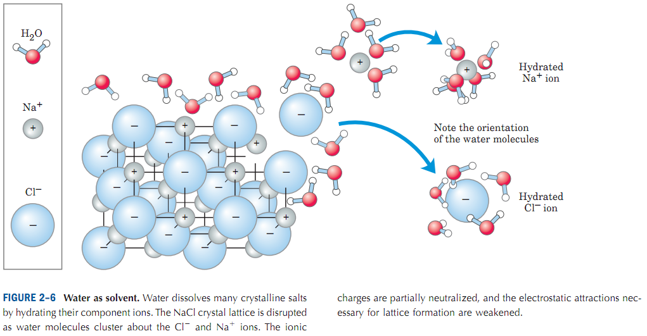
Water: Weak Interactions in Aqueous System
Water interacts electrostatically with charged solutes
Nonpolar molecules that repel the water molecules are said to be hydrophobic (water-hating) and molecules forming ionic or a hydrogen bond with the water molecule are said to be hydrophilic (water-loving).
Water dissolves salts such as NaCl by hydrating and stabilizing the Na⁺ and Cl⁻ ions, weakening the electrostatic interactions between them and thus counteracting their tendency to associate in a crystal lattice.
Q1. Define hydrophobic and hydrophilic molecules.
Q2. Discuss how water solubilizes NaCl crystal.

Slide 10
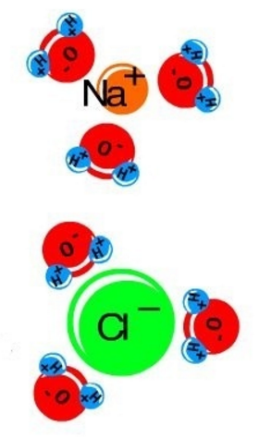
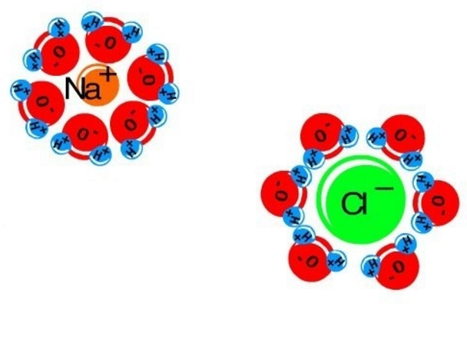
Water: Weak Interactions in Aqueous System
Dissolving NaCl with water
NaCl (Table Salt) is soluble in water. Reaction: NaCl (solid) + H₂O -> Na⁺(aqueous) + Cl⁻(aqueous) + H₂O
This causes the sodium chloride to split in water, and the NaCl dissolves into separate Na⁺ and Cl⁻ atoms. A hydration shell is formed around them which prevents Na⁺ and Cl⁻ to form ionic bonds.
On addition to water the Na+ section of NaCl is attracted to the oxygen side of the water molecules, while the Cl- side is attracted to the hydrogens' side of the water molecule.
https://www.quora.com/What-happens-if-NaCl-table-salt-is-mixed-with-water
Q1. Discuss how water solubilizes NaCl crystal.

Slide 11
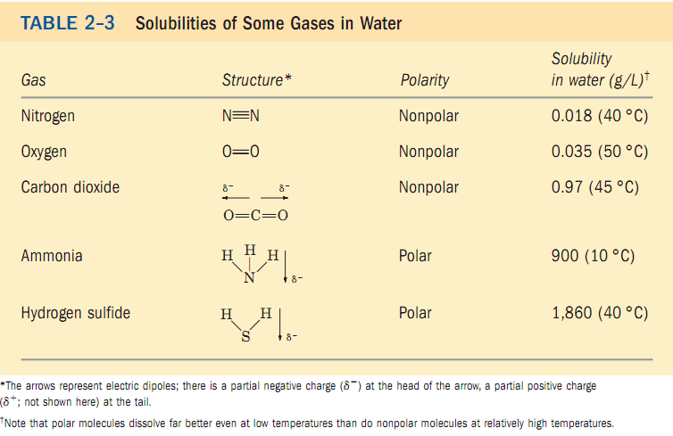
Water: Weak Interactions in Aqueous System
Non-polar gases are poorly soluble in water
Biologically important non-polar gases like nitrogen, oxygen, carbon dioxide are poorly soluble in water.
Q1. Write the name of three gases that are poorly soluble in water.

Slide 12
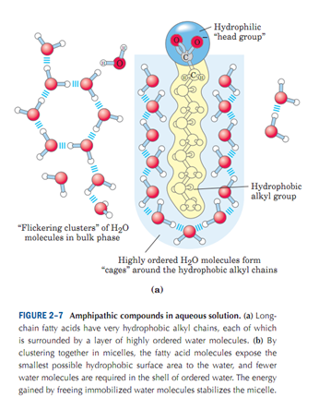
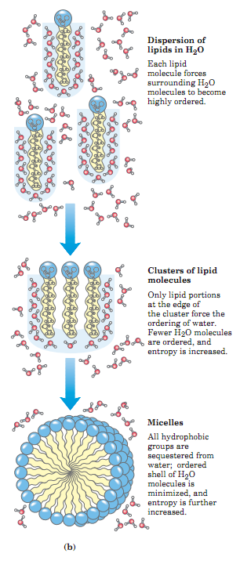
Water: Weak Interactions in Aqueous System
Amphipathic compounds
Amphipathic compounds: Amphiphile is a term describing chemical compound possessing both hydrophilic (water-loving, polar) and lipophilic (fat-loving) properties. Such a compound is called amphiphilic or amphipathic.
Many biomolecules are amphipathic: proteins, pigments, certain vitamins, and the sterols, phospholipids of the membranes all have polar and nonpolar surface regions.
Q1. Define amphipathic compounds.

Slide 13
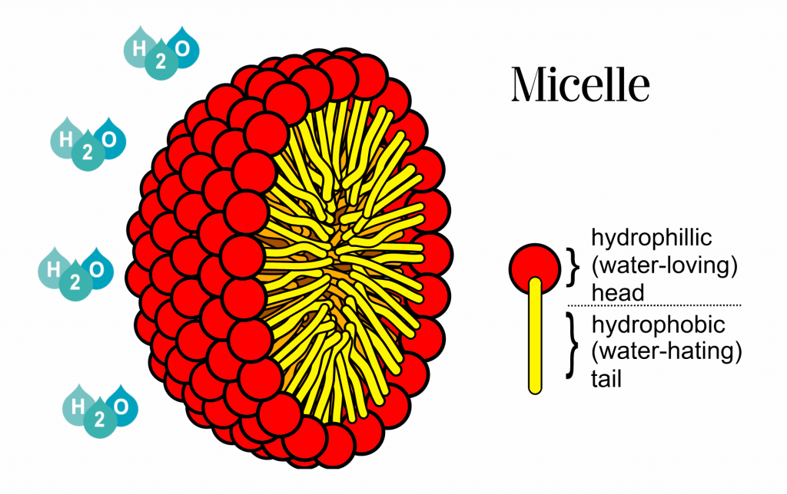
Water: Weak Interactions in Aqueous System
Micelle
In aqueous solution, molecules having both polar or charged groups and non polar regions (amphiphilic molecules) form aggregates called micelles.
http://www.beautybythegeeks.com/garnier-micellar-cleansing-water-review/
Q1. How micelles are formed?

Slide 14
Water: Weak Interactions in Aqueous System
van der Waals forces
The van der Waals forces (or van der Waals interaction) are the residual attractive or repulsive forces between molecules or atomic groups that do not arise from covalent bonds, nor ionic bonds. Van der Waals (dispersion) forces contribute to interactions of proteins with other molecules or with surfaces.
http://image.slidesharecdn.com/basicsoforganic-141011234053-conversion-gate01/95/basics-of-organic-18-638.jpg?cb=1413071066
Q1. What is van der Waals force?

Slide 15
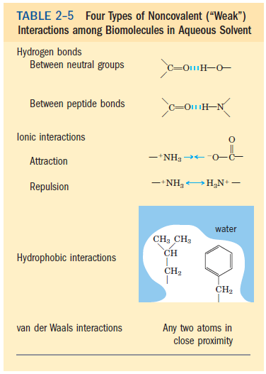
Water: Weak Interactions in Aqueous System
Weak Interactions among biomolecules in aqueous solvent
Q1. Discuss the four types of noncovalent (weak) interactions among biomolecules in aqueous solvent.

Slide 16
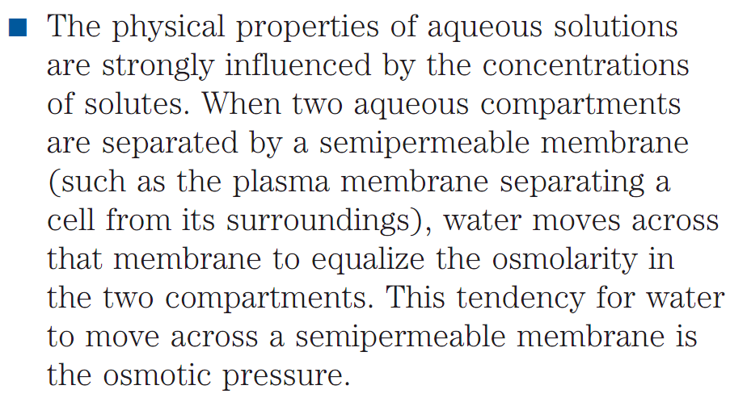
Water: Weak Interactions in Aqueous System
Osmotic pressure
Q1. What is osmotic pressure?

Slide 17
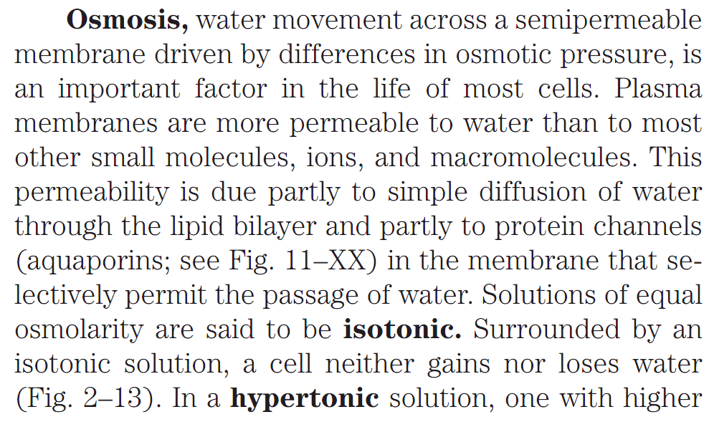
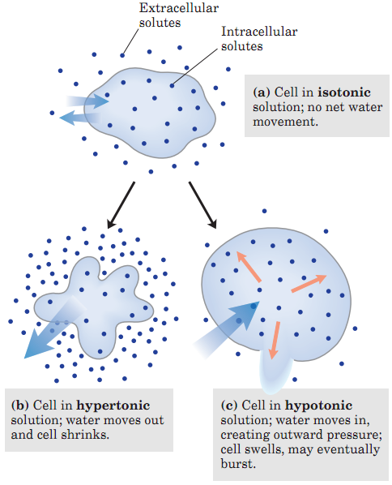
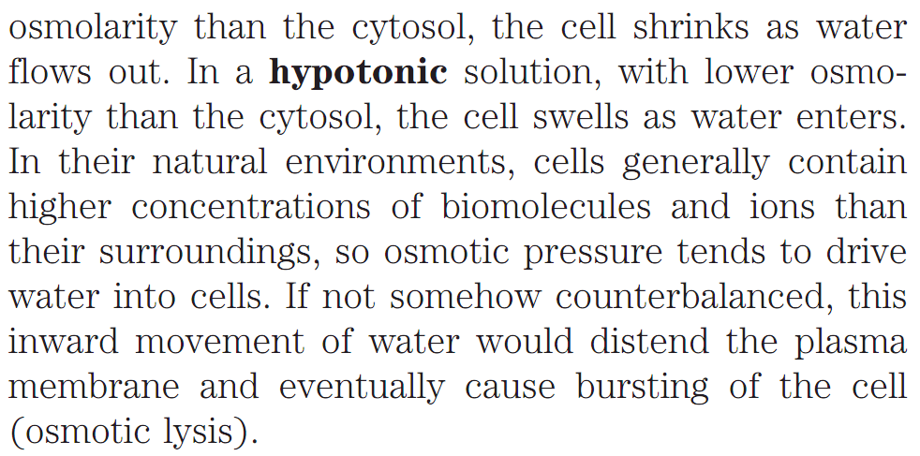
Water: Weak Interactions in Aqueous System
Isotonic, Hypertonic, Hypotonic solutions
Q1. What is osmosis?
Q2. What are isotonic, hypertonic, and hypotonic solutions?

Slide 18
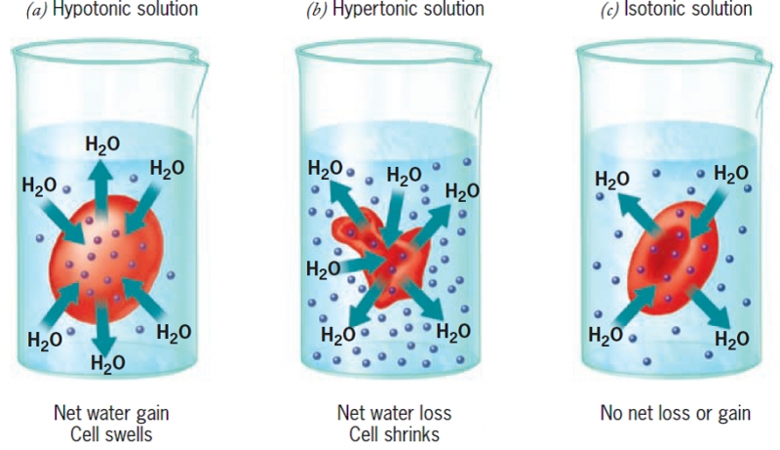
Water: Weak Interactions in Aqueous System
Examples of Isotonic, Hypertonic, Hypotonic solutions
https://www.superteachertools.net/speedmatch/speedmatchfromj.php?gamefile=1415123799#.WSlrqpKGPcs
https://www.slideshare.net/Drsaqbaalam/iv-fluids-52595712
No question in exam from this slide.

Slide 19
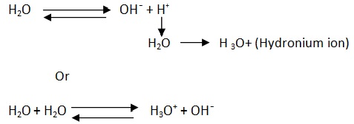
Water: Ionization of water, weak acids, weak bases
Pure water is slightly ionized
Pure water can be ionized to yield a hydrogen ion (H⁺, a proton) and a hydroxide ion (OH⁻). The proton is immediately hydrated into hydronium ion (H₃O⁺).
Equilibrium constant: The position of equilibrium of any chemical reaction is given by its equilibrium constant, K_{eq}.
Q1. What is equilibrium constant?

Slide 20
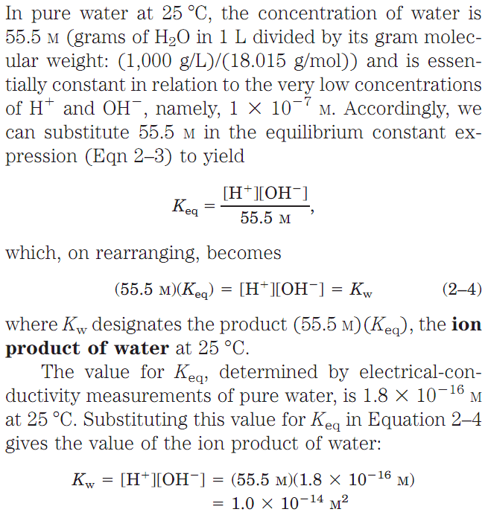
Water: Ionization of water, weak acids, weak bases
Ion Product of Water
The Ionic Product of Water, K_{w}, is the equilibrium constant for the reaction in which water undergoes an acid-base reaction with itself. That is, water is behaving simultaneously as both an acid and a base.
Q1. What is ion product of water?

Slide 21
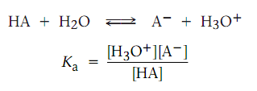
Water: Ionization of water, weak acids, weak bases
Weak Acids and Bases Have Characteristic Dissociation Constants
Acids differ in their ability to donate H⁺. Stronger acids like hydrochloric acid (HCl) react almost completely with water, whereas weaker acids like acetic acid (CH₃COOH) react only slightly.
Dissociation constant: The exact strength of a given acid in water solution is described using the acidity constant (K_{a}) for the acid-dissociation equilibrium.
Calculating K_{a}:
pK_{a}: Acid strengths are normally expressed using pK_{a} values rather than K_{a} values, where pK_{a} is the negative common logarithm of K_{a}.
A stronger acid (larger K_{a}) has a smaller pK_{a}.
Q1. Write the equation to calculate dissociation constant.

Slide 22
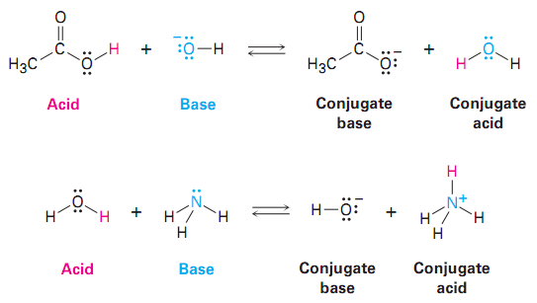
Water: Ionization of water, weak acids, weak bases
Titration Curve of Acetic Acid
Titration is used to determine the amount of acid in a solution.
The half-equivalence point of an acid base titration is the point in which the pH of the original aqueous acidic solution is equal to the pKa of the conjugate base of the acid.
Conjugate Acid: A species formed by the reception of a proton by a base.
Conjugate Base: The conjugate base of an acid is formed when the acid donates a proton.
Q1. What is titration?

Slide 23
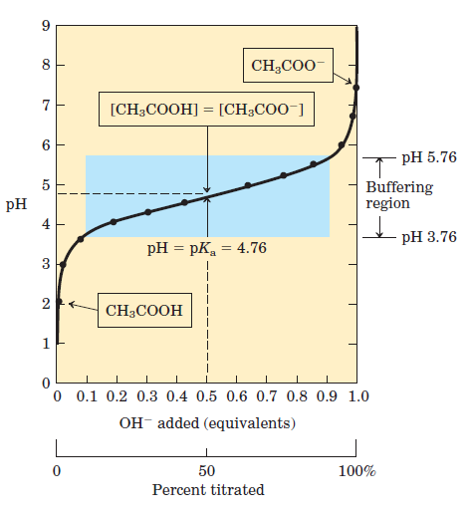
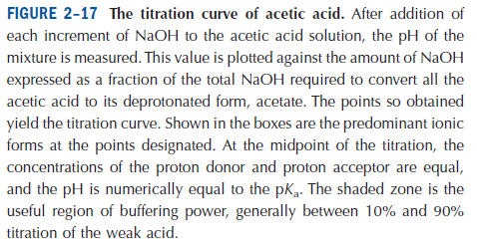
Water: Ionization of water, weak acids, weak bases
Titration Curve of Acetic Acid
Q1. Can acetic acid-acetate be used as buffer?

Slide 24
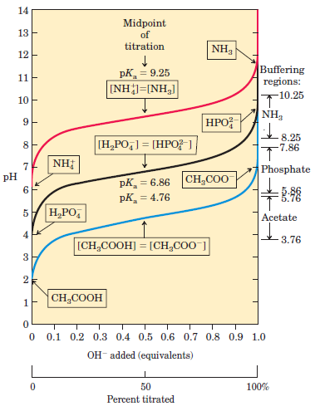
Water: Ionization of water, weak acids, weak bases
Titration Curves of three weak acids
Q1. Name three weak acids that can be used as buffers.

Slide 25
Water: Buffering against pH changes in biological systems
Buffers
Buffers are mixtures of weak acids and their conjugate base that resist changes of pH by addition of H⁺ or OH⁻.
Q1. How buffers work?

Slide 26
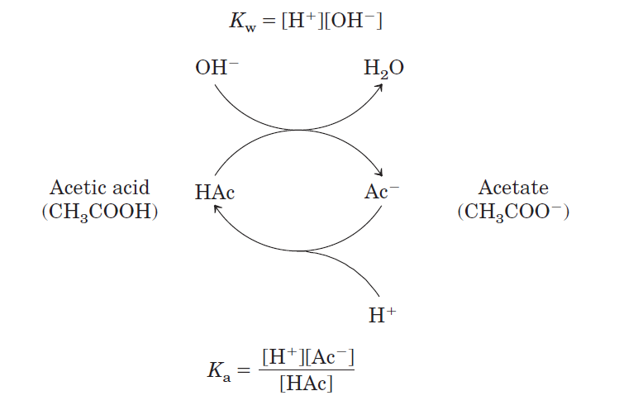
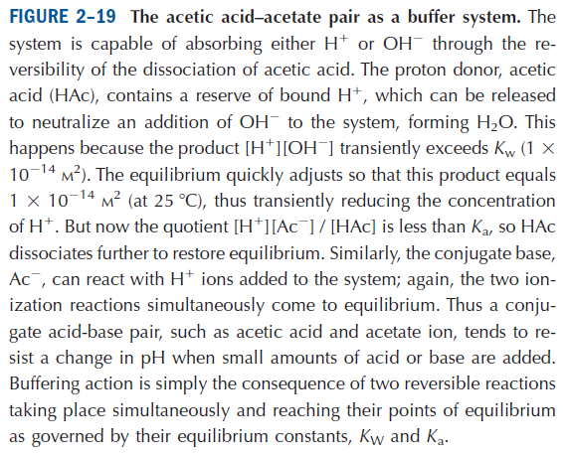
Water: Buffering against pH changes in biological systems
Acetic Acid-Acetate as Buffer system
Q1. Discuss acetic acid-acetate buffer system.

Slide 27
Water: Buffering against pH changes in biological systems
Henderson-Hasselbalch Equation
In chemistry, the Henderson–Hasselbalch equation describes the derivation of pH as a measure of acidity (using pK_{a}, the negative log of the acid dissociation constant) in biological and chemical systems.
Q1. Write Henderson-Hasselbalch equation. What is its use?

Slide 28
Next Lecture: Amino Acids
Reference Textbook: Lehninger Principles of Biochemistry
4th or 5th Edition
David L. Nelson, Michael M. Cox WH Freeman & Company,
New York, USA

