Slide 1
BIO201/SPRING 2018 Introduction to Biochemistry & Biotechnology
Lecture #2

Slide 2
Lehninger
Principles of Biochemistry
Chapter 1
FOUNDATIONS OF
BIOCHEMISTRY

Slide 3
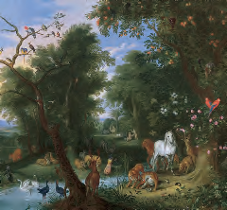
Diverse living organisms share common chemical features
FIGURE 1–2
Animals, plants and microorganisms share with humans the same basic structural units (cells) and the same kinds of macromolecules (DNA, RNA, and proteins).
Shown here is a detail from “The Garden of Eden,” by Jan van Kessel the Younger (1626–1679).
Q1. What is the basic structural unit of all living organisms?
Q2. Which macromolecules are shared by all living organisms?

Slide 4
Foundations of Biochemistry
Biochemistry is the study of the chemistry of living organisms.
There are five foundations of biochemistry:
Cellular
Chemical
Physical (thermodynamic)
Genetic
Evolutionary
Q1. What is biochemistry?
Q2. Name the foundations of biochemistry.

Slide 5
Foundations of Biochemistry
There are five foundations of biochemistry:
Cellular
Chemical
Physical (thermodynamic)
Genetic
Evolutionary

Slide 6
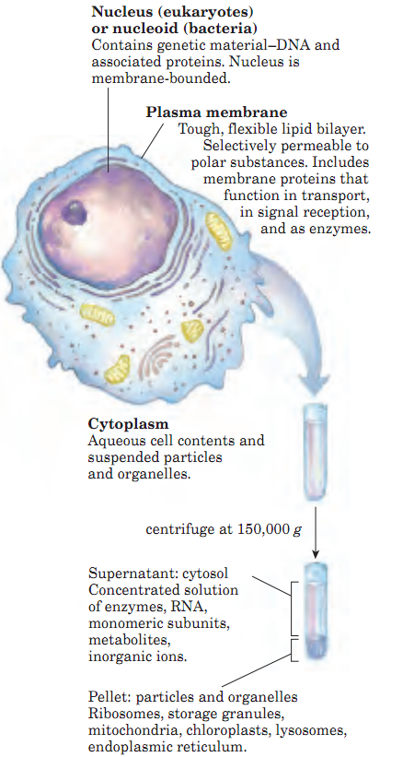
Foundations of Biochemistry
1. Cellular foundation
Q1. What are the universal features of a living cell?

Slide 7
Foundations of Biochemistry
1. Cellular foundation
All cells have plasma membrane, DNA and cytoplasm
Cells with nuclear envelopes are called eukaryotes (Greek eu, “true” and karyon “nucleus”).
Cells without nuclear envelopes-bacterial cells-are called prokaryotes (Greek pro, “before”).
The three major components of a cell are:
Nucleus (in eukaryotes) or nucleoid (in prokaryotes) that contains DNA
Plasma membrane
Cytoplasm
Q1. Define prokaryotes and eukaryotes.
Q2. Where will you find DNA in an animal cell?

Slide 8
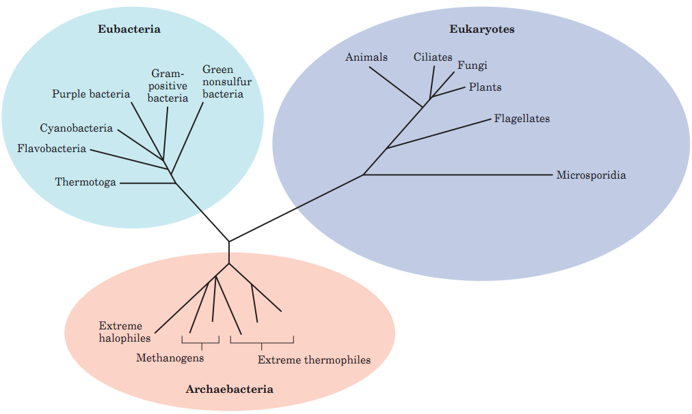
Foundations of Biochemistry
1. Cellular foundation
Three distinct domains of life: Archaebacteria, Eubacteria, Eukaryotes
-Archaebacteria (ancient bacteria) grow in harsh conditions like salt lakes, hot springs, acidic bogs, ocean depth.
-Eubacteria (true bacteria) live in soils, surface waters, tissues of organisms.
-Eukaryotes are more closely related with archaebacteria than eubacteria.
FIGURE 1–4 Phylogeny of the three domains of life. Phylogenetic relationships are often illustrated by a “family tree” of this type. The fewer the branch points between any two organisms, the closer is their evolutionary relationship
Q1. What are the three distinct domains of life?
Q2. Where do archaebacteria and eubacteria usually live?

Slide 9
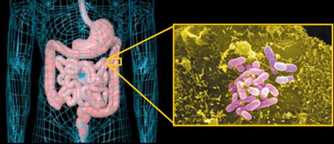
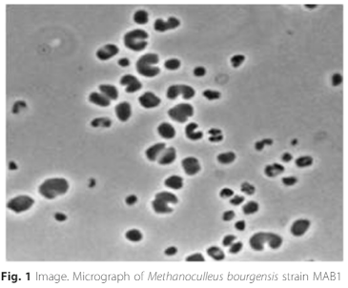
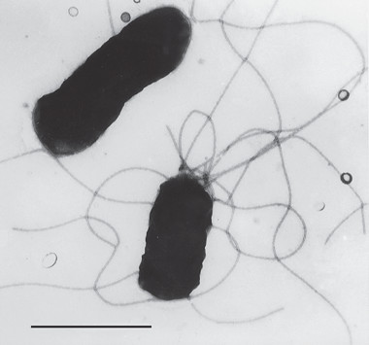
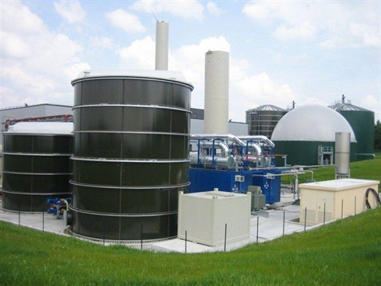
Foundations of Biochemistry
1. Cellular foundation
Example of Archaebacteria:
Methanoculleus bourgensis
Example of Eubacteria: Escherichia coli
Manzoor et al. Standards in Genomic Sciences (2016) 11:80
-Methanoculleus bourgensis is used in the production methane in biogas plants.
A Biogas Plant
-Escherichia coli can be found in human guts. They prevent colonization of pathogenic microorganisms by occupying the exposed surfaces of internal organs like intestine.
http://seaus.free.fr/spip.php?article808
Q1. Give example of each of archaebacteria and eubacteria.
Q2. Why colonization of human guts by E. coli is important?

Slide 10
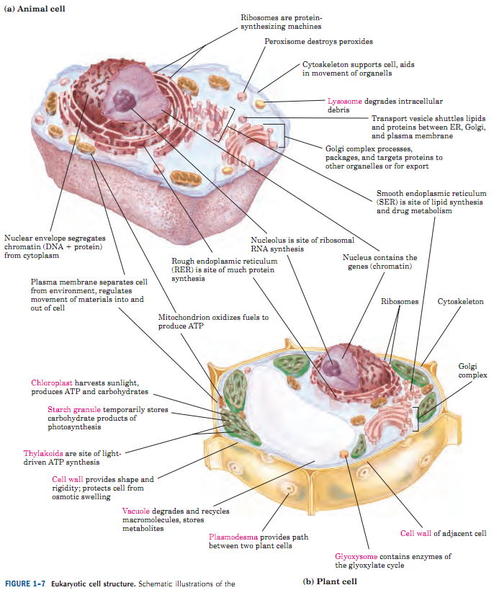
Foundations of Biochemistry
1. Cellular foundation
There are common and distinct features between animal and plant cells
Common structures in both animal and plant cells:
Plasma membrane
Nucleus
Ribosomes
Peroxisomes
Cytoskeleton
Golgi complex
Smooth endoplasmic reticulum
Rough endoplasmic reticulum
Animal cell-specific structure:
Lysosomes
Plant cell-specific structures:
Cell wall
Vacuole
Chloroplast
Plasmodesma
Glyoxysome
Q1. What is the most significant difference between prokaryotes and eukaryotes?
Q2. List the common structural features of animal and plant cells.
Q3. List the animal cell- and plant cell-specific structures. Write down their functions.

Slide 11
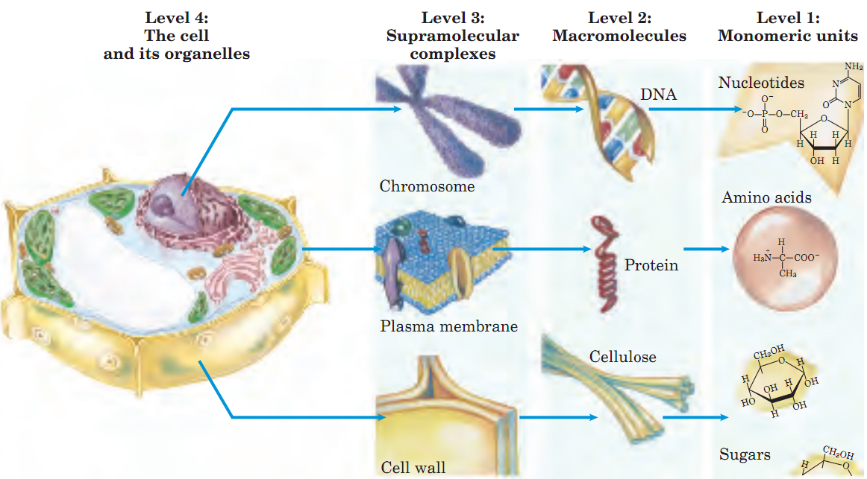
Foundations of Biochemistry
1. Cellular foundation
Cells have four levels of molecular organization
There are four levels of
molecular organization
of cells:
Level 1: Monomeric units
Level 2: Macromolecules
Level 3: Supramolecular complexes.
Level 4: Cellular organelles.
Q1. How many levels are there in the molecular organization of cells?
Q2. Name the levels of molecular organization of cells.
Q3. Give examples of supramolecular complexes.

Slide 12
Foundations of Biochemistry
1. Cellular foundation
Cells build macromolecular structures
Building
blocks
Amino Acids
Sugars
Nucleotides
Macro-
molecules
Proteins
Carbohydrates
(Examples:
Glycogen, Starch)
Nucleic Acids
(DNA, RNA)
Amino acids are organic compounds that combine together to construct proteins.
Sugars like glucose, fructose, galactose combine to construct carbohydrates.
Nucleotides combine together to form nucleic acids like deoxyribonucleic acid (DNA) and ribonucleic acid (RNA).
Q1. What are the building blocks of a cell?
Q2. Name the macromolecules of a cell.

Slide 13
Foundations of Biochemistry
There are five foundations of biochemistry:
Cellular
Chemical
Physical (thermodynamic)
Genetic
Evolutionary

Slide 14
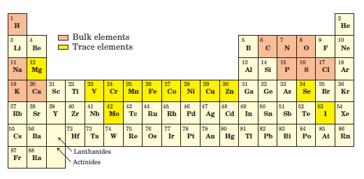
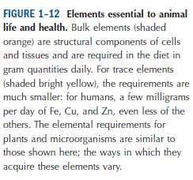
Foundations of Biochemistry
2. Chemical foundation
Elements required by living organisms
Bulk elements: H, C, N, O, Na, P, S, Cl, K, Ca
Trace elements: Mg, V, Cr, Mn, Fe, Co, Ni, Cu, Zn, Se, Mo, I
Q1. Name the elements required in bulk amount by living organisms.

Slide 15
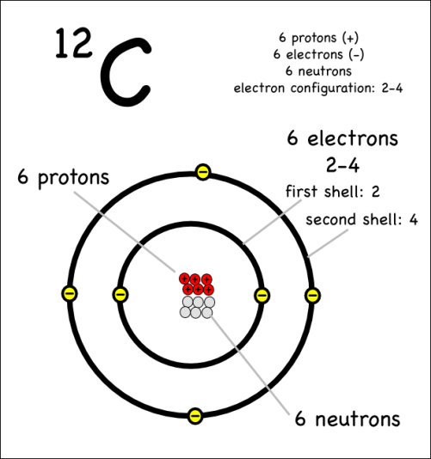
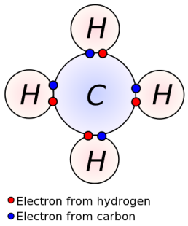
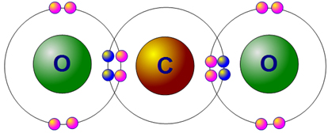
Foundations of Biochemistry
2. Chemical foundation
Biomolecules are based on carbon atoms
Carbon is the fourth most abundant element in universe. Carbon is a highly reactive element.
Carbon-12 atom
Carbon has four valence electrons
that can form bonds with other atoms
Methane
Carbon dioxide
Q1. How many covalent bonds a carbon atom can form?
Q2. Show the possible bonding between a carbon and an oxygen atom.

Slide 16
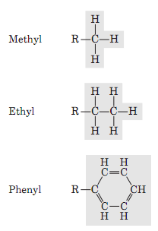
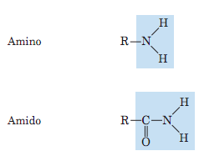
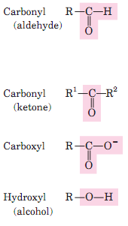
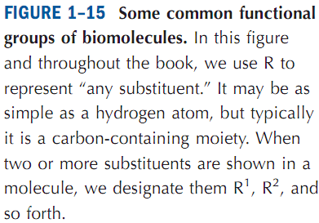
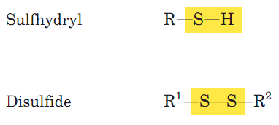
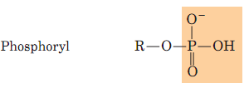
Foundations of Biochemistry
2. Chemical foundation
Some Functional Groups of Biomolecules
Functional group is an atom or a group of atoms in an organic compound that defines the structure of a family of compounds and determines the properties of a family.
Q1. Define functional group.
Q2. Write the chemical structure of any three functional groups found in biomolecules.

Slide 17
Foundations of Biochemistry
There are five foundations of biochemistry:
Cellular
Chemical
Physical (thermodynamic)
Genetic
Evolutionary

Slide 18
Foundations of Biochemistry
3. Physical foundation
Energy for the living organisms
-Living cells and organisms must perform work to stay alive or to reproduce themselves. All anabolic or synthetic reactions in cells require energy.
-Nearly all living organisms derive their energy from sunlight.
Q1. What is the ultimate source of energy for all living cells?

Slide 19
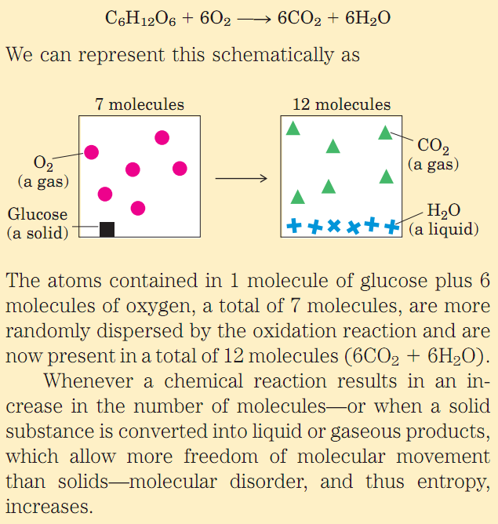
Foundations of Biochemistry
3. Physical foundation
Entropy
Entropy, S
The randomness or disorder of the components of a chemical system is expressed as entropy, S.
Any change in the randomness of the system is expressed as entropy change (∆S).
Q1. Explain entropy with example.

Slide 20
Foundations of Biochemistry
3. Physical foundation
Free Energy & Enthalpy
Gibbs Free Energy, G
Free energy content, G can be defined in terms of three quantities: Enthalpy (H), Entropy (S) and Temperature (T in degrees Kelvin).
The free energy (G) is a thermodynamic quantity equal to the enthalpy minus the product of entropy and the absolute temperature. It is expressed with the following equation:
G = H-TS
Enthalpy, H reflects the number and kinds of bonds in the chemical reaction.
Q1. What is Gibbs free energy?

Slide 21
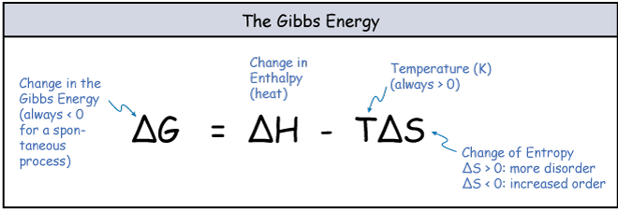
Foundations of Biochemistry
3. Physical foundation
Free Energy Change
Free Energy Change, ∆G
When a chemical reaction occurs at constant temperature, the free energy change (∆G), is determined by the enthalpy change, ∆H reflecting the kinds and numbers of chemical bonds and non-covalent interactions broken and formed and the entropy change, ∆S describing the change in systems randomness.
The free energy change can be calculated with the following equation: ∆G = ∆H - T∆S
If the free energy change, ∆G is negative for a reaction, it is a favorable reaction.
Q1. What is free-energy change?
Q2. Write the equation to calculate the free energy-change.
Q3. If the free energy change is negative for a reaction, is it a favorable or an unfavorable reaction?

Slide 22
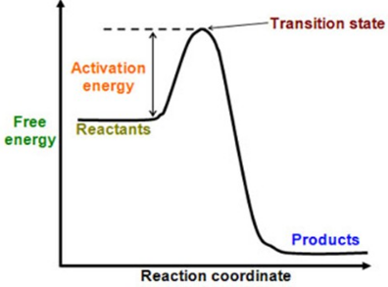
Foundations of Biochemistry
3. Physical foundation
Activation Energy
Activation energy, E_{a}
All chemical reactions need an initial investment of energy, called activation energy (E_{a}). This is the energy required to begin the reaction.
http://slideplayer.com/slide/9119934/
Q1. What is activation energy?

Slide 23
Foundations of Biochemistry
3. Physical foundation
Exergonic & Endergonic Reactions
Exergonic & Endergonic Reactions
Endergonic reaction: An endergonic reaction is a chemical reaction in which the free energy-change is positive, and energy is absorbed. An example for endergonic reaction is photosynthesis.
Exergonic reaction: An exergonic reaction is a reaction that loses energy during the process of reaction. An example for exergonic reaction is respiration.
http://www.slideshare.net/sbarkanic/enzymes-26700846
Q1. Define endergonic and exergonic reactions with examples.

Slide 24
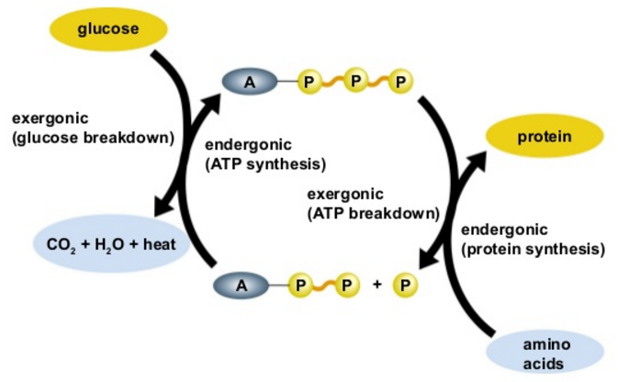
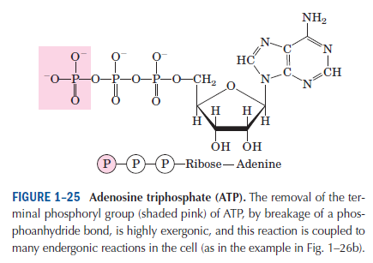
Foundations of Biochemistry
3. Physical foundation
Coupling of Endogenous & Exogenous reactions in Biology
Coupling of Exergonic & Endergonic Reactions
A process tends to occur spontaneously only if ∆G is negative. Cell function depends largely on molecules, such as proteins and nucleic acids, for which the free energy of formation is positive: the molecules are less stable and more highly ordered than a mixture of their monomeric components. To carry out these thermodynamically unfavorable, energy-requiring (endergonic) reactions, cells couple them to other reactions that liberate free energy (exergonic reactions), so that the overall process is exergonic: the sum of the free energy changes is negative. The usual source of free energy in biology is released by hydrolysis of phosophoanhydride bonds like those found in ATP (adenosine triphosphate). Hydrolysis of one ATP molecule releases 30.5 kJ/mol energy. ATP is called the “biological currency”.
ATP is the biological currency
http://www.slideshare.net/DocWithers/ch06-lecture-31917260
Q1. Explain the coupling of endergonic and exergonic reactions with example.
Q2. What is called as the biological currency?

Slide 25
Foundations of Biochemistry
There are five foundations of biochemistry:
Cellular
Chemical
Physical (thermodynamic)
Genetic
Evolutionary

Slide 26
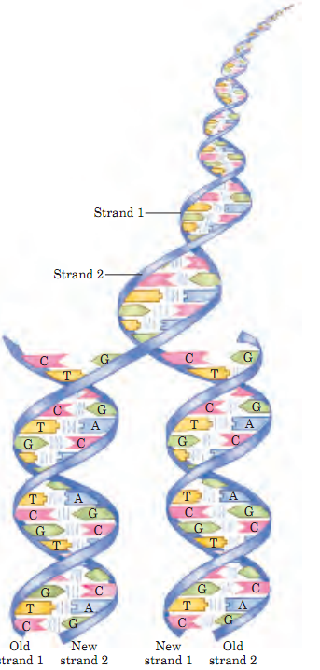
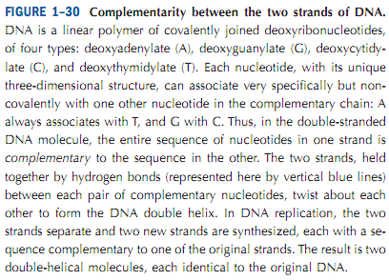
Foundations of Biochemistry
4. Genetic foundation
DNA stores all the information
Q1. What is the composition of DNA?

Slide 27
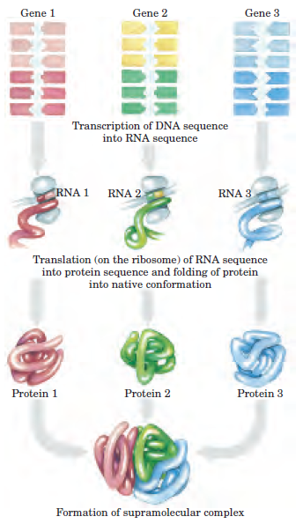
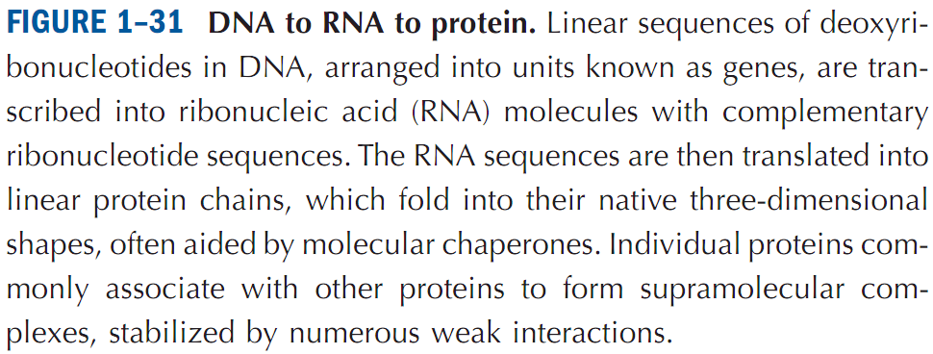
Foundations of Biochemistry
4. Genetic foundation
DNA to RNA to Protein
The Genetic Code
Transcription
Translation
Q1. Schematically show how proteins are synthesized from DNA.

Slide 28
Foundations of Biochemistry
There are five foundations of biochemistry:
Cellular
Chemical
Physical (thermodynamic)
Genetic
Evolutionary

Slide 29
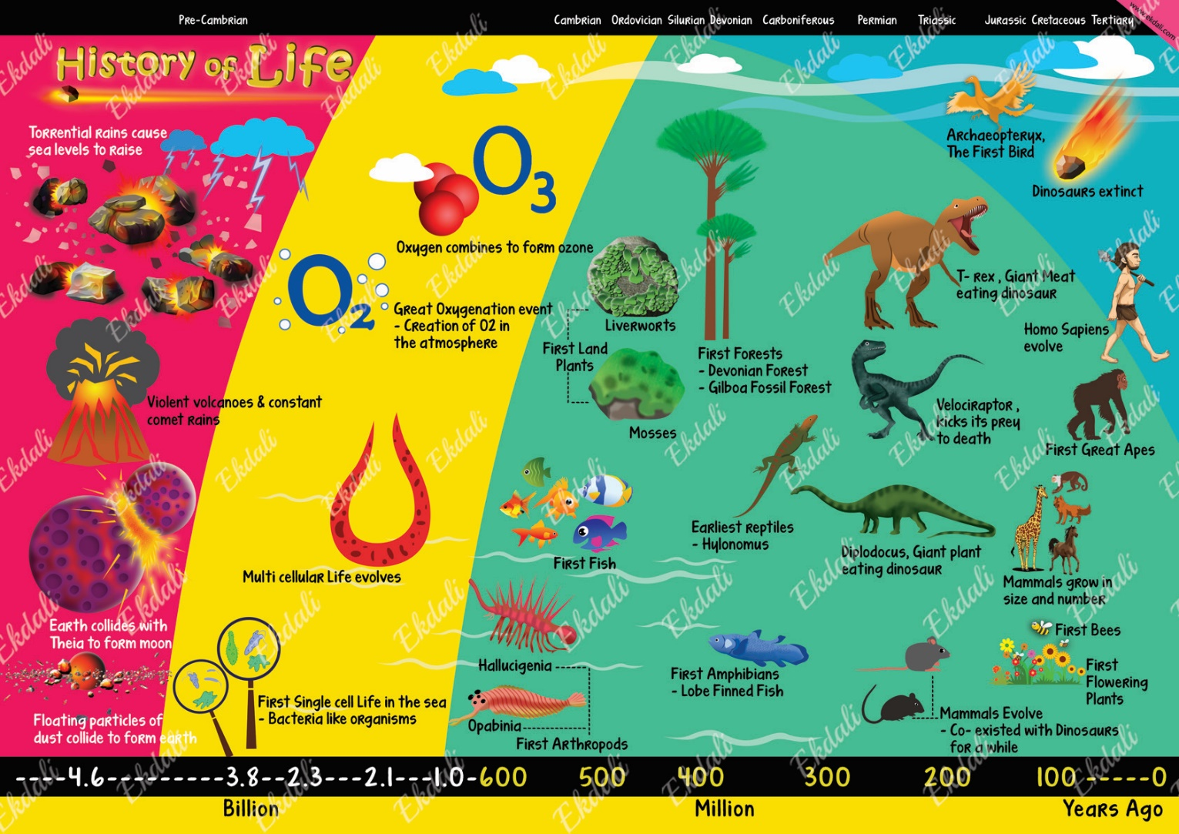
Foundations of Biochemistry
5. Evolutionary foundation
Biological evolution on earth began more than 3.5 billion years ago
Evolution is the process by which different kinds of living organisms are thought to have developed from earlier forms during the history of Earth.
https://www.pinterest.com/pin/752453050211274430/
Q1. What is evolution?
Q2. How long ago life arose on earth?
No other question in exam from this slide.

Slide 30
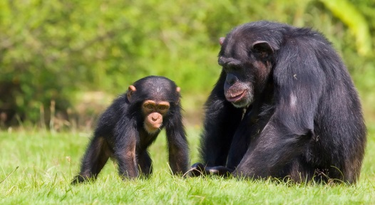
Foundations of Biochemistry
5. Evolutionary foundation
Heritable changes in DNA drive evolution
Mutation is defined as random change in DNA of an organism that results in a new characteristic that can be inherited.
Example for mutation:
There are two differences in the DNA sequence of FOXP2 gene between humans and chimpanzee.
FOXP2 gene is called as the speech gene as it is required for proper development of speech and language.
http://www.redorbit.com/news/science/1112789450/human-speech-studies-reveal-mechanisms-and-evolution-022213/
http://kids.nationalgeographic.com/animals/chimpanzee/
Will chimpanzees start talking if they have FOXP2 gene of humans? Answer: No one knows.
Q1. Define mutation. Give an example.

Slide 31
Next Lecture: Water
Reference Textbook: Lehninger Principles of Biochemistry
4th or 5th Edition
David L. Nelson, Michael M. Cox WH Freeman & Company,
New York, USA

