Slide 1
BIO 201 :
Introduction to Biochemistry
&
Biotechnology
Instructor
Abhinandan Chowdhury
Lecturer
Dept. Biochemistry & Microbiology
North South University
Dhaka, Bangladesh

Slide 2
Abhinandan Chowdhury (ACh)
Lecturer
Dept. Biochemistry & Microbiology
North South University
Dhaka, Bangladesh
Email; abcnsuedu@gmail.com
Website: www.abhinandanchowdhury.weebly.com
Room: SAC 833 (C)
Research Interest:
Antibiotic resistance, microbiology. Chemical biology, analytical bioscience , Toxionology

Slide 3
Brief Description
The course aims to give the students an understanding of the fundamentals of chemistry of living organisms and application of the biochemical knowledge in biotechnology. The principal aim of the course is to equip students with a basic knowledge of biochemical reactions and the chemical nature of biological macromolecules that can be applied in biotechnological inventions. The course also gives an introduction of molecular biology to achieve basic knowledge about nucleic acids.
Course Objective
Upon successful completion of this course the student should be able to: (i) Define and explain the basic concepts in biochemistry; (ii) Discuss biochemical pathways; (iii) Define biological macromolecules; (iv) Discuss functions of DNA and RNA in the information pathways of cells; (v) Discuss the application of biochemical knowledge in biotechnological inventions; (vi) Explain the underlying concepts in biotechnology.

Slide 4
Text Books
Lehninger Principles of Biochemistry, 4th or 5th Edition. David L. Nelson & Michael M. Cox. WH Freeman & Company, New York, USA.
Biotechnology, 5th Edition, 2009. John E. Smith. Cambridge University Press, New York, USA.
Lecture Contents
Overview of Biochemistry & Biotechnology
Foundations of Biochemistry
Chemistry of Water
Introduction to Biological Macromolecules
Biological Membranes
Bio-signaling
Bioenergetics
Overview of Metabolic Pathways
Introduction to Biotechnology
Biochemical applications in Biotechnology

Slide 5
How are the marks distributed?
Quiz----------------------------------30 %
Midterm………….30%
Attendance ------------------5%
Final-----------------------------------35%
Exam?
T/F, FB, short question & bonus questions

Slide 6
Policies
Be happy inside and outside of the classroom. Being happy keeps human body healthy.
Questions during the lectures are always welcome.
Attend classes on time and regularly. Do not attend classes late regularly.
There will be no make-up quiz. Make-up for mid-term exams will be considered only under special circumstances. Any make-up of mid-term exam will be based primarily on questions with answers on essay-format.
If an exam is not held due to unavoidable circumstances, it will be held on the following class day.
Mobile phones are allowed in the classroom only for video and/or audio recordings of all the lectures inside the classroom.
Switch your mobile phones to vibration mode inside the classroom. Do not receive or make calls inside the class. Do not exchange messages using your phone inside the classroom.
Students should be aware of the policy about probation in NSU.
Avoid going to the washroom during the lectures. Go to the washroom before the lectures, if required. No visit to the washroom is allowed in the middle of an exam.

Slide 7

“…once you have learned to ask questions – relevant and appropriate and substantial
questions – you have learned how to learn
and no one can keep you from learning
whatever you want or need to know.”
Neil Postman & Charles Weingartner
in Teaching as a Subversive Activity, 1969

Slide 8

Teaching as a Subversive Activity
A major goal of higher education is to enable students to think independently.
Independent thinkers seek understanding.
Independent thinkers challenge superficial answers.
Independent thinkers develop strong convictions.
Independent thinkers question authority.
Independent thinkers become leaders.
If you don’t change as a result of taking this course, we are wasting our time.

Slide 9
Characteristics Needed For Success
1. Communication Skills - both verbal and written.
2. Ability to define problems, gather and evaluate information related to the problem, and develop solutions.
3. Ability to work with others, especially in team settings.
4. Ability to address specific problems in complex, real-world settings.
From 1994 Wingspread Conference on “Quality Assurance in Undergraduate Education”

Slide 10
Characteristics Needed For Success
Oral
Written
Visual
Communication Skills

Slide 11
Characteristics Needed For Success
Education
and
Training
Problem-
Solving
Ability
Acquired
Skills
Accumulated
Knowledge

Slide 12
Introduction to Biochemistry
Instructional Goals For Students
Become intellectually independent learners
Recognize and confront areas of personal ignorance
Review and apply chemical, biological, physical, and mathematical principles in a biochemical context
Improve problem-solving skills
Create, understand, and value abstract biochemical models
See biochemistry in relevant historical and societal contexts

Slide 13
Introduction to Biochemistry
Instructional Goals For Students, Cont.
Discover and use the resources of the library and the Internet
Gain confidence in reading and understanding scientific articles
Experience the powers (and pitfalls) of collaborative work
Appreciate importance of clear oral and written communication
Learn to organize logical arguments based on evidence

Slide 14
Problem-Based Learning: The Process
Learning initiated with problem.
Students organize ideas and previous knowledge.
Students pose questions, defining what they know and don’t know.
Assign responsibility for questions, discuss resources.
Reconvene, explore newly learned information, refine questions.
Notes:
PBL: The Process.
How does PBL play out in the classroom?

Slide 15
Problem-Based Learning: The Process
Resolution of Problem;
(How did we do?)
Presentation of Problem
Next stage of
the problem
Organize ideas and
prior knowledge
(What do we know?)
Integrate new
Information;
Refine questions
Pose questions (What do
we need to know?)
Reconvene, report
on research;
Research questions;
summarize;
analyze findings
Assign responsibility
for questions; discuss
resources

Slide 16
BIO201
Introduction to
Biochemistry & Biotechnology
Lecture 1

Slide 17
What is Biochemistry?
Biochemistry is the chemistry of life.
Biochemistry is the explanation of biology at the molecular level using chemical and physical properties.
Basic principles of biochemistry are common to all living organisms.

Slide 18
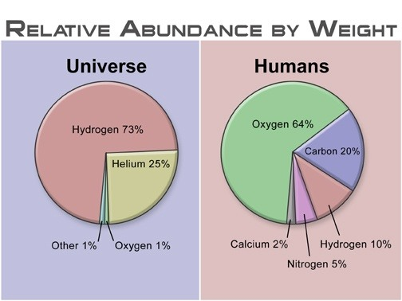
https://qph.ec.quoracdn.net/main-qimg-54294074b8c90415f011e65f5a23f887-c
Other major elements include phosphorus, sulfur.
60-65% of our body is water.

Slide 19
How does Biochemistry affect your life
Medicine
Agriculture
Industrial applications
Environmental applications

Slide 20
Principal Areas of Biochemistry
Structure & Function of Biological Macromolecules: Proteins, Carbohydrates, Nucleic Acids, Lipids
Metabolism: Catabolic & Anabolic Reactions
Molecular Genetics: Replication of Life and Regulations of Protein Synthesis

Slide 21
What is Biotechnology?
Biotechnology: Bio means living and technology is the application of science to achieve industrial or commercial objectives. So, Biotechnology is the use of living materials for an industrial or commercial objective.

Slide 22
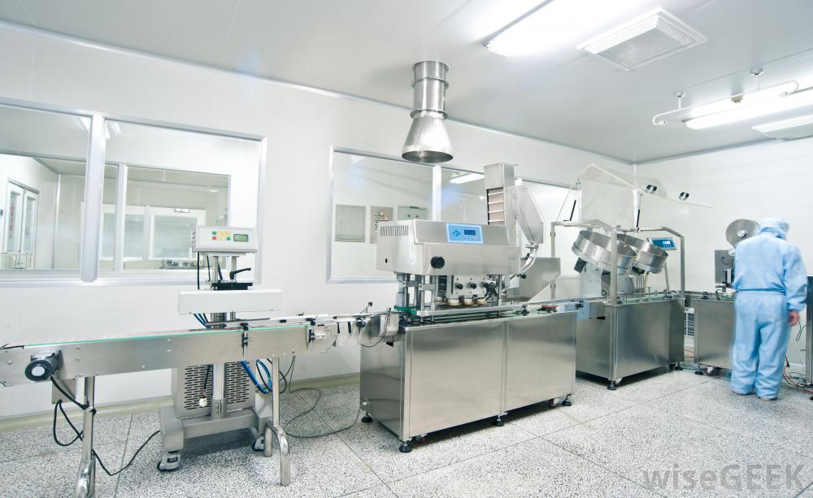
A Biotech Lab
http://www.wisegeek.com/what-does-a-biotechnology-technician-do.htm

Slide 23

Jute Genome Project
Whole Genome Sequencing of jute by Bangladeshi Scientists led by late Maqsudul Alam open up the way for manipulation of jute DNA by genetic engineering not only to protect it from diseases but also to improve jute quality.

Slide 24
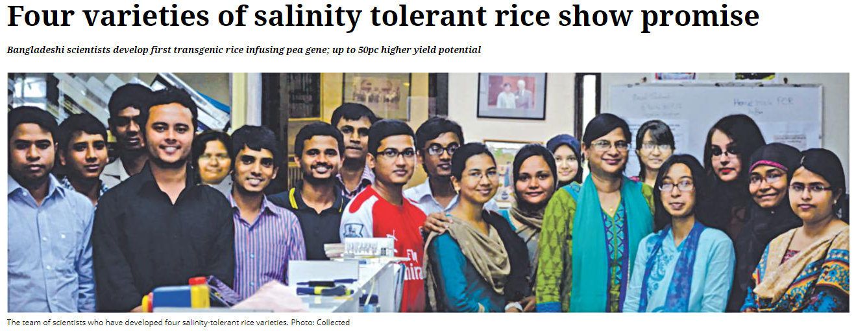
Developing salinity tolerant
rice variety in Bangladesh
http://www.thedailystar.net/frontpage/salinity-tolerant-rice-shows-promise-141355
A particular pea gene -- helicase -- was infused into four high yielding rice varieties (HYVs) that helped rice plants have higher salt tolerance and higher yield potential.

Slide 25
What can one do with a major in
Biochemistry and Biotechnology or Microbiology?
-Biological scientists study living organisms and their relationship to the environment. They perform research to gain a better understanding of fundamental life processes and apply that understanding to developing new products or processes.
-Research can be broken down into two categories: basic and applied. Basic research is conducted without any intended aim; the goal is simply to expand on human knowledge. Applied research is directed towards solving a particular problem.
-Most biological scientists specialize in one area of biology, such as zoology (the study of animals) or microbiology (the study of microscopic organisms).
https://www.mnstate.edu/biosciences/careersinbiochemistryandbiotechnologyemphasis.aspx

Slide 26
Next Lecture:
Foundations of Biochemistry
Reference Textbook:
Lehninger Principles of Biochemistry
4th or 5th Edition
David L. Nelson, Michael M. Cox
WH Freeman & Company,
New York, USA

