Slide 1
Chapter 19
Oxidative Phosphorylation
& Photophosphorylation

Slide 2
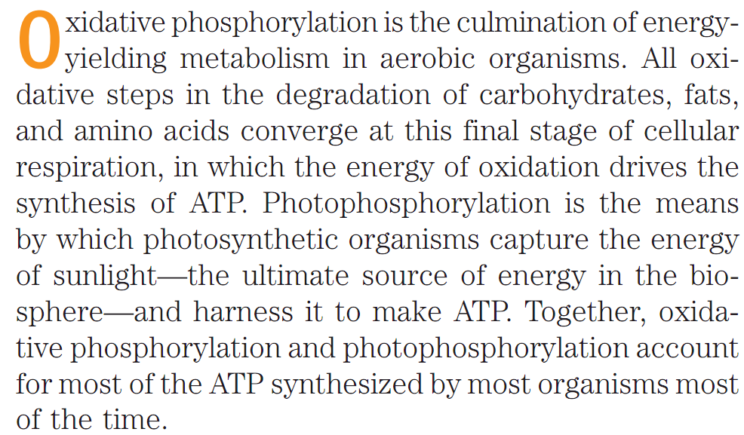
Oxidative Phosphorylation & Photophosphorylation
Most of the ATPs are synthesized by Oxidative Phosphorylation or Photophosphorylation
Q1. What is the ultimate goal for oxidative phosphorylation and photophosphorylation?

Slide 3
Oxidative Phosphorylation & Photophosphorylation
Differences between Oxidative phosphorylation and Photophosphorylation
In eukaryotes, oxidative phosphorylation occurs in mitochondria, photophosphorylation in chloroplasts.
Oxidative phosphorylation involves the reduction of O₂ to H₂O with electrons donated by NADH and FADH₂; it occurs equally well in light or darkness.
Photophosphorylation involves the oxidation of H₂O to O₂, with NADP⁺ as ultimate electron acceptor; it is absolutely dependent on the energy of light.
Despite their differences, these two highly efficient energy-converting processes have fundamentally similar mechanisms.
Q1. What is the fundamental difference between oxidative phosphorylation and photophosphorylation?

Slide 4
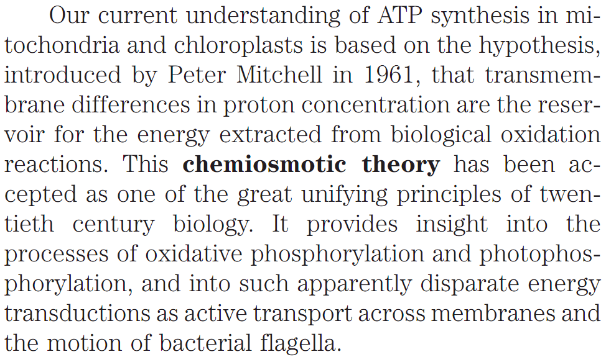
Oxidative Phosphorylation & Photophosphorylation
Similarities between Oxidative phosphorylation and Photophosphorylation
Q1. What is chemiosmotic theory?
Q2. Who proposed the chemiosmotic theory?

Slide 5
Oxidative Phosphorylation & Photophosphorylation
Similarities between Oxidative phosphorylation and Photophosphorylation
Oxidative phosphorylation and photophosphorylation are mechanistically similar in three respects.
(1) Both processes involve the flow of electrons through a chain
of membrane-bound carriers.
(2) The free energy made available by this “downhill” (exergonic) electron flow is coupled to the “uphill” transport of protons across a
proton-impermeable membrane, conserving the free energy of fuel oxidation as a transmembrane electro-chemical potential.
(3) The transmembrane flow of protons down their concentration gradient through specific protein channels provides the free energy for synthesis of ATP, catalyzed by a membrane protein complex (ATP synthase) that couples proton flow to phosphorylation of ADP.
Q1. What are the mechanistic similarities between oxidative phosphorylation and photophosrylation?

Slide 6
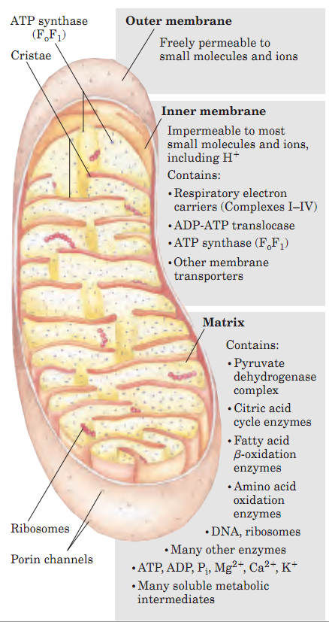
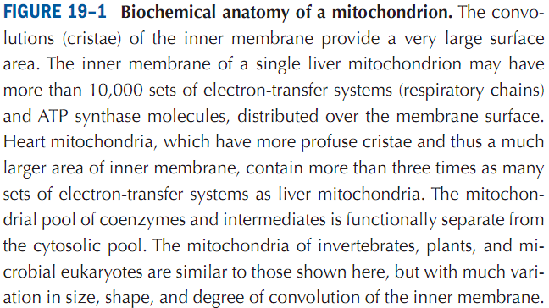
Oxidative Phosphorylation
Permeability of Mitochondrial Outer and Inner Membranes
Mitochondria, like gram-negative bacteria, have two
membranes (Fig. 19–1):
The outer mitochondrial membrane is readily permeable to small molecules and ions.
The inner mitochondrial membrane is not permeable to most small molecules and ions, including protons (H⁺): specific transporter proteins are required by small molecules and ions to cross this membrane.
The inner membrane bears the components of the respiratory chain and the ATP synthase.
Q1. Diagrammatically explain the biochemical anatomy of a mitochondrion.
Q2. What is the difference between outer- and inner mitochondial membrane with respect to transport of solutes?
Q3. Where do electron transport chain (ETC) components and the ATP synthase reside?

Slide 7
Oxidative Phosphorylation
ATP can be made by Substrate-level phosphorylation & Oxidative phosphorylation
https://www.slideshare.net/thelawofscience/cellular-respiration-oxidative-phosphorylation
Q1. What are the two general methods by which ATP can be synthesized in biological systems?

Slide 8
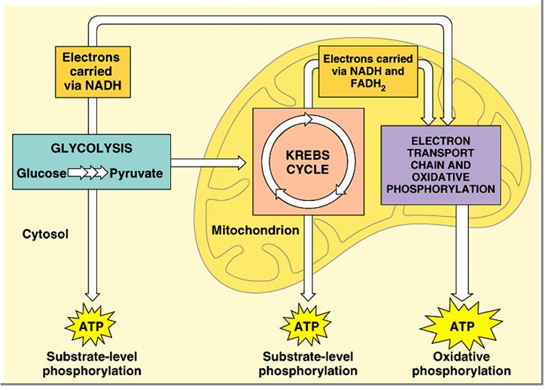
Oxidative Phosphorylation
ATP can be made by Substrate-level phosphorylation & Oxidative phosphorylation
http://slideplayer.com/slide/4905421/
Q1. Schematically show how ATP molecules are synthesized using substrate-level and oxidative phosphorylation.

Slide 9
Oxidative Phosphorylation
Scheme of the three key stages of production of ATP
Q1. Schematically show how electron transfer and oxidative phosphorylation are coupled.

Slide 10
Oxidative Phosphorylation
Key stages of the production of ATP
1. Electron carriers are reduced during glycolysis and the citric acid cycle to NADH + H⁺ and FADH₂. These carriers then donate electrons and protons to the electron carrier proteins of the electron transport chain (ETC) in mitochondria. The final electron acceptor is oxygen. Together with oxygen, electrons and protons form molecules of water.
2. An electron transport chain (ETC) is a series of complexes that transfer electrons from electron donors to electron acceptors via redox (both reduction and oxidation occurring simultaneously) reactions, and couples this electron transfer with the transfer of protons (H⁺ ions) across a membrane.
3. The proton gradient produced by proton pumping during the electron transport chain is used to synthesize ATP. Protons flow down their concentration gradient into the matrix through the membrane protein ATP synthase, causing it to spin (like a water wheel) and catalyze conversion of ADP to ATP.
Q1. Discuss the three key stages through which ATP is produced.

Slide 11
Oxidative Phosphorylation
Components of mitochondrial ETC
The protein components in mitochondrial ETC are:
Complex I (NADH dehydrogenase)
Complex II (Succinate dehydrogenase)
Complex III (Ubiquinone cytochrome c oxidoreductase)
Cytochrome c (freely soluble protein between Complexes III and IV)
4. Cytochrome oxidase
In the mitochondrial electron transport chain electrons move from an electron donor (NADH or FADH₂) to a terminal electron acceptor (O₂) via a series of redox reactions. These reactions are coupled to the creation of a proton gradient across the mitochondrial inner membrane.
Q1. What are the protein components of ETC?
Q2. Discuss different protein components of ETC using a table.

Slide 12
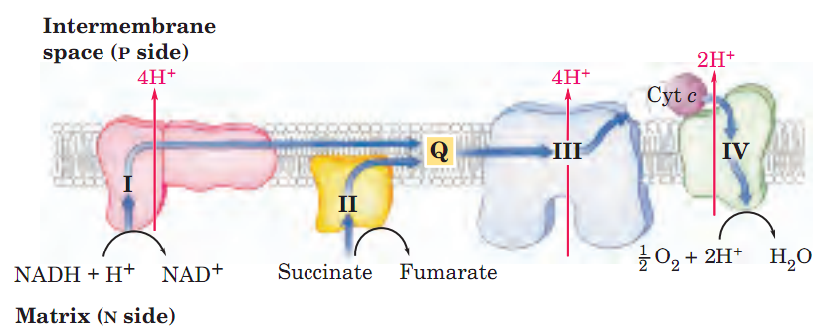
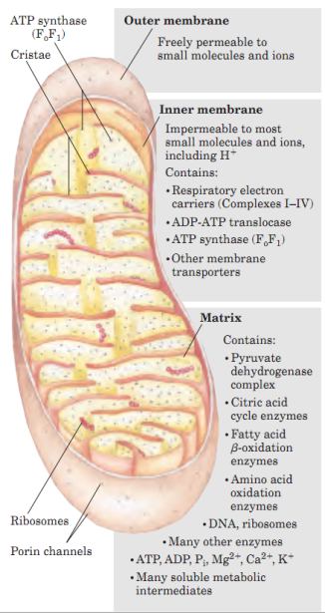
Oxidative Phosphorylation
Flow of electrons through ETC of mitochondrial inner membrane
Q1. Diagrammatically summarize the flow of electrons and protons through the four complexes of the respiratory chain.

Slide 13
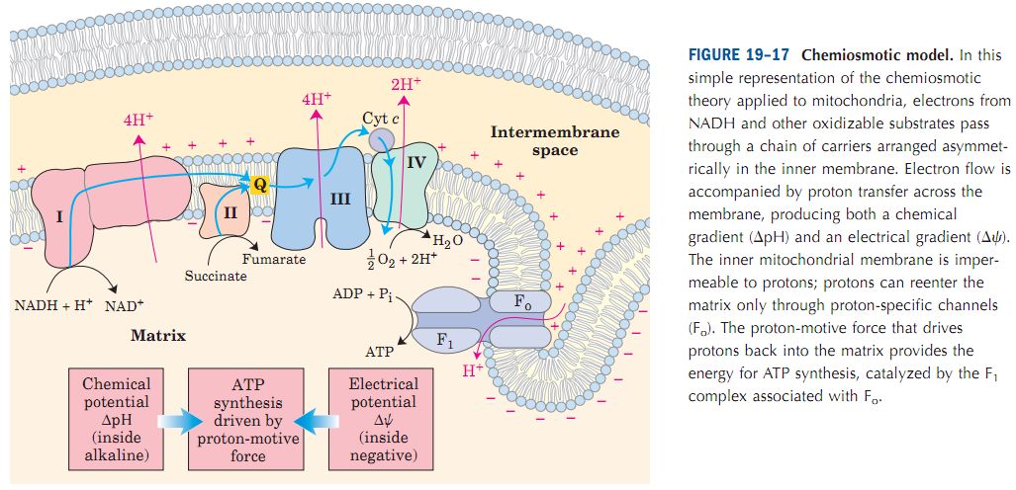
Oxidative Phosphorylation
Chemiosmotic Model
The flow of electrons through Complexes I, III, and IV results in pumping of protons across the inner mitochondrial membrane, making the matrix alkaline relative to the inter membrane space. This proton gradient provides the energy (in the form of the proton-motive force) for ATP synthesis from ADP and Pi by ATP synthase (F_{o}F₁ complex) in the inner membrane.
Q1. Discuss with a scheme the chemiosmotic model of Peter Mitchell.

Slide 14
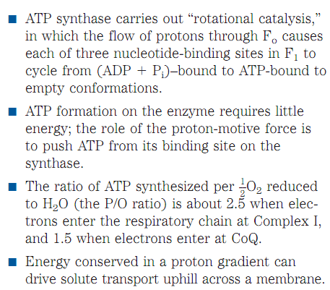
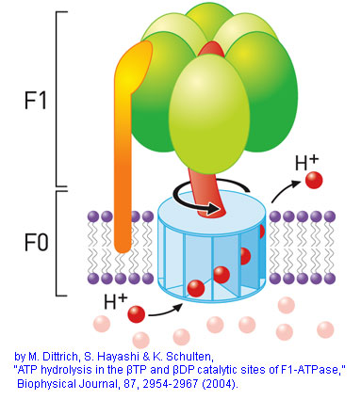
Oxidative Phosphorylation
F_{o}F₁ ATP synthase
F_{o}F₁ synthase catalyzes the conversion of ADP and inorganic phosphate to ATP.
F_{o} domain transfers 4 protons and F₁ domain converts ADP and P_{i} to ATP.
Matrix
Intermembrane space
http://fig.cox.miami.edu/~cmallery/150/makeatp/makeatp.htm
Q1. Name an enzyme that carries out “rotational catalysis”.
Q2. What are the phosphate : oxygen ratio when electrons enter at Complex I and coenzyme Q (ubiquinone) of the electron transport chain?

Slide 15
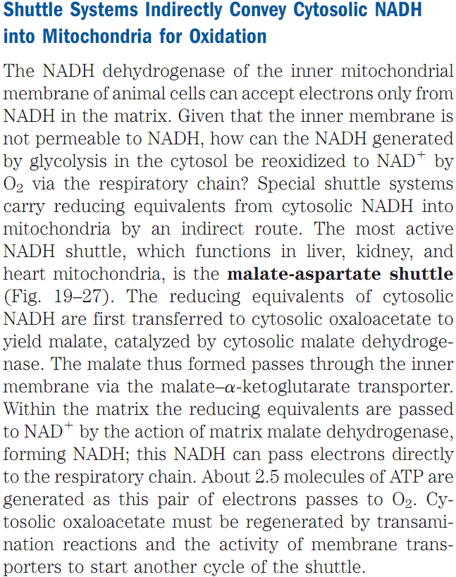
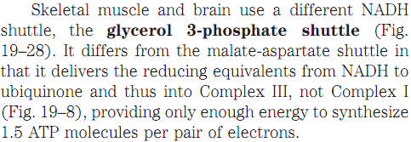
Oxidative Phosphorylation
Shuttle systems indirectly convey cytosolic NADH into mitochondria for oxidation
Q1.What are the shuttle systems that carry NADH from the cytosol to mitochondria?
Q2. What is the malate-aspartate shuttle? In which tissues this shuttle system operates?
Q3. What is glycerol 3-phosphate shuttle? In which tissues this shuttle system operates?
Q4. How many ATP molecules are produced upon transfer of a pair of electrons to oxygen through ETC using (a) malate-aspartate shuttle, (b) glycerol 3-phosphate shuttle?
(Answer: (a) 2.5, (b) 1.5)

Slide 16
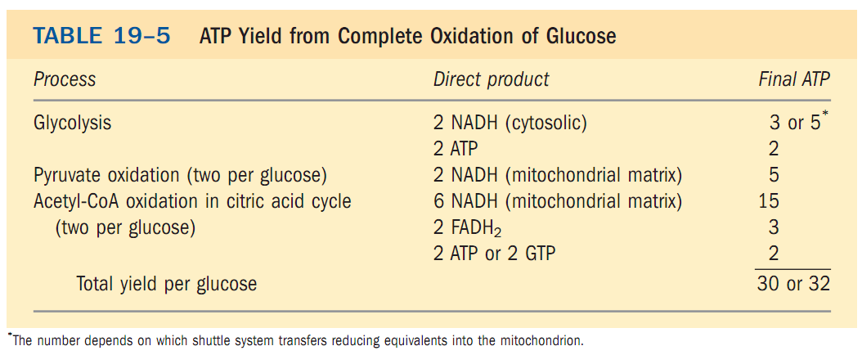
Oxidative Phosphorylation
ATP yield from complete oxidation of one molecule of Glucose
Q1. Using a table show the ATP yield from complete oxidation of one molecule of glucose.

Slide 17
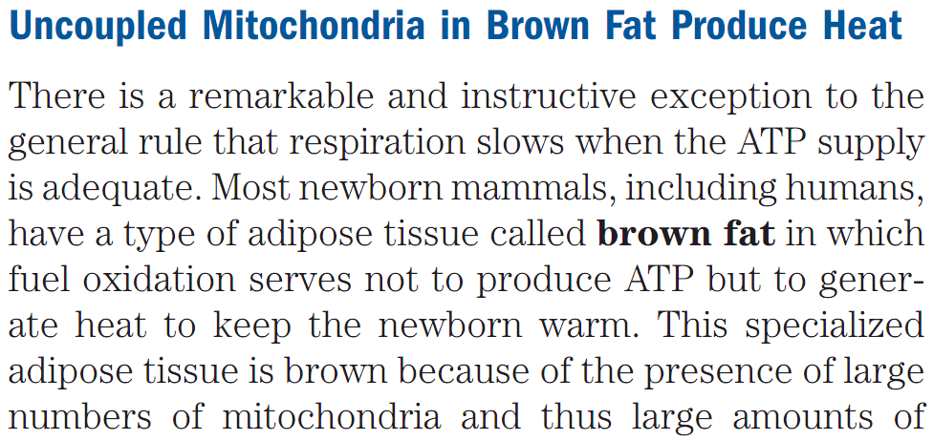
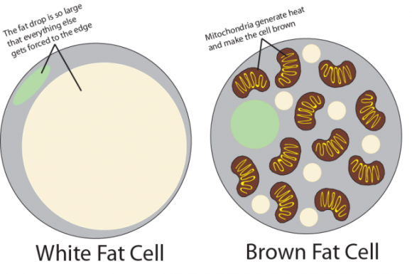
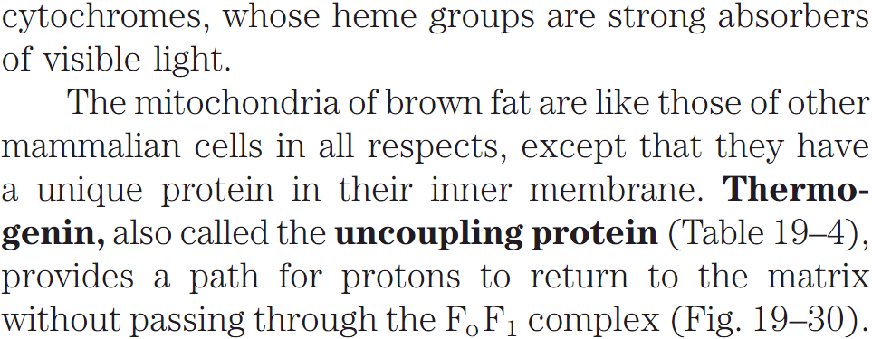
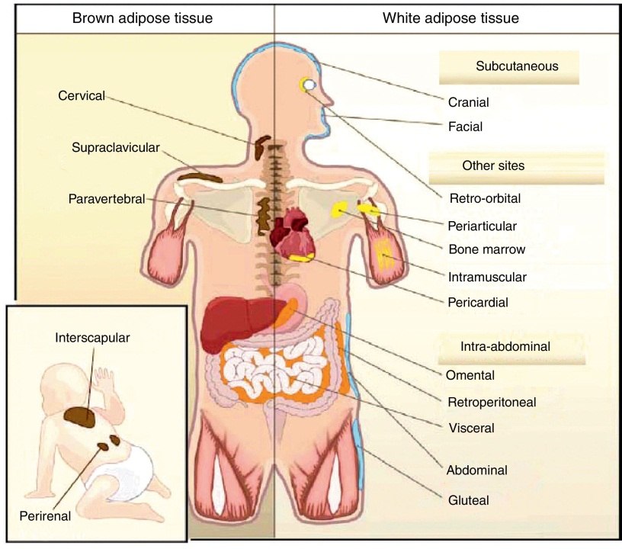
Oxidative Phosphorylation
Biologic significance of fuel oxidation to produce heat (not ATP)
http://www.fitnessvsweightloss.com/winter-is-the-best-time-for-losing-weight/
Q1. What is brown fat? Why is it called so?
Q2. What is the name of the unique protein in brown fat?
No question on the images of this slide in exam.
http://www.elsevier.es/es-revista-endocrinologia-nutricion-english-edition--412-articulo-adipose-tissue-cell-heterogeneity-functional-S2173509314000336

Slide 18
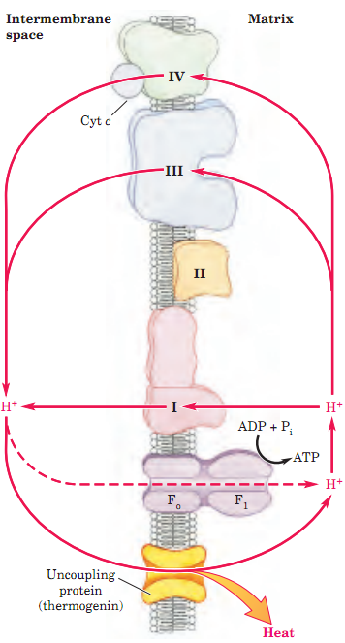
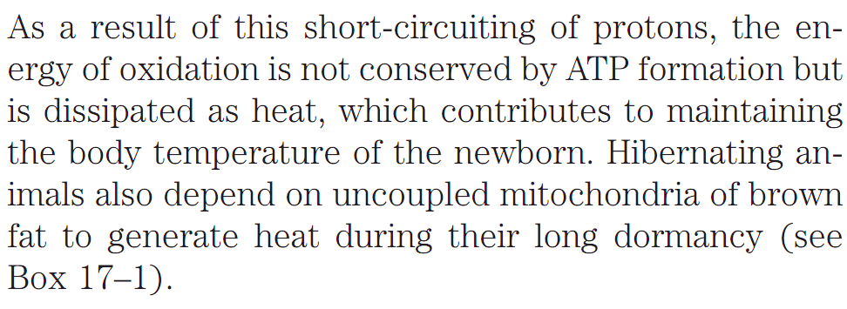
Oxidative Phosphorylation
Biologic significance of fuel oxidation to produce heat (not ATP)
Q1. Diagrammatically explain how heat is generated by thermogenin or uncoupling protein in mitochondria?
Q2. Give two biologic significance of the heat produced by brown fat.

Slide 19
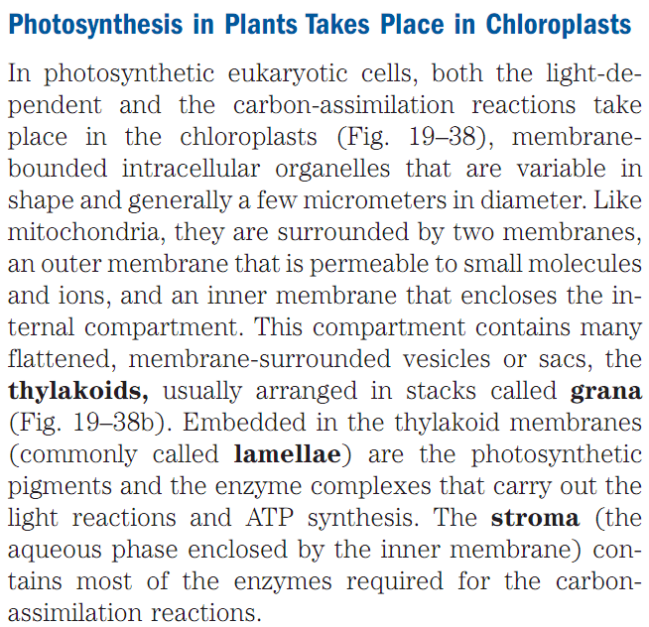
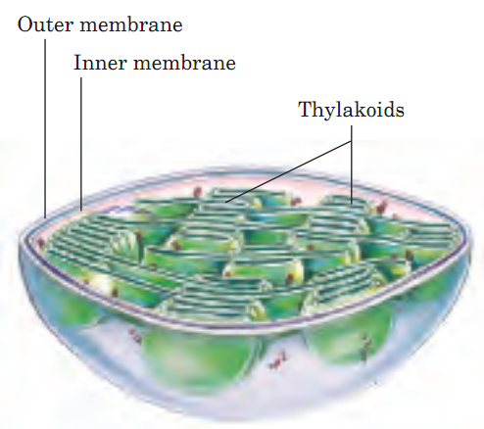
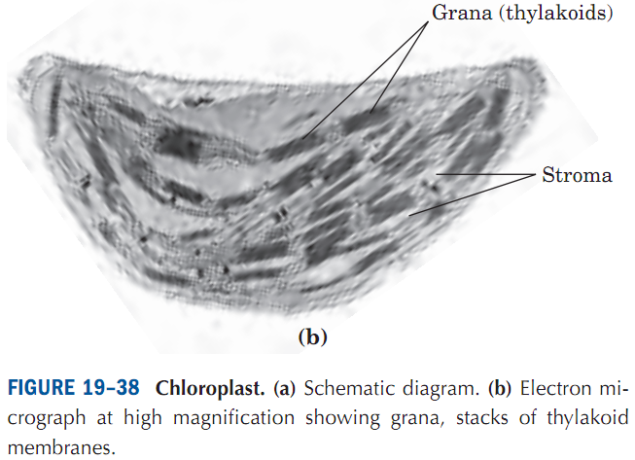
Photophosphorylation
Chloroplasts
Q1. Where does photosynthesis take place in plants?
Q2. Diagrammatically show different parts of chloroplasts.
Q3. What are thylakoids, granna, lamellae, stroma?

Slide 20
Photophosphorylation
Chloroplasts
http://slideplayer.com/slide/7742400/
No question in exam from the image of this slide.

Slide 21
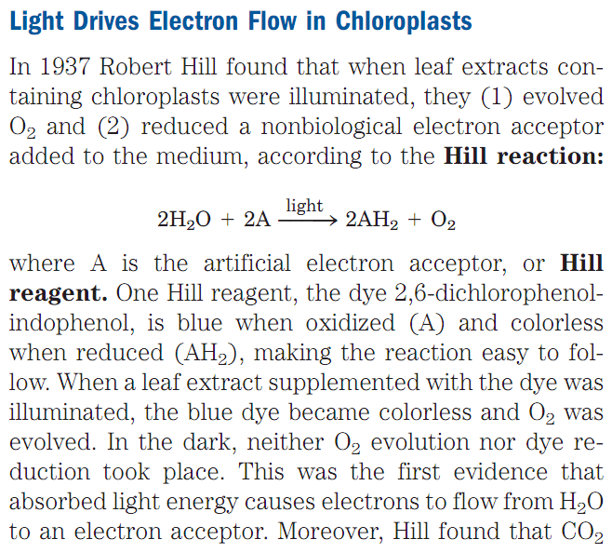
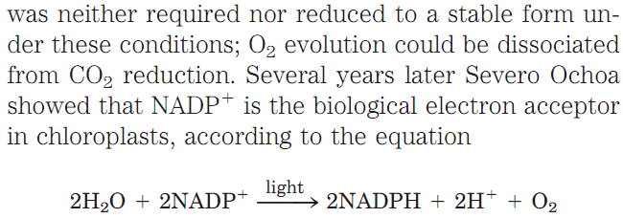
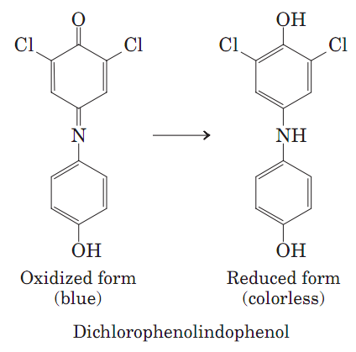
Photophosphorylation
Light drives electron flow in chloroplasts
Q1. What is Hill reaction with respect to photosynthesis?
Q2. What is the biological electron acceptor in the chloroplasts?
No question in exam on Dichlorophenolindophenol.

Slide 22
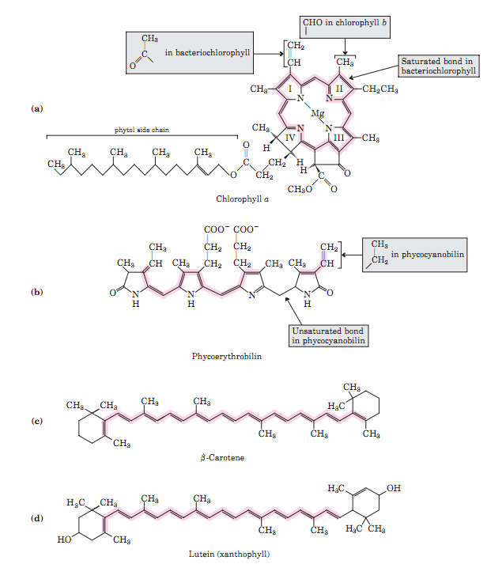
Photophosphorylation
Light absorbing pigments in plants
The most important light-absorbing pigments in the thylakoid membranes are the chlorophylls, green pigments with polycyclic, planar structures resembling the protoporphyrin of hemoglobin, except that Mg²⁺, not Fe²⁺, occupies the central position.
In addition to chlorophylls, thylakoid membranes contain secondary light-absorbing pigments, or accessory pigments, called carotenoids. Carotenoids may be yellow, red, or purple. The most important are β-carotene, which is a red-orange isoprenoid, and the yellow carotenoid lutein (Fig. 19–40c, d). The carotenoid pig-
ments absorb light at wavelengths not absorbed by the chlorophylls (Fig. 19–41) and thus are supplementary light receptors.
Q1. Name the most-important light-absorbing pigments in plants.
Q2. Name two secondary light-absorbing pigments in plants.
No question in the exam on the structures of chlorophyll and lutein.

Slide 23
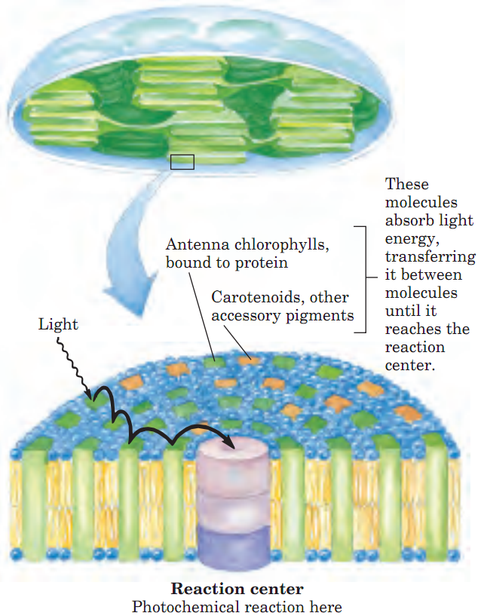
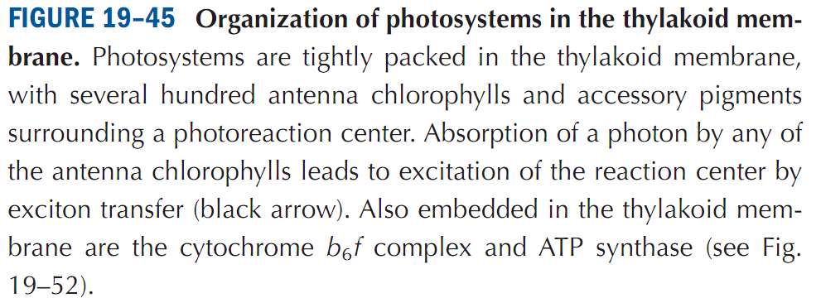
Photophosphorylation
Photosystems
The light-absorbing pigments of thylakoid or bacterial
membranes are arranged in functional arrays called
photosystems. In spinach chloroplasts, for example,
each photosystem contains about 200 chlorophyll and
50 carotenoid molecules.
All the pigment molecules in a photosystem can absorb photons, but only a few chlorophyll molecules associated with the photochemical reaction center are specialized to transduce light into chemical energy. The other pigment molecules in a photosystem are called light-harvesting or antenna molecules. They absorb light energy and transmit it rapidly and efficiently to the reaction center (Fig. 19–45).
Q1. What are photosystems?
Q2. What is photochemical reaction center?
Q3. Which type of chlorophylls can transduce light into chemical energy?
Q4. What are antenna chlorophylls? What is their importance?

Slide 24
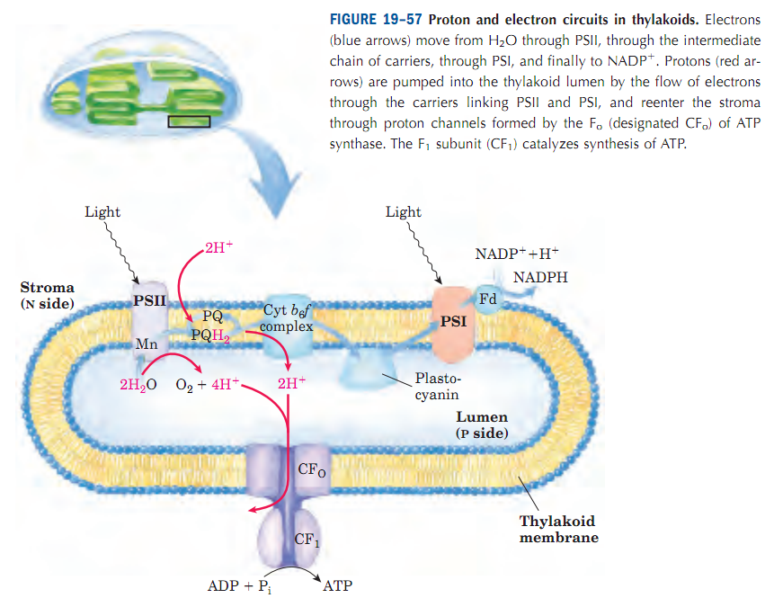
Photophosphorylation
ATP synthesis in thylakoids
No question in the exam from this slide.

Slide 25
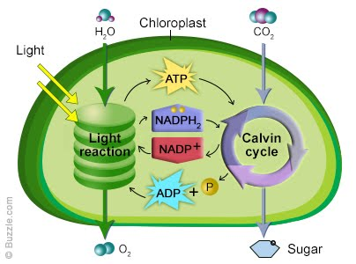
Photophosphorylation
ATP synthesis by photophosphorylation & Utilization of it in making Carbohydrates
https://sites.google.com/a/fhsbiology.com/main/faculty/mrderosa/lab-biology-1/marking-period-4/photosythesis
Q1. Diagrammatically show how light-induced formation of ATP can be used for the synthesis of carbohydrates by Calvin cycle in chloroplast.

Slide 26
Next Lecture: Overview of Metabolic Pathways-VI
Reference Textbook: Lehninger Principles of Biochemistry
4th or 5th Edition
Chapters 14-23
David L. Nelson, Michael M. Cox WH Freeman & Company,
New York, USA

