Slide 1
BIO201 SPRING 2018 MSH3 Introduction to Biochemistry & Biotechnology
Lecture #16

Slide 2
Lehninger
Principles of Biochemistry
Chapter 14-23
Overview of Metabolic Pathways-IV

Slide 3
Chapter 18
Amino Acid Oxidation & the Production of Urea

Slide 4
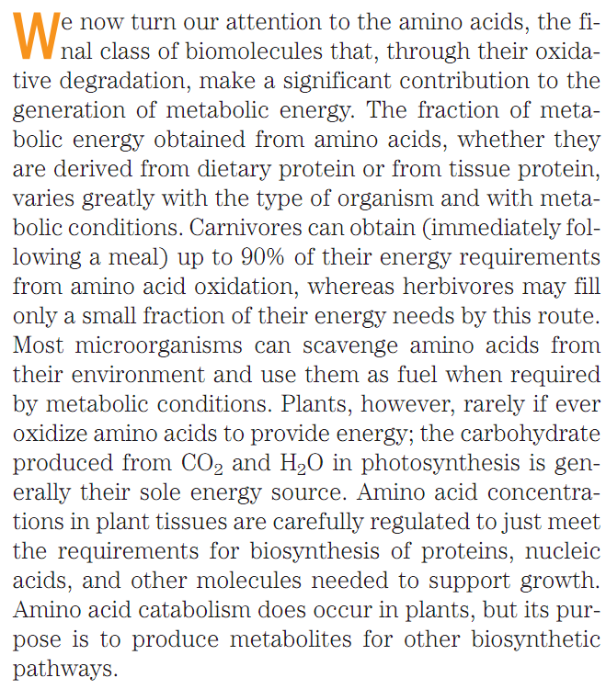
Amino Acid Catabolism
Amino Acids as Energy Source
Q1. How much energy can be provided by amino acid oxidation in carnivores?
Q2. Do plants oxidize amino acids?
Q3. What is the sole energy source in plants?

Slide 5
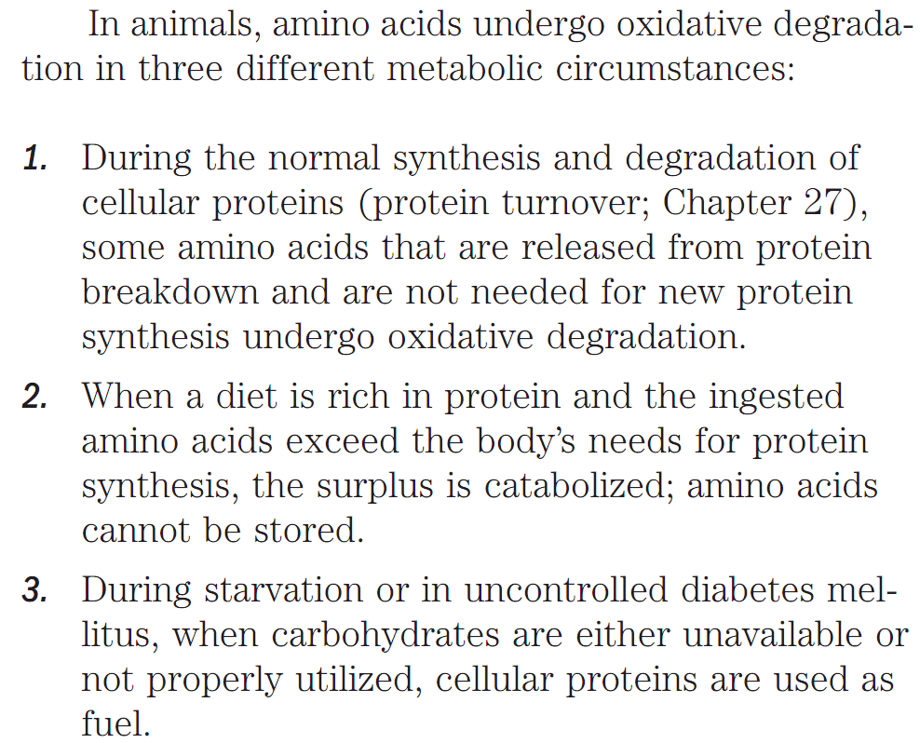
Amino Acid Catabolism
Oxidation of Amino Acids in Animals in Three Conditions
Q1. Mention the three different metabolic circumstances when amino acids are oxidatively degraded in animals.

Slide 6
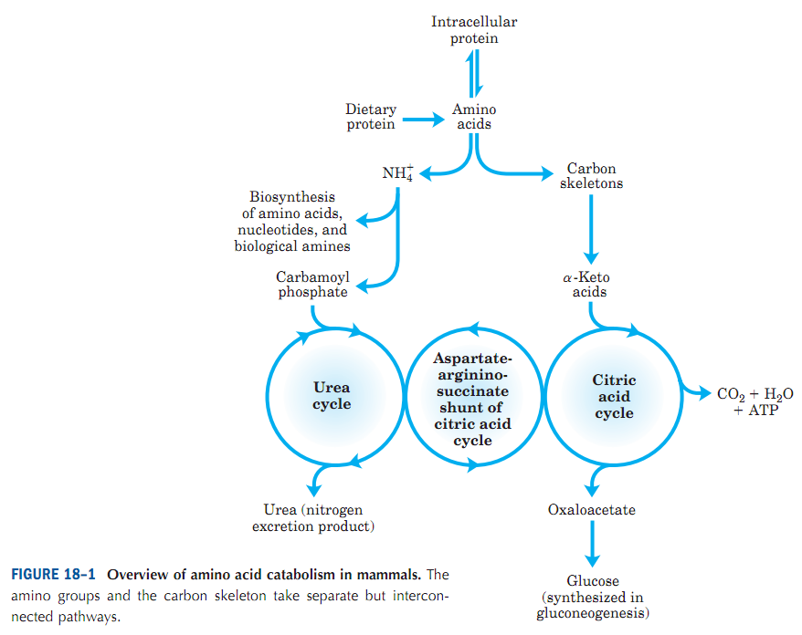
Amino Acid Catabolism
Overview of Amino Acid Catabolism in Mammals
One important feature distinguishes amino acid
degradation from other catabolic processes described to this point: every amino acid contains an amino group, and the pathways for amino acid degradation therefore include a key step in which the α-amino group is separated from the carbon skeleton and shunted into the
pathways of amino group metabolism (Fig. 18–1).
Q1. Schematically give an overview of amino acid catabolism in mammals.

Slide 7
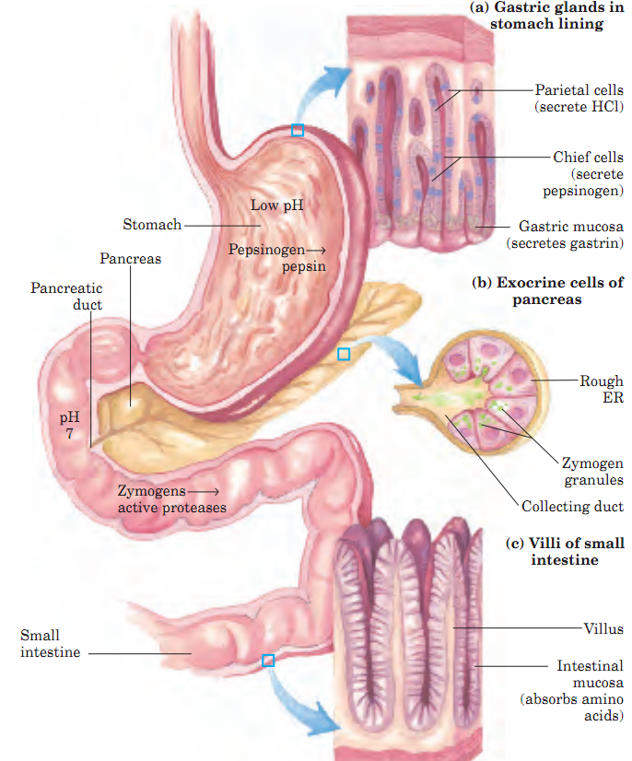
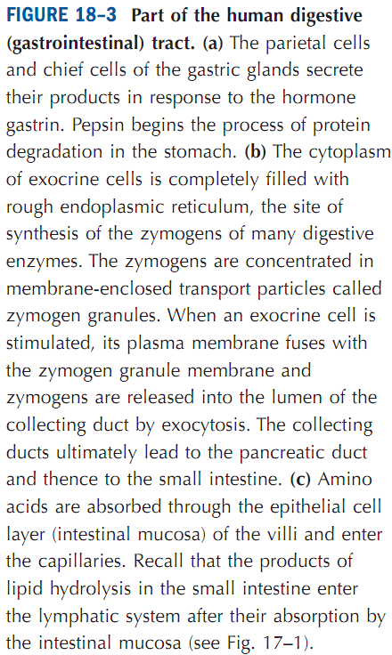
Amino Acids from Diet
Dietary Protein is Enzymatically degraded to Amino Acids
Q1. Name the stomach protein that begins degradation of dietary proteins.
Q2. Where do amino acids obtained from dietary proteins get absorbed?

Slide 8
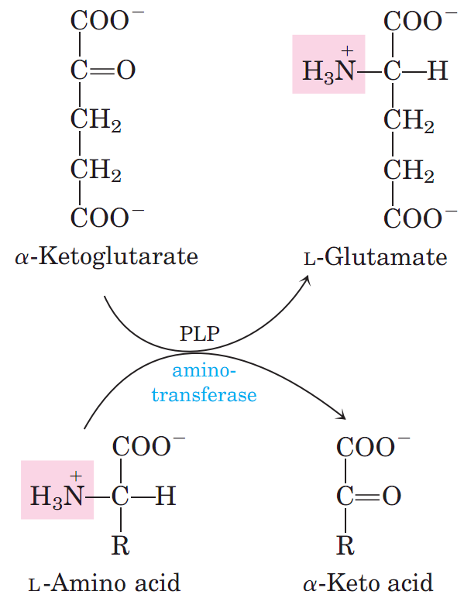
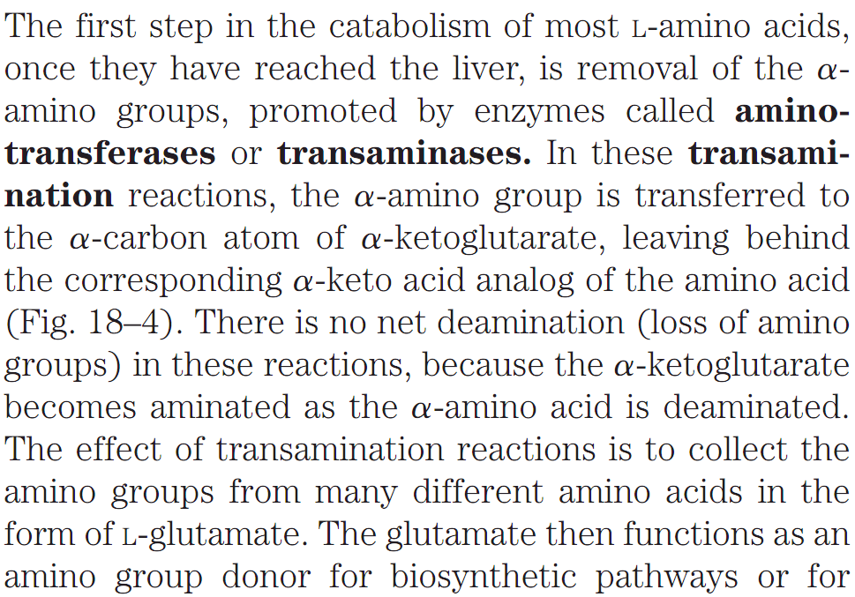
Metabolic fates of Amino Groups
Aminotransferases transfer Amino group from Dietary Amino Acids to Glutamate in Liver
Q1. What are aminotransferases? Give an example.
Q2. What is the significance of the transamination reactions in liver?
Q3. Schematically show an enzyme-catalyzed transamination reaction.

Slide 9
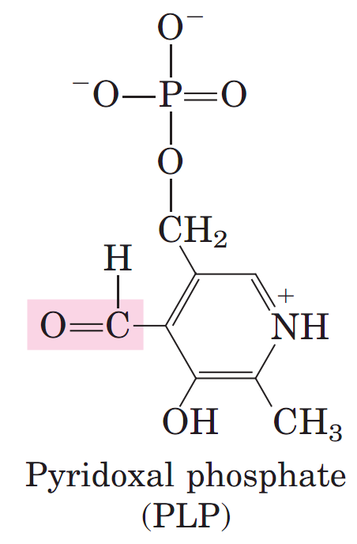
Metabolic fates of Amino Groups
Pyridoxal Phosphate participates in the transfer of α-Amino groups to α-Ketoglutarate
All aminotransferases have the same prosthetic group and the same reaction mechanism. The prosthetic group is pyridoxal phosphate (PLP), the coenzyme form of pyridoxine, or vitamin B₆.
Q1. What is the common prosthetic group of all aminotransferases.? Draw its structure.
Q2. What is pyridoxal phosphate? Why is it important in metabolism? Draw its structure.

Slide 10
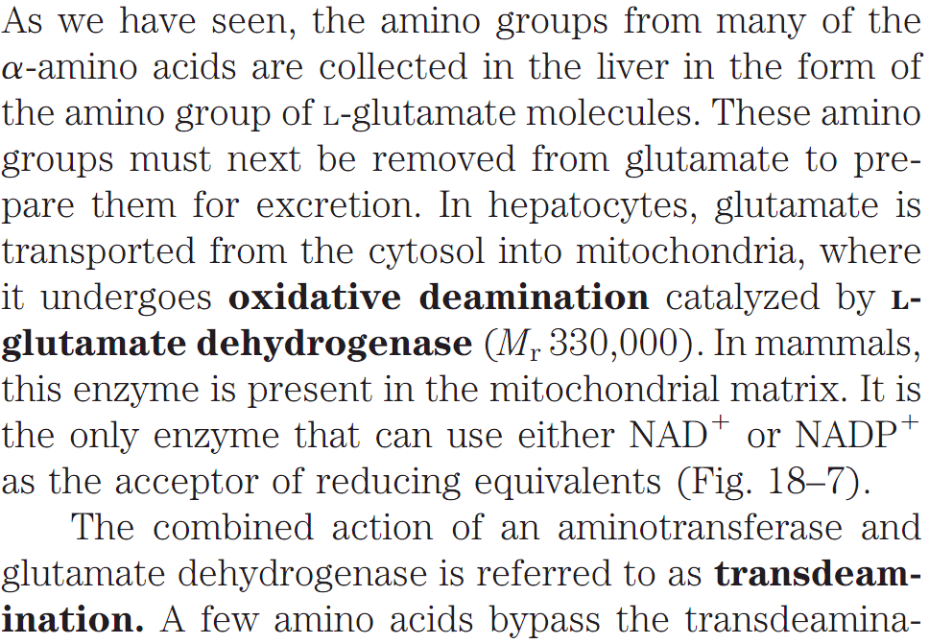
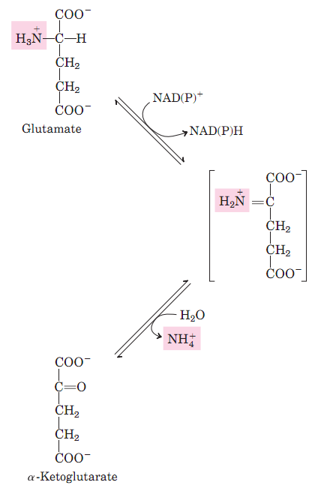
Metabolic fates of Amino Groups
Glutamate releases its Amino group in Liver as Ammonia
Q1. What is oxidative deamination? Give an example.
Q2. Show the reaction catalyzed by glutamate dehydrogenase. Where does it reside in cells? Why it is important?
Q3. What is transdeamination?

Slide 11
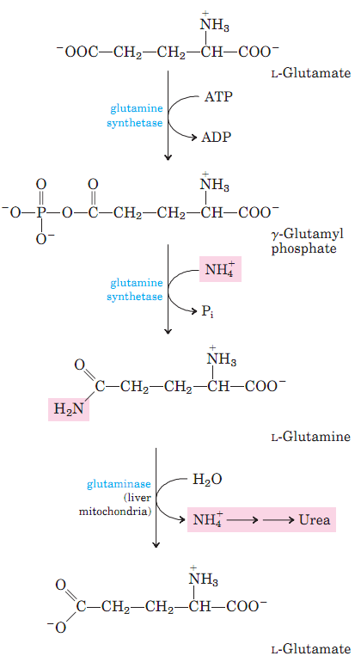
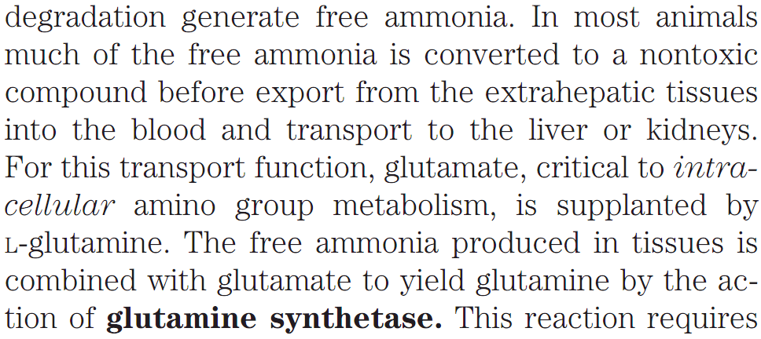
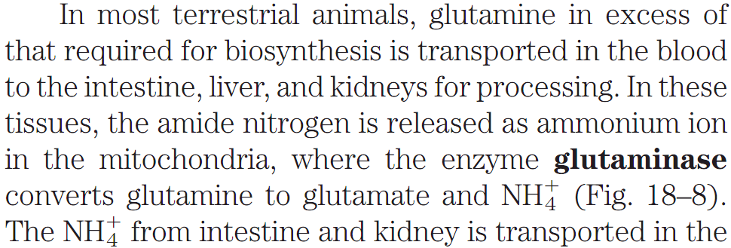
Metabolic fates of Amino Groups
Glutamine transports Ammonia in bloodstream
Glutamine is a nontoxic transport form of ammonia; it is normally present in blood in much higher concentrations than other amino acids. Glutamine also serves as a source of amino groups in a variety of biosynthetic reactions.
Q1. Why removal of ammonia from body is important?
Q2. How free ammonia can be generated in brain?
Q3. Schematically show the reactions for the transport of ammonia as glutamine.
Q4. What is the function of glutamine synthetase?
Q5. What is the function of glutaminase?
Q6. Which amino acid is present in much higher concentrations in blood than others?
Q7. In what form ammonia is excreted in humans?

Slide 12
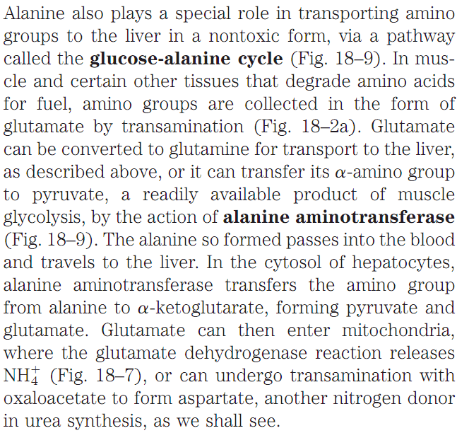
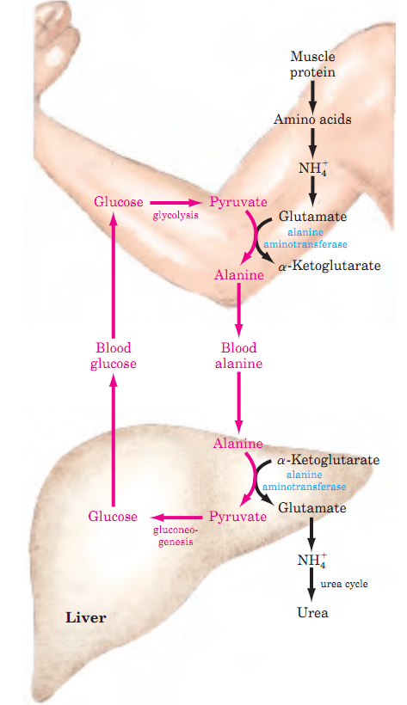
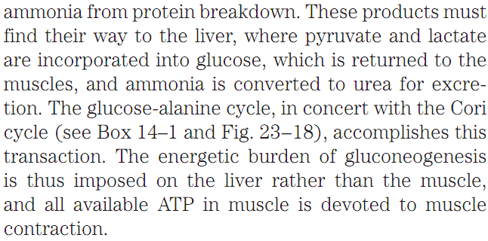
Metabolic fates of Amino Groups
Alanine transports Ammonia from Skeletal Muscles to Liver
Q1. Diagrammatically show the glucose-alanine cycle.
Q2. What is the importance of alanine aminotransferase in skeletal muscle?
Q3. Explain why the use of alanine to transport ammonia from skeletal muscles to liver is an example of intrinsic economy of living organisms.

Slide 13
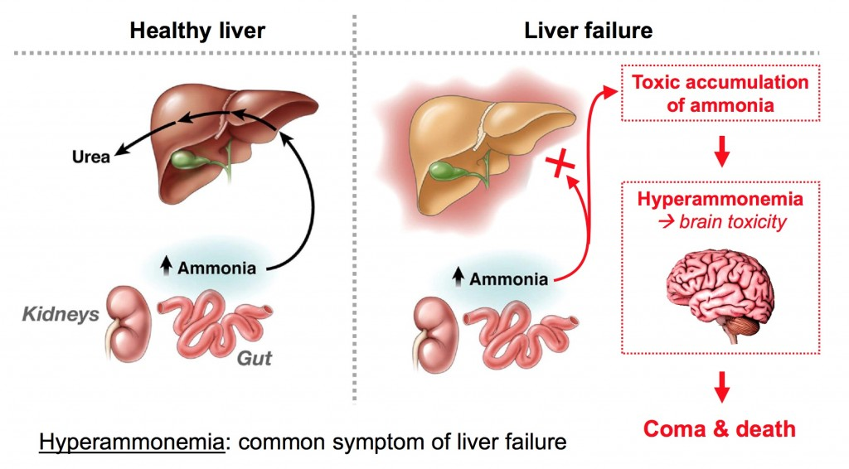
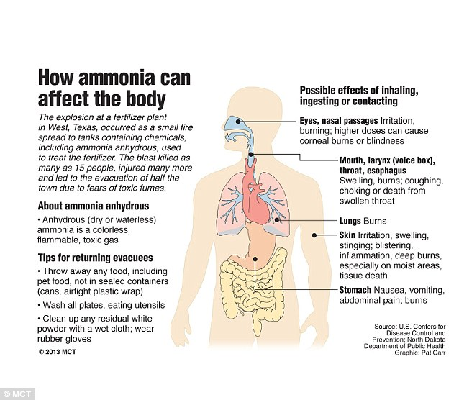
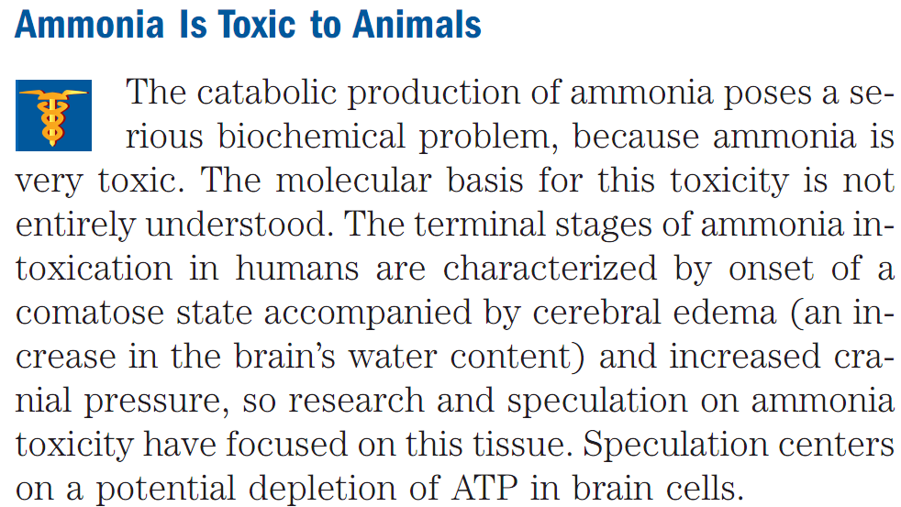
Nitrogen Excretion and the Urea Cycle
Ammonia is very toxic
http://labiotech.eu/versantis-using-liposomes-technology-to-detoxicate-the-body/
https://www.slideshare.net/DJ4SDM/class-5-formation-and-fate-of-ammonia
Q1. Why ammonia is toxic?
Q2. What is the major of ammonia intoxication? What is the cause of this condition? (Answer; coma probably due to depletion of ATP)
NO OTHER QUESTION FROM THIS SLIDE.
http://www.dailymail.co.uk/news/article-2310874/There-chemical-leaks-control-Texas-police-play-fears-ammonium-air-leak-following-fertilizer-plant-blast.html

Slide 14
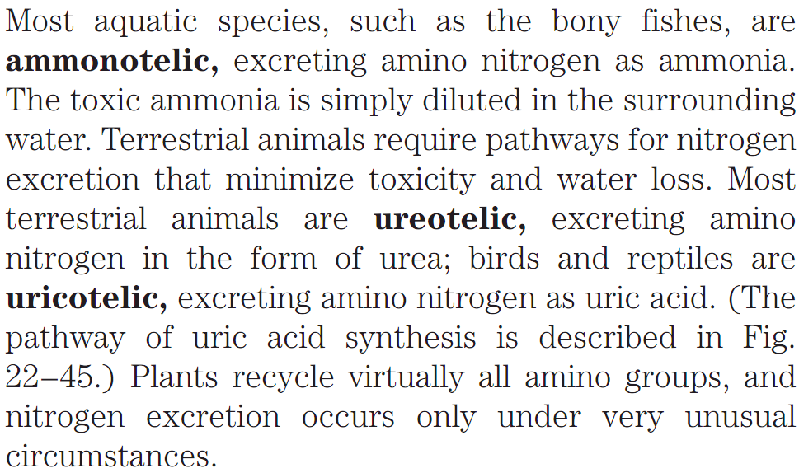
Nitrogen Excretion and the Urea Cycle
Channeling of Amino groups in the Excretory Product
Q1. What are ammonotelic, ureotelic, and uricotelic animals?
Q2. Do plants recycle amino acids?
Q3. Are humans ureotelic?

Slide 15
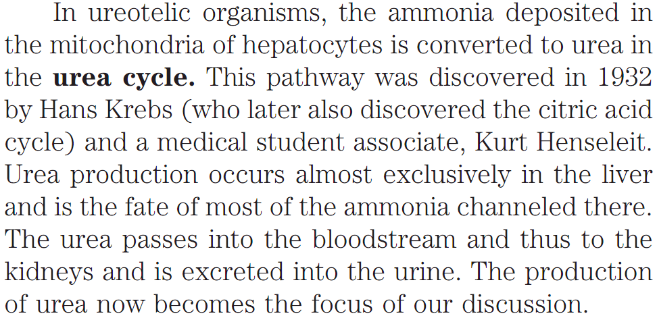
Nitrogen Excretion and the Urea Cycle
Urea Cycle
Q1. Which cycle converts ammonia into urea in liver?
Q2. Who discovered the urea cycle?
Q3. Where does urea form in the body and where does it mix with urine?

Slide 16
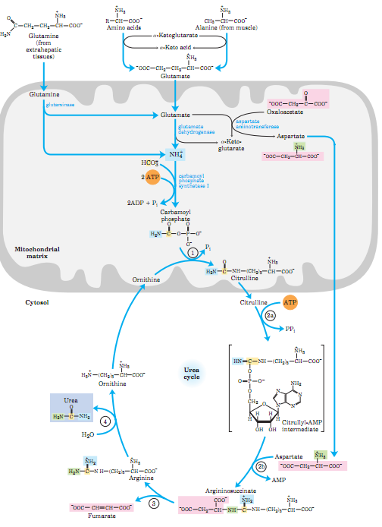
Nitrogen Excretion and the Urea Cycle
Urea is Produced from Ammonia in Five enzymatic steps
The urea cycle begins inside liver mitochondria, but three of the subsequent steps take place in the cytosol.
The cycle thus spans two cellular compartments (Fig. 18–10).
One amino group enters the urea cycle as carbamoyl phosphate, formed in the matrix; the other enters as aspartate, formed
in the matrix by transamination of oxaloacetate and glutamate, catalyzed by aspartate aminotransferase.
Q1. Where does urea cycle take place in a cell?
Q2. What are the two sources of amino groups in urea cycle?
No question on the complete image on this slide in exam.

Slide 17
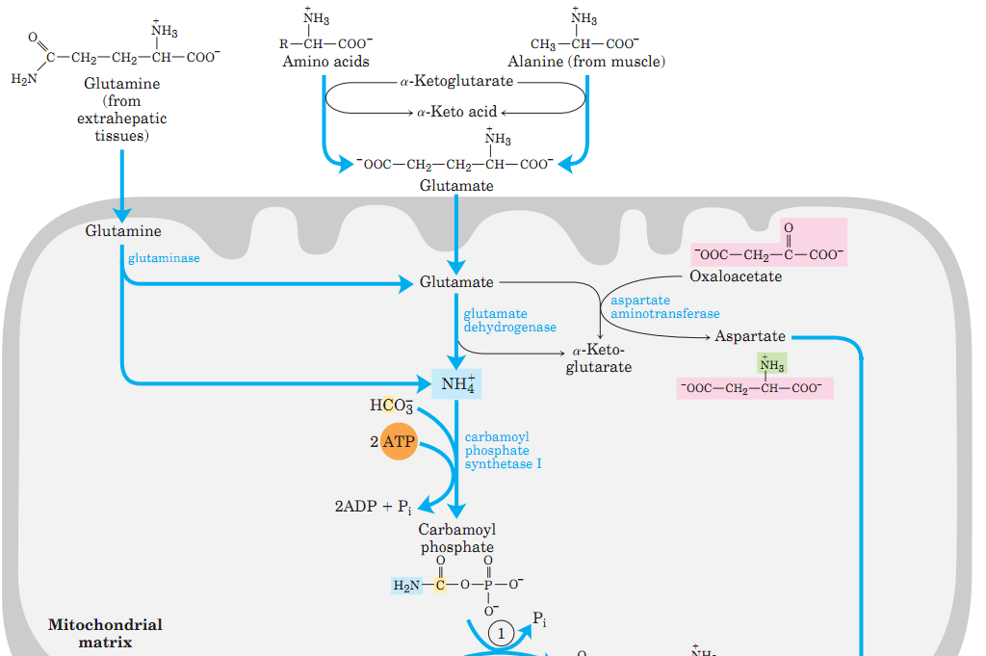
Nitrogen Excretion and the Urea Cycle
Urea Cycle
The NH₄⁺ generated in liver mitochondria is immediately used, together with CO₂
(as HCO₃⁻) produced by mitochondrial respiration, to form carbamoyl phosphate in the matrix. This ATP-dependent reaction is
catalyzed by carbamoyl phosphate synthetase I, a regulatory enzyme.
Q1. Show the reaction of the formation carbamoyl phosphate from ammonia. Which enzyme catalyzes this step? Where does this reaction take place?

Slide 18
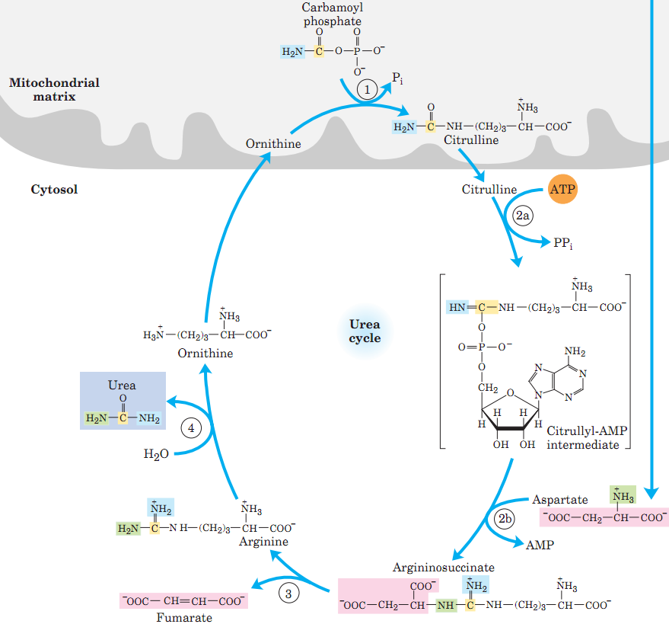
Nitrogen Excretion and the Urea Cycle
Urea Cycle
The urea cycle consists of four steps:
Formation of citrulline from ornithine and carbamoyl phosphate (entry of the first amino group) by ornithine transcarbamoylase (present in mitochondrial matrix); the citrulline passes into the cytosol.
Formation of argininosuccinate through a citrullyl-AMP intermediate (entry of the second amino group) by the cytosolic enzyme, argininosuccinate synthetase.
Formation of arginine from argininosuccinate by the cytosolic enzyme argininosuccinase; this reaction releases fumarate, which enters the citric acid cycle.
Formation of urea by the cytosolic enzyme arginase; this reaction also regenerates, ornithine.
Q1. Diagrammatically show different steps of urea cycle with the structures of the intermediates and the name of the enzymes.
Q2. How many steps are there in urea cycle? (Answer: 4)
Q3. How many steps are required for the production of urea from ammonia? (Answer: 5 including carbamoyl phosphate synthetase I-catalyzed step)
Q4. Which enzyme of the urea cycle resides in mitochondrial matrix?
Q5. Write the name of the four enzymes of the urea cycle.

Slide 19
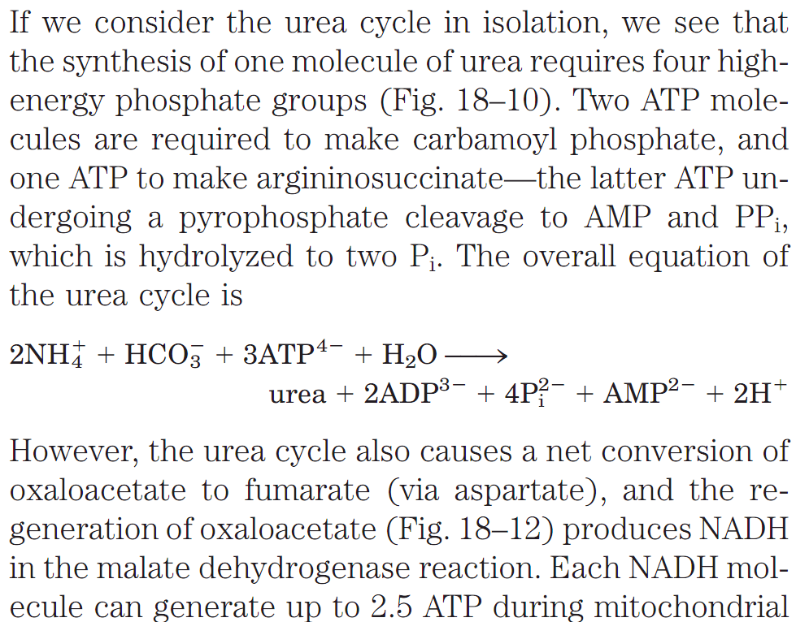
Nitrogen Excretion and the Urea Cycle
Pathway interconnections reduce the energetic cost of Urea synthesis
Q1. Write the overall reaction of the urea cycle.
Q2. Explain how the energetic cost of urea cycle is reduced by animals.

Slide 20
Pathways of Amino Acid Degradation
Fates of the Carbons in Amino Acids
Six major products obtained from amino acid catabolism:
α-ketoglutarate,
Succinyl CoA,
Fumarate,
Oxaloacetate,
Pyruvate,
Acetyl-CoA.
Ketogenesis is the biochemical process by which organisms produce a group of substances collectively known as ketone bodies by the breakdown of fatty acids and ketogenic amino acids.
Q1. How much energy is normally obtained by humans from amino acid catabolism?
Q2. Name the six major products that are obtained from amino acid catabolism.
Q3. What are the ultimate fates of the carbons of amino acids after catabolism?
Q4. What is ketogenesis?

Slide 21
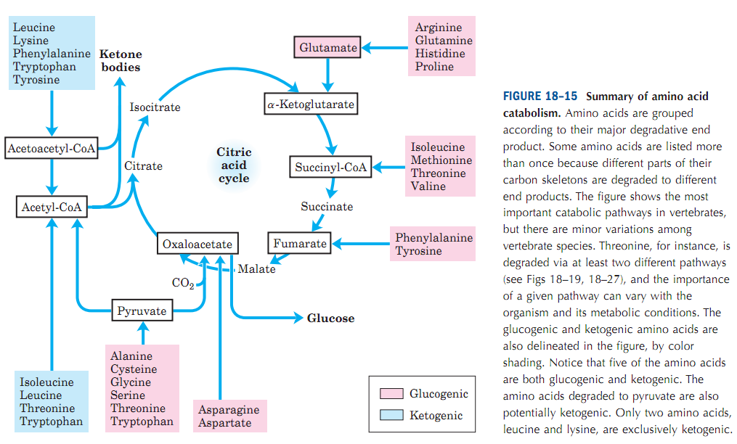
Pathways of Amino Acid Degradation
Summary of amino acid catabolism
Glucogenic: converted into glucose
Ketogenic: converted into ketone
bodies
Q1. Name the six major products that are obtained from amino acid catabolism.
Q2. Which class of amino acids are not degraded in liver?
(Answer: Branched-chain amino acids-Val, Leu, Ile)
No question in the exam from the whole image of this slide.

Slide 22
Pathways of Amino Acid Degradation
Summary of amino acid catabolism
http://slideplayer.com/slide/4479159/
Q1. What are glucogenic and ketogenic amino acids? Give examples.
Q2. List the glucogenic, glucogenic+ketogenic and ketogenic amino acids.
Q3. Which of the following amino acids is glucogenic: Alanine, Leucine, Lysine?
Q4. Which of the following amino acids is ketogenic: Alanine, Proline, Lysine?
Q5. Which of the following amino acids is both glucogenic and ketogenic: Tyrosine, Alanine, Leucine.

Slide 23
Next Lecture: Overview of Metabolic Pathways-V
Reference Textbook: Lehninger Principles of Biochemistry
4th or 5th Edition
Chapters 14-23
David L. Nelson, Michael M. Cox WH Freeman & Company,
New York, USA

