Slide 1
Introduction to Biochemistry & Biotechnology
Lecture #14

Slide 2
Lehninger
Principles of Biochemistry
Chapter 14-23
Overview of Metabolic Pathways-III

Slide 3
Chapter 17
Fatty Acid Catabolism

Slide 4
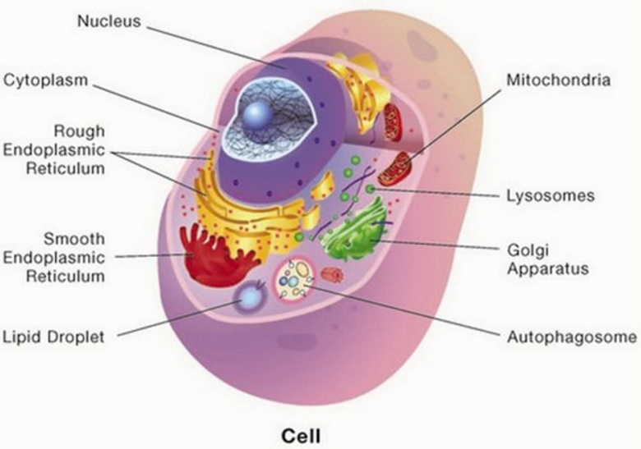
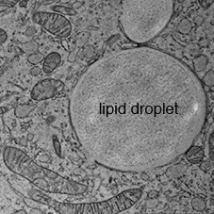
Digestion, Mobilization & Transport of Fats
Digestion, Mobilization & Transport of Fats
Cells can obtain fatty acid fuels from three sources:
fats consumed in the diet,
fats stored in cells as lipid droplets, and
fats synthesized in one organ for export to another.
http://slideplayer.com/slide/10472142/
http://www.limes-institut-bonn.de/forschung/arbeitsgruppen/unit-3/abteilung-thiele/kuerschner-junior-group/
Q1. Name the three sources from where cells can obtain fatty acids.
No question on the images of this slide in exam.

Slide 5
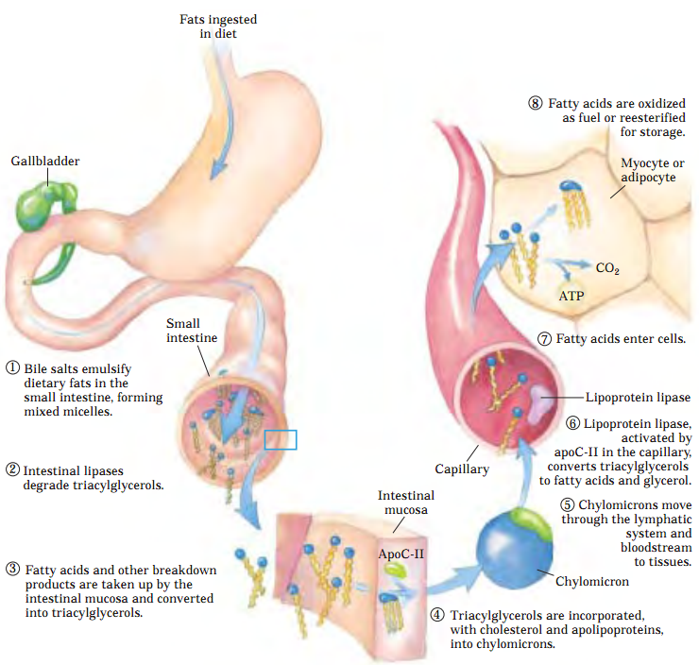
Digestion, Mobilization & Transport of Fats
Processing of Dietary Lipids in Vertebrates
On average, 40% or more of the daily energy requirement of humans in highly industrialized countries is supplied by dietary triacylglycerols (although most
nutritional guidelines recommend no more than 30% of daily caloric intake from fats).
Triacylglycerols provide
more than half the energy requirements of some organs, particularly the liver, heart, and resting skeletal muscle.
Q1. What is the recommended percentage of daily caloric intake from fats?
Q2. How much energy is usually provided by triacylglycerols to organs like liver, heart and resting skeletal muscle? (Answer: 50%)
Q3. Which type of biological compounds can emulsify dietary fats in vertebrates?
Q4. Which intestinal enzymes degrade triacylglycerols derived from diet?
Q5. What carries triacylglycerols derived from diet in blood?
Q6. Which enzyme convert triacylglycerols into fatty acids and glycerol?
Q7. What are the two major fates of fatty acids derived from diet in adipocyte or myocyte?
(Answer: Oxidation to produce energy or re-esterification to be stored.)
No question in exam about the whole image of this slide.

Slide 6
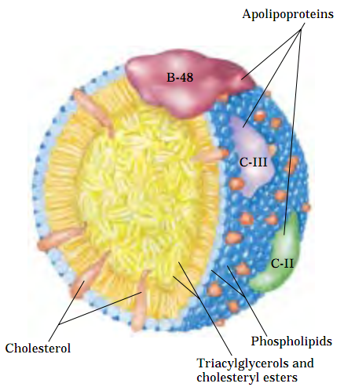
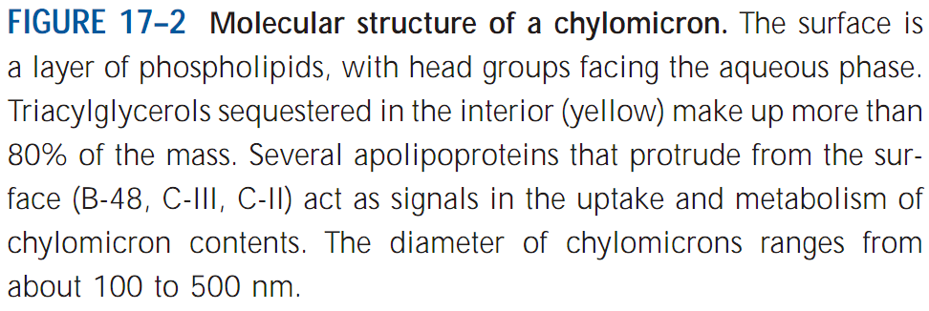
Digestion, Mobilization & Transport of Fats
Molecular Structure of a Chylomicron that carries Triacylglycerols in circulation
No question in exam from this slide.

Slide 7
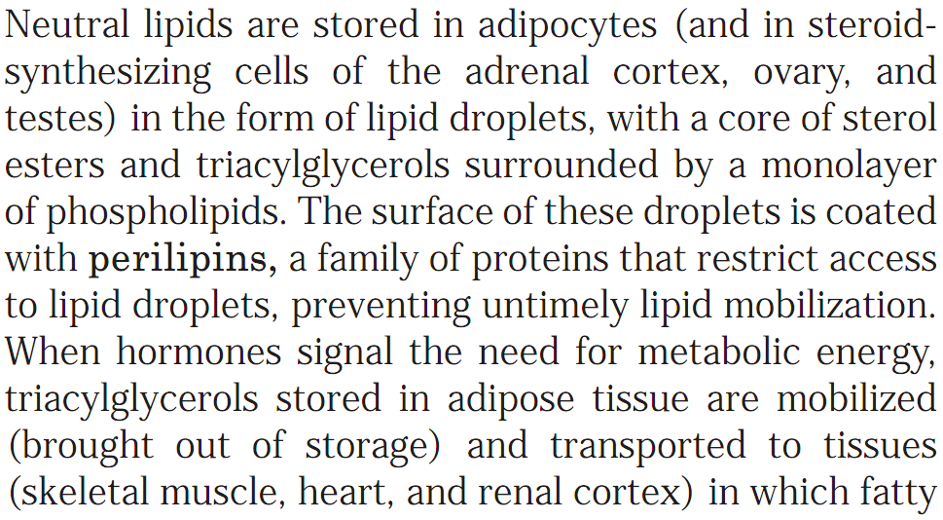
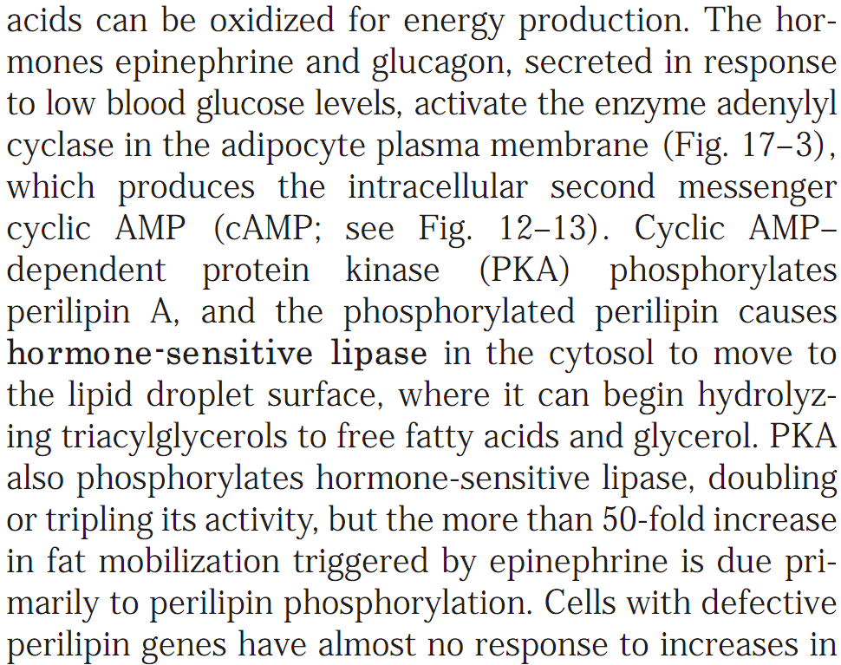
Digestion, Mobilization & Transport of Fats
Hormones trigger mobilization of stored Triacylglycerols
Q1. Name three types of cells where neutral lipids are stored.
Q2. Name the protein that coats the surface of lipid droplets in cells. What is the function of this protein?
Q3. How mobilization of stored triacylglycerols stored in adipost tissue is initiated?

Slide 8
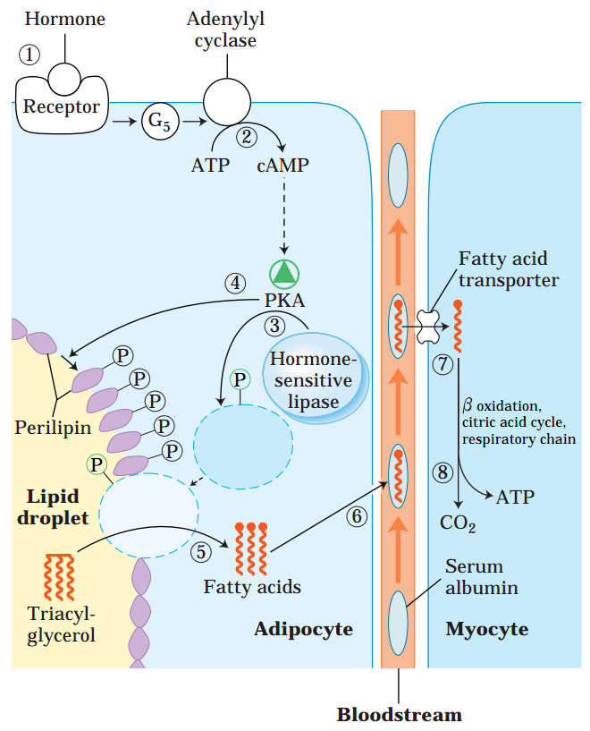
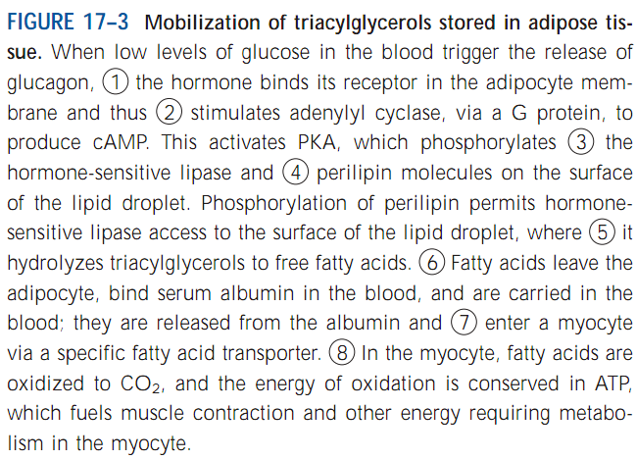
Digestion, Mobilization & Transport of Fats
Hormones trigger mobilization of stored Triacylglycerols
Q1. Diagrammatically show the mobilization of triacylglycerols stored in adipose tissue in response to hormone.
Q2. Name a hormone that can trigger mobilization of stored TAGs. (Answer: Glucagon).
Q3. Which protein phosphorylates perilipins and hormone-sensitive lipase? (Answer: Protein kinase A).
Q4. What is the consequence of the phosphorylation of perilipin on the surface of lipid droplets?
Q5. What is the role of hormone-sensitive lipase in mobilizing stored TAGs?
Q6. Which protein carries fatty acids to peripheral tissues through blood?
Q7. What is the purpose of delivering fatty acids to myocytes (muscle cells) from adipocytes after glucagon-triggered mobilization of stored TAGs?
(Answer: To make ATPs)

Slide 9
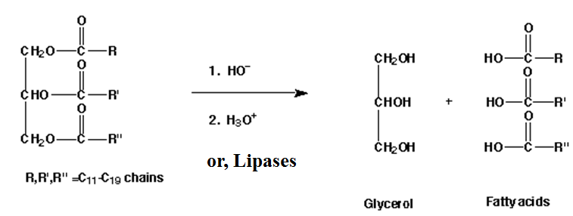
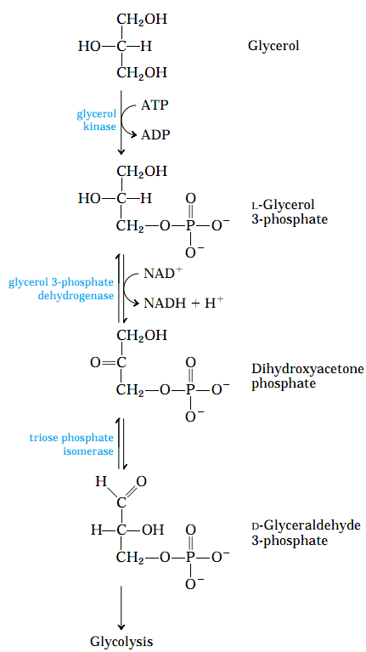
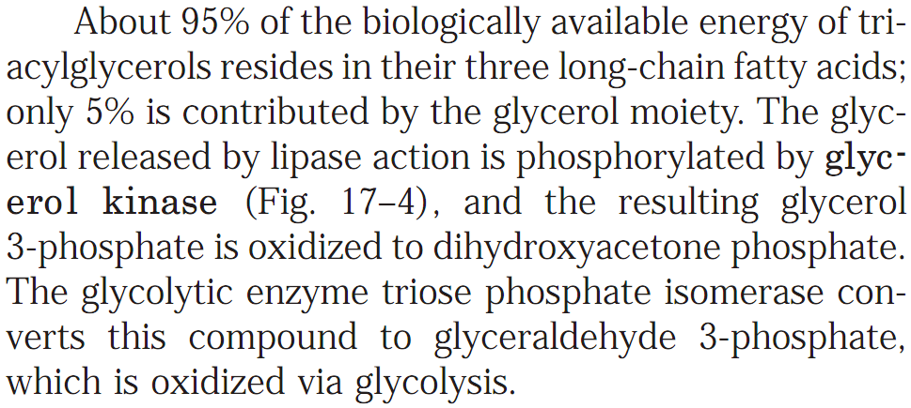
What happens to Glycerol released from TAGs after lipase action?
Hormones trigger mobilization of stored Triacylglycerols: Fate of Glycerol
Triacylglycerol (TAG)
Q1. Schematically show how glycerol can enter glycolytic pathway.
Q2. Name the enzyme that phosphorylates glycerol that has been released from triacylglycerols by lipases.
Q3. What is the contribution of the glycerol moiety of the triacylglycerols with respect to biologically available energy?

Slide 10
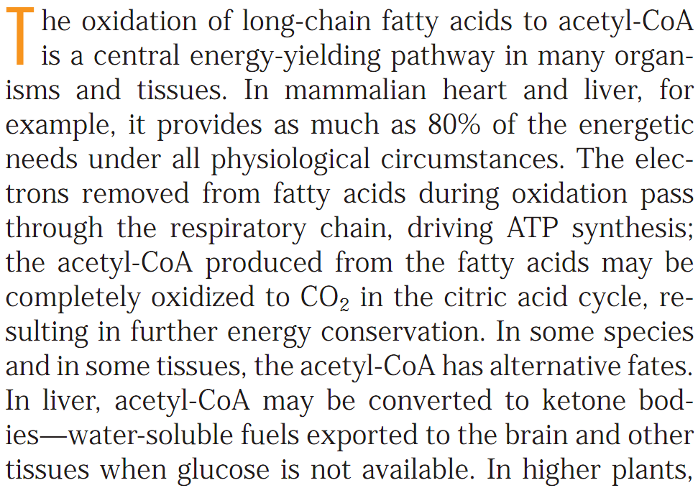
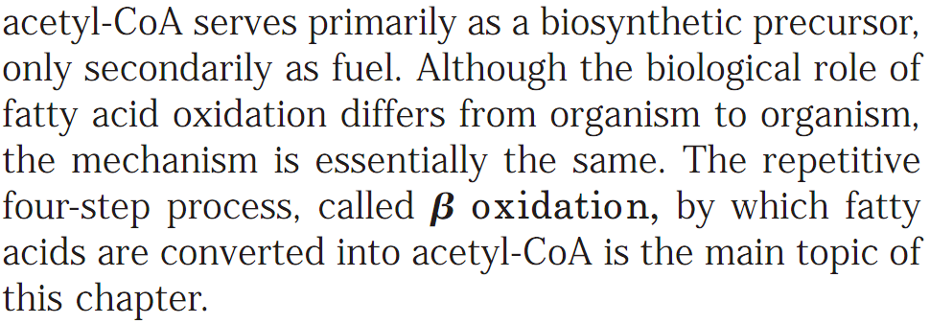
β-Oxidation of Fatty Acids to provide energy
The Degradation process of Fatty Acids to provide energy is called β-oxidation
Q1. Which catabolic pathway provides 80% of the energetic needs under all physiological circumstances in mammalian heart and liver?
Q2. What is the ultimate purpose of fatty acid oxidation? (Answer: To make ATPs)
Q3. What are the alternative source of fuels that can be used by brain in the absence of glucose? (Answer: Ketone bodies)
Q4. Is the mechanism of fatty acid oxidation common in different organisms? (Answer: Yes)
Q5. What is the name of the process by which fatty acids are converted into acetyl-CoA? (Answer: β-oxidation)

Slide 11
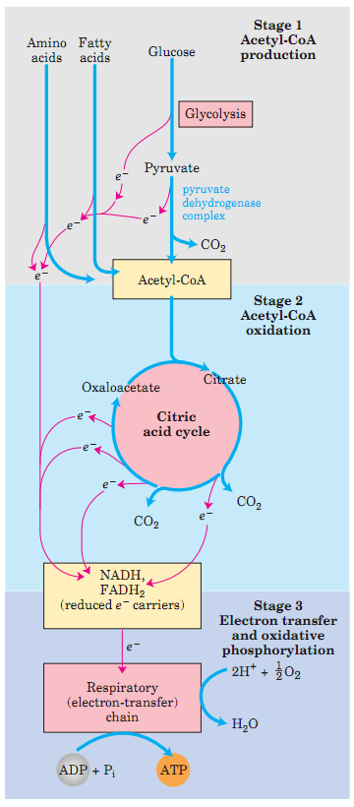
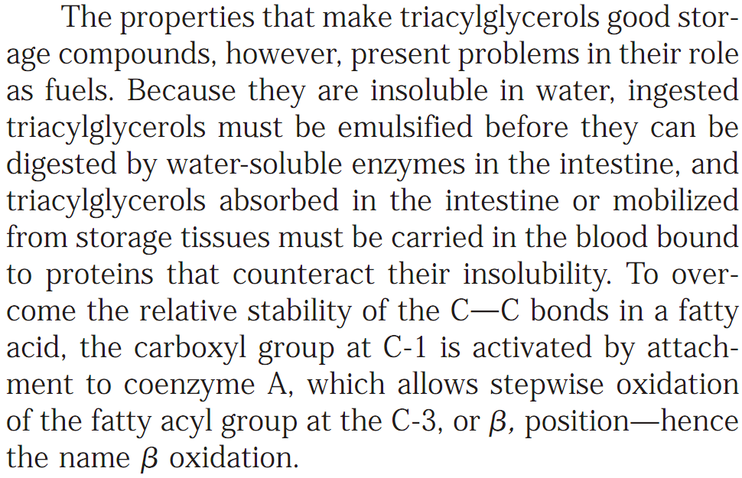
Fatty Acid Oxidation
The Degradation process of Fatty Acids to provide energy is called β-oxidation
A fatty acyl-CoA
Q1. Why attachment of coenzyme A to the C-1 of carboxyl group of fatty acid is important?

Slide 12
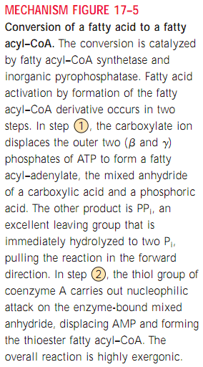
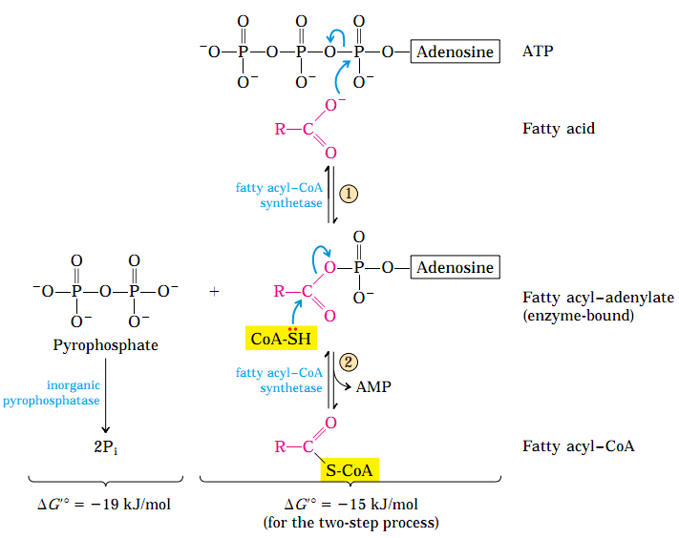
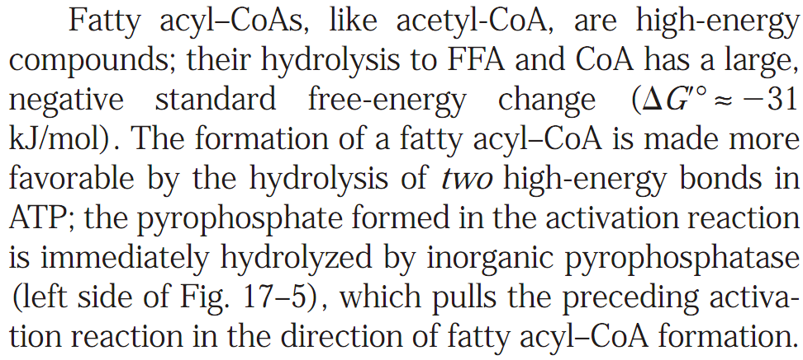
Activation of Fatty Acids for Oxidation Catabolism
Fatty Acids are activated for oxidation by the addition of Coenzyme A
The fatty acid activation is catalyzed by a family of isozymes present in the outer mitochondrial membrane, the acyl-CoA synthetases, which promote the general reaction:
Thus, acyl-CoA synthetases catalyze the formation of a thioester linkage between the fatty acid carboxyl group and the thiol group of coenzyme A to yield a fatty acyl–CoA, coupled to the cleavage of ATP to AMP and PP_{i}.
Q1. Show the general reaction of fatty acid oxidation by acyl-CoA synthetase.
Q2. What is the driving force behind the formation of fatty acyl-CoA from the fatty acids by acyl-CoA synthetases?
(Answer: hydrolysis of pyrophosphates)
No question in exam on Figure 17-5 of this slide.

Slide 13
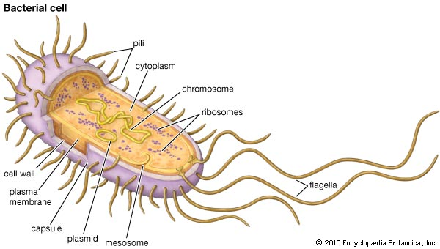
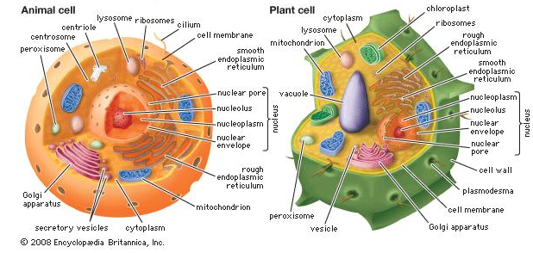
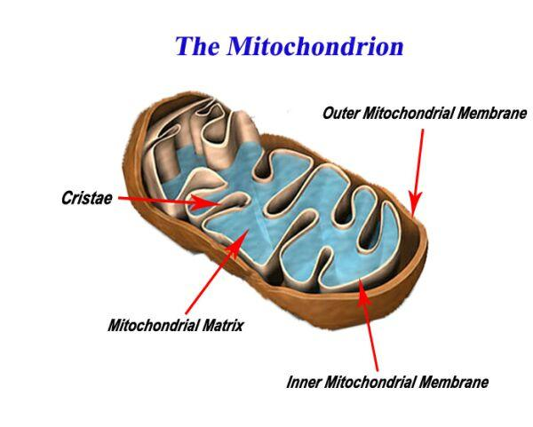
Localization of Enzymes for Fatty Acid Oxidation
Fatty Acid oxidation takes place in mitochondria of animal cells
The enzymes of fatty acid oxidation in animal cells are located in the mitochondrial matrix. In plants, fatty acid oxidation primarily takes place in the peroxisomes.
In bacteria, fatty acid oxidation takes place in the plasma membrane.
https://www.britannica.com/science/bacteria
https://www.britannica.com/science/peroxisome
In Animal cells:
Q1. Where does fatty acid oxidation take place in (i) animal cells, (ii) plant cells, (iii) bacterial cells?
Q2. Where in an animal cell the enzymes for fatty oxidation are localized? (Answer: Mitochondrial matrix)
https://www.studyblue.com/notes/note/n/bio-220-study-guide-2016-17-thomas/deck/19120459

Slide 14
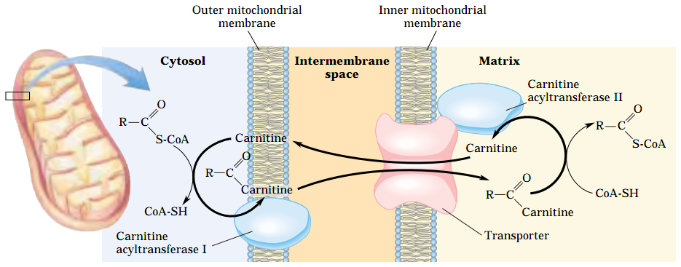
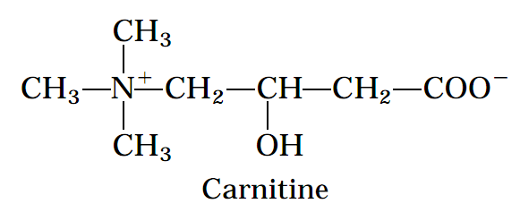
Transport of Activated Fatty Acid to the Mitochondrial Matrix
Fatty Acids are Transported into Mitochondria by the Acyl-Carnitine/Carnitine transporter
The fatty acids with chain lengths of 12 or fewer carbons enter mitochondria without the help of membrane transporters. The fatty acids with 14 or more carbons, which constitute the majority of the FFA obtained in the diet or released from adipose tissue, cannot pass directly through the mitochondrial membranes—they must first undergo the three enzymatic reactions of the carnitine shuttle.
Q1. Diagrammatically show fatty acid entry into mitochondria via the acyl-carnitine/carnitine transporter.
Q2. Draw the structure of carnitine.
Q3. What is the rate-limiting step of fatty acid oxidation?
Q4. Why the carnitine-mediated entry process of fatty acid into mitochondria is the rarte-limiting step of fatty acid oxidation?
The carnitine-mediated entry process is the rate-limiting step for oxidation of fatty acids in mitochondria and, as discussed later, is a regulation point. Once inside the mitochondrion, the fatty acyl–CoA is acted upon by a set of enzymes in the matrix.

Slide 15
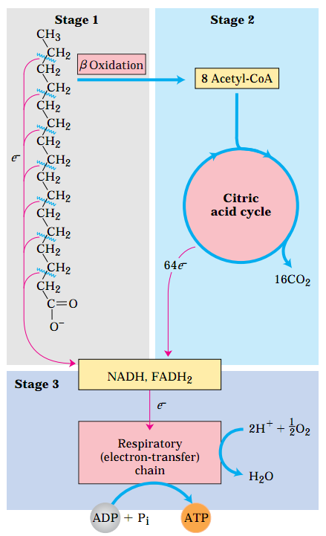
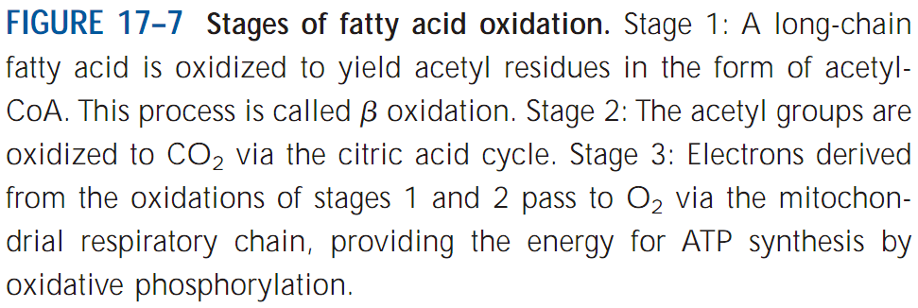
Fatty Acid Catabolism
There are three stages of β-Oxidation of Fatty Acids
Q1. Diagrammatically show the different stages of fatty acid β-oxidation that results in the formation of ATP and CO₂.

Slide 16
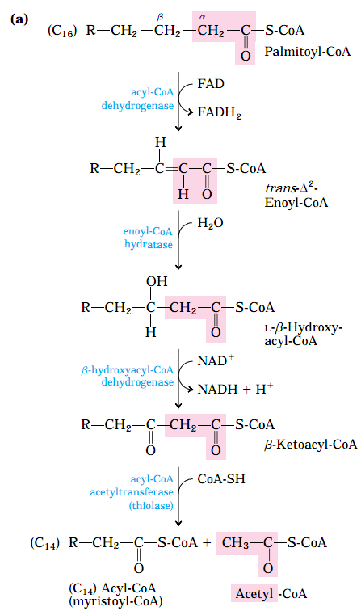
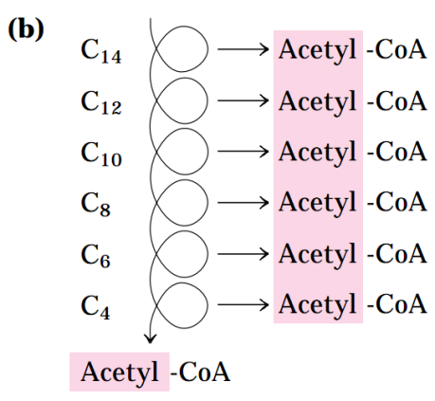
Fatty Acid Catabolism
β-Oxidation of Fatty Acids
From 1 molecule of FADH₂ and NADH, 1.5 and 2.5 molecules of ATP are formed by electron transfer and oxidative phosphorylation, respectively. Thus four molecules of ATP are formed for each two-carbon unit removed in one pass through the sequence.
Q1. Show how eight acetyl-CoA molecules are formed from the oxidation of one molecule of palmitoyl-CoA.
[Answer: Both (a) and (b) of Figure 17-8 with the name of the enzymes]
Q2. Write the overall equation of the formation of FADH₂ and NADH from the oxidation of one molecule of palmitoyl-CoA.

Slide 17
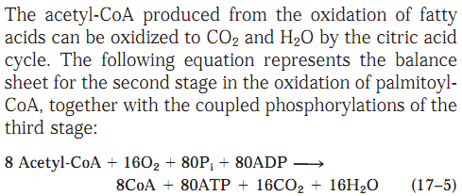
Fatty Acid Catabolism
β-Oxidation of Fatty Acids
Q1. Write equations to show how 108 ATP molecules can be formed from oxidation of one palmotoyl-CoA molecule.

Slide 18
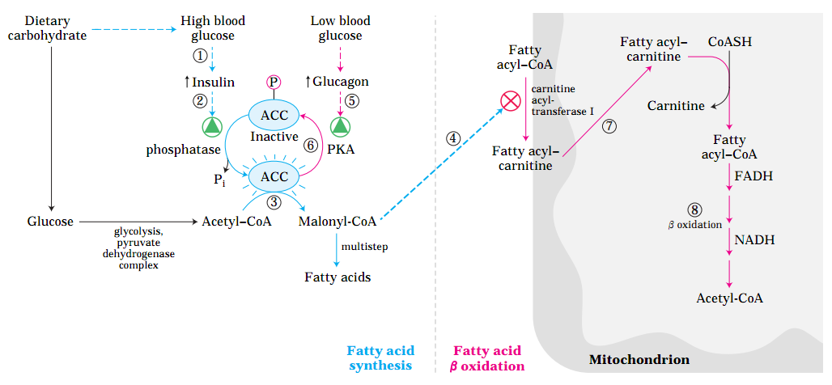
Fatty Acid Catabolism
β-Oxidation of Fatty Acids
Malonyl-CoA, the first intermediate in the cytosolic biosynthesis of long-chain fatty acids from acetyl-CoA
(see Fig. 21–1), increases in concentration whenever the animal is well supplied with carbohydrate; excess
glucose that cannot be oxidized or stored as glycogen is converted in the cytosol into fatty acids for storage
as triacylglycerol. The inhibition of carnitine acyltransferase I by malonyl-CoA ensures that the oxidation of fatty acids is inhibited whenever the liver is amply supplied with glucose as fuel and is actively making triacylglycerols from excess glucose.
Q1. Which intermediate of fatty acid biosynthesis regulates fatty acid oxidation?
No question in exam from the image of this slide.

Slide 19
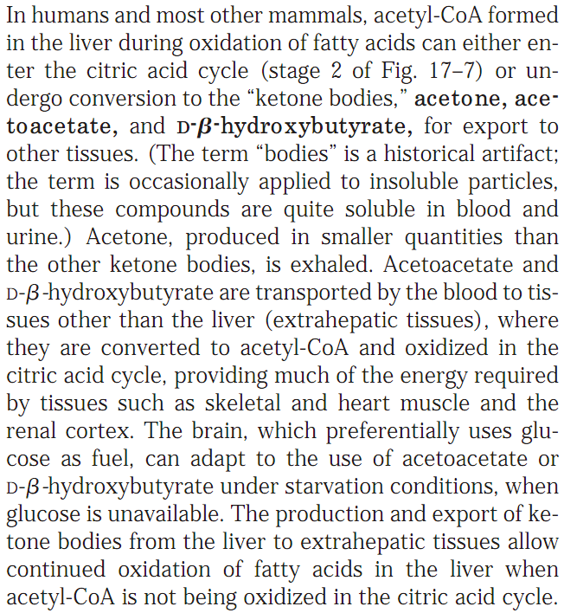
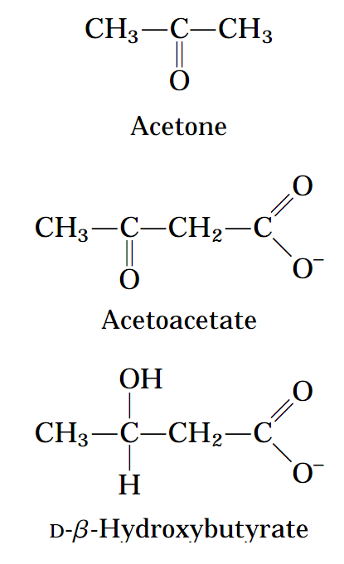
Fatty Acid Catabolism
Ketone Bodies
Q1. What are “ketone bodies”?
Q2. Write the names and draw the structures of all three “ketone bodies”.
Q3. Which fuel other than glucose brain can use during starvation?

Slide 20
Next Lecture: Overview of Metabolic Pathways-IV
Reference Textbook: Lehninger Principles of Biochemistry
4th or 5th Edition
Chapters 14-23
David L. Nelson, Michael M. Cox WH Freeman & Company,
New York, USA

