Slide 1
Lehninger
Principles of Biochemistry
Chapter 14-23
Overview of Metabolic Pathways-I
Lecture 13

Slide 2
Chapter 14
Carbohydrate Metabolism:
Glycolysis, Gluconeogenesis & the Pentose phosphate pathway

Slide 3
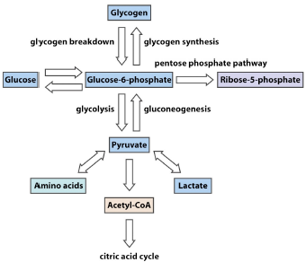

Slide 4
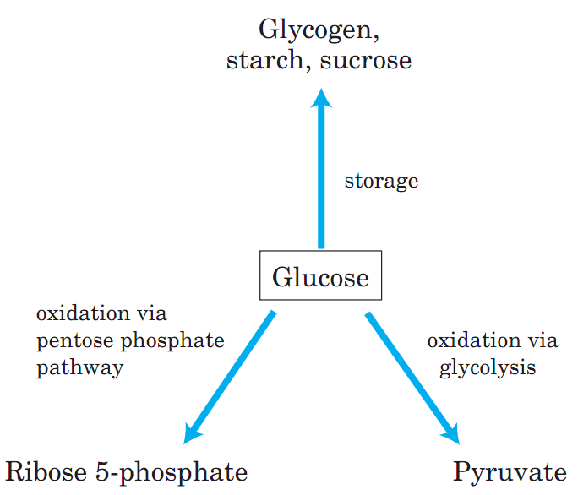
Carbohydrate Metabolism
Fates of Glucose
Glucose occupies a central position in the metabolism of plants, animals, and many microorganisms.
It is relatively rich in potential energy, and thus a good fuel; the complete oxidation of glucose to
carbon dioxide and water proceeds with a standard free-energy change of 2,840 kJ/mol.
In animals and vascular plants, glucose has three major fates:
it may be stored (as a polysaccharide or as sucrose);
oxidized to a three-carbon compound (pyruvate) via glycolysis to provide ATP and metabolic intermediates; or
oxidized via the pentose phosphate pathway to yield ribose 5-phosphate for nucleic acid synthesis and NADPH for reductive biosynthetic processes (Fig. 14–1).
Q1. What are the three major fates of glucose in animals?
Q2. Diagrammatically show the major pathways for glucose utilization in animals.

Slide 5
Carbohydrate Metabolism
Glycolysis
In glycolysis (from the Greek glykys, meaning “sweet,” and lysis, meaning “splitting”), a molecule of glucose is degraded in a series of enzyme-catalyzed reactions to yield two molecules of the three-carbon compound pyruvate. During the sequential reactions of glycolysis, some of the free energy released from glucose is conserved in the form of ATP and NADH.
Glycolysis is an almost universal central pathway of glucose catabolism, the pathway with the largest flux of carbon in most cells. The glycolytic breakdown of glucose is the sole source of metabolic energy in some mammalian tissues and cell types (erythrocytes, renal medulla, brain, and sperm, for example).
Some plant tissues that are modified to store starch (such as potato tubers) and some aquatic plants (watercress, for example) derive most of their energy from glycolysis; many anaerobic microorganisms are entirely dependent on glycolysis.
Fermentation is a general term for the anaerobic degradation of glucose or other organic nutrients to obtain energy, conserved as ATP.
Because living organisms first arose in an atmosphere without oxygen, anaerobic breakdown of glucose is probably the most ancient biological mechanism for obtaining energy from organic fuel molecules. In the course of evolution, the chemistry of this reaction sequence has been completely conserved; the glycolytic enzymes of vertebrates are closely similar, in amino acid sequence and three-dimensional structure, to their homologs in yeast and spinach.
Glycolysis differs among species (i) in the details of its regulation and (ii) in the subsequent metabolic fate of the pyruvate formed.
Q1. What is glycolysis?
Q2. Why glycolysis is very important for some mammalian tissues?
Q3. What is fermentation?
Q4. Is glycolysis an evolutionarily conserved pathway?
Q5. How glycolysis can differ among species?

Slide 6
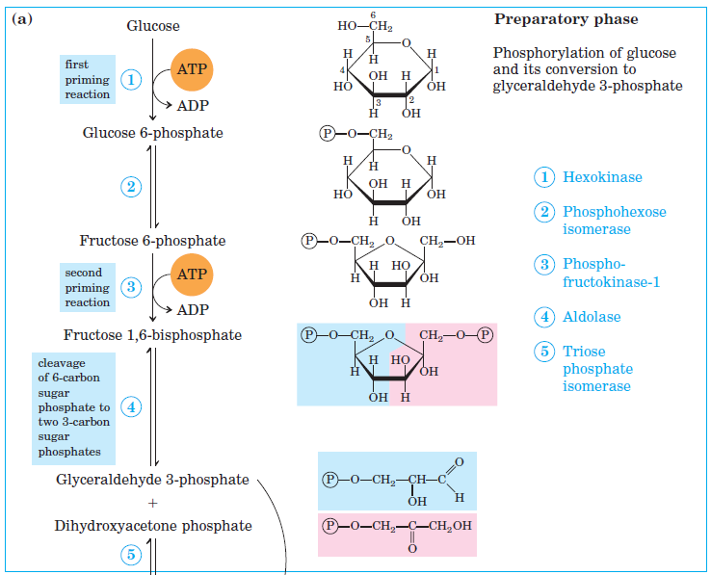
Carbohydrate Metabolism
Glycolysis has Two Phases: Preparatory phase & Pay-off phase
The breakdown of the six-carbon glucose into two molecules of the three-carbon pyruvate occurs in ten steps, the first five of which constitute the preparatory phase (Fig. 14–2a).
(irreversible)
(irreversible)
Q1. Show the reactions at the preparatory phase of glycolysis with the name of the enzymes.

Slide 7
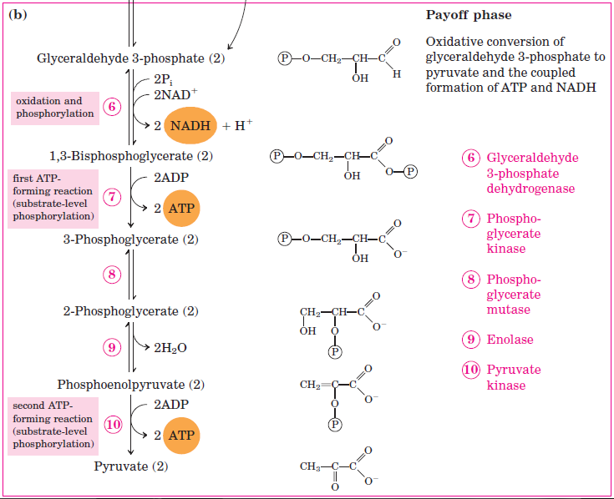
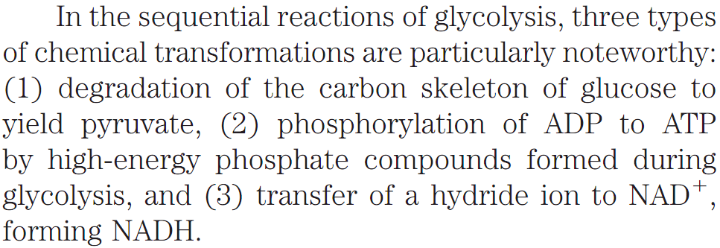
Carbohydrate Metabolism
Glycolysis has Two Phases: Preparatory phase & Pay-off phase
The energy gain comes in the payoff phase of glycolysis (Fig. 14–2b).
(irreversible)
(irreversible)
Q1. Show the reactions at the preparatory phase of glycolysis with the name of the enzymes.
Q2. Schematically show all the steps of glycolysis with both the name of the enzymes and the structures of the intermediates.
Q3. Name the enzymes that catalyze the four irreversible steps of glycolysis.
Q4. What is the net yield of ATP in glycolysis?
Q5. What are the three major types of reactions in glycolysis?

Slide 8
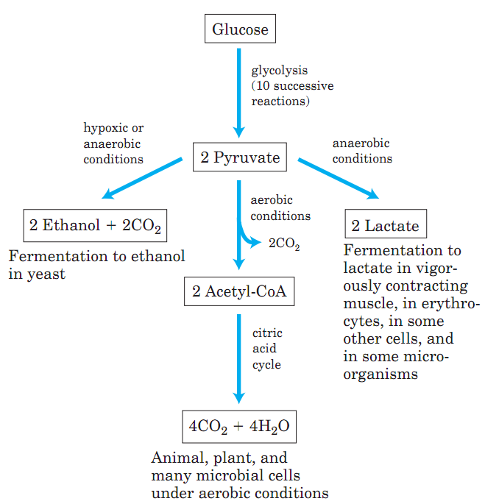
Carbohydrate Metabolism
Three Possible Catabolic Fates of Pyruvate
The pyruvate formed by glycolysis is further metabolized via one of three catabolic routes.
Fate 1: In aerobic organisms or tissues, under aerobic conditions, glycolysis is only the first stage in the complete degradation of glucose (Fig. 14–3). Pyruvate is oxidized, with loss of its carboxyl group as CO₂, to yield the acetyl group of acetyl-coenzyme A; the acetyl group is then oxidized completely to CO₂ by the citric acid cycle (Chapter 16). The electrons from these oxidations are passed to O₂ through a chain of carriers in the mitochondrion, to form H₂O. The energy from the electron-transfer reactions drives the synthesis of ATP in the mitochondrion (Chapter 19).
Fate 3
Fate 1
Fate 2
Fate 2: The second route for pyruvate is its reduction to
lactate via lactic acid fermentation. Certain tissues and cell types (retina and erythrocytes, for example) convert glucose to lactate even under aerobic conditions, and lactate is also the product of glycolysis under anaerobic conditions in some microorganisms (Fig. 14–3).
Fate 3: The third major route of pyruvate catabolism leads
to ethanol. In some plant tissues and in certain invertebrates, protists, and microorganisms such as brewer’s yeast, pyruvate is converted under hypoxic or anaerobic conditions into ethanol and CO2, a process called ethanol (alcohol) fermentation (Fig. 14–3).
The oxidation of pyruvate is an important catabolic process, but pyruvate has anabolic fates as well. It can, for example, provide the carbon skeleton for the synthesis of the amino acid alanine.
Q1. Discuss the fates of pyruvate formed in glycolysis.
Q2. Diagrammatically show the three possible catabolic fates of pyruvate.
Q3. Can pyruvate be anabolic? Give example.

Slide 9
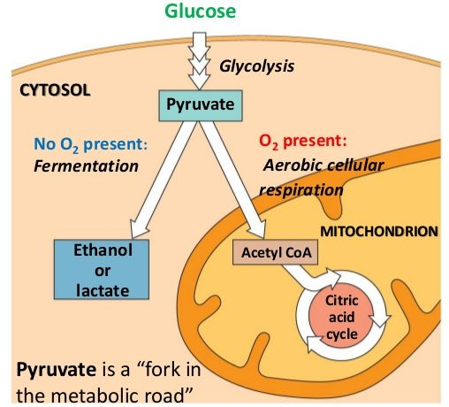
Carbohydrate Metabolism
Glycolysis takes place in cytosol
http://www.cscsquestions.com/cscs-comprehensive-question-sets/glycolysis-questions/
Q1. Where does glycolysis take place in a cell?
Q2. Diagrammatically explain why pyruvate is referred to as a “fork in the metabolic road”?

Slide 10
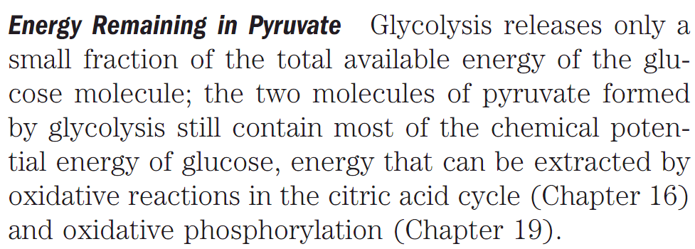
Carbohydrate Metabolism
2 ATPs are generated by degradation of 1 glucose molecule by glycolysis
The overall equation for glycolysis is:
For each molecule of glucose degraded to pyruvate, two molecules of ATP are generated from ADP and Pi.
Q1. Write the overall equation for glycolysis.
Q2. How many ATP molecules are generated after degradation of one glucose molecule by glycolysis?
Q3. Name the pathways that can extract all the potential chemical energy from one molecule of glucose.

Slide 11
Carbohydrate Metabolism
Gluconeogenesis
In mammals, some tissues depend almost completely on glucose for their metabolic energy.
For the human brain and nervous system, as well as the erythrocytes, testes, renal medulla, and embryonic tissues, glucose from the blood is the sole or major fuel source. The brain alone requires about 120 g of glucose each day—more than half of all the glucose stored as glycogen in muscle and liver.
However, the supply of glucose from these stores is not always sufficient; between meals and during longer fasts, or after vigorous exercise, glycogen is depleted. For these times, organisms need a method for synthesizing glucose from
non-carbohydrate precursors.
This is accomplished by a pathway called gluconeogenesis (“formation of new sugar”).
Gluconeogenesis pathway converts pyruvate and related three- and four-carbon compounds to glucose.
Q1. What is gluconeogenesis?
Q2. What is the biological significance of gluconeogenesis?

Slide 12
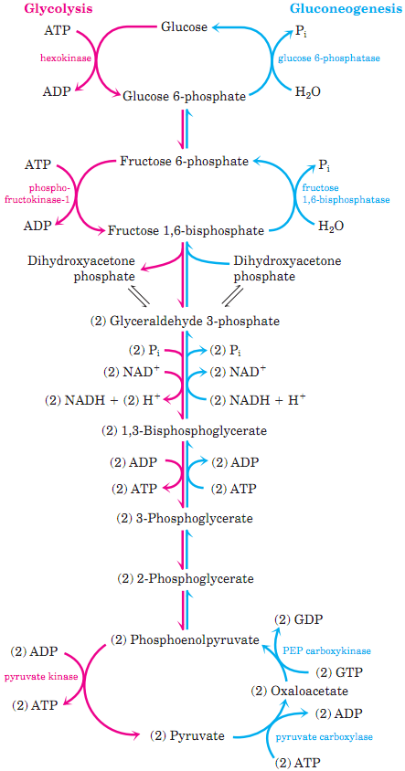
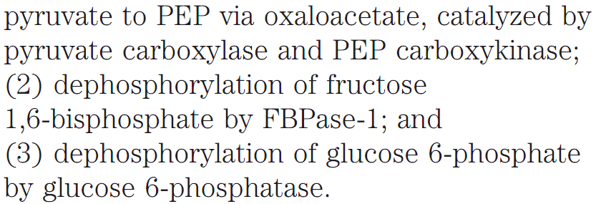
Carbohydrate Metabolism
Steps of Glycolysis that are bypassed during Gluconeogenesis
Q1. Schematically show the opposing pathways of glycolysis and gluconeogenesis with the names of the enzymes catalyzing the irreversible steps.
Q2. What are the steps of glycolysis that are bypassed during gluconeogenesis? Is gluconeogenesis expensive?
Q3. What is the use of the glucose generated by gluconeogenesis in mammals?
Q4. Can animals convert acetyl-CoA derived from fatty acids into glucose?
Q5. How wasteful operation of glycolysis and gluconeogenesis at the same time are prevented?

Slide 13
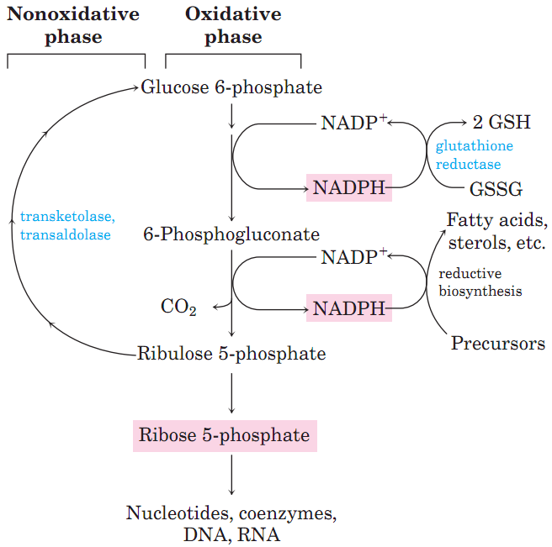
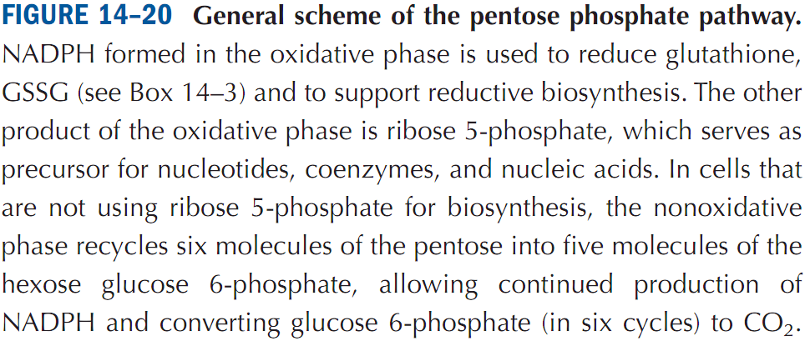
Carbohydrate Metabolism
Pentose Phosphate Pathway of Glucose Oxidation
In some tissues, glucose 6-phosphate is oxidized to pentose phosphates by the pentose phosphate pathway (also called the phosphogluconate pathway or the hexose monophosphate pathway; Fig. 14–20).
In pentose phosphate pathway, NADP⁺ is the electron acceptor, yielding NADPH. Rapidly dividing cells, such as those of bone marrow, skin, and intestinal mucosa, use the pentoses to make RNA, DNA, and such coenzymes as ATP, NADH, FADH₂, and coenzyme A.
In other tissues, the essential product of the
pentose phosphate pathway is not the pentoses but the electron donor NADPH, needed for reductive biosynthesis (e.g., in liver) or to counter the damaging effects of oxygen radicals (e.g., in erythrocytes).
Q1. Schematically show the general steps of the pentose phosphate pathway.
Q2. What is pentose phosphate pathway?
Q3. Write two biological significance of the pentose phosphate pathway.

Slide 14
Chapter 15
Carbohydrate Metabolism:
Glycogenolysis & Glycogenesis

Slide 15
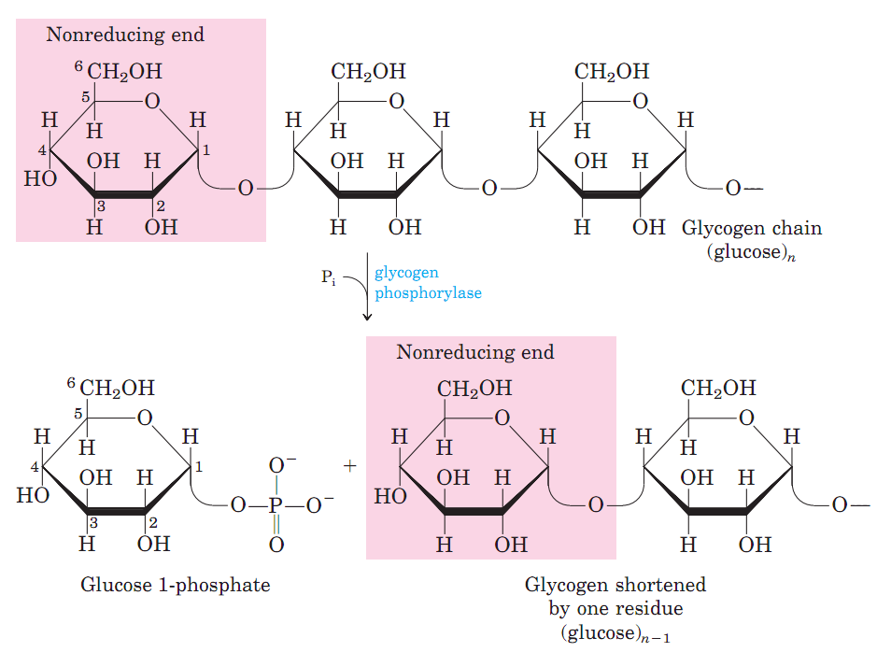
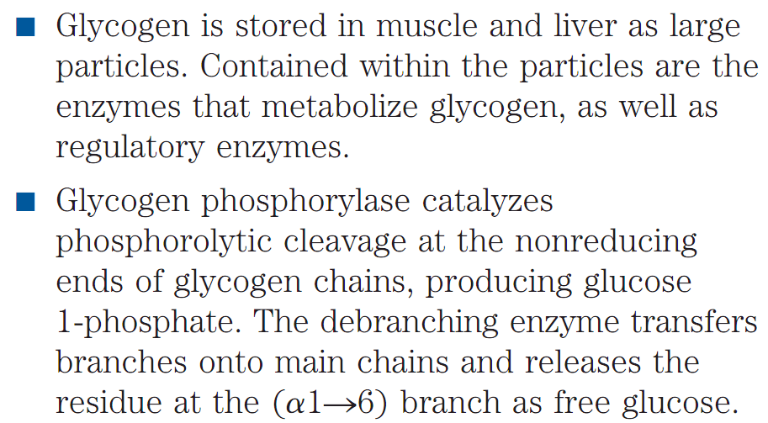
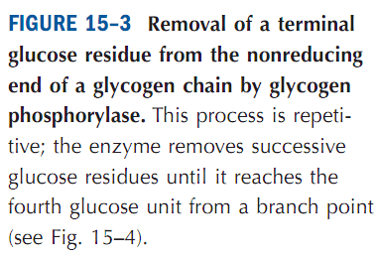
Carbohydrate Metabolism
Glycogenolysis
Glycogenolysis is the breakdown of glycogen (n) to glucose-6-phosphate and glycogen (n-1).
In liver and kidney, Glucose-6-phosphate is converted into glucose by Glucose-6-phosphatase to maintain blood glucose (e.g., in between meals).
Q1. What is glycogenolysis?
Q2. Where is glycogen stored in human body?
Q3. Which enzyme removes terminal glucose from glycogen?
Q4. Which enzyme converts Glucose-1-phosphate generated during glycogenolysis to Glucose-6-phosphate?
Q5. Which enzyme of liver and kidney helps maintain blood glucose level in fasting condition?

Slide 16
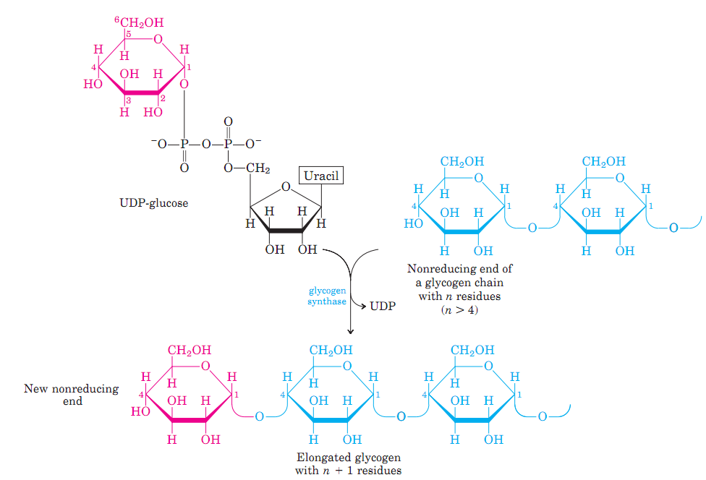
Carbohydrate Metabolism
Glycogenesis
Glycogenesis is the process of glycogen synthesis, in which glucose molecules are added to chains of glycogen for storage.
Q1. What is glycogenesis?
Q2. Which enzyme catalyzes the synthesis of glycogen?
Q3. Schematically show how glycogen chain is elongated by glycogen synthase.

Slide 17
Carbohydrate Metabolism
Summary of interaction of Glucose-metabolizing pathways in Animals
Glycogen
Glycogenolysis
Glycogenesis
Lactate or Ethanol
Starch
Anaerobic glycolysis
Digestion,
Absorption
Glucose
Aerobic glycolysis
Gluconeogenesis
Pentose phosphate pathway
Pyruvate
H₂O+CO₂
Lactate, Amino Acids, Glycerol
Ribose, NADPH
Q1. Schematically show the summary of interaction of glucose-metabolizing pathways in animals.

Slide 18
Next Lecture: Overview of Metabolic Pathways-II
Reference Textbook: Lehninger Principles of Biochemistry
4th or 5th Edition
Chapters 14-23
David L. Nelson, Michael M. Cox WH Freeman & Company,
New York, USA

