Slide 1
Introduction to Biochemistry & Biotechnology
Lecture #12

Slide 2
Lehninger
Principles of Biochemistry
Chapter 13
Bioenergetics

Slide 3
Bioenergetics
Bioenergetics is the quantitative study of the energy
transductions that occur in living cells.
Q1. What is bioenergetics?

Slide 4
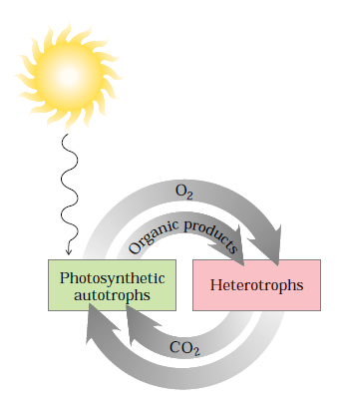
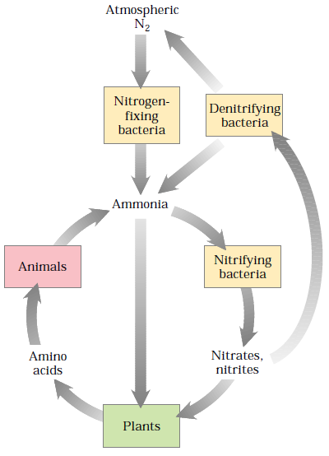
Bioenergetics
Bioenergetics & Metabolism
Carbon, oxygen, and water are constantly cycled between the heterotrophic and autotrophic worlds, with solar energy as the driving force for this global process (Fig. 1).
Only a few organisms—the cyanobacteria and many species of soil bacteria that live symbiotically on the roots of some plants—are capable of converting (“fixing”) atmospheric nitrogen (N₂) into ammonia.
The cycling of carbon, oxygen, and nitrogen, which ultimately involves all species, depends on a proper balance between the activities of the producers (autotrophs) and consumers (heterotrophs)
in our biosphere.
Q1. Explain how carbon and oxygen are cycled in biosphere.
Q2. Explain how nitrogen is cycled in biosphere.

Slide 5
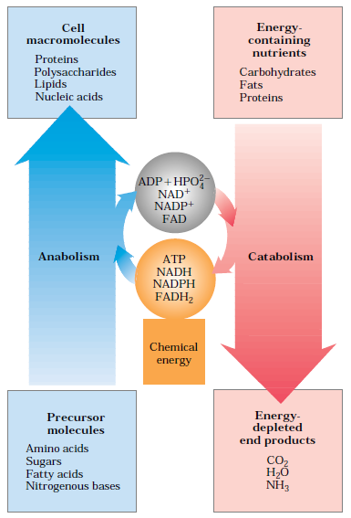
Bioenergetics
Bioenergetics & Metabolism
Metabolism: Metabolism is the sum of all the chemical transformations taking place in a cell or organism.
Metabolic pathways: Metabolism occurs through a series of enzyme-catalyzed reactions that constitute metabolic pathways.
Catabolism is the degradative phase of metabolism in which organic nutrient molecules (carbohydrates, fats, and proteins) are converted into smaller, simpler end products (such as lactic acid, CO₂, NH₃). Catabolic pathways release energy, some of which is conserved in the formation of ATP and reduced electron carriers (NADH, NADPH, and FADH₂); the rest is lost as heat.
In anabolism, also called biosynthesis, small, simple precursors are built up into larger and more complex molecules, including lipids, polysaccharides, proteins, and nucleic acids. Anabolic reactions require an input of energy, generally in the form of the phosphoryl group transfer potential of ATP and the reducing power of NADH, NADPH, and FADH₂ (Fig. 3).
Q1. Schematically explain the energy relationships between catabolic and anabolic pathways.

Slide 6
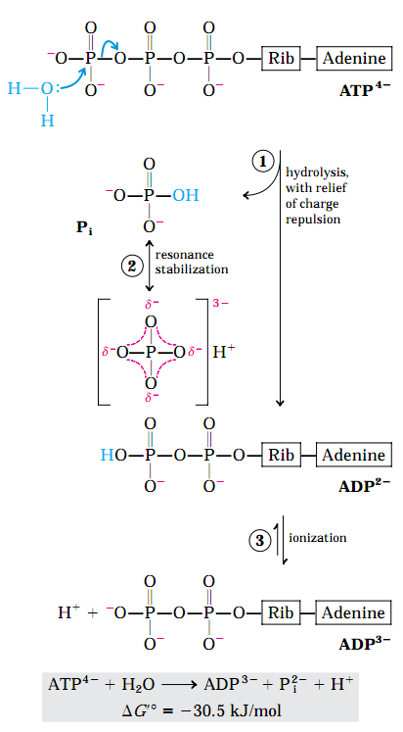
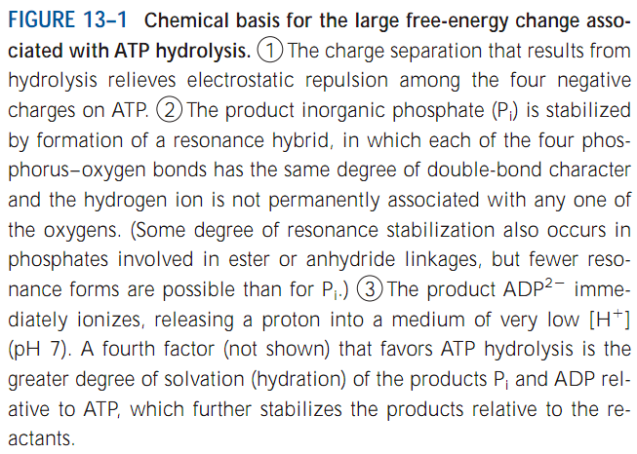
Bioenergetics
ATP provides energy by group transfers in living cells
ATP hydrolysis per se usually accomplishes nothing but the liberation of heat, which cannot drive a chemical process in an isothermal system.
Direct hydrolysis of ATP is the source of energy in the conformational changes that produce muscle contraction. However, in general, it is not ATP hydrolysis but the transfer of a phosphoryl, pyrophosphoryl, or adenylyl group from ATP to a substrate or enzyme molecule that couples the energy of ATP breakdown to endergonic transformations of substrates.
Q1. Schematically explain the chemical basis for the large free-energy change associated with ATP hydrolysis.

Slide 7
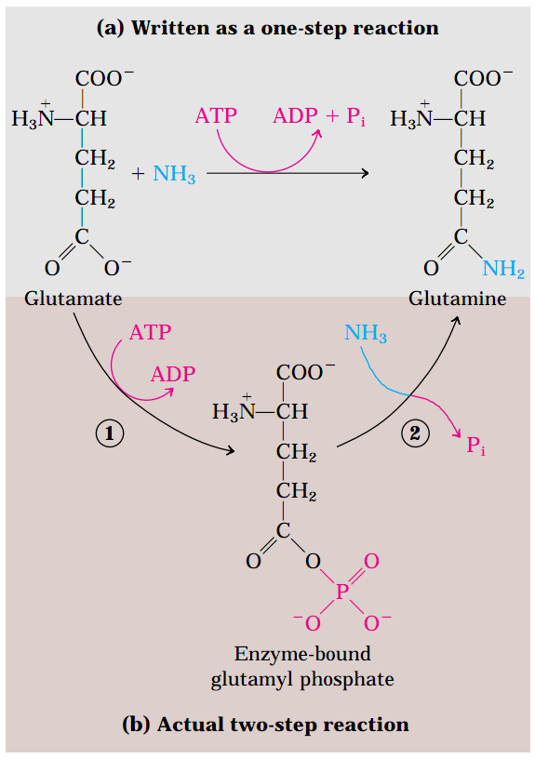
Bioenergetics
ATP provides energy by group transfers in living cells
ATP hydrolysis per se usually accomplishes nothing but the liberation of heat, which cannot drive a chemical process.
A single reaction arrow such as that in Figure 13–8a almost invariably represents a two-step process (Fig. 13–8b) in which part of the ATP molecule, a phosphoryl or pyrophosphoryl group or the adenylate moiety (AMP), is first transferred to a substrate molecule or to an amino acid residue in an enzyme, becoming covalently attached to the substrate or the enzyme and raising its free-energy content. Then, in a second step, the phosphate-
containing moiety transferred in the first step is
displaced, generating P_{i}, PPi, or AMP. Thus ATP participates covalently in the enzyme-catalyzed reaction to which it contributes free energy.
Q1. Schematically explain how ATP provides energy by group transfers in living cells.

Slide 8
Bioenergetics
Biological oxidation-reduction reactions
Many biological oxidation reactions are dehydrogenations in which one or two hydrogen atoms (H⁺+e⁻) are transferred from a substrate to a hydrogen acceptor. Oxidation-reduction reactions in living cells involve specialized electron carriers.
A few types of coenzymes and proteins serve as universal electron carriers. The reduction of these carriers in catabolic processes results in the conservation of free energy released by substrate oxidation.
NAD, NADP, FMN, and FAD are water-soluble coenzymes that undergo reversible oxidation and reduction in many of the electron transfer reactions of metabolism.
Q1. What is the importance of dehydrogenation reactions in biology with respect to energy?

Slide 9
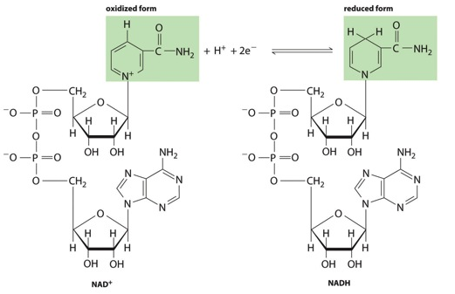
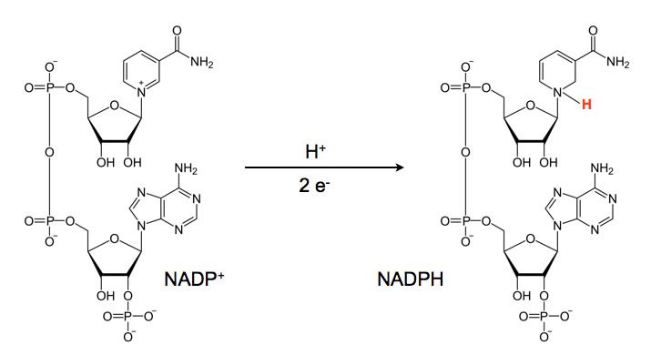
Bioenergetics
Biological oxidation-reduction reactions
The nucleotides NAD and NADP move readily from one enzyme to another. NAD and NADP are the freely diffusible coenzymes of many dehydrogenases. Both NAD and NADP accept two electrons and one proton. the flavin nucleotides FMN and FAD are usually very tightly bound to the enzymes, called flavoproteins, for which they serve as prosthetic groups.
NAD⁺/NADH
NADP⁺/NADPH
Q1. Draw the structures of NAD⁺, NADH, NADP⁺, NADPH.

Slide 10
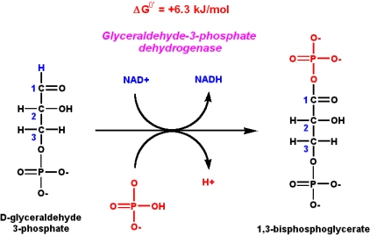
Bioenergetics
Biological oxidation-reduction reactions
Examples of biological reactions involving NAD⁺/NADH or NADP⁺/NADPH:
Example 1:
Example 2:
Q1. Give an example of biological reactions where (1) NAD⁺/NADH; (2) NADP⁺, NADPH are involved.

Slide 11
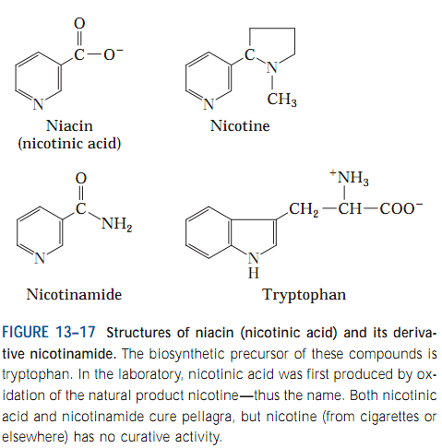
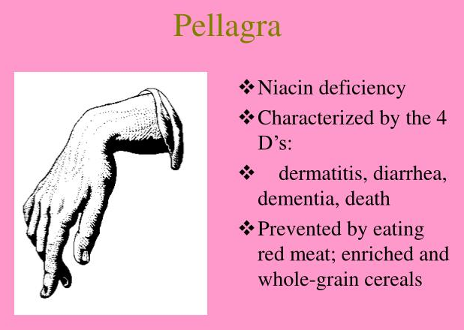
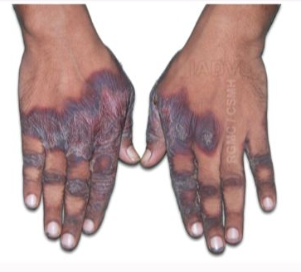
Bioenergetics
Biological oxidation-reduction reactions
The pyridine-like rings of NAD and NADP are derived from the vitamin niacin (nicotinic acid; Fig.
13–17), which is synthesized from tryptophan. Humans generally cannot synthesize niacin in sufficient quantities, and this is especially so for those with diets low in tryptophan (maize, for example, has a low tryptophan content).
In a few places, including the Deccan Plateau in India, pellagra still occurs, especially among the poor.
Q1. What is the precursor of the pyridine-like rings of NAD and NADP?
Q2. What is the importance of tryptophan in diet?
Q3. What causes pellagra? How can it be prevented?
No question in the exam on the structure of nicotine or nicotinamide.

Slide 12
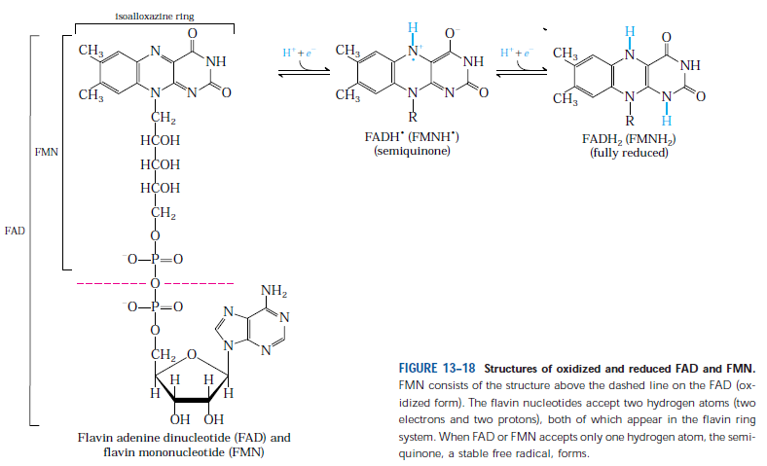
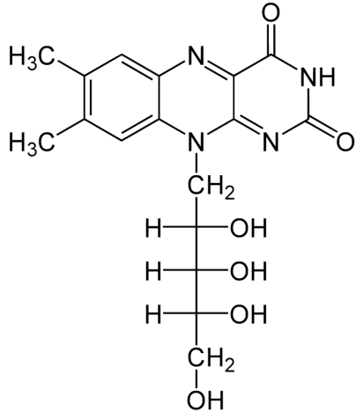
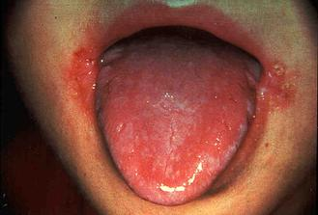
Bioenergetics
Biological oxidation-reduction reactions
FAD and FMN, the flavin nucleotides, serve as tightly bound prosthetic groups of flavoproteins. They can accept either one or two electrons.
Flavoproteins are enzymes that catalyze oxidation-reduction reactions using either flavin
mononucleotide (FMN) or flavin adenine dinucleotide (FAD) as coenzyme (Fig. 13–18). These coenzymes, the flavin nucleotides, are derived from the vitamin riboflavin (vitamin B2).
Riboflavin
Riboflavin deficiency shows symptoms and signs of sore throat, lesions of the lips and mucosa of the mouth etc.
Q1. Draw the structures of riboflavin, FMN, FAD.
Q2. Show how FMN, FAD act as electron carriers.
Q3. What are flavoproteins?
Q4. What are the symptoms of riboflavin deficiency?

Slide 13
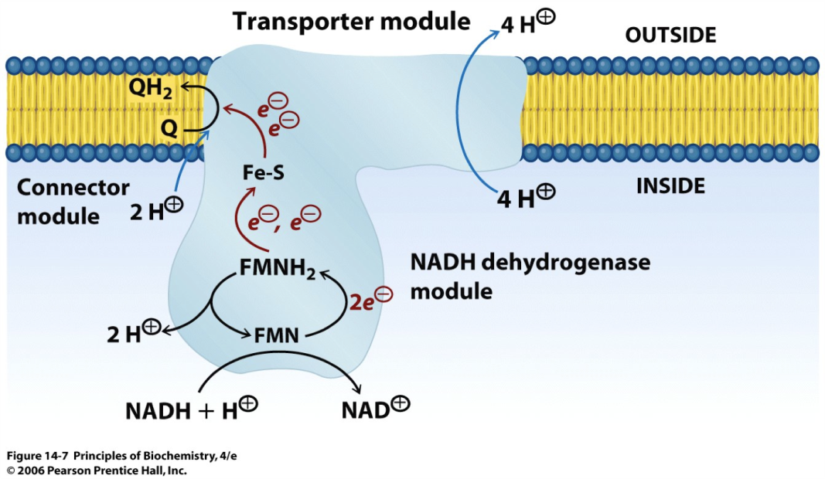
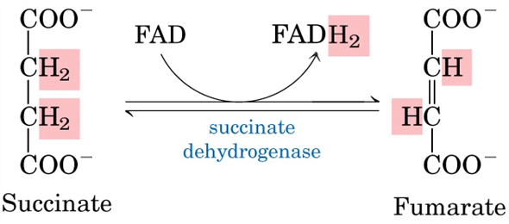
Bioenergetics
Biological oxidation-reduction reactions
Examples of biological reactions involving FAD and FMN:
Example 1:
NADH dehydrogenase I complex with FMN in electron transport chain in mitochondria
Example 2:
Succinate dehydrogenase of citric acid cycle
Q1. Show enzymatic reactions where FMN and FAD are involved.

Slide 14
Next Lecture: Overview of Metabolic Pathways-I
Reference Textbook: Lehninger Principles of Biochemistry
4th or 5th Edition
Chapters 14-23
David L. Nelson, Michael M. Cox WH Freeman & Company,
New York, USA

