Slide 1
Introduction to Biochemistry & Biotechnology
Lecture #11

Slide 2
Lehninger
Principles of Biochemistry
Chapter 12
Bio-signaling

Slide 3
Bio-signaling

Slide 4
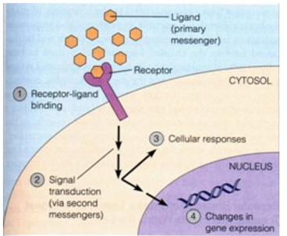
Bio-signaling
Signal Transduction
Signal transduction is the process by which a cell converts an extracellular signal into a response.
The signal represents information that is detected by specific receptors and converted to a cellular response, which always involves a chemical process.
The importance of signal transduction is signal amplification through a cascade of chemical reactions.
Q1. What is signal transduction? What is its importance?
No question in the exam from the image of this slide.

Slide 5
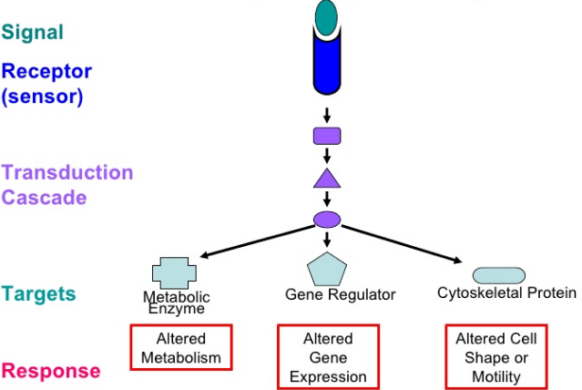
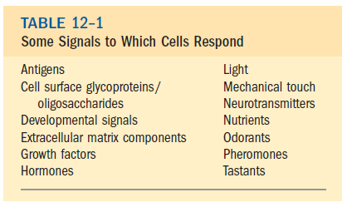
Bio-signaling
Signal Transduction
Generic Signaling Pathway
https://www.slideshare.net/deepikatripathi/cancer-signaltransduction
Q1. Schematically show the generic signaling pathway with their effects.
Q2. Write five different generic signals to which cells respond.

Slide 6
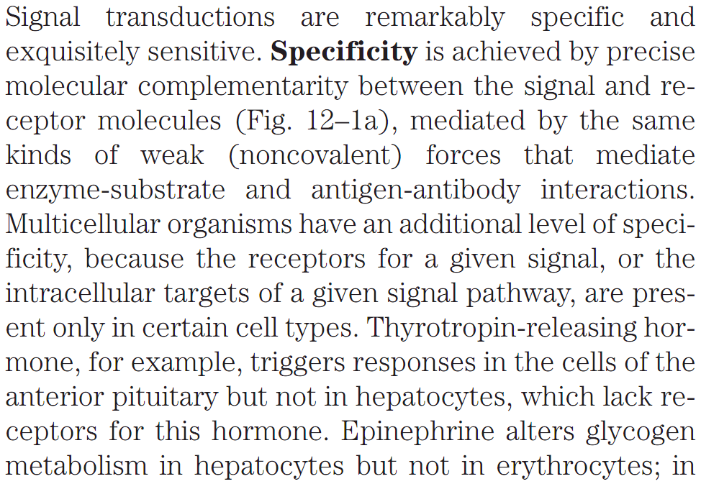
Bio-signaling
Specificity of Signal-Transducing Systems
Q1. How specificity is achieved between signal and receptor molecules?
Q2. What is the additional level of specificity in multicellular organisms with respect to signal transduction? Give example.

Slide 7
Bio-signaling
Factors Affecting Sensitivity of Signal Transducing Systems
Three factors account for the extraordinary sensitivity of signal transducers:
The high affinity of receptors for signal molecules,
Co-operativity (often but not always) in the ligand-receptor interaction, and
Amplification of the signal by enzyme cascades.
Q1. Which factors account for the extraordinary sensitivity of signal transducers?

Slide 8
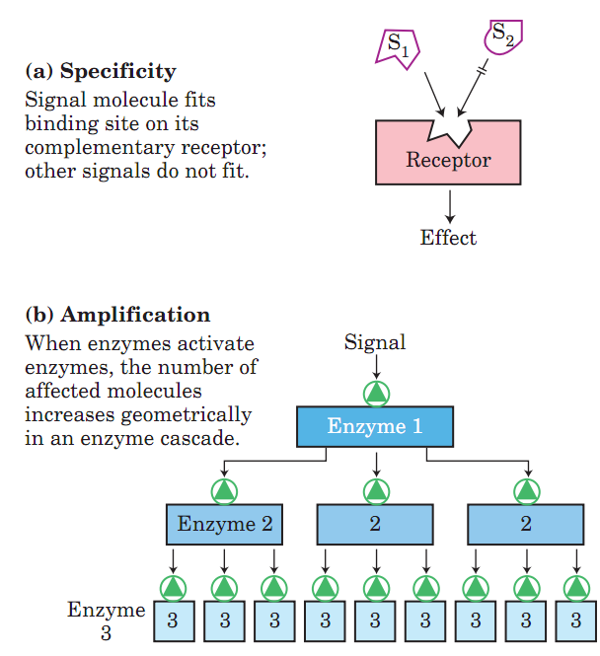
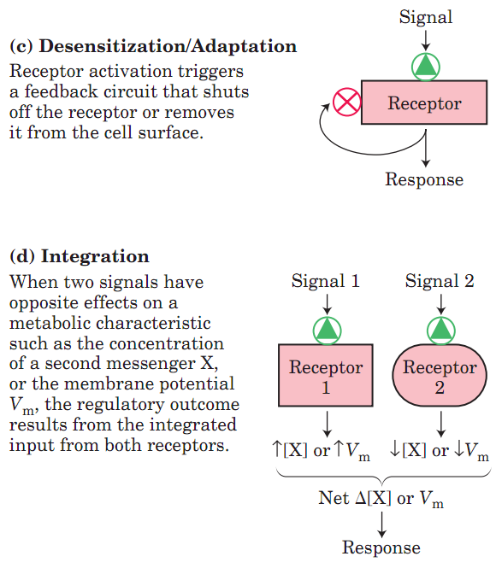
Bio-signaling
Four Features of Signal Transducing Systems
Q1. What are the four major features of signal-transducing systems?
Q2. Diagrammatically show the four major features of signal-transducing systems.

Slide 9
Bio-signaling
Six Different Types of Signal Transduction in Eukaryotes
(1) Signaling by gated ion channel proteins
in plasma membrane
(6) Signaling by adhesion receptor proteins
in plasma membrane
(2) Signaling by receptor proteins
with enzyme activity
in plasma membrane
Types of Signal Transduction in Eukaryotes
(5) Signaling by proteins
in plasma membrane
that attract and activate
cytoplasmic protein kinases
(3) Signaling by serpentine receptor
proteins without enzyme activity
in plasma membrane
(4) Signaling by receptor proteins
in the nucleus
Q1. What are the six different types of signaling mechanisms of eukaryotes?

Slide 10
Bio-signaling
Six Different Types of Signal Transduction in Eukaryotes
Eukaryotic cells have six different types of signaling mechanisms:
Gated ion channels of the plasma membrane open and close (hence the term “gating”) in response to the binding of chemical ligands or changes in transmembrane potential (example: signaling by the acetylcholine receptor ion channel);
Receptor enzymes are plasma membrane receptors that are also enzymes (example: signaling by the insulin receptor);
Serpentine receptor proteins indirectly activate (through GTP-binding proteins, or G proteins) enzymes that generate intracellular second messengers (example: signaling by β-adrenergic receptor system);
Nuclear receptors (steroid receptors), when bound to their specific ligand (such as the hormone estrogen), alter the rate at which specific genes are transcribed and translated into cellular proteins. Nuclear proteins that bind steroids and act as transcription factors (example: signaling by sex hormones-testosterone and estradiol);
Membrane proteins that attract and activate soluble protein kinases (example: signaling by the JAK-STAT pathway);
Adhesion receptors that carry information between the extracellular matrix and the cytoskeleton (example: signaling by integral membrane proteins, integrin).
Q1. Give one example of each of the six different types of signaling mechanisms of eukaryotes.

Slide 11
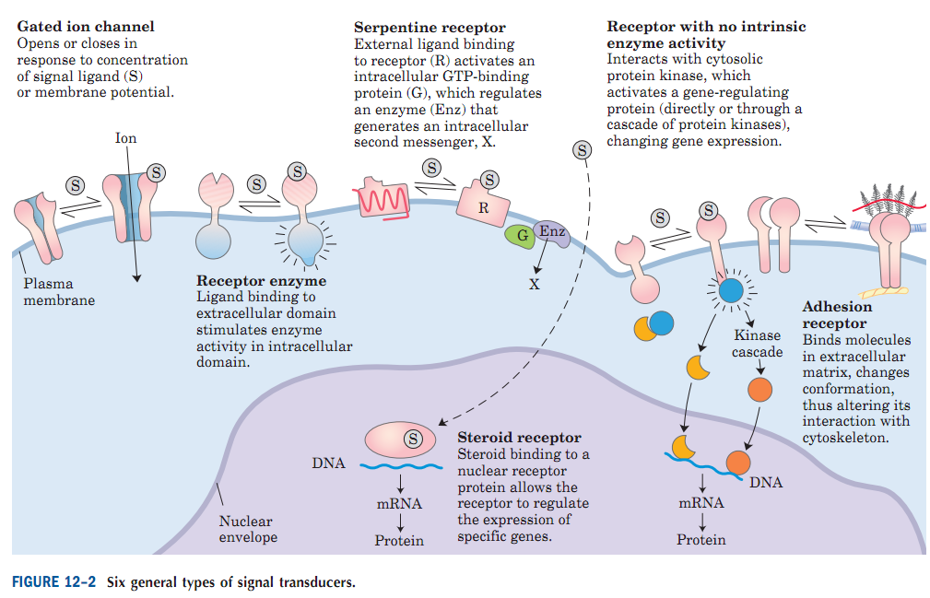
Bio-signaling
Six Different Types of Signal Transduction in Eukaryotes
Q1. Diagrammatically show the six different signal transducers in eukaryotes.

Slide 12
Bio-signaling
Six Different Types of Signal Transduction in Eukaryotes

Slide 13
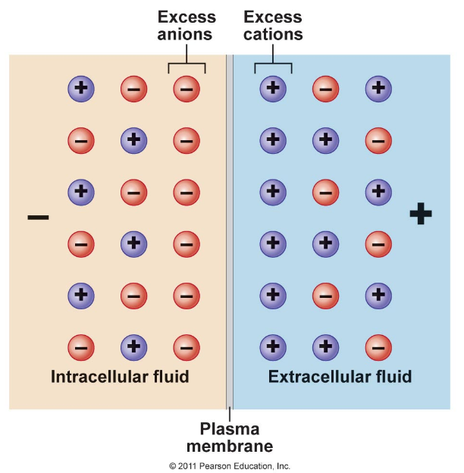
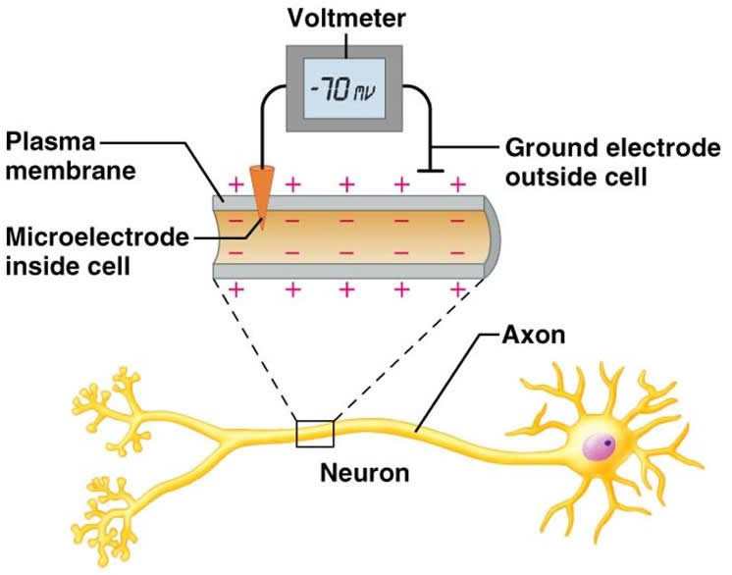
Bio-signaling
1. Signaling by Gated ion channels due to charge imbalance across the cell membrane
All cells under resting conditions have an electrical potential difference across the plasma membrane such that the inside of the cell is negatively charged with respect to the outside and it is known as the resting membrane potential.
The magnitude of the resting membrane potential depends on the type of cell, but usually ranges between -60 and -90 mV. By convention the polarity (positive or negative) of the membrane potential is stated in terms of the sign of the excess charge on the inside of the cell.
http://bodhi.name/ru/zhivomordnost/potencial-dejstviya1/
Q1. What is resting membrane potential?
No question on the images of this slide in exam.
http://droualb.faculty.mjc.edu/Course%20Materials/Physiology%20101/Chapter%20Notes/chapter_4_with%20figures.htm

Slide 14
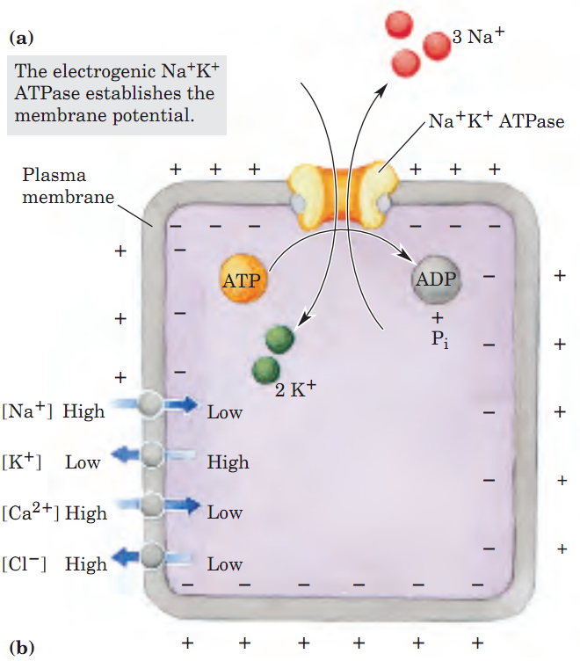
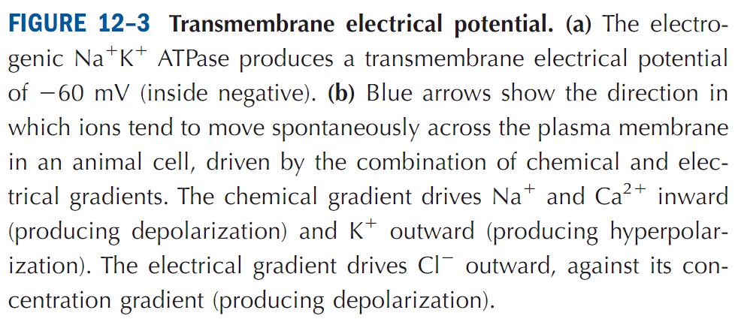
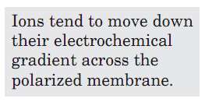
Bio-signaling
1. Signaling by Gated ion channels due to charge imbalance across the cell membrane
Ion channels gated by ligands or membrane potential (voltage) are central to signaling in neurons and other cells.
The Na⁺K⁺ ATPase creates a charge imbalance across the plasma membrane by carrying 3 Na⁺ out of the cell for every 2 K⁺ carried in (Fig. 12–3a), making the inside negative relative to the outside. The membrane is said to be polarized.
Q1. Discuss how transmembrane electric potential is maintained by Na⁺-K⁺-ATPase.

Slide 15
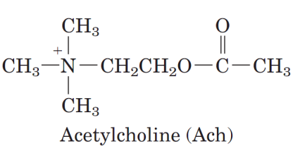
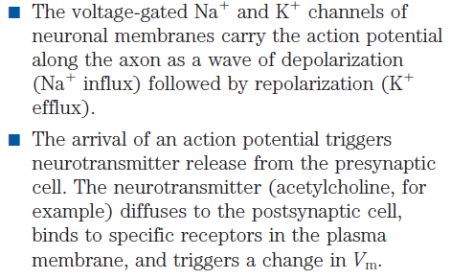
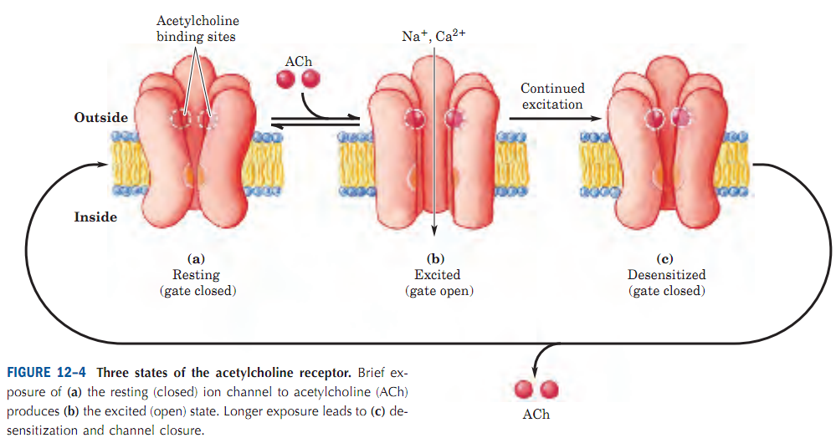
Bio-signaling
1. Signaling by Gated ion channels: Acetylcholine is a neurotransmitter
Neurotransmitters: These are the brain chemicals that communicate information throughout our brain and body. They relay signals between nerve cells, called “neurons.” The brain uses neurotransmitters to tell your heart to beat, your lungs to breathe, and your stomach to digest.
Acetylcholine is a neurotransmitter.
Both voltage-gated Na⁺ and K⁺ ion channels and ligand-gated Ach receptor ion channels are required for neurotransmission.
The acetylcholine receptor of neurons (nerve cells) and myocytes (muscle cells) is a ligand-gated ion channel.
Q1. What are neurotransmitters?
Q2. What is acetylcholine? Draw its structure.
Q3. Discuss the three states of the acetylcholine receptor.
Q4. What is the role of voltage-gated and ligand-gated ion channels in neurotransmission?

Slide 16
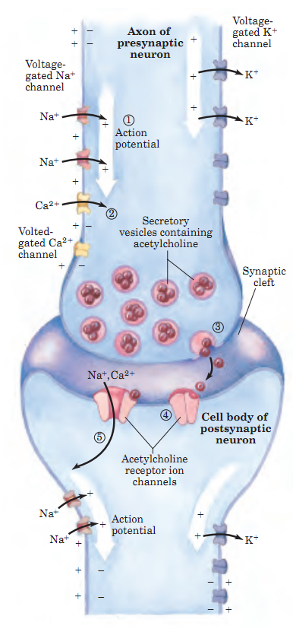
Bio-signaling
1. Signaling by Gated ion channels: Neurotransmission
FIGURE 12–5
Role of voltage-gated and ligand-gated ion channels in neural transmission.
Initially, the plasma membrane of the presynaptic neuron is polarized (inside negative) through the action of the electrogenic Na⁺K⁺-ATPase, which pumps 3 Na⁺ out for every 2 K⁺ pumped into the neuron (see Fig. 12–3).
(1) A stimulus to this neuron causes an action potential to move along the axon (white arrow), away from the cell body. The opening of one voltage-gated Na⁺ channel allows Na⁺ entry, and the resulting local depolarization causes the adjacent Na⁺ channel to open, and so on. The directionality of movement of the action potential is ensured by the brief refractory period that follows the opening of each voltage-gated Na⁺ channel.
(2) When the wave of depolarization reaches the axon tip, voltage-gated Ca²⁺ channels open, allowing Ca²⁺ entry into the presynaptic neuron.
(3) The resulting increase in internal [Ca²⁺ ] triggers exocytic release of the neurotransmitter acetylcholine into the synaptic cleft.
(4) Acetylcholine binds to a receptor on the postsynaptic neuron, causing
its ligand-gated ion channel to open.
(5) Extracellular Na⁺ and Ca²⁺ enter through this channel, depolarizing the postsynaptic cell.
The electrical signal has thus passed to the cell body of the postsynaptic neuron and will move along its axon to a third neuron by this same sequence of events.
Q1. Discuss how voltage-gated and ligand-gated ion channels work together in neural transmission.

Slide 17
Bio-signaling
Six Different Types of Signal Transduction in Eukaryotes

Slide 18
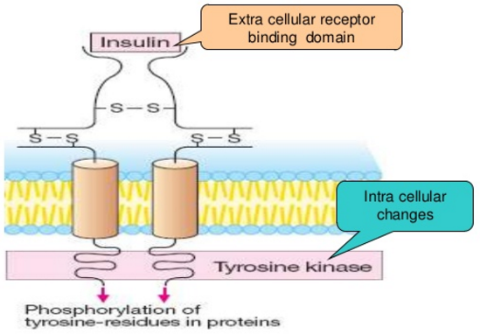
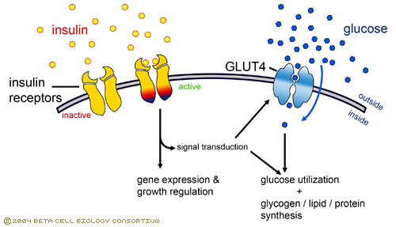
Bio-signaling
2. Signaling by Receptor Enzymes: Insulin Receptor is a Protein Kinase
Insulin receptor is a tyrosine-specific protein kinase, i.e. after the binding of insulin with the insulin receptor, the tyrosine kinase domain of the receptor phosphorylates downstream cellular proteins to relay the signal inside the cell.
-Insulin promotes glucose-uptake, syntheses of glycogen, lipids, proteins.
Insulin
action:
(GLUT4
is glucose
transporter)
Increased glucose uptake
Increased glycogen/lipid/protein synthesis
https://www.slideshare.net/VIJAYFARMAC/pharmacodynamics-24831593
Q1. Draw the structure of insulin receptor.
Q2. Show how insulin causes intracellular changes after binding with its receptor.
Q3. Show insulin action with a diagram.

Slide 19
Bio-signaling
Six Different Types of Signal Transduction in Eukaryotes

Slide 20
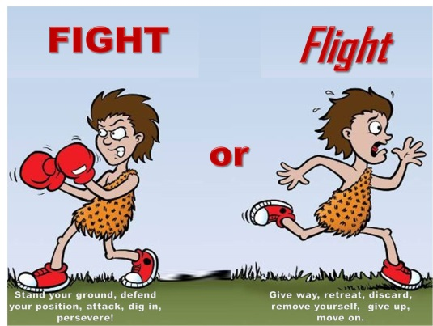
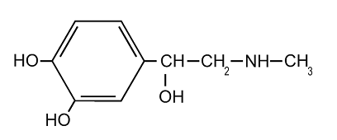
Bio-signaling
3. Signaling by Membrane receptors that act through G proteins
Signaling through membrane proteins that act through G proteins (G protein-coupled receptors or GPCR) is defined by three essential components:
a plasma membrane receptor with seven transmembrane helical segments;
a guanosine nucleotide–binding protein (G protein);
an enzyme in the plasma membrane that generates an intracellular second messenger.
The β-adrenergic receptor which mediates the effects of epinephrine (adrenaline) on many tissues, is the prototype for this type of transducing system. Epinephrine is known as the “fight or flight hormone”.
https://sites.psu.edu/siowfa16/2016/10/17/fight-or-flight/
http://slideplayer.com/slide/10288273/
Q1. What are G protein-coupled receptors (GPCRs)?
Q2. What is the “fight or flight” hormone? Draw its structure. Why is it important?
Epinephrine (Adrenaline)

Slide 21
Bio-signaling
3. Signaling by Membrane receptors that act through G proteins
https://www.youtube.com/watch?v=uO_XnmH40mk
No question in the exam from this slide.

Slide 22
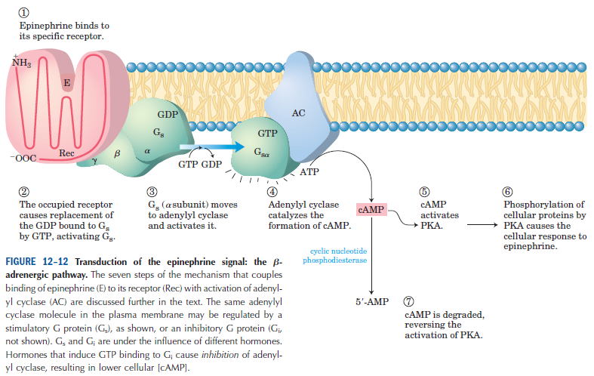
Bio-signaling
3. Signaling by Membrane receptors that act through G proteins
Transduction of the epinephrine (adrenaline) signal
Q1. Diagrammatically show how signal is transduced from the cell membrane by epinephrine.

Slide 23
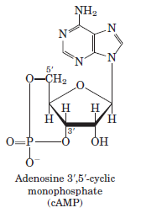
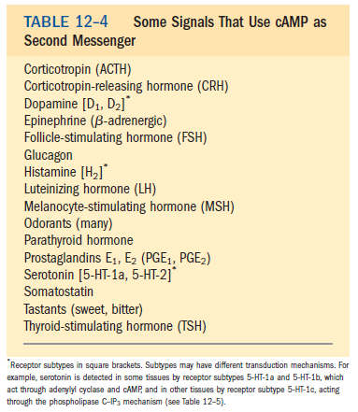
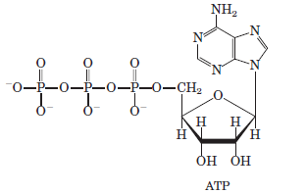
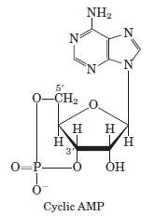
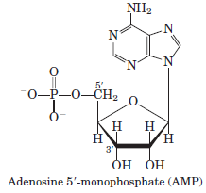
Bio-signaling
3. Signaling by Membrane receptors that act through G proteins: Second messengers
Second messenger: Second messengers are molecules that relay signals received at receptors on the cell surface — such as the arrival of protein hormones, growth factors, etc. — to target molecules in the cytosol and/or nucleus. For example, cyclic AMP (produced by the enzyme, adenylyl cyclase from ATP) is a second messenger.
Adenylyl cyclase
(membrane-bound)
Cyclic nucleotide phosphodiesterase
(in cytosol)
Cyclic AMP, the intracellular second messenger in the signaling of epinephrine system, is short-lived. It is quickly degraded by cyclic nucleotide phosphodiesterase to 5’-AMP which is not active as a second messenger.
Other second messengers include diacylglycerol, inositol-1,4,5-tris phosphate (IP₃), cGMP, Ca²⁺ ion.
Q1. What are second messengers? Give four examples.
Q2. Discuss the formation and degradation of cAMP.
Q3. Mention three signals where cAMP acts as a second messenger.

Slide 24
Bio-signaling
Six Different Types of Signal Transduction in Eukaryotes

Slide 25
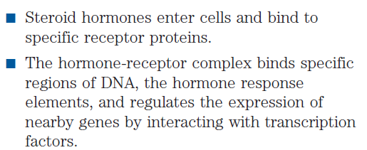
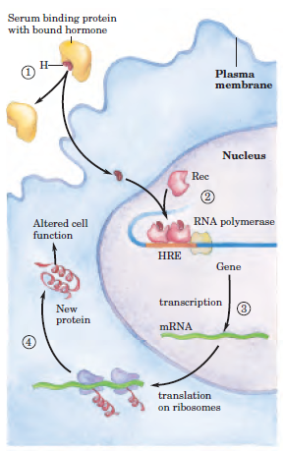
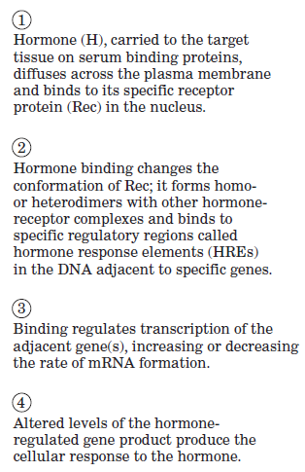
Bio-signaling
4. Signaling by Nuclear proteins that bind steroids
Steroid hormone, any of a group of hormones that belong to the class of chemical compounds known as steroids.
Examples include sex hormones, cortisol, vitamin D metabolites.
Q1. Discuss the general mechanism of steroid hormone action.

Slide 26
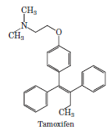
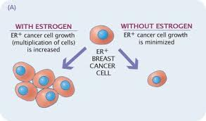
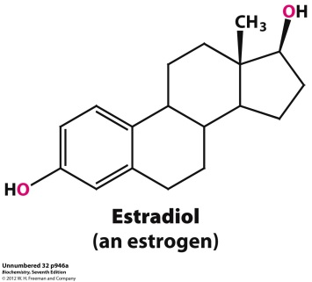
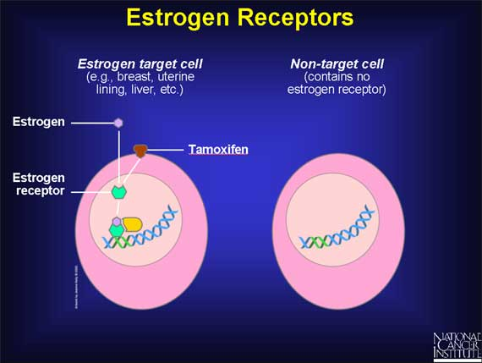
Bio-signaling
4. Signaling by Nuclear proteins that bind steroids: Tamoxifen as anticancer drug
High estrogen level can cause breast cancer:
Tamoxifen is an antagonist of estrogens
Tamoxifen administered
after surgery or during chemotherapy slows or stops the growth of remaining cancerous cells in breast cancer.
Tamoxifen binds to the estrogen receptor but does not activate downstream gene expression resulting in the reduction of the expression of genes involved in cancer progression.
Q1. Name a drug that can be used as an anticancer agent to treat breast cancer.
No question on the structure of tamoxifen.
No question on the images of this slide in exam.
http://www.drpasswater.com/nutrition_library/gordon_2(1).htm

Slide 27
Bio-signaling
Six Different Types of Signal Transduction in Eukaryotes

Slide 28
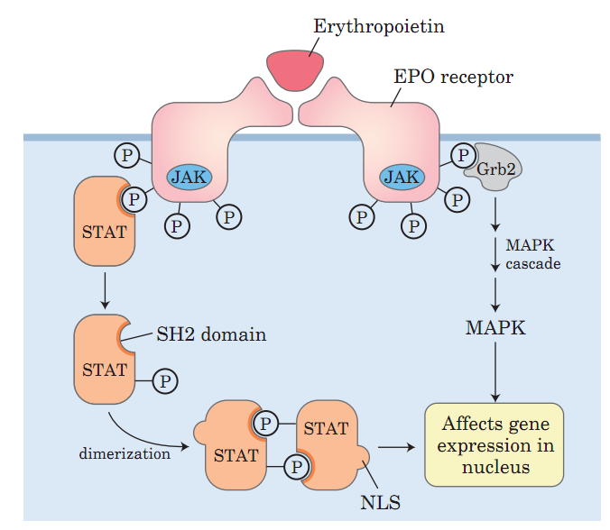
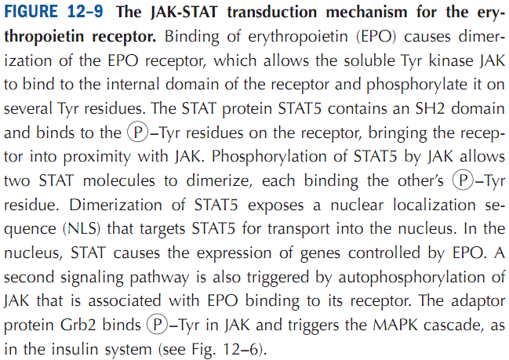
Bio-signaling
5. Membrane proteins that attract and activate soluble protein kinases
A variation on the basic theme of receptor Tyrosine kinases is seen in receptors that have no intrinsic protein kinase activity but, when occupied by their ligand, bind a soluble Tyrosine kinase. One example is the system that regulates the formation of erythrocytes in mammals.
The cytokine (developmental signal) for this system is erythropoietin (EPO), a 165 amino acid protein produced in the kidneys.
When EPO binds to its plasma membrane receptor (Fig. 12–9), the receptor dimerizes and can now bind the soluble protein kinase JAK (Janus kinase). This binding activates JAK, which phosphorylates several Tyr residues in the cytoplasmic domain of the EPO receptor. JAK-STAT pathway is an example of non-receptor tyrosine kinase.
A family of transcription factors, collectively called STATs (signal transducers and activators of transcription), are also targets of the JAK kinase activity. An SH2 domain in STAT5 binds P –Tyr residues in the EPO receptor, positioning it for this phosphorylation by JAK. When STAT5 is phosphorylated in response to EPO, it forms dimers, exposing a signal for its
transport into the nucleus. There, STAT5 causes the expression (transcription) of specific genes essential for
erythrocyte maturation.
Q1. Give an example of signaling pathway that uses non-receptor tyrosine kinase.
Q2. What is JAK-STAT signaling? Give an example.
Q3. Diagrammatically show the JAK-STAT transduction mechanism for the erythropoietin receptor.

Slide 29
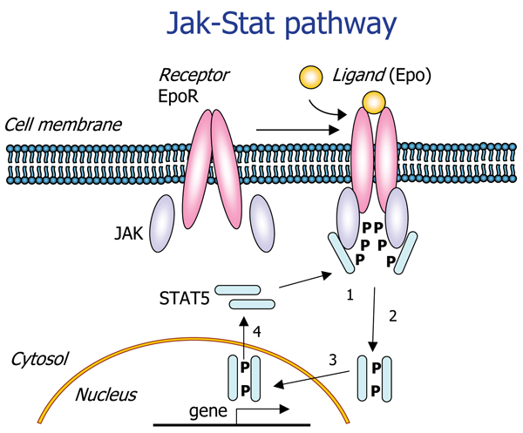
Bio-signaling
5. Membrane proteins that attract and activate soluble protein kinases: JAK-STAT
Erythrocyte (blood cell) maturation
http://www.antibodyreview.com/proteins/416/Epor.html
Q1. Schematically show how JAK-STAT pathway affects erythrocyte maturation.

Slide 30
Bio-signaling
Six Different Types of Signal Transduction in Eukaryotes

Slide 31
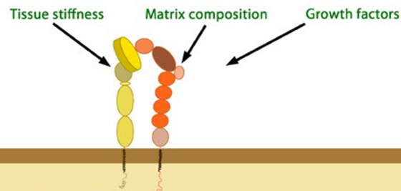
Bio-signaling
6. Adhesion receptors in the membrane: Example- Integrins
Integrins are proteins that function mechanically, by attaching the cell cytoskeleton to the extracellular matrix (ECM), and biochemically, by sensing whether adhesion has occurred.
The integrin family of proteins consists of alpha and beta subtypes, which form transmembrane heterodimers.
Signals
Integrin heterodimer bound to plasma membrane
plasma membrane
cytoplasm
https://www.mechanobio.info/topics/mechanosignaling/cell-matrix-adhesion/integrin-mediated-signalling-pathway/
Q1. What are integrins?
Q2. Write the name of 3 signals that can stimulate integrin signaling.
Q3. Write three effects of integrin signaling in cells.
Effect of integrin signaling

Slide 32
Next Lecture: Bioenergetics
Reference Textbook: Lehninger Principles of Biochemistry
4th or 5th Edition
Chapters 13
David L. Nelson, Michael M. Cox WH Freeman & Company,
New York, USA

