Slide 1
Introduction to Biochemistry & Biotechnology
Lecture #10

Slide 2
Lehninger
Principles of Biochemistry
Chapter 11
Biological Membranes

Slide 3
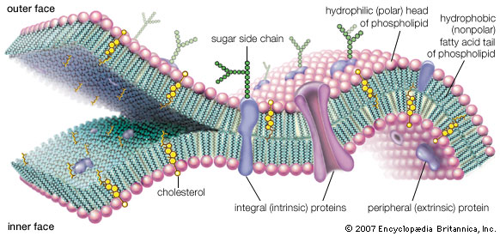
Biological Membranes
Membranes: Common features
https://global.britannica.com/topic/life
No question in exam from this slide.

Slide 4
Biological Membranes
Membranes: Common features
Biological membranes define cellular boundaries, divide cells into discrete compartments, organize complex reaction sequences, and act in signal reception and energy transformations.
Basic function of a cell membrane: to protect the cell from its surroundings.
Key features of biological membranes:
The biological membrane is made up of lipids with hydrophobic tails and hydrophilic heads.
Phospholipids are abundant in all biological membranes.
The structure is highly fluid and most of the lipid and protein molecules can move about in the plane of the membrane. The lipid and protein molecules are held together mainly by non- covalent interactions. Sugars are attached by covalent bonds to some of the lipid and protein molecules.
The cell membrane is selectively permeable to ions and organic molecules and controls the movement of substances in and out of cells.
Integral membrane proteins float in this sea of lipid, held by hydrophobic interactions with their nonpolar amino acid side chains.
Both proteins and lipids are free to move laterally in the plane of the bilayer, but movement of either from one face of the bilayer to the other is restricted.
Q1. What is a membrane?
Q2. What is the basic function of a membrane?
Q3. Write six common features of biological membranes.

Slide 5
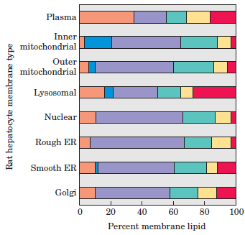
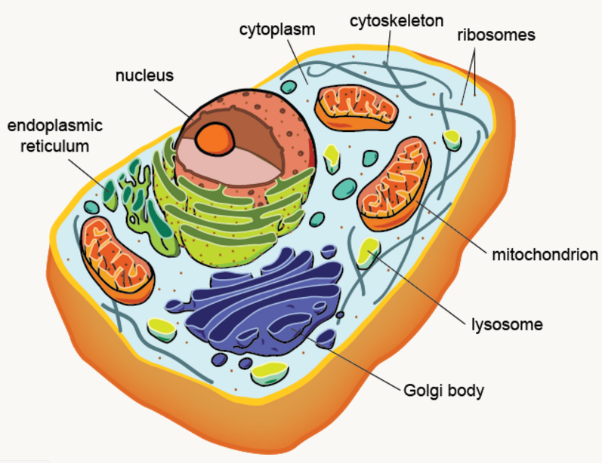
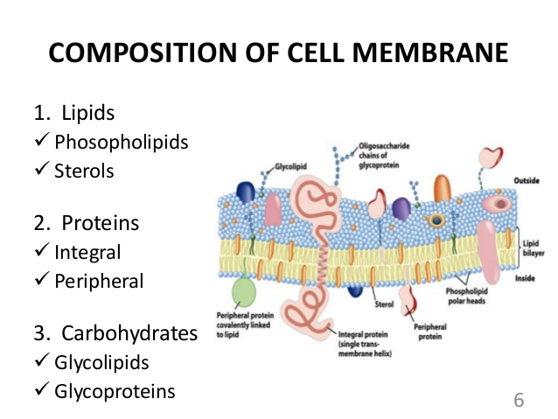
Biological Membranes
Composition and Architecture
Composition: Membranes are composed of lipids and proteins in varying combinations particular to each species, cell type, and organelle.
FIGURE 11–2 Lipid composition of the plasma membrane and organelle membranes of a rat hepatocyte.
Q1. List the major molecules with which biological membranes are composed of.
https://www.slideshare.net/AmitKumar2325/cell-membrane-and-transport-52246921
No question on Figure 11-2 in exam.

Slide 6
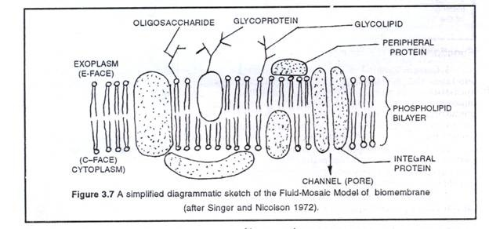
Biological Membranes
Composition and Architecture: Fluid Mosaic Model
The Singer-Nicholson fluid mosaic model of the plasma membrane describes the plasma membrane as a fluid combination of phospholipids, cholesterol, and proteins. Carbohydrates attached to lipids (glycolipids) and to proteins (glycoproteins) extend from the outward-facing surface of the membrane.
http://keywordsuggest.org/gallery/532229.html
Q1. What is Singer-Nicholson fluid mosaic model of cell membrane?
Q2. Draw a cell membrane according to the fluid mosaic model.

Slide 7
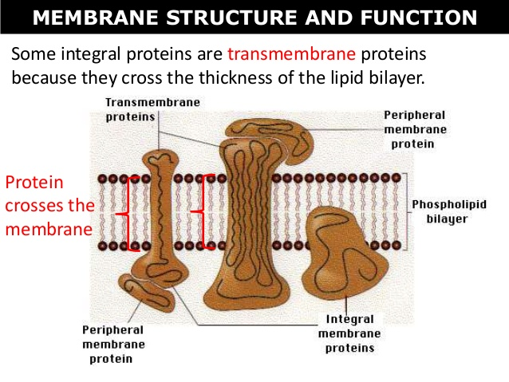
Biological Membranes
Composition and Architecture: Integral & Peripheral proteins
Membrane proteins: Membrane proteins can be divided operationally into two groups: integral and peripheral.
Peripheral proteins in membranes: Peripheral membrane proteins are membrane proteins that adhere only temporarily to the biological membrane with which they are associated. These proteins attach to integral membrane proteins, or penetrate the peripheral regions of the lipid bilayer.
Example: Ankyrin, Spectrin.
Integral proteins in membranes: Integral proteins are embedded within the lipid bilayer. They cannot easily be removed from the cell membrane without the use of harsh detergents that destroy the lipid bilayer. Example: Glycophorin,
Bacteriorhodopsin.
https://www.slideshare.net/mrtangextrahelp/tang-05-membrane-structure-and-functions
Q1. What are the two types of membrane proteins? Give examples.
Q2. Draw diagram to show the locations of peripheral and membrane proteins.

Slide 8
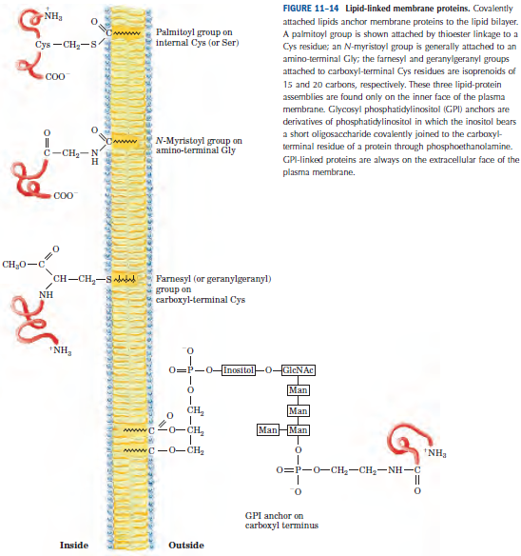
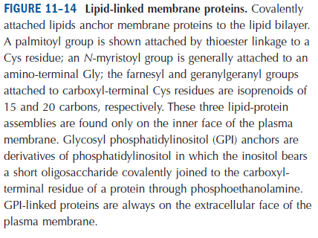
Biological Membranes
Composition and Architecture: Examples of Lipid-linked proteins
Lipid-linked membrane proteins: Lipid-anchored proteins (also known as lipid-linked proteins) are proteins located on the surface of the cell membrane that are covalently attached to lipids embedded within the cell membrane. These lipids insert and assume a place in the bilayer structure of the membrane alongside the similar fatty acid tails.
Q1. What are lipid-linked membrane proteins?
Q2. Draw diagrams to describe five examples of lipid-linked membrane proteins.

Slide 9
Biological Membranes
Membrane Dynamics: Order of Acyl Groups in Bilayer interior
Throughout the biological world, a 30 Å hydrophobic film typically delimits the environments that serve as the margin between life and death for individual cells. Nature Reviews Molecular Cell Biology 9, 112-124 (February 2008)
One remarkable feature of all biological membranes is their flexibility—their ability to change shape without losing their integrity and becoming leaky. The basis for this property is the noncovalent interactions among lipids in the bilayer and the motions allowed to individual lipids because they are not covalently anchored to one another.
Q1. Mention a remarkable feature of cell membranes.
Q2. Explain why biological membranes are flexible.

Slide 10
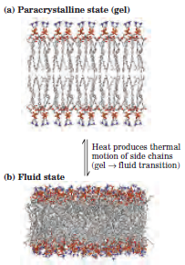
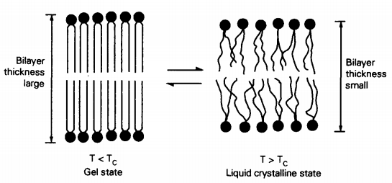
Biological Membranes
Membrane Dynamics: Order of Acyl Groups in Bilayer interior
Although the lipid bilayer structure is quite stable, its individual phospholipid and sterol molecules have some freedom of motion (Fig. 11–15). The structure and flexibility of the lipid bilayer depend on temperature and on the kinds of lipids present.
Lipid bilayer
Low
temperature
High
temperature
Moderate
temperature
Paracrystalline state
(gel-phase)
Liquid-disordered state
(fluid state)
Liquid-ordered state
(physiological state)
All types of motion of individual lipid molecules in the bilayer are strongly constrained, and the interior of the bilayer is more solid than liquid.
Polar head groups are uniformly arrayed at the
surface, and the acyl chains are nearly motionless and packed with
regular geometry.
The interior of the bilayer is more fluid than solid and the bilayer is like a sea of constantly moving lipids. Acyl chains undergo much thermal motion and have no regular organization.
Less motion of acyl chains than the fluid state but lateral movement in the plane of the bilayer still takes place. Individual phospholipid molecules can diffuse laterally but
the acyl groups remain extended and more or less ordered.
http://onlinelibrary.wiley.com/doi/10.1016/0307-4412(91)90103-F/pdf
These differences in bilayer state are easily observed in liposomes composed of a single lipid, but biological membranes contain many lipids with a variety of fatty acyl chains and thus do not show sharp phase changes with temperature.
Q1. Discuss different types of lipid bilayers of a liposome with a single lipid.
No question on the image of this slide in exams.

Slide 11
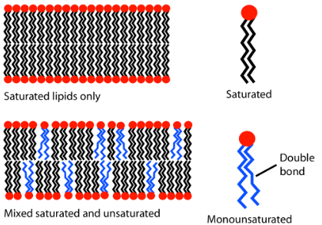
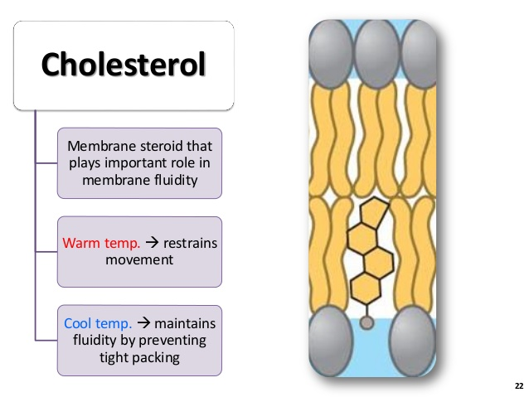
Biological Membranes
Membrane Dynamics: Factors affecting membrane fluidity
Cells regulate their lipid composition to achieve a constant membrane fluidity under various growth conditions. For example, bacteria synthesize more unsaturated fatty acids and fewer saturated ones when cultured at low temperatures than when cultured at higher temperatures. At lower temperatures, tails of saturated fatty acids might crystallize and hence behave like a solid (rigid structure).
Diagram showing the effect of unsaturated lipids on a bilayer. The lipids with an unsaturated tail (blue) disrupt the packing of those with only saturated tails (black). The resulting bilayer (bottom) has more fluidity at lower temperatures than the one with saturated lipids only (top).
https://en.wikipedia.org/wiki/Lipid_bilayer
Major factors that can affect membrane fluidity:
Lipid chains (acyl tails) with carbon-carbon double bonds (unsaturated) are more fluid in membranes than lipids that are saturated with hydrogens and thus have only single bonds.
Shorter fatty acyl tails are less likely to interact, which makes the membrane more fluid than membranes with long acyl tails.
The rigid planar structure of the steroid nucleus in sterols like cholesterol, inserted between fatty acyl side chains, reduces the freedom of neighboring fatty acyl chains to move by rotation about their carbon–carbon bonds, forcing acyl chains into their fully extended conformation. The presence of sterols therefore reduces the fluidity in the core of the bilayer, thus favoring the liquid-ordered phase.
https://www.slideshare.net/robswatski/biol-101-chp-7-membrane-structure-and-function
Q1. Give an example of maintaining the degree of fluidity in biological membranes.
Q2. Discuss the major factors that can affect membrane fluidity.
Q3. Diagrammatically show the role of cholesterol in eukaryotic cell membranes.

Slide 12
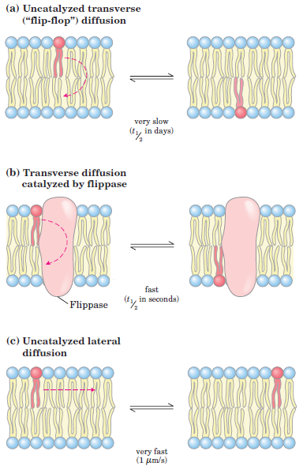
Biological Membranes
Membrane Dynamics: Transbilayer movement of lipids by enzymes
Transbilayer movement (flip-flop) of lipids in membrane:
At physiological temperature, transbilayer—or “flipflop”—diffusion of a lipid molecule from one leaflet of the bilayer to the other (Fig. 11–16a) occurs very slowly if at all in most membranes.
Transbilayer movement requires that a polar or charged head group leave its aqueous environment and move into the hydrophobic interior of the bilayer, a process with a large, positive free-energy change. There are, however, situations in which such movement is essential. For example, during synthesis of the bacterial plasma membrane, phospholipids are produced on the inside surface of the membrane and must undergo flip-flop diffusion to enter the outer leaflet of the bilayer. Similar transbilayer diffusion must also take place in eukaryotic cells as membrane lipids synthesized in one organelle move from the inner to the outer leaflet and into other organelles.
Q1. What is transbilayer movement? Why is it important?
Q2. Which enzymes carry out transbilayer movement?
Diagrammatically show lateral and transverse diffusions.
Q3. Give examples to explain the importance of transbilayer movements in prokaryotic and eukaryotic cells.

Slide 13
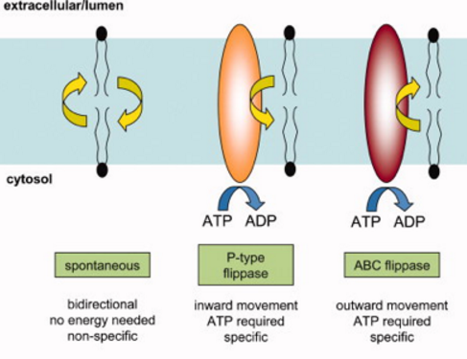
Biological Membranes
Membrane Dynamics: Transbilayer movement of lipids by enzymes
A family of proteins, the flippases (Fig. 11–16b), facilitates flipflop diffusion, providing a transmembrane path that is energetically more favorable and much faster than the uncatalyzed movement.
http://biochimej.univ-angers.fr/Page2/COURS/Zsuite/7MembraneLipides/1MembraneLipides.htm
Q1. What are flippases?
Q2. Give an example of a flippase enzyme.

Slide 14
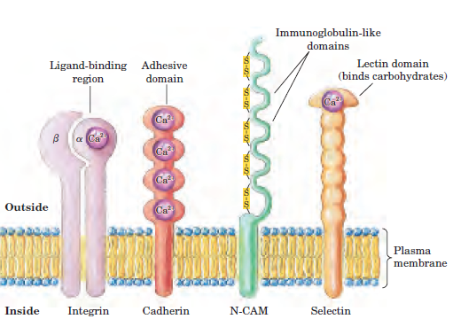
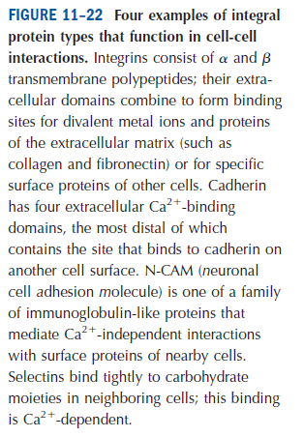
Biological Membranes
Membrane Dynamics: Certain Integral proteins mediate cell-cell interactions
Several families of integral proteins in the plasma membrane provide specific points of attachment between cells, or between a cell and extracellular matrix proteins.
Q1. Give four examples of integral proteins that are involved in cell-cell interactions.
Q2. Diagrammatically show four different types of integral proteins.

Slide 15
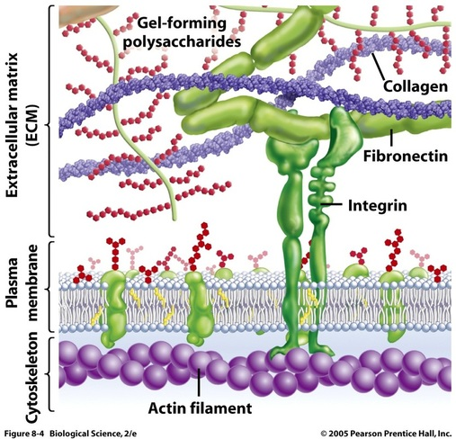
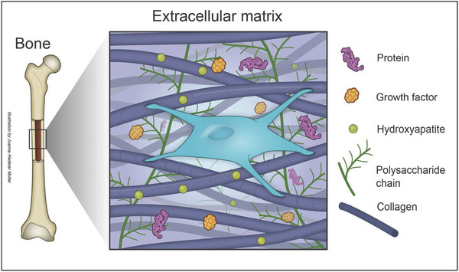
Biological Membranes
Membrane Dynamics: Interaction of plasma membranes with ECM
The extracellular matrix (ECM) is a collection of extra-cellular molecules secreted by cells that provides structural and biochemical support to the surrounding cells.
In biology, the extracellular matrix (ECM) is a collection of extracellular molecules secreted by cells that provides structural and biochemical support to the surrounding cells. Because multicellularity evolved independently in different multicellular lineages, the composition of ECM varies between multicellular structures.
http://apbiocellorganelles.weebly.com/ecm.html
Common functions of ECM:
cell adhesion;
cell-to-cell communication;
cell differentiation.
https://www.researchgate.net/figure/284728652_fig5_Figure-1-The-combinatorial-extracellular-matrix-ECM-of-bone-A-range-of-biological
Q1. What is extracellular matrix (ECM)?
Q2. What are the common functions of ECM?
Q3. Does bone have extracellular matrix?
No question in the exam from the images of this slide.

Slide 16
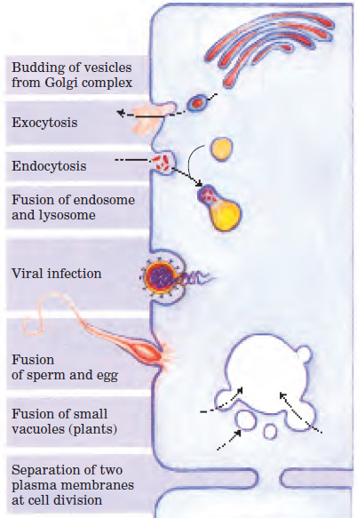
Biological Membranes
Membrane Dynamics: Membrane fusion in biological processes
Membrane fusion: In membrane biology, fusion is the process by which two initially distinct lipid bilayers merge their hydrophobic cores, resulting in one interconnected structure. Membrane fusion is central in many biological processes.
Endomembrane: These membranes divide the cell into functional and structural compartments, or organelles.
Although membranes are stable, they are by no means static. Within the eukaryotic endomembrane system (which includes the nuclear membrane, endoplasmic reticulum, Golgi, and various
small vesicles), the membranous compartments constantly re-organize. Vesicles bud from the endoplasmic reticulum to carry newly synthesized lipids and proteins to other organelles and to the plasma membrane. Exocytosis, endocytosis, cell division, fusion of egg and sperm cells, and entry of a membrane-enveloped virus into its host cell all involve membrane reorganization in which the fundamental operation is fusion of two membrane segments without loss of continuity (Fig. 11–23).
Certain proteins on cell membranes known as fusion proteins facilitate the process of membrane fusion in biological systems.
Q1. What is membrane fusion?
Q2. Give six examples of membrane fusion.
Q3. What is the function of fusion proteins during membrane fusion?

Slide 17
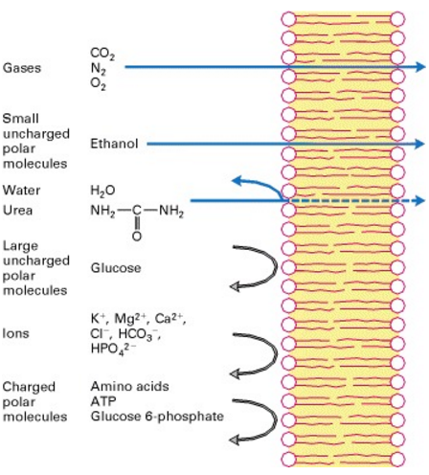
Biological Membranes
Solute transport across membranes
Every living cell must acquire from its surroundings the raw materials for biosynthesis and for energy production, and must release to its environment the byproducts of metabolism.
A few nonpolar compounds can dissolve in the lipid bilayer and cross the membrane unassisted, but for polar or charged compounds or ions, a membrane protein is essential for transmembrane movement. In some cases a membrane protein simply facilitates the diffusion of a solute down its concentration gradient, but transport often occurs against a gradient of concentration, electrical charge, or both, in which case solutes must be “pumped” in a process that requires energy (Fig. 11–26). The energy may come directly from ATP hydrolysis or may be supplied in the form of movement of another solute down its electrochemical gradient with enough energy to carry another solute up its gradient. Ions may also move across membranes via ion channels formed by proteins, or they may be carried across by ionophores, small molecules that mask the charge of the ions and allow them to diffuse through the lipid bilayer. With very few exceptions, the traffic of small molecules across the plasma membrane is mediated by proteins such as transmembrane channels, carriers, or pumps. Within the eukaryotic cell, different compartments have different concentrations of metabolic intermediates and products and of ions, and these, too, must move across intracellular membranes in tightly regulated, protein-mediated processes.
Figure 15-1 A pure artificial phospholipid bilayer is permeable to small hydrophobic molecules and small uncharged polar molecules.
https://www.ncbi.nlm.nih.gov/books/NBK21626/
The phospholipid bilayer is slightly permeable to water and urea and impermeable to ions and to large uncharged polar molecules.
Q1. Mention the solutes that are freely permeable through phospholipid bilayer.
Q2. What is the most common method of transporting samll molecules across cell membrane?
Q3. Diagrammatically show permeability of small molecules that are hydrophobic or uncharged polar.

Slide 18
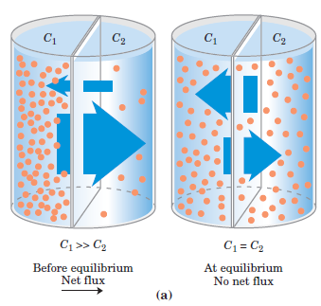
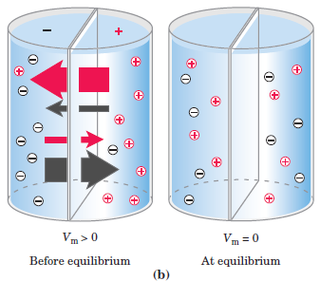
Biological Membranes
Solute transport across membranes: Electrochemical Gradient
When two aqueous compartments containing unequal concentrations of a soluble compound or ion are separated by a permeable divider (membrane), the solute moves by simple diffusion from the region of higher concentration, through the membrane, to the region of lower concentration, until the two compartments have equal solute concentrations (Fig. 11–27a).
When ions of opposite charge are separated by a permeable membrane, there is a transmembrane electrical gradient, a membrane potential, V_{m} (expressed in volts or millivolts). This membrane potential produces a force opposing ion movements that increase V_{m} and driving ion movements that reduce V_{m} (Fig. 11–27b).
The direction in which a charged solute tends to move spontaneously across a membrane depends on both:
the chemical gradient (the difference in solute concentration); and
the electrical gradient (V_{m}) across the membrane.
Together, these two factors are referred to as the electrochemical gradient or electrochemical potential. This behavior of solutes is in accord with the second law of thermodynamics: molecules tend to spontaneously assume the distribution of greatest randomness and lowest energy.
The electrochemical gradient consists of two parts, the chemical gradient, or difference in solute concentration across a membrane, and the electrical gradient, or difference in charge across a membrane.
Q1. What is electrochemical gradient?
Q2. Diagrammatically explain the factors that create electrochemical gradient.

Slide 19
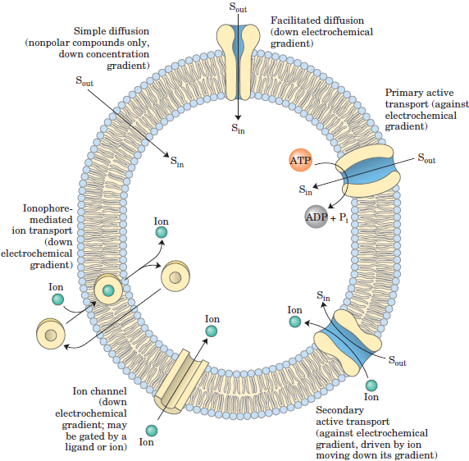
Biological Membranes
Solute transport across membranes: Types of Transport across Membranes
Examples of transport types across cells membrane:
Transport type name | Mechanism | Example
Simple diffusion | Down concentration gradient | Gases: O₂, CO₂, N₂; Small uncharged polar molecules: ethanol
Facilitated diffusion | Down electrochemical gradient | Quick transport of water by Aquaporins
Primary active transport | Against electrochemical gradient | Maintaining low Na⁺ ion concentration inside the cell by Na⁺K⁺ ATPases
Secondary active transport | Against electrochemical gradient: driven by ions moving down its gradient | Lactose transporter of E. coli
Ion channel | Down electrochemical gradient; may or may not be gated by a ligand or ion | Voltage-gated Na+ channels of neurons
Ionophore-mediated ion transport | Down electrochemical gradient | Valinomycin, a peptide ionophore that binds K⁺
Q1. Draw a diagram to show the six different transport types across cell membranes.
Q2. Give one example of each of the six different transport types across cell membranes.

Slide 20
Next Lecture: Bio-signaling (Part I)
Reference Textbook: Lehninger Principles of Biochemistry
4th or 5th Edition
Chapter 12
David L. Nelson, Michael M. Cox WH Freeman & Company,
New York, USA

