Slide 1


Slide 2
Outline
What is Homeostasis?
Controlling body temperature
Controlling Glucose levels
Controlling water levels

Slide 3
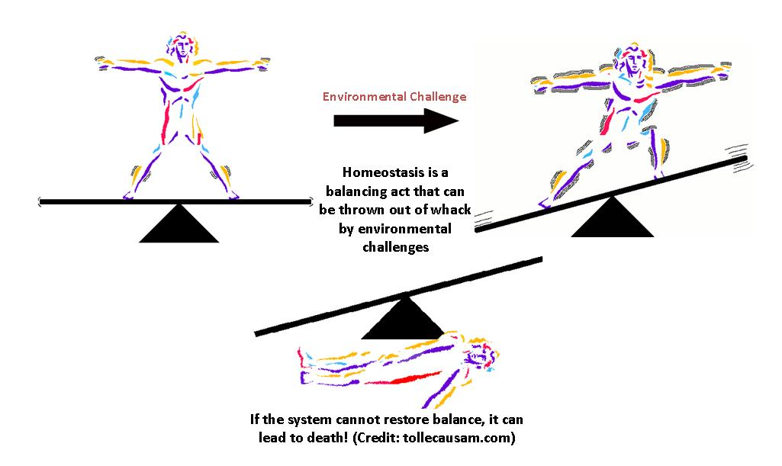
What is Homeostasis?
Body cells work best if they have the correct
  Temperature
  Water levels
  Glucose concentration
Your body has mechanisms to keep the cells in a constant environment.
The maintenance of nearly constant internal environment inside the body is called Homeostasis

Slide 4
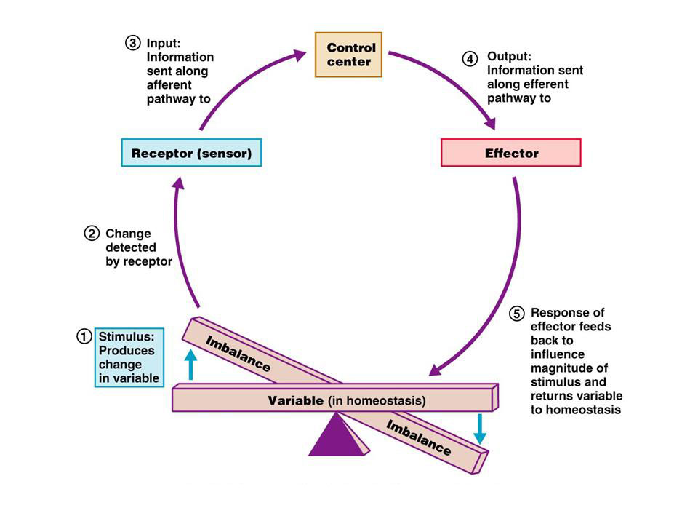
Control of Homeostasis
Homeostasis is controlled by feedback mechanism.
The feedback mechanism consist of three parts:
1. A sense organ
2. A control center (usually the brain)
3. A responding organ
The 3 parts of a typical feedback mechanism

Slide 5
Organs of Homeostasis
Musculoskeletal system
Skin
Nervous system
Endocrine glands
Read these Topics from respective slides
Lungs and respiratory tract
Heart and circulatory system
Liver, pancreas and gastrointestinal tract
Kidneys

Slide 6
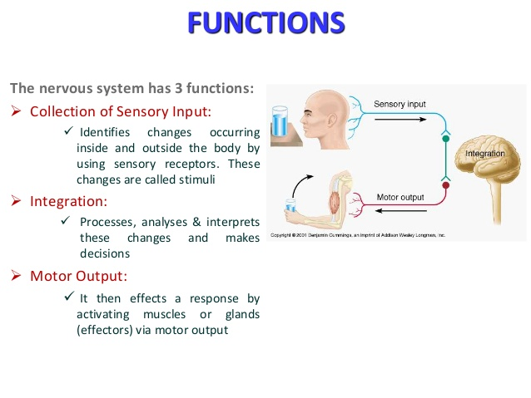
Nervous System

Slide 7
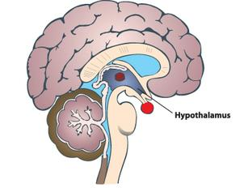
In Brain :The hypothalamus contains a central heat control center.
An area in the Hypothalamus called “The Thermo-regulatory Center (TRC)” has the responsibility of maintaining the body’s core temperature.
It can respond to extremely small changes in blood temperature.
The TRC is the body’s thermostat.

Slide 8
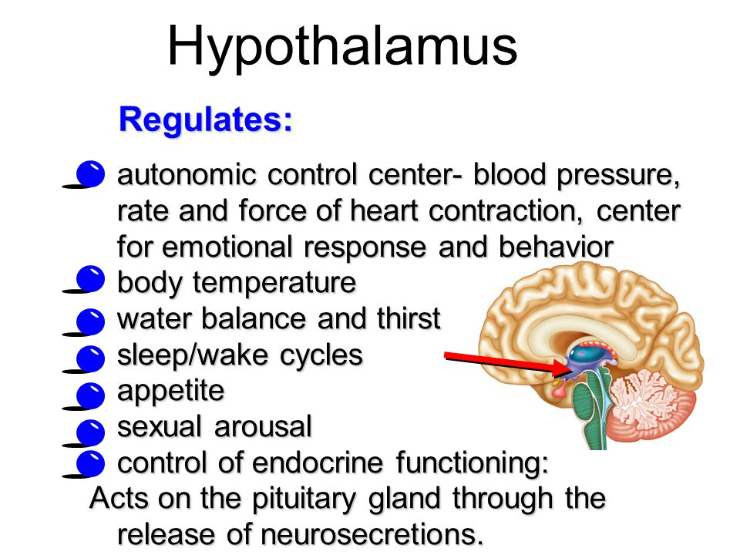
Anterior Region in the hypothalamus is responsible for marinating body temperature constant, which is also called TRC

Slide 9
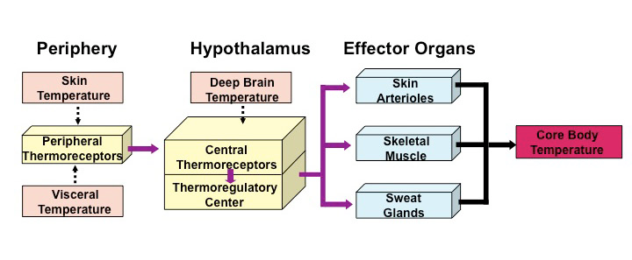
How The TRC Works?
1. It receives information from the body regarding temperature.
2. It sends signals to the body to adjust the temperature to maintain a relatively fixed core temperature.
3. The body has two thermo-receptors which signals the TRC when temperature changes.
4. The Thermo-Receptors signal the Thermo-regulatory center (TRC).

Slide 10
Skin:
Skin helps to keep the body at a steady temperature of 37ºC± 1 ºC.
Sweat glands let the body loss excess heat and cool down.
A layer under our skin helps keep heat inside our body.
Shivering action of muscles generates extra heat to warm the body up in the cold weather.
Skin Function
It protects our body against damage, dirt and germs.
It contains millions of tiny sense organs, which are sensitive to touch, temperature and pain.
It excretes water and salts from the body as sweat.
It helps to keep the body at a steady temperature of 37⁰C±1⁰C.
Acts as a storage center for lipids and water, as well as synthesise vitamin D by action of UV on certain parts of the skin.

Slide 11
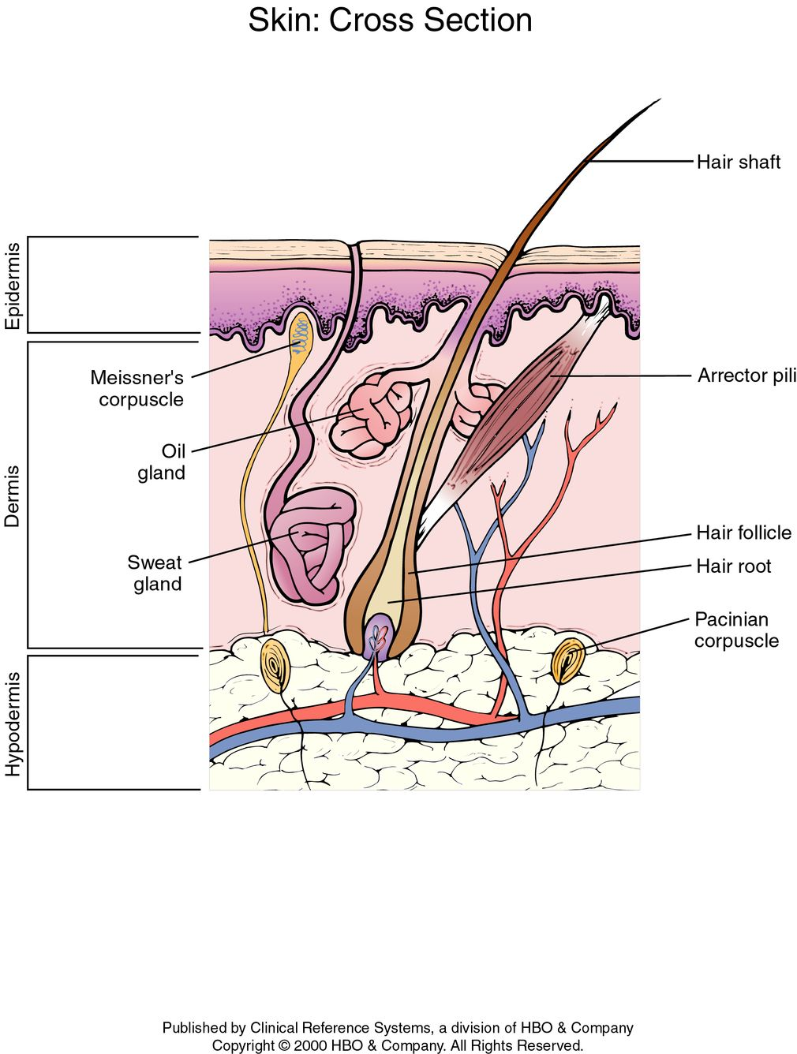
The structure of skin:

Slide 12
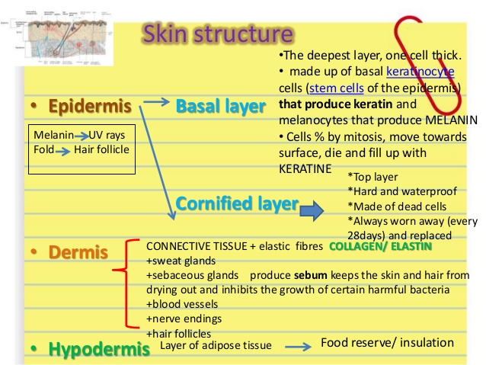

Slide 13
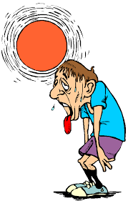
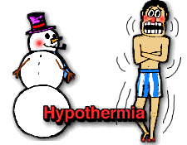
Controlling body temperature
All mammals maintain a constant body temperature.
Human beings have a body temperature of about 37ºC.
  E.g. If your body is in a hot environment your body temperature is 37ºC
  If your body is in a cold environment your body temperature is still 37ºC
Extremes of body temperature are dangerous because:
  Hypothermia (colder than normal body temperature) and frostbite can happen to anyone who is not properly protected from the cold.
  High temperatures can cause dehydration, heat stroke and death if untreated.

Slide 14
Controlling body temperature
Mechanisms to cool the body:
  Sweating
  Vasodilation
Mechanisms to warm the body:
  Vasoconstriction
  Piloerection

Slide 15
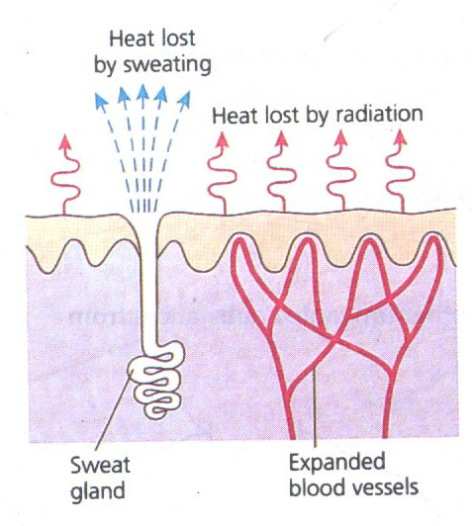
Mechanisms to cool the down body
Sweating
When your body is heated up, sweat glands are stimulated to release sweat.
The liquid sweat turns into a gas (it evaporates)
To do this, it needs heat.
It gets that heat from your skin.
As your skin loses heat, it cools down.
2. Vasodilation
Your blood carries most of the heat energy around your body.
There are capillaries underneath your skin that can be filled with blood if you get too hot.
This brings the blood closer to the surface of the skin so more heat can be lost.
This is why you look red when heat rises!

Slide 16
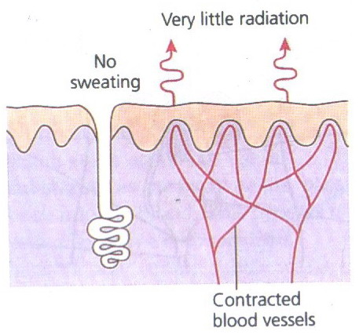
Mechanisms to warm the body
1. Vasoconstriction
This is the opposite of vasodilation
The capillaries underneath your skin get constricted (shut off).
This takes the blood away from the surface of the skin so less heat can be lost.
Muscles start rapid, jerky movements which we call shivering. This produces extra heat, which warms up the body.
2. Piloerection
This is when the hairs on your skin “stand up” .
It is sometimes called “goose bumps”!
The hairs trap a layer of air next to the skin which is then warmed by the body heat
The air becomes an insulating layer.

Slide 17
Fever and hyperthermia
Fever occurs when the core temperature of the body is raised above normal steady state levels. The body reacts as if it is too cold, while the temperature rises up to the new higher set point. Fever attacks imply shivering combined with vasoconstriction, headache, body pains, and general discomfort.
Following an attack of fever, vasodilatation and sweat evaporation reduces the core temperature.

Slide 18
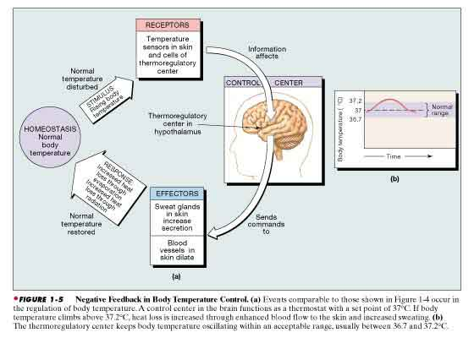
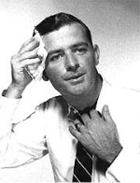
Overview: Temperature Regulation
Cyclic representation

Slide 19
Endocrine glands:
Located in the body are eight major endocrine glands that secrete chemical substances called hormones.
Hormones are transported into the extracellular fluid to all parts of the body to help regulate cellular function.
For instance, thyroid hormone increases the rates of most chemical reactions in all cells, thus helping to set the tempo of bodily activity.
Insulin controls glucose metabolism
Hormones are a system of regulation that complements the nervous system.
The nervous system regulates mainly muscular and secretory activities of the body, whereas the hormonal system regulates mainly metabolic functions.

Slide 20
