Slide 1
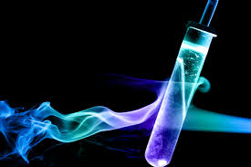
Photometry:
Estimation of analyte concentration on the basis of light absorption

Slide 2
Photometry
Photometry is one of the most widely used analytical procedures in biochemistry.
For simple routine determination of small quantities of materials. The principle is based on physical laws of radiant energy or light.
Basic photometric principle can be applied in several analytical procedures,
1. Measurement of absorbed or transmitted light: colorimeter, spectrophotometery, atomic absorption, turbidometery
2. Measurement of emitted light, flame emission photometery: flourometery

Slide 3
Spectrophotometer
These are optical instruments for measurement of the absorption of light of a given wavelength of coloured substances in solution.
Beer's law makes it possible to calculate the concentration of the coloured substance in the solution.
Absorption photometers for work in aqueous solution work in the ultraviolet and visible ranges, from wavelength around 240 nm up to 750 nm.
The principle of spectrophotometers and filter photometers is that monochromatic light is allowed to pass through a container (cell) with optically flat windows containing the solution.
It then reaches a light detector, that measures the intensity of the light compared to the intensity after passing through an identical cell with the same solvent but without the coloured substance.
From the ratio between the light intensities, knowing the capacity of the coloured substance to absorb light, it is possible to calculate the concentration of the substance using Beer's law.
In spectrophotometers a monochromator (with prism or with grating) is used to obtain monochromatic light of one defined wavelength.

Slide 4
spectrophotometer

Slide 5
Beer’s Law and Spectrophotometry
Relates concentration to the optical measurement of ‘absorbance’
Combined with spectrophotometry can be used to distinguish and compare different molecules in solution
Light of a particular wavelength enters the ‘sample’.
Light scatters from particles in solution reducing light transmission
Light is absorbed by molecules/particles and remitted at different wavelengths, reducing light transmission.
Absorptivity is usually specified only at λ max which is the wavelength at which light is most strongly absorbed by the light absorbing species.
Absorption is proportional to concentration

Slide 6
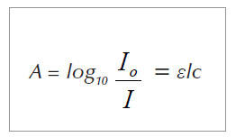
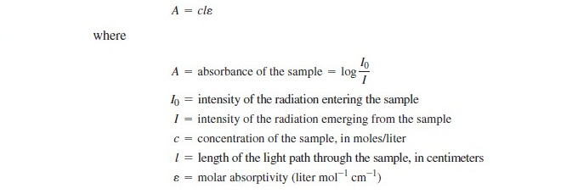
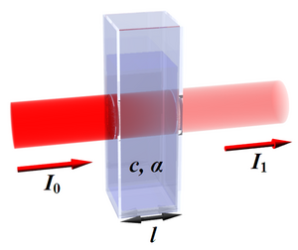
Beer’s Law

Slide 7
Beer Lambert Law
The Beer Lambert Law states that there is a linear relationship between the concentration of a solution and the absorbance of said solution.
For a spectrophotometer, the direct proportionality between absorbance and concentration must be established.
A calibration constant (K) may be derived and used to calculate the concentration of an unknown solution by comparing with a calibrating solution.
A₁/ C₁= A₂/ C₂

Slide 8
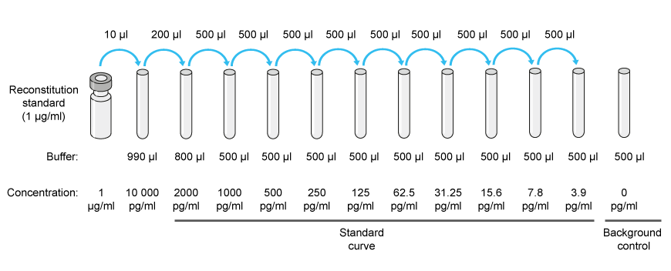
Analysis of unknown solution
You will need:
Blank
Standard solution A standard solution is a solution in which the analyte concentration is accurately known. The absorbance of the standard solutions are measured and used to prepare a calibration curve.
Calibration curve : A calibration curve is a linear graph showing how the experimental observable variable (the absorbance in this case) varies with the concentration.
Calculation of concentration of unknown sample using calibration factor
can use y=mx +c
Calculation of concentration of unknown sample using standard sample
Calculation of concentration of unknown sample using molar extinction coefficient

Slide 9
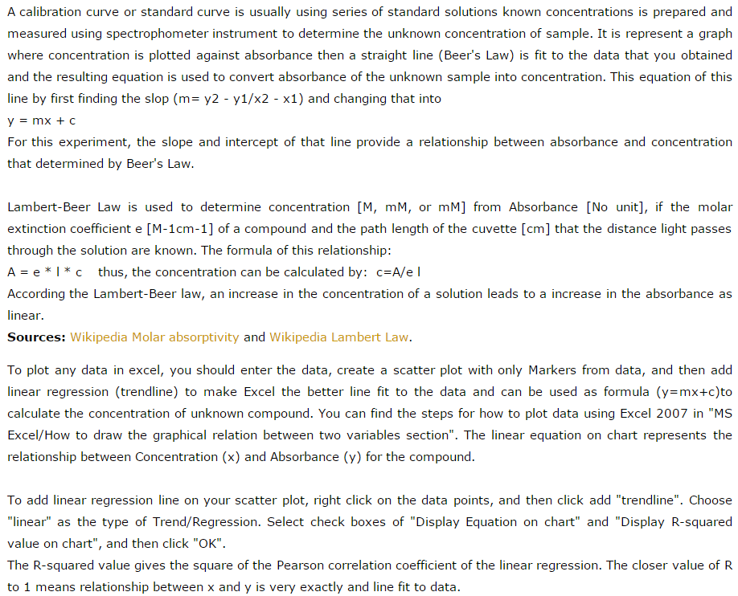

Slide 10
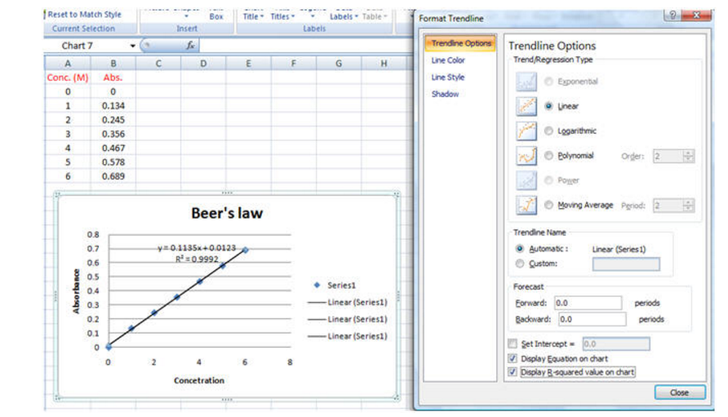
http://www.biochemcs.com/beer's_law_scatter_plot_and_linear_regression.htm

Slide 11
HOW TO MAKE STANDARD CURVE
Multiple samples with known properties are measured and graphed, which then allows the same properties to be determined for unknown samples by interpolation on the graph.
The samples with known properties are the standards, and the graph is the standard curve.
Draw the points with protein concentrations as x values and the average absorbance as y values on a grid or graph paper
Draw a straight line through the points
Lookup the unknown protein concentration from the plot using the absorbance value of the unknown protein.

Slide 13
Estimation of Glucose
EXP_ 2
ACh

Slide 14
Introduction
Living system
Organic compounds
Inorganic Compounds
Macromolecules
Carbohydrates
Proteins
Lipids
Nucleic Acids
Carbon containing
And the rest
Assembling into complex form
Building blocks of living organism
Notes:
Living systems are composed of various types of molecules. There are two main types: Organic and Inorganic molecules. All organic molecules contain carbon and those that don't are classified as inorganic molecules. Organisms maintain reserves of small organic molecules that they can assemble into complex Macromolecules such as carbohydrates, lipids, proteins, and nucleic acids. These are the building blocks of the living organisms.

Slide 15
3.2 Terminologies
Carbohydrates
Glucose
Building Blocks/monomers
Macromolecules
Proteins
Amino acids
Lipids
Fatty acid and glycerol
Nucleic Acids
Phosphate group (p), Sugar, Bases

Slide 16
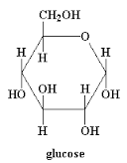
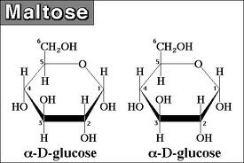
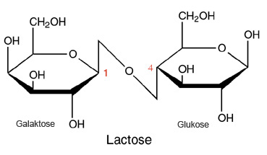
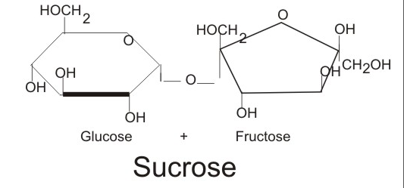
CARBOHYDRATE
Types of Carbohydrates
1. Monosaccharides: Simple sugars consisting of three to seven carbon atoms. Example: Glucose, fructose, galactose
2. Disaccharides: Two monosaccharide molecules joined together form a disaccharide. Examples:
Sucrose (glucose+fructose) (Table Sugar)
Lactose (glucose+galactose) (Milk Sugar)
Maltose (glucose+glucose) (Barley/germinating seeds)
Notes:
Simple sugars consisting of three to seven carbon atoms are monosaccharides. In living things, monosaccharides form ring-shaped structures and can join together to form longer sugars. The most common monosaccharide is glucose.
Two monosaccharide molecules joined together form a disaccharide. Common disaccharides include sucrose (table sugar) and lactose (the sugar found in milk).

Slide 17
Functions of Carbohydrate hence glucose standard curve
1. Providing energy – carbohydrates are the preferred fuel source of our body.
Carbohydrate -> glucose -> energy
2. Store energy – excess glucose is stored as glycogen in muscles and liver of animals (or starch in plants).
3. Build macromolecules – some sugar is used to make cell components such as DNA, RNA and ATP
4. Spare protein and fat for other uses – when energy demands cannot be met by carbohydrates, body starts breaking down proteins from muscles an other tissues
5. Dietary fiber – essential for the elimination of waste materials from the body and prevents constipation
Notes:
The primary role of carbohydrates is to supply energy to all cells in the body. Carbohydrates are the the preferred fuel source of your body. When you eat foods that contain carbohydrate, your body breaks them down into glucose. Glucose provides fuel for each cell in your body, particularly your brain and nerve cells.
If the body already has enough energy to support its functions, the excess glucose is stored as glycogen (the majority of which is stored in the muscle and liver).
Although most absorbed glucose is used to make energy, some glucose is converted to ribose and deoxyribose, which are essential building blocks of important macromolecules, such as RNA, DNA, and ATP
If there is not enough carbohydrates to meet the energy demand of the body, it starts using proteins as energy source which causes destruction of proteins primarily from the muscle tissues.
Fiber is a type of carbohydrate that is necessary for digestive health. It helps food move through intestine and prevents constipation.

Slide 18
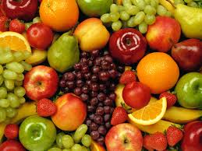
Glucose estimation in fruits
Trinder method
Glucose+O₂+ H₂O→ Gluconic acid +H₂O₂
2H₂O₂ +4-AAP+ Phenol→ Quinoneimine dye (red coloured) +4H₂O
Glucose oxidase (GOD)
Peroxidase (POD)

Slide 19
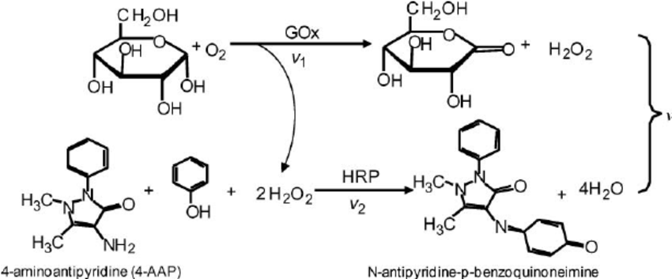

Slide 20
Procedure
Procedure:
Specimen: grape juice
Standard preparation: Using the given glucose standard,
prepare 5 standards of different concentrations
(25, 50, 100, 200 and 400 mg/dl) using serial dilution from a stock solution of 800 mg/dl.
Buffer R | TrispH7.4 | 92 mmol/l
 | Phenol | 0.3 mmol/l
 | Glucose oxidase (GOD) | 15000 U/l (unit/liter)
 | Peroxidase (POD) | 1000 U/l
 | 4-aminophenazone (4-AP) | 2.6 mmol/l

Slide 21
Biochemistry Analyzer
Calculation: Calculate the total Protein concentration by using the following formula:
Total Protein concentration =
(Absorbance of sample/Absorbance of standard) x [Standard]
(Unit conversion: mg/dl x 1.45 = ___ mmol/L)
Expected value:
Adults 6.3-8.3 g/dL
Children
> 1 year 6.0-8.0 g/dL
< 1 year 4.6-7.6 g/dL

Slide 22
HomeWork
Graph preparation: Produce two graphs
Plot an abs vs. concentration graph using the values using a graph paper. (Attach the graph in your report. In exam you have to draw one by hand. So practice this.)
Plot an abs vs. concentration graph using the values using excel sheet ( paste the excel generated graph)
Calculation:
Calculate the concentration of SAMPLE A & B from the standard curve, (can use Beer-Lambart law & y= mx+C)
Any limitations you faced? How could you improve them?
Elaborate the purpose of this experiment.
How does your standard curve look like? Why? Explain if there is any distortion.
Comment on your results and on the method. Discuss sources of error.
Why do you need to prepare dilutions of the fruit juice?
Find out hazardous property of each of the chemicals used. What are the precautions you need to take while working with hazardous chemicals?

