Slide 1
Electronic structure and Quantum Theory
Ach

Slide 2
Electron Configuration
The way electrons are arranged around the nucleus.
It is the representation of the arrangement of electrons distributed among the orbital shells and subshells.
For now, remember this: 1. First shell, maximum 2 electrons 2. The rest, maximum 8 electrons.
What is the charge? Atoms have no charge. Ions have charge. In general, the following are the charges: Group I --> +1 Group II --> +2 Group III --> +3 Group V --> -3 Group VI --> -2 Group VII --> -1

Slide 3
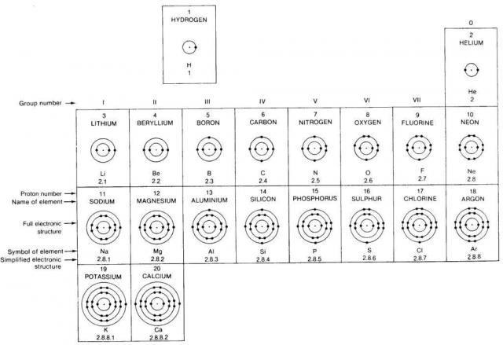

Slide 4
Inner Core and Valence Electron Configuration
Inner core electrons: the filled “shells”
Valence electrons: electrons occupying the outer energy level
These are the electrons that participate in:
Bonding
Making cations – lose
Making anions – gain
Atoms tend to gain, lose, or share electrons
until they have eight valence electrons.- The Octet Rule

Slide 5
Electron Configuration for Ions
Electrons are removed or added to the VALENCE SHELL.
Valence shell is the outermost energy level that an atom’s electrons occupy.
Electrons in the valence shell are referred to as the valance electrons.
Cations
Metals tend to form cations.
Cations are elements having fewer electrons than protons.
Cations are positively charged atoms.
Anions
Nonmetals tend to form anions.
Anions are elements that have more electrons than protons.
Anions are negatively charged atoms.

Slide 6
The “Full-Shell” Look: Eight Valence Electrons
Quantum-mechanical calculations show that an atom with eight valence electrons should be unreactive – meaning the atom is very stable.
The noble gases have eight valence electrons and are all very stable and unreactive.
Exception is Helium (He), which has two valence electrons, but that fills its valence shell.
If a “full-shell” look implies stability, then elements having either one more electron (alkali metals) or one less electron (halogens) should be predicted to be very reactive.
Halogens, with seven valence electrons, are the most reactive of the nonmetals.
They gain ONE electron to form anions.
Alkali metals, with one more electron than the preceding noble gas, are the most reactive of the metals.
They lose ONE electron to form cations.

Slide 7
Energy Levels
Quantum mechanics has a principal quantum number. It is represented by a little n. It represents the “energy level” similar to Bohr’s model.
n=1 describes the first energy level
n=2 describes the second energy level
Etc.
Each energy level represents a period or row on the periodic table. It’s amazing how all this stuff just “fits” together.
Red n = 1
Orange n = 2
Yellow n = 3
Green n = 4
Blue n = 5
Indigo n = 6
Violet n = 7

Slide 8
Table Summary of Quantum Numbers of Electrons in Atoms
Name
Symbol
Allowed Values
Property
principal
n
positive integers (1, 2, 3,…)
orbital energy (size)
angular momentum
l
integers from 0 to n-1
orbital shape (l values of 0, 1, 2 and 3 correspond to s, p, d and f orbitals, respectively.)
magnetic
m_{l}
integers from -l to 0 to +l
orbital orientation
spin
m_{s}
+1/2 or -1/2
direction of e⁻ spin
Each electron in an atom has its own unique set of four (4) quantum numbers.

Slide 9
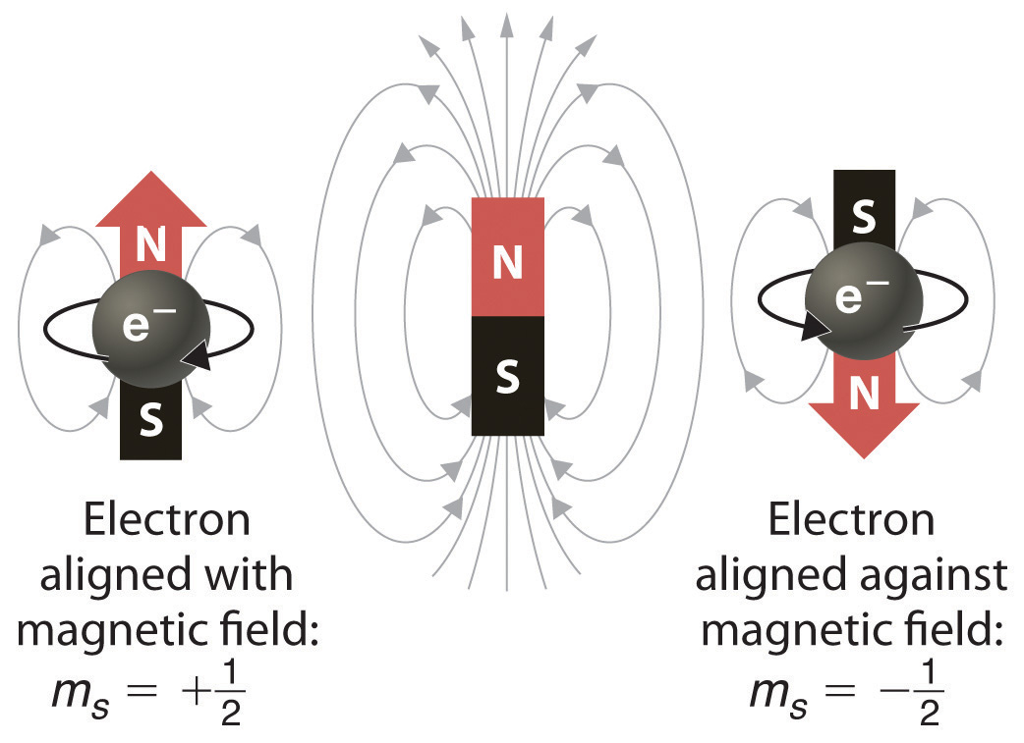

Slide 10
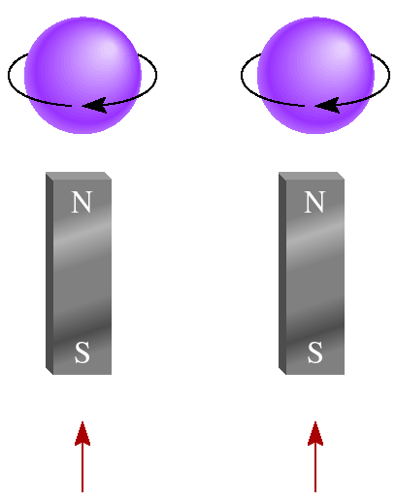
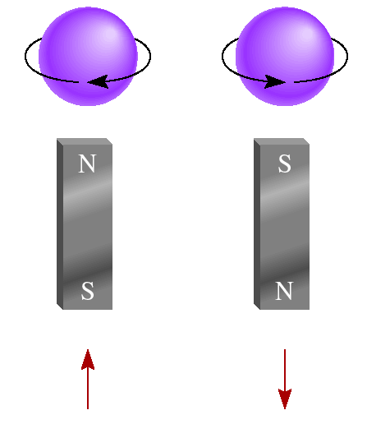
Paramagnetic
Diamagnetic
unpaired electrons
all electrons paired
2p
2p

Slide 11
Schrodinger Wave Equation
quantum numbers: (n, l, m_{l}, m_{s})
Shell – electrons with the same value of n
Subshell – electrons with the same values of n and l
Orbital – electrons with the same values of n, l, and m_{l}
If n, l, and m_{l} are fixed, then m_{s} = ½ or - ½
An orbital can hold 2 electrons

Slide 12
Sub-levels = Specific Atomic Orbitals
Each energy level has 1 or more “sub-levels” which describe the specific “atomic orbitals” for that level.
n = 1 has 1 sub-level (the “s” orbital)
n = 2 has 2 sub-levels (“s” and “p”)
n = 3 has 3 sub-levels (“s”, “p” and “d”)
n = 4 has 4 sub-levels (“s”, “p”, “d” and “f”)
There are 4 types of atomic orbitals:
s, p, d and f
Each of these sub-levels represent the blocks on the periodic table.
Blue = s block
Yellow = p block
Red = d block
Green = f block

Slide 13
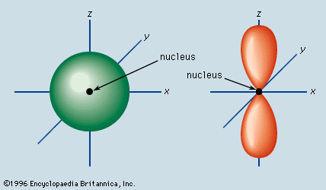
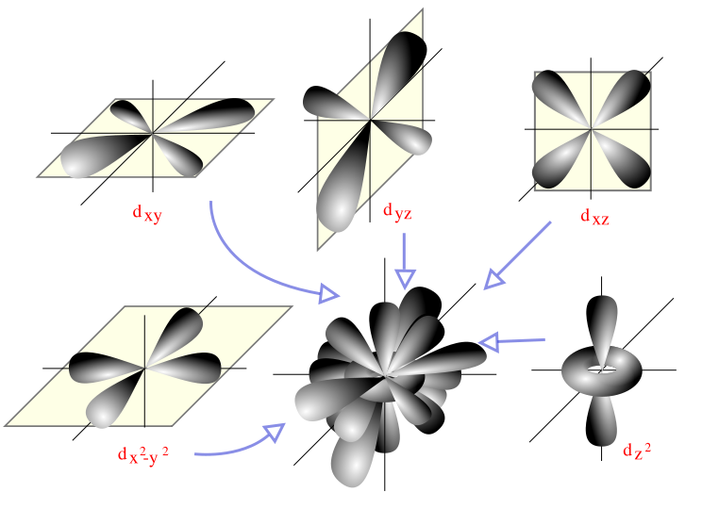
Orbitals The space where there is a high probability that it is occupied by a pair of electrons.
d
s
p
In the s block, electrons are going into s orbitals.
In the p block, the s orbitals are full. New electrons are going into the p orbitals.
In the d block, the s and p orbitals are full. New electrons are going into the d orbitals.

Slide 14
General Energy Ordering of Electrons in Atomic Orbitals

Slide 15
Azimuthal Quantum Number, l l = 0, 1...,n-1
Value of l | 0 | 1 | 2 | 3
Type of orbital | s | p | d | f
So each of these letters corresponds to a shape of orbital.

Slide 16
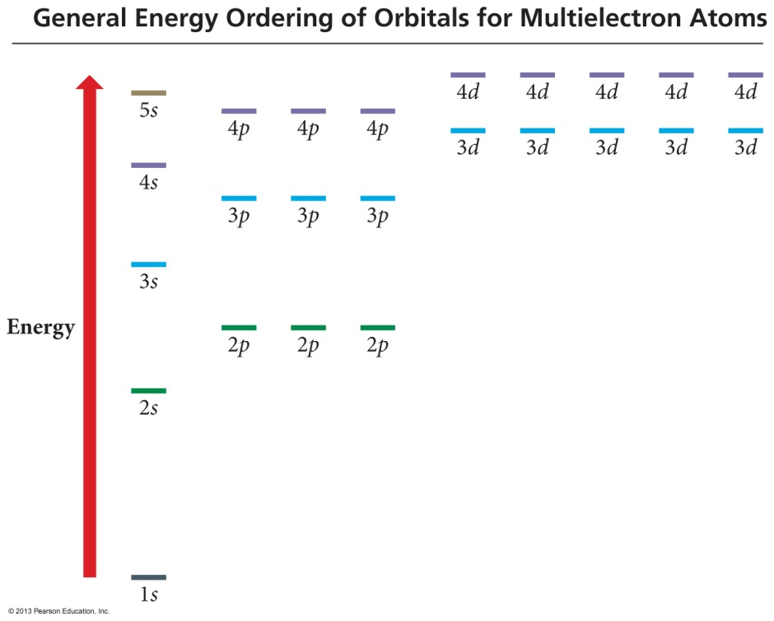
Arrangement of Electrons in Atoms
Electrons are arranged around an
atom’s nucleus according to the
Aufbau principle.
Electrons enter the lowest energy level (n) and orbitals (l) available.
n + l rule
Electrons will enter lowest
energy subshell (l) that is empty in that energy level (n).
Example: 2s vs. 2p
For 2s: n = 2 and l = 0 (s)
So, (n + l) = 2 = 0 = 2
For 2p: n = 2 and l = 1 (p)
So, (n + l) = 2 + 1 = 3
The electron goes into the empty 2s orbital, not the 2p.

Slide 17
Electron Configuration
According to quantum mechanics:
Electron location around the atom’s nucleus is described by the four quantum numbers:
n (principle energy level)
l (orbital type: s, p, d, f…)
m_{l} (orientation of orbital)
m_{s} (spin of electron in orbital)
No two electrons can have the same four quantum numbers: Pauli exclusion principle

Slide 18
Writing Atomic Electron Configurations
Electron configuration for He, atomic number = 2
number of electrons in the orbital
1 s ²
orbital type (value of l)
Energy level (value of n)

Slide 19
Energy Level | Sub-levels | Total Orbitals | Total Electrons | Total Electrons per Level
n = 1 | s | 1 (1s orbital) | 2 | 2
n = 2 | s p | 1 (2s orbital) 3 (2p orbitals) | 2 6 | 8
n = 3 | s p d | 1 (3s orbital) 3 (3p orbitals) 5 (3d orbitals) | 2 6 10 | 18
n = 4 | s p d f | 1 (4s orbital) 3 (4p orbitals) 5 (4d orbitals) 7 (4f orbitals) | 2 6 10 14 | 32
Complete the chart in your notes as we discuss this.
The first level (n=1) has an s orbital. It has only 1. There are no other orbitals in the first energy level.
We call this orbital the 1s orbital.

Slide 20
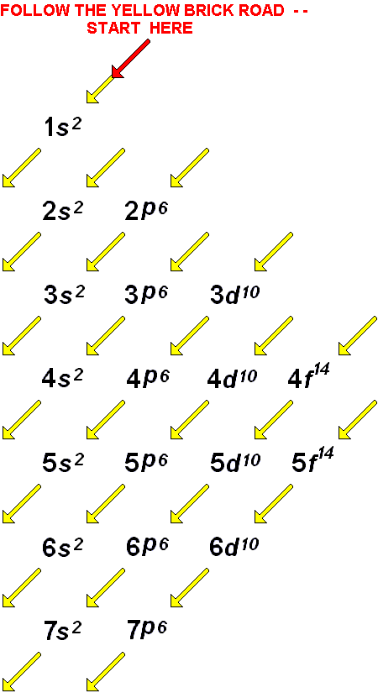
Rules for Electron Configurations
In order to write an electron configuration, we need to know the RULES.
3 rules govern electron configurations.
Aufbau Principle
Pauli Exclusion Principle
Hund’s Rule
Using the orbital filling diagram at the right will help you figure out HOW to write them
Start with the 1s orbital. Fill each orbital completely and then go to the next one, until all of the elements have been accounted for.

Slide 21
Filling Rules for Electron Orbitals
Aufbau Principle: Electrons are added one at a time to the lowest
energy orbitals available until all the electrons of the atom
have been accounted for.
Pauli Exclusion Principle: An orbital can hold a maximum of two electrons. To occupy the same orbital, two electrons must spin in opposite
directions.
Hund’s Rule: Electrons occupy equal-energy orbitals so that a maximum
number of unpaired electrons results.
*Aufbau is German for “building up”
Notes:
The Aufbau principle
– Used to construct the periodic table
– First, determine the number of electrons in the atoms
– Then add electrons one at a time to the lowest-energy orbitals available without violating the Pauli principle
– Each of the orbitals can hold two electrons, one with spin up ↑, which is written first, and one with spin down ↓
– A filled orbital is indicated by ↑↓, in which the electron spins are paired
– The electron configuration is written in an abbreviated form, in which the occupied orbitals are identified by their principal quantum n and their value of l (s, p, d, or f), with the number of electrons in the subshell indicated by a superscript

Slide 22
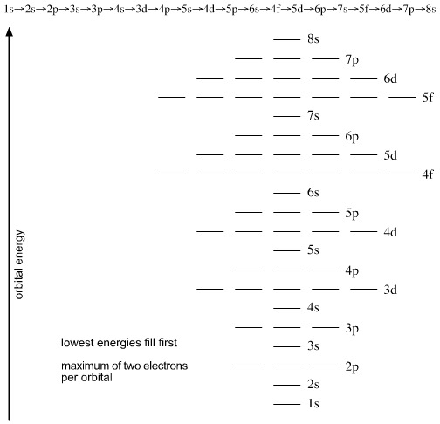
Fill Lower Energy Orbitals FIRST http://www.meta-synthesis.com/webbook/34_qn/qn3.jpg
Each line represents an orbital.
1 (s), 3 (p), 5 (d), 7 (f)
High Energy
The Aufbau Principle states that electrons enter the lowest energy orbitals first.
The lower the principal quantum number (n) the lower the energy.
Within an energy level, s orbitals are the lowest energy, followed by p, d and then f. F orbitals are the highest energy for that level.
Low Energy

Slide 23
Orbital Diagrams
Each box represents one orbital.
Half-arrows represent the electrons.
The direction of the arrow represents the spin of the electron.
1s²2s¹

Slide 24
Energy Level Diagram
6s 6p 5d 4f
Bohr Model
5s 5p 4d
4s 4p 3d
Arbitrary Energy Scale
3s 3p
N
2s 2p
1s
Electron Configuration
NUCLEUS
H He Li C N Al Ar F Fe La
CLICK ON ELEMENT TO FILL IN CHARTS

Slide 25
Energy Level Diagram
Hydrogen
6s 6p 5d 4f
Bohr Model
5s 5p 4d
4s 4p 3d
Arbitrary Energy Scale
3s 3p
N
2s 2p
1s
Electron Configuration
NUCLEUS
H = 1s¹
H He Li C N Al Ar F Fe La
CLICK ON ELEMENT TO FILL IN CHARTS

Slide 26
Energy Level Diagram
Helium
6s 6p 5d 4f
Bohr Model
5s 5p 4d
4s 4p 3d
Arbitrary Energy Scale
3s 3p
N
2s 2p
1s
Electron Configuration
NUCLEUS
He = 1s²
H He Li C N Al Ar F Fe La
CLICK ON ELEMENT TO FILL IN CHARTS

Slide 27
Energy Level Diagram
Lithium
6s 6p 5d 4f
Bohr Model
5s 5p 4d
4s 4p 3d
Arbitrary Energy Scale
3s 3p
N
2s 2p
1s
Electron Configuration
NUCLEUS
Li = 1s²2s¹
H He Li C N Al Ar F Fe La
CLICK ON ELEMENT TO FILL IN CHARTS

Slide 28
Energy Level Diagram
Carbon
6s 6p 5d 4f
Bohr Model
5s 5p 4d
4s 4p 3d
Arbitrary Energy Scale
3s 3p
N
2s 2p
1s
Electron Configuration
NUCLEUS
C = 1s²2s²2p²
H He Li C N Al Ar F Fe La
CLICK ON ELEMENT TO FILL IN CHARTS

Slide 29
Energy Level Diagram
Nitrogen
6s 6p 5d 4f
Bohr Model
5s 5p 4d
4s 4p 3d
Arbitrary Energy Scale
3s 3p
N
Hund’s Rule “maximum
number of unpaired orbitals”.
2s 2p
1s
Electron Configuration
NUCLEUS
N = 1s²2s²2p³
H He Li C N Al Ar F Fe La
CLICK ON ELEMENT TO FILL IN CHARTS

Slide 30
Energy Level Diagram
Fluorine
6s 6p 5d 4f
Bohr Model
5s 5p 4d
4s 4p 3d
Arbitrary Energy Scale
3s 3p
N
2s 2p
1s
Electron Configuration
NUCLEUS
F = 1s²2s²2p⁵
H He Li C N Al Ar F Fe La
CLICK ON ELEMENT TO FILL IN CHARTS

Slide 31
Energy Level Diagram
Aluminum
6s 6p 5d 4f
Bohr Model
5s 5p 4d
4s 4p 3d
Arbitrary Energy Scale
3s 3p
N
2s 2p
1s
Electron Configuration
NUCLEUS
Al = 1s²2s²2p⁶3s²3p¹
H He Li C N Al Ar F Fe La
CLICK ON ELEMENT TO FILL IN CHARTS

Slide 32
Energy Level Diagram
Argon
6s 6p 5d 4f
Bohr Model
5s 5p 4d
4s 4p 3d
Arbitrary Energy Scale
3s 3p
N
2s 2p
1s
Electron Configuration
NUCLEUS
Ar = 1s²2s²2p⁶3s²3p⁶
H He Li C N Al Ar F Fe La
CLICK ON ELEMENT TO FILL IN CHARTS

Slide 33
Energy Level Diagram
Iron
6s 6p 5d 4f
Bohr Model
5s 5p 4d
4s 4p 3d
Arbitrary Energy Scale
3s 3p
N
2s 2p
1s
Electron Configuration
NUCLEUS
Fe = 1s²2s²2p⁶3s²3p⁶4s²3d⁶
H He Li C N Al Ar F Fe La
CLICK ON ELEMENT TO FILL IN CHARTS

Slide 34
Energy Level Diagram
Lanthanum
6s 6p 5d 4f
Bohr Model
5s 5p 4d
4s 4p 3d
Arbitrary Energy Scale
3s 3p
N
2s 2p
1s
Electron Configuration
NUCLEUS
La = 1s²2s²2p⁶3s²3p⁶4s²3d¹⁰
4s²3d¹⁰4p⁶5s²4d¹⁰5p⁶6s²5d¹
H He Li C N Al Ar F Fe La
CLICK ON ELEMENT TO FILL IN CHARTS

Slide 35
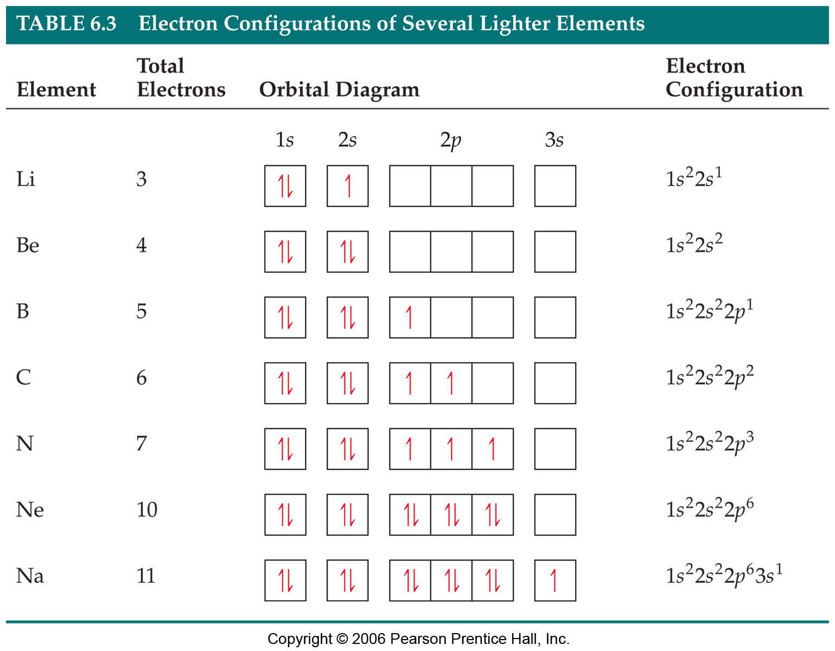
Electron configurations

Slide 36
We fill orbitals in increasing order of energy.
Different blocks on the periodic table, then correspond to different types of orbitals.

Slide 38
Introduction
Quantum theory enables us to understand the critical role that electrons play in chemistry.
Studying atoms leads to the following questions:
How many electrons are present in a particular atom?
What energies do individual electrons possess?
Where in the atom can electrons be found?
The answer to these questions have a direct relationship to the behavior of all substances in chemical reactions.

Slide 39
From Classical Physics to Quantum Theory
The new era in physics started in 1900 with a young German physicist named Max Planck.
While studying the data on radiation emitted by solids heated to various temperatures, Planck discovered that atoms and molecules emit energy only in certain discrete quantities, or quanta.
Physicists had always assumed that energy is continuous and that any amount of energy could be released in a radiation process.
Planck’s quantum theory turned physics upside down.

Slide 40
Waves
A
time
Wave: some sort of periodic function
something that periodicaly changes vs. time.
wavelength (λ): distance between equivalent points
Amplitude: “height” of wave, maximum displacement of periodic function.

Slide 41
Waves
The number of waves passing a given point per unit of time is the frequency (ν).
For waves traveling at the same velocity, the longer the wavelength, the smaller the frequency.
Higher frequency
shorter wavelength
lower frequency
longer wavelength

Slide 42
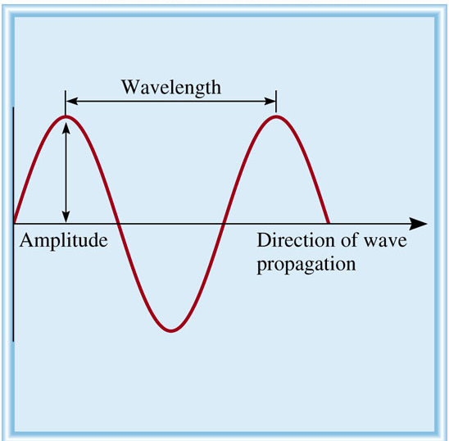
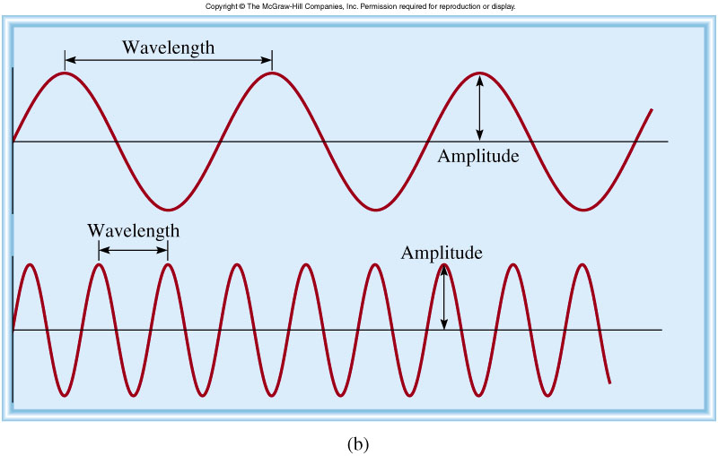
Properties of Waves
Wavelength (λ) is the distance between identical points on successive waves.
Amplitude is the vertical distance from the midline of a wave to the peak or trough.
Frequency (ν) is the number of waves that pass through a particular point in 1 second (Hz = 1 cycle/s).
The speed (u) of the wave = λ x ν

Slide 43
Waves
v = wavelength x frequency
meters x (1/sec) = m/sec
v = λν

Slide 44
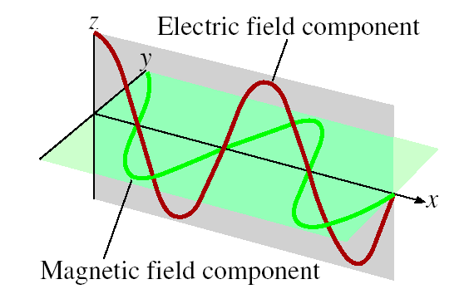
James Clerk Maxwell (1873), proposed that visible light consists of electromagnetic waves.
Electromagnetic radiation is the emission and transmission of energy in the form of electromagnetic waves.
Speed of light (c) in vacuum = 3.00 x 10⁸ m/s
All electromagnetic radiation
l x n = c

Slide 45
Electromagnetic Radiation
All electromagnetic radiation travels the speed of light (c), 3.00 × 10⁸ m/s (in a vacuum).
Therefore: c = λν

Slide 46
A photon has a frequency of 6.0 x 10⁴ Hz. Convert this frequency into wavelength (nm). Does this frequency fall in the visible region?
λ x ν = c
λ
λ = c/ν
ν
= 3.00 x 10⁸ m/s / 6.0 x 10⁴ Hz
= 5.0 x 10³ m
= 5.0 x 10¹² nm

Slide 47
The three mysteries of 19th century physics Mystery #1: Blackbody radiation
Why does metal glow when heated?
K.E. of electrons
What light is given off?

Slide 48
Mystery 1: Black body radiation
Higher T leads to shorter wavelength of light
More K.E., more E
Must be relationship between E and wavelength
Plank concluded that energy is quantized. It comes in packets (like fruit snacks) and is proportional to frequency:
E = hν
where h is Planck’s constant, 6.63 × 10⁻³⁴ J-s. The minimum packet of E.

Slide 49
Mystery # 1, “Heated Solids Problem” Solved by Max Planck in 1900
When solids are heated, they emit electro- magnetic radiation over a wide range of wavelengths.
Radiant energy emitted by an object at a certain temperature depends on its wavelength.
Energy (light) is emitted or absorbed only in discrete quantities, like small packages or bundles (quantum).
Quantum: the smallest quantities of energy that can be emitted (or absorbed) in the form of electromagnetic radiation.

Slide 50
What did Einstein get the Nobel Prize for?

Slide 51
Mystery #2: The Photo-electric effect
Note, this is what a photo cell does
Turn light into work (current)

Slide 52
Einstein: Light is both a particle and a wave.
E_{photon} = 1/2mv² + hν_{ο} = Ε_{electron}
light comes in packets of energy. Each packet
runs into one electron. Each packet must have
enough E to break electron loose from metal.
The rest of the energy goes into kinetic energy.
Frequency tells us the E of each packet.
I tells us how many packets/second we get.
More packets, more current (more electrons
knocked off).
e- K.E.
“escape energy”
e-
e-
hν
metal

Slide 53
The Nature of Energy
Energy, λ, ν, related:
c = λν
E = hν
c= speed of light in vacuum,
constant

Slide 54
When copper is bombarded with high-energy electrons, X rays are emitted. Calculate the energy (in joules) associated with the photons if the wavelength of the X rays is 0.154 nm.
E = h x ν
= h x c / λ
= 6.63 x 10⁻³⁴ (J•s) x 3.00 x 10 ⁸ (m/s) / 0.154 x 10⁻⁹ (m)
= 1.29 x 10 ⁻¹⁵ J

Slide 55
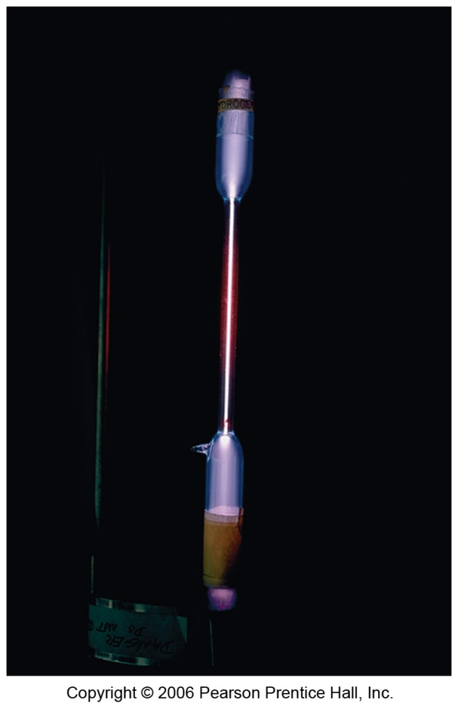
Mystery number 3: element line spectrum
Gas discharge tube
(full of some elemental gas)
Gives off specific frequencies of light only.
Different elements give off different colors.
i.e. different energies.
Hydrogen
Neon

Slide 56
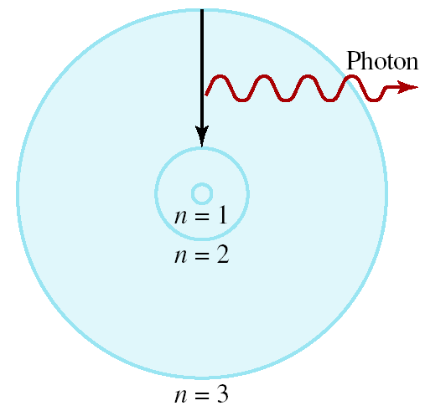
Bohr’s Model of
the Atom (1913)
e⁻ can only have specific (quantized) energy values
light is emitted as e⁻ moves from one energy level to a lower energy level
1
E_{n} = -R_{H}
( )
n²
n (principal quantum number) = 1, 2, 3,…
R_{H} (Rydberg constant) = 2.18 x 10⁻¹⁸J

Slide 57
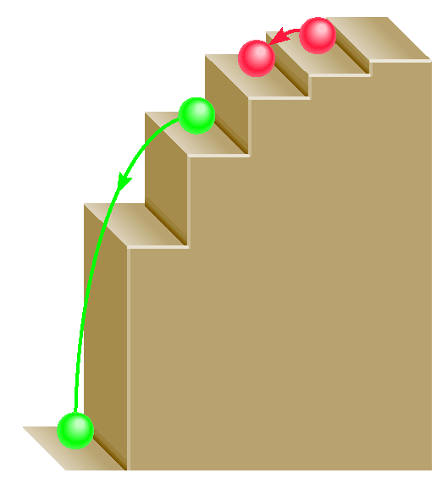
E = hν
E = hν

Slide 58
The Nature of Energy
Niels Bohr adopted Planck’s assumption and explained these phenomena in this way:
Electrons in an atom can only occupy certain orbits (corresponding to certain energies).

Slide 59
The Nature of Energy
Niels Bohr adopted Planck’s assumption and explained these phenomena in this way:
Electrons in permitted orbits have specific, “allowed” energies;

Slide 60
The Nature of Energy
Niels Bohr adopted Planck’s assumption and explained these phenomena in this way:
Energy is only absorbed or emitted in such a way as to move an electron from one “allowed” energy state to another; the energy is defined by
E = hν

Slide 61
The Nature of Energy
The energy absorbed or emitted from electron promotion or demotion can be calculated by the equation:
where R_{H} is the Rydberg constant, 2.18 × 10⁻¹⁸ J, and n_{i} and n_{f} are integers, the initial and final energy levels of the electron.

Slide 62
Calculate the wavelength (in nm) of a photon emitted by a hydrogen atom when its electron drops from the n = 5 state to the n = 3 state.
1
1
E_{photon} =
ΔE = R_{H}
( )
n²
n²
i
f
= 2.18 x 10⁻¹⁸ J x (1/25 - 1/9)
= -1.55 x 10⁻¹⁹ J
E_{photon} = h x c / λ
λ = h x c / E_{photon}
= 6.63 x 10⁻³⁴ (J•s) x 3.00 x 10⁸ (m/s)/1.55 x 10⁻¹⁹J
= 1280 nm

Slide 63
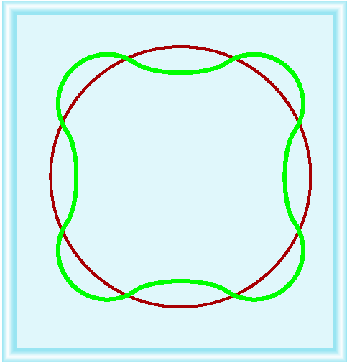
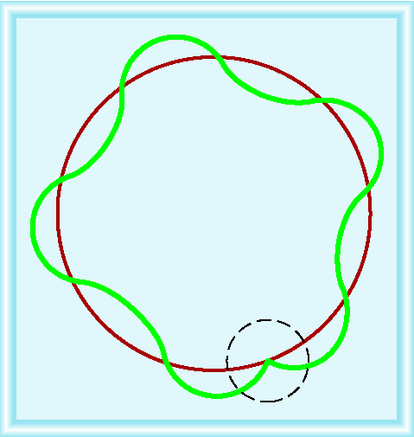
Why is e⁻ energy quantized?
De Broglie (1924) reasoned that e⁻ is both particle and wave.
h
2πr = nλ λ =
mu
u = velocity of e-
m = mass of e-

Slide 64
What is the de Broglie wavelength (in nm) associated with a 2.5 g Ping-Pong ball traveling at 15.6 m/s?
λ = h/mu
h in J•s
m in kg
u in (m/s)
λ = 6.63 x 10⁻³⁴ / (2.5 x 10⁻³ x 15.6)
= 1.7 x 10⁻³² m = 1.7 x 10⁻²³ nm

