Slide 1
Digestion
&
Excretion

Slide 2
Digestion
The process by which food is converted into substances that
can be absorbed and assimilated by the body.
Mechanical & chemical breakdown of food into
nutrients.
Four main macromolecules in food: nucleic acids,proteins,
fats, and carbohydrates.
broken down into smaller molecules of nucleotides, amino
acids, fatty acids and glycerol, and simple sugars.
being absorbed
Important minerals, vitamins, and water are also extracted from
food during the process of digestion.

Slide 3
Food Sources
Biologists categorize animals into three groups based
on their food source.
Herbivores obtain all food from plants. Examples: cows, horses, and nearly all rodents.
Carnivores obtain all food from meat.
Examples: cats, eagles, wolves, and frogs.
Omnivores obtain food from both plants and meat. Examples: humans and bears.
The digestive tract is the area where digestion takes place.
The digestive tract varies widely in complexity from species to species.
3

Slide 4
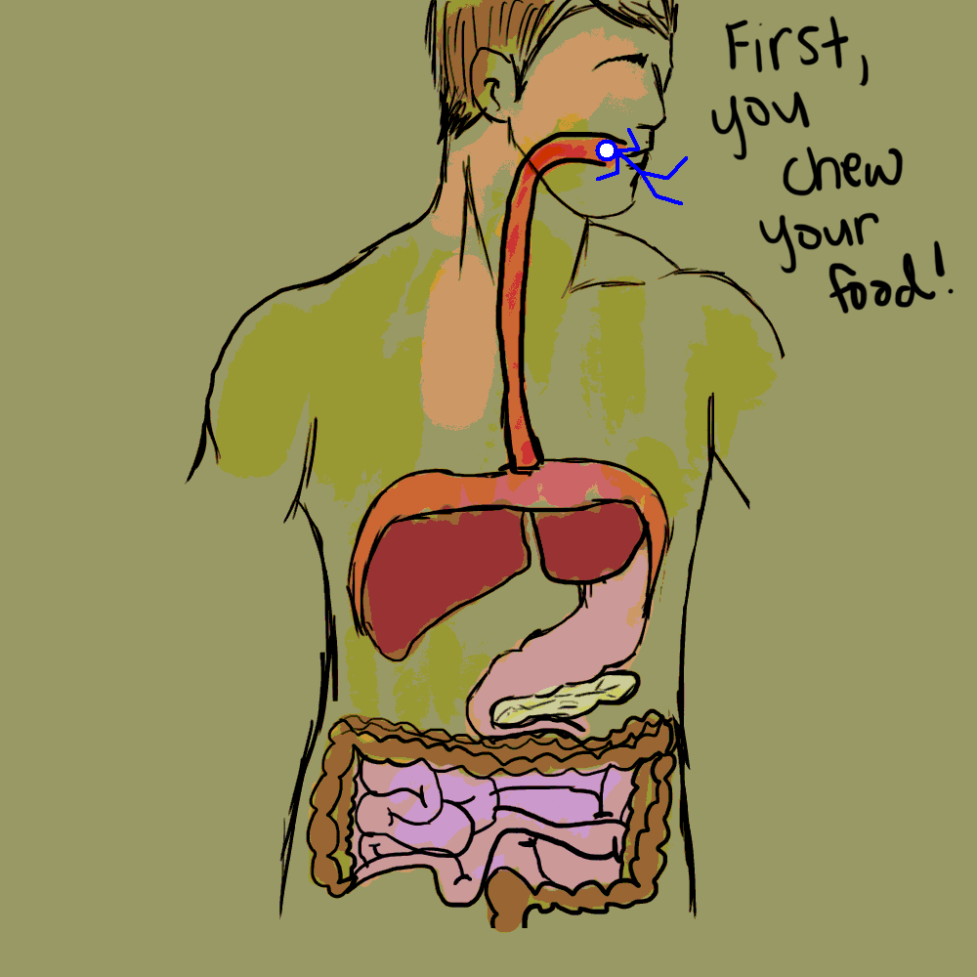

Slide 5
Digestion: Overview
1. Ingestion is the act of eating
2. Digestion is the process of breaking food down into molecules small enough to be absorbed
Mechanical digestion, including chewing, increases the surface area of food
Chemical digestion splits food into small molecules that can pass through membranes; these are used to build larger molecules. In chemical digestion, the process of enzymatic hydrolysis splits bonds in molecules with the addition of water
3. Absorption is uptake of nutrients by body cells
4. Elimination is the passage of undigested material out of the digestive system

Slide 6
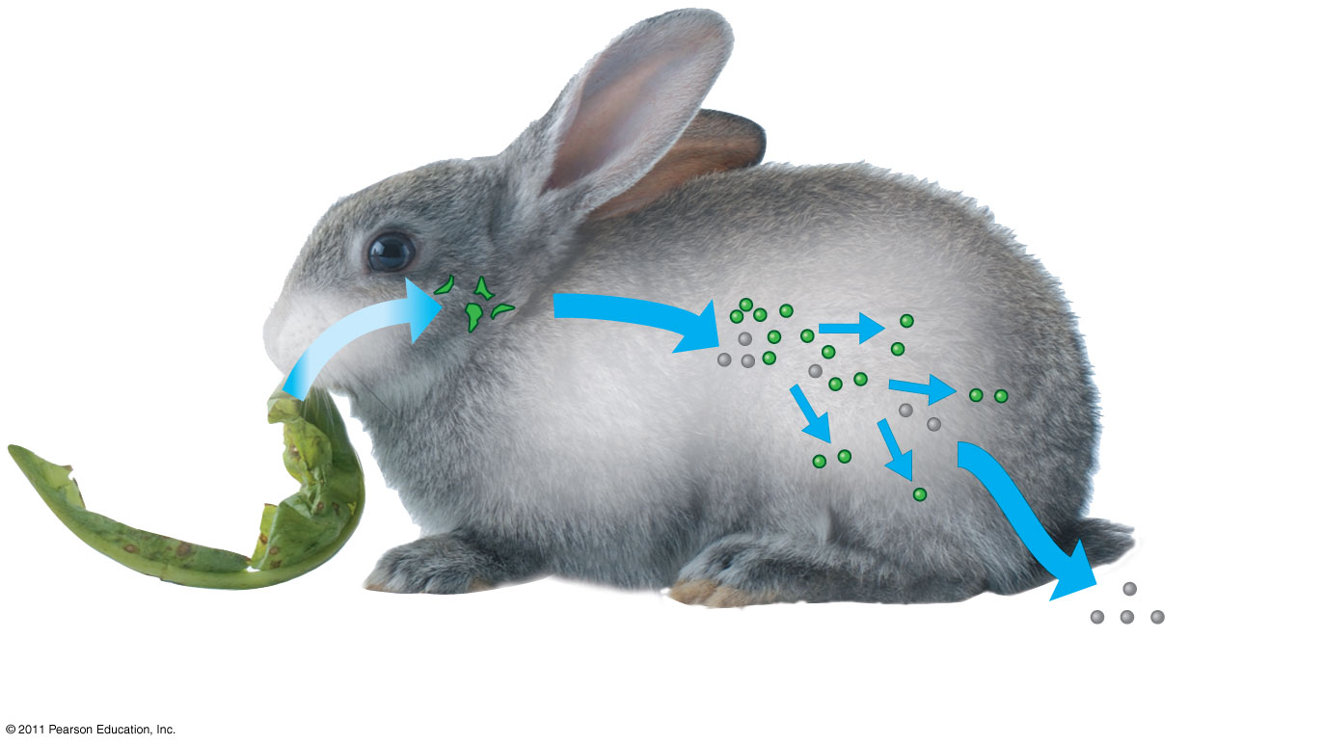
Figure 41.5
Nutrient molecules
enter body cells
Mechanical
digestion
Chemical
digestion
(enzymatic
hydrolysis)
Undigested
material
1
Ingestion
2
Digestion
3
Absorption
4
Elimination
Notes:
Figure 41.5 The four stages of food processing.

Slide 7
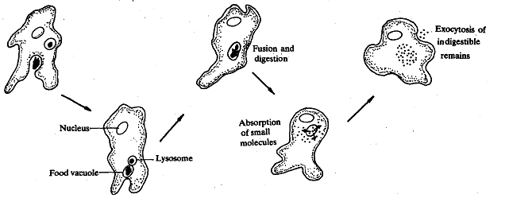
Types of digestion
Intracellular
In intracellular digestion, food particles are engulfed by phagocytosis
Food vacuoles, containing food, fuse with lysosomes containing hydrolytic enzymes
Small molecules are retained by the cell
Indigestible remains are released into the surrounding
Example: Digestion in amoeba
Extracellular
Breakdown of food particles outside of cells
It occurs in compartments that are continuous with the outside of the animal’s body
Example: Digestion in animals

Slide 8
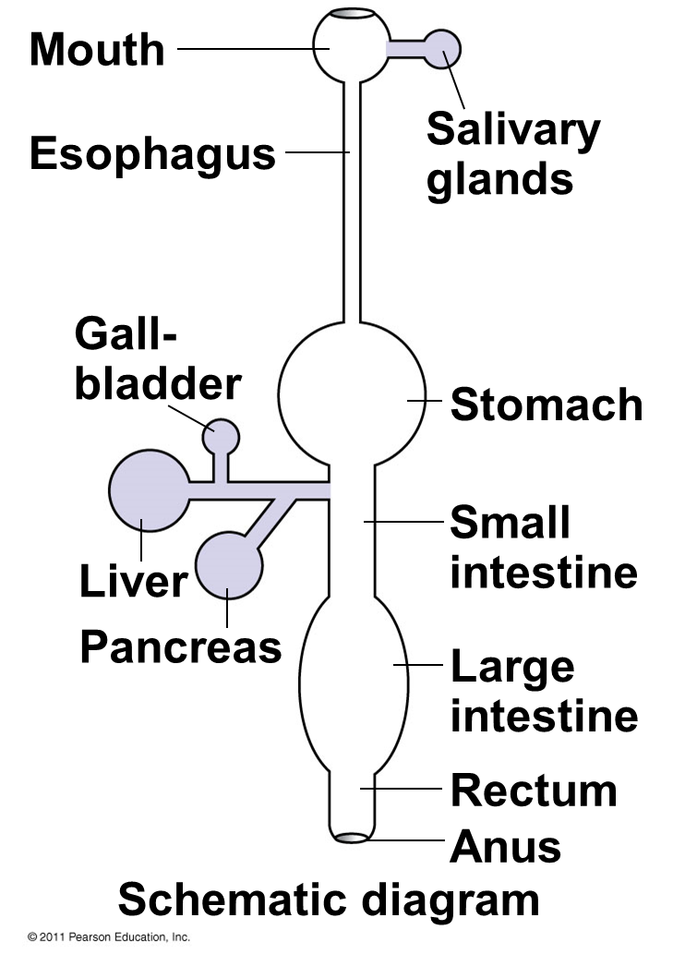
Steps in digestion
The mammalian digestive system consists of an alimentary canal and accessory glands that secrete digestive juices through ducts
Mammalian accessory glands are the salivary glands, the pancreas, the liver, and the gallbladder
Food is pushed along by peristalsis, rhythmic contractions of muscles in the wall of the canal
Valves called sphincters regulate the movement of material between compartments
© 2011 Pearson Education, Inc.

Slide 9
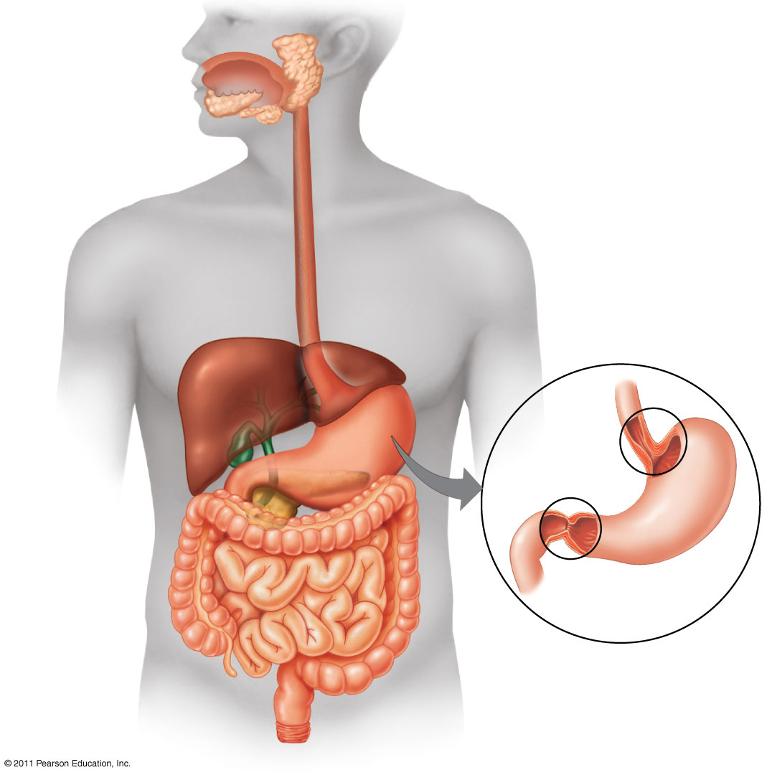
Figure 41.9a
Tongue
Oral cavity
Salivary
glands
Pharynx
Esophagus
Liver
Sphincter
Gall-
bladder
Sphincter
Pancreas
Stomach
Small
intestine
Large
intestine
Duodenum of
small intestine
Rectum
Anus
Notes:
Figure 41.9 The human digestive system.

Slide 10
Steps in digestion
Digestion in Oral Cavity
Salivary glands deliver saliva to lubricate food
Teeth chew food into smaller particles that are exposed to salivary amylase, initiating breakdown of glucose polymers
The tongue shapes food into a bolus and provides help with swallowing
The esophagus connects to the stomach and carries food from the oral cavity down to the stomach by peristalsis
© 2011 Pearson Education, Inc.
Notes:
Swallowing causes the epiglottis to block entry to the trachea, and the bolus is guided by the larynx, the upper part of the respiratory tract
Coughing occurs when the swallowing reflex fails and food or liquids reach the windpipe

Slide 11
Digestion in the Stomach
Steps in digestion
The stomach stores food and secretes gastric juice
Gastric juice has the following components:
1. HCl – low pH of about 2 which kill many bacteria taken in with the food. It provides the acidity needed to keep the pepsin enzyme working.
2. Pepsin - a protease, or protein-digesting enzyme, that cleaves proteins into smaller peptides
3. Mucin- coats the stomach, protecting it from the effects of the acid and pepsin
© 2011 Pearson Education, Inc.

Slide 12
Steps in digestion
Digestion in the small intestine
The small intestine is the longest section of the alimentary canal.
It is divided into:
Duodenum
Jejenum
Ileum
It is the major organ of digestion and absorption
The first portion of the small intestine is the duodenum, where chyme from the stomach mixes with digestive juices from the (1) pancreas, (2) liver and gallbladder, and the (3) small intestine itself
© 2011 Pearson Education, Inc.

Slide 13
Accessory organ
Liver - Produces bile; Stores glucose as glycogen & releases glucose into blood stream
Gallbladder - Stores bile, Squirts bile into small intestine when fat arrives
Pancreas - Makes enzymes. Empties into small intestine
Pancreatic juice: enzymes, bicarbonate
Insulin and glucagon secreted directly into blood
Insulin: Enables cells to use glucose (glucose enters
cells) & promotes formation of glycogen in liver
Glucagon: Signals to the liver to convert glycogen
into glucose & release it into the bloodstream

Slide 14
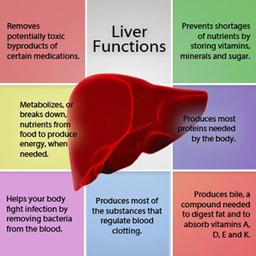
Liver
Largest internal organ
Called the ‘chemical factory’
The liver has multiple functions:
its main function within the
digestive system is to process
the nutrients absorbed from the
small intestine.
Bile from the liver secreted into
the small intestine also plays an
important role in digesting fat.
the liver also detoxifies potentially harmful chemicals.
It breaks down and secretes many drugs.

Slide 15
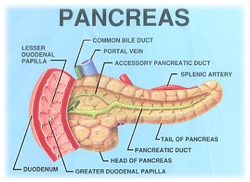
Pancreas
Leaf like organ which lies between the stomach and
duodenum
It secretes pancreatic juice which passes to the
duodenum to help in digestion
Amylase – for digesting starch
Protease – protein
Lipase – fat
amylase
Starch ------------------ maltose
protease
Proteins --------------- polypetides
lipase
Fats -------------------- fatty acid + glycerol
Role in Digestion:
enzymes break down protein, fats, and carbohydrates.
Bicarbonate in the pancreatic juice neutralizes the acidic nature of chyme from stomach.
The pancreas also makes hormone insulin, secreting it directly into the bloodstream. Insulin is the chief hormone for metabolizing sugar.

Slide 16
Gallbladder and Bile
The gallbladder is a pear-shaped organ that stores
about 50 mL of bile (or "gall") until the body
needs it for digestion. It is connected to the
liver and the duodenum by the biliary tract.
Bile is a complex fluid containing water,
electrolytes and a battery of organic molecules
including bile acids, cholesterol, phospholipids
and bilirubin that flows through the biliary tract
into the small intestine.
Two fundamentally important functions of bile:
Bile contains bile acids, which are critical for digestion and absorption of fats and fat-soluble vitamins in the small intestine.
Many waste products, including bilirubin, are eliminated from the body by secretion into bile and elimination in feces.
16
Notes:
16

Slide 17
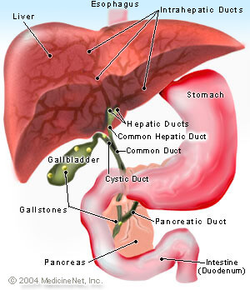
The gall bladder stores and concentrates bile during the fasting state.
Bile Duct Blockage
Obstruction of bile duct between the gallbladder and the small intestine causes fat digestion disrupted.
In addition, bile pigments are absorbed into the bloodstream, resulting in a buildup known as jaundice, a yellow discoloration of the skin.

Slide 18
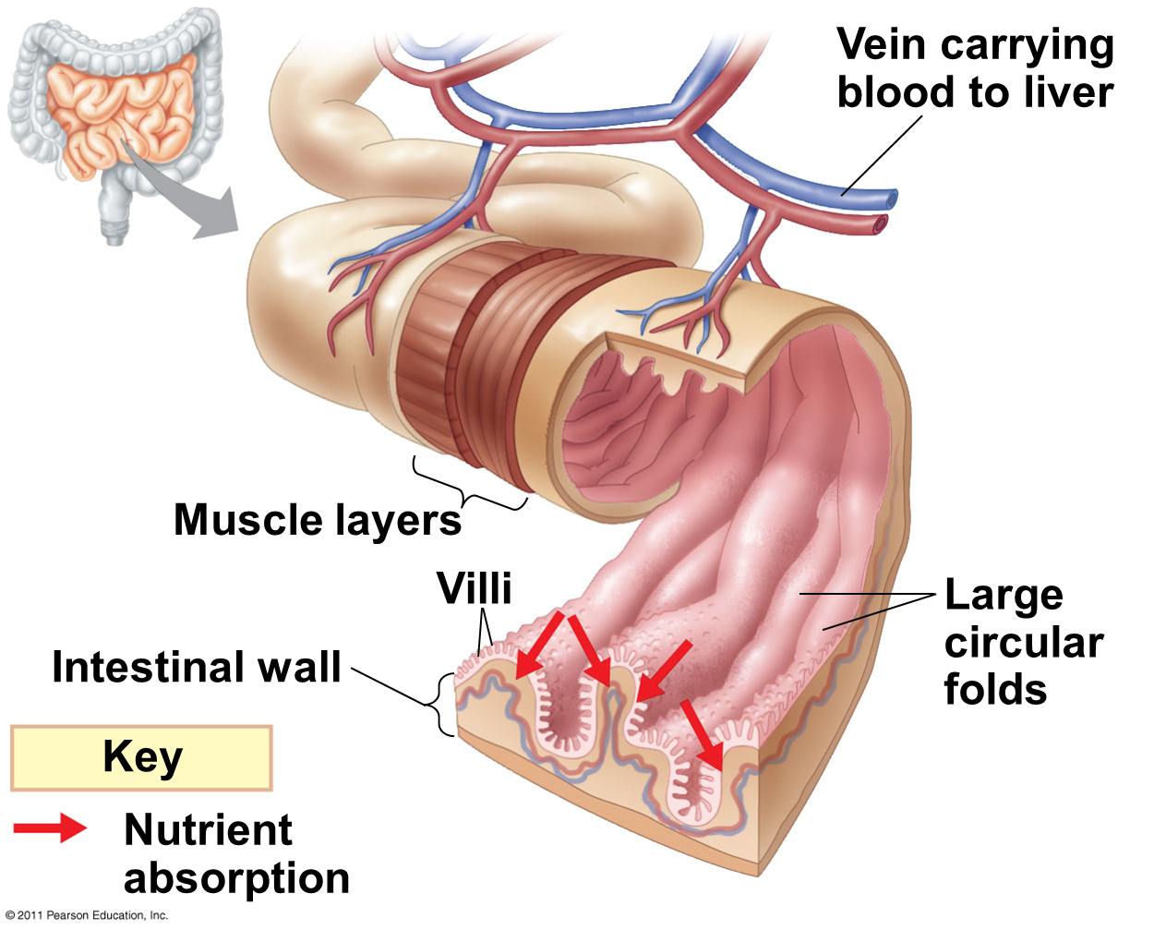
Steps in digestion
Absorption in the small intestine
The small intestine has a huge surface area, due to villi and microvilli that are exposed to the intestinal lumen
The enormous microvillar surface creates a brush border that greatly increases the rate of nutrient absorption
Transport across the epithelial cells can be passive or active depending on the nutrient
© 2011 Pearson Education, Inc.

Slide 19
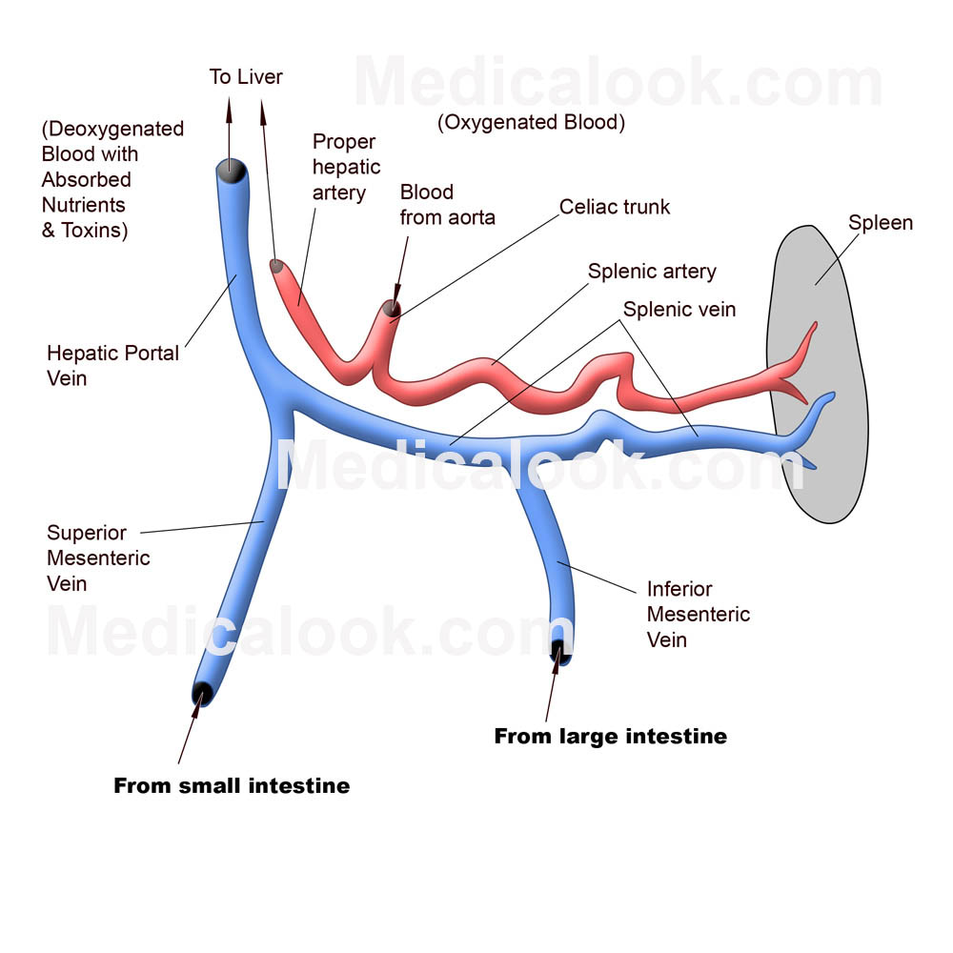
The hepatic portal vein carries nutrient-rich blood from the capillaries of the villi to the liver, then to the heart
The liver regulates nutrient distribution, interconverts many organic molecules, and detoxifies many organic molecules
© 2011 Pearson Education, Inc.

Slide 20
Steps in digestion
Absorption in the large intestine
The colon of the large intestine is connected to the small intestine
A major function of the colon is to recover water that has entered the alimentary canal
The colon houses bacteria (e.g., Escherichia coli) that live on unabsorbed organic material; some produce vitamins
Feces, including undigested material and bacteria, become more solid as they move through the colon
Feces are stored in the rectum until they can be eliminated through the anus
Two sphincters between the rectum and anus control bowel movements
© 2011 Pearson Education, Inc.

Slide 21
Food Type | Major Digestion area | Major Digestive Enzyme | End products
Carbohydrates | Mouth | Amylase | Glucose
Protein | Stomach | Pepsin | Amino acids
Fats | Small Intestine | Lipase | Small lipid molecules

Slide 22
Excretory System
Kidneys are the excretory organ of our body. These are the major component of urinary system.
Urinary system includes
(i) Kidneys...formation of urine
(ii) Ureters…transport of urine from kidneys to urinary bladder
(iii) Urinary bladder…reservoir of urine
(iv) urethra...passage of urine from urinary bladder to outside

Slide 23
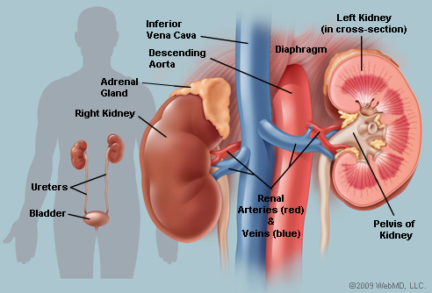
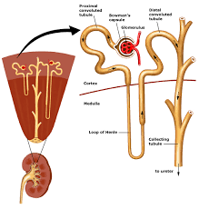
Kidney Structure
Each kidney contains about one million Nephrones which are the structural & functional unit of kidneys.

Slide 24
Functions of kidneys
Excretion of excess unnecessary substances & metabolic waste products
Osmoregulation
Regulation of (i) water & electrolyte balances
(ii) acid-base balances
(iii) blood pressure (iv) red cell production
Osmoregulation is the process by which cells and simple organisms maintain fluid and electrolyte balance with their surroundings.

Slide 25
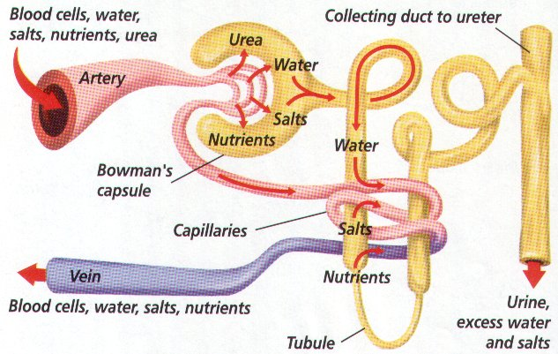
How kidneys clean blood
Kidneys clean blood by filtering it. They filter all our blood 300 times a day. The filtering is done by over a million tubes packed into each kidney. These tubes are called nephrones.
Some people’s kidneys are not very good at filtering blood. Kidney machines help by filtering blood for them.

