Slide 1
Circulatory & Respiratory system

Slide 2
Functions of circulatory system
Delivering oxygen to cells and picking up carbon dioxide
Distributing hormones to cells
Maintaining body temperature by transporting heat
Transporting cells to fight infection

Slide 3
The Blood System
Blood is a specialized body fluid that is composed of a liquid called blood plasma and blood cells suspended within the plasma.
Blood constitute about 7% of the body's total weight (5 liters/70 kg person).
The blood flows from the heart into arteries, then to capillaries, and returns to the heart through veins.
Notes:
There are two main fluid systems in the body: blood and lymph.
The blood and lymph systems are intertwined throughout the body and they are responsible for transporting the agents of the immune system.
The 5 liters of blood of a 70 kg (154 lb) person constitute about 7% of the body's total weight. The blood flows from the heart into arteries, then to capillaries, and returns to the heart through veins.
Blood is composed of 52–62% liquid plasma and 38–48% cells. The plasma is mostly water (91.5%) and acts as a solvent for transporting other materials (7% protein [consisting of albumins (54%), globulins (38%), fibrinogen (7%), and assorted other stuff (1%)] and 1.5% other stuff). Blood is slightly alkaline (pH = 7.40 ± .05) and a tad heavier than water (density = 1.057 ± .009).

Slide 4
Composition
52–62% liquid plasma
38–48% cells
The plasma:
water, 91.5%
(solvent for transporting other materials)
protein, 7%
albumins (54%), globulins (38%), fibrinogen (7%),
other stuff (1%)
Blood is slightly alkaline (pH = 7.40 ± .05) and a slightly heavier than water (density = 1.057 ± .009).

Slide 5
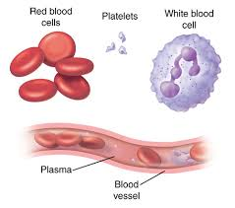
The Blood System
Cells:
all blood cells are manufactured by stem cells
stem cells live mainly in the bone marrow
formation of blood cellular components from stem cells is called hematopoiesis
Notes:
All blood cells are manufactured by stem cells, which live mainly in the bone marrow, via a process called hematopoiesis.
The stem cells produce hemocytoblasts that differentiate into the precursors for all the different types of blood cells.
Hemocytoblasts mature into three types of blood cells: erythrocytes (red blood cells or RBCs), leukocytes (white blood cells or WBCs), and thrombocytes (platelets).

Slide 6
The Blood System
Three types of blood cells
Erythrocytes,
Red blood cells, RBCs
Leukocytes,
White blood cells, WBCs
Thrombocytes,
Platelets
Granulocytes
large granules in the cytoplasm
Agranulocytes
without granules
Neutrophils
Eosinophils
Basophils
Lymphocytes
Monocytes
T Lymphocytes
B Lymphocytes
Notes:
All blood cells are manufactured by stem cells, which live mainly in the bone marrow, via a process called hematopoiesis.
The stem cells produce hemocytoblasts that differentiate into the precursors for all the different types of blood cells.
Hemocytoblasts mature into three types of blood cells: erythrocytes (red blood cells or RBCs), leukocytes (white blood cells or WBCs), and thrombocytes (platelets).
The leukocytes are further subdivided into granulocytes (containing large granules in the cytoplasm) and agranulocytes (without granules).
The granulocytes consist of neutrophils (55–70%), eosinophils (1–3%), and basophils (0.5–1.0%).
The agranulocytes are lymphocytes (consisting of B cells and T cells) and monocytes.
Lymphocytes circulate in the blood and lymph systems, and make their home in the lymphoid organs

Slide 7
The Blood System
Normal Adult Blood Cell Counts
Red Blood Cells |  | 5.0 X 10⁶/mm³
Platelets |  | 2.5 X 10⁵/mm³
Leukocytes |  | 7.3 X 10³/mm³
 | Neutrophil |  | 50-70%
 | Lymphocyte |  | 20-40%
 | Monocyte |  | 1-6%
 | Eosinophil |  | 1-3%
 | Basophil |  | <1%
Notes:
There are 5000–10,000 WBCs per mm3 and they live 5-9 days.
About 2,400,000 RBCs are produced each second and each lives for about 120 days (They migrate to the spleen to die. Once there, that organ scavenges usable proteins from their carcasses).
A healthy male has about 5 million RBCs per mm3, whereas females have a bit fewer than 5 million.

Slide 8
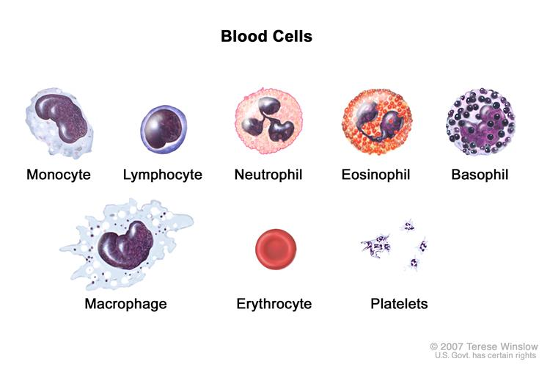

Slide 9
Function of Blood
Blood performs many important functions within the body including:
Supply of oxygen to tissues (bound to hemoglobin
which is carried in red cells)
Supply of nutrients such as glucose, amino acids and
fatty acids (dissolved in the blood or bound to plasma
proteins)
Removal of waste such as carbon dioxide, urea and
lactic acid
Immunological functions, including circulation of
white cells, and detection of foreign material by antibodies
It maintains acid base balance, body temperature.
Messenger functions, including the transport of hormones and
the signaling of tissue damage.

Slide 10
Plasma
Blood plasma is the liquid component of blood, in which the blood cells are suspended. It makes up about 55% of total blood volume.
Blood plasma is prepared simply by spinning a tube of fresh blood in a centrifuge until the blood cells fall to the bottom of the tube.
Blood serum is blood plasma without fibrinogen or the other clotting factors.

Slide 11
Red Blood Cell
Red blood cells are the most common type of blood cell and also known as RBCs, or erythrocytes.
Erythrocytes consist mainly of hemoglobin, a complex molecule containing heme groups.
Oxygen can easily diffuse through the red blood cell's cell membrane.
The diameter of a typical human erythrocyte disk is 6–8 µm, much smaller than most other human cells.
The process by which red blood cells are produced is called erythropoiesis.
Erythrocytes are continuously being produced in the red bone marrow of large bones, at a rate of about 2 million per second. (In the embryo, the liver is the main site of red blood cell production). In an adult, the total count of RBC is 4.5 to 5.5 million per mm3 of blood.

Slide 12
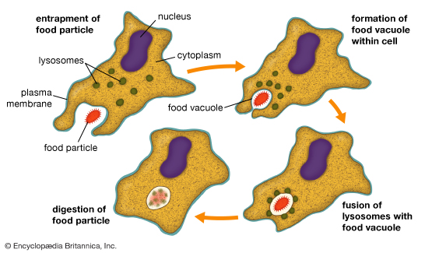
White Blood Cells
White blood cells or leukocytes are cells of the immune system defending the body against both infectious disease and foreign materials.
Leukocytes are found throughout the body, including the blood and lymphatic system.
White cells called phagocytes can eat up the germs that cause diseases.

Slide 13
Platelets
Platelets, or thrombocytes, are the cells circulating in the blood that are involved in the cellular mechanisms of primary hemostasis leading to the formation of blood clots.
Dysfunction or low levels of platelets predisposes to bleeding, while high levels, although usually asymptomatic, may increase the risk of thrombosis.
Like red blood cells, platelets in mammals are anuclear (no cell nucleus) and discoid (disc shaped); they measure 1.5–3.0 μm in diameter.

Slide 14
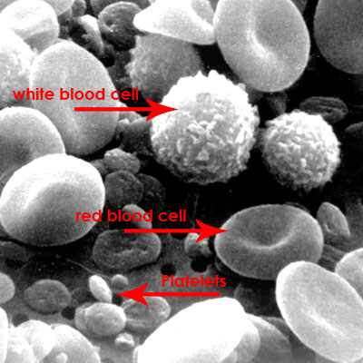
Figure – RBC, WBC and Platelets

Slide 15
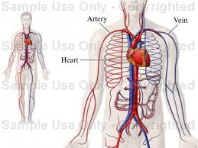
Parts of the Circulatory System
The circulatory system is divided into three major parts:
Heart
Blood
Blood Vessels

Slide 16
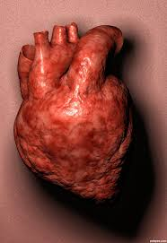
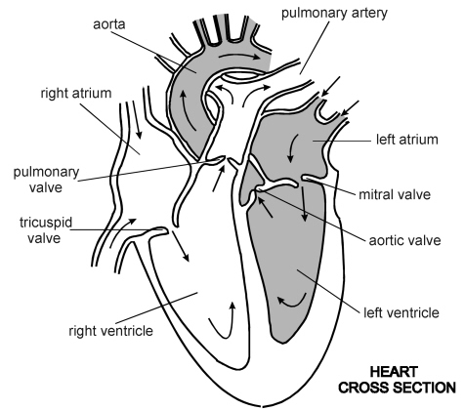
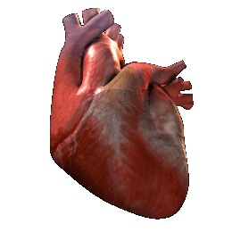
Heart
The heart is a muscular pump.
Function:
When it beats it pumps blood to the lungs and around the body.
The heart provides the pressure needed to keep the blood flowing through the network of tubing.

Slide 17
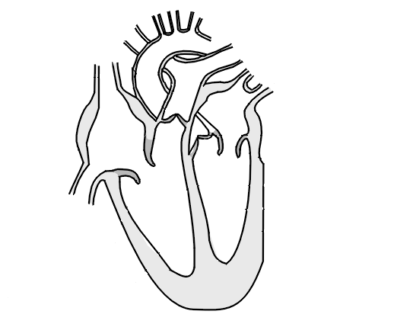
Heart
Structure:
The heart has four chambers. The two atria collect the blood. The two ventricles pump the blood out of the heart.
Valves prevent the blood from flowing backwards.
The septum separates the two sides of the heart.
The right side of the heart pumps
de-oxygenated blood to the lungs to pick up oxygen.
The left side of the heart pumps the oxygenated blood from the lungs around the rest of the body.
Left atrium
Right atrium
Right ventricle
Left ventricle
Valves
Septum

Slide 18
Heart
The walls of these chambers are made of a special muscle called myocardium, which contracts continuously and rhythmically to pump blood.
The pumping action of the heart occurs in two stages for each heartbeat:
(1) DIASTOLE, when the heart is at rest
(2) SYSTOLE, when the heart contracts to pump deoxygenated blood toward the lungs and oxygenated blood to the body.
During each heartbeat, typically about 60 to 90 ml of blood are pumped out of the heart.
If the heart stops pumping, death usually occurs within four to five minutes.

Slide 19
Normal range: | Diastole 60 – 80 mmHg (adults); | Systole 90 – 120 mmHg (adults);
https://www.youtube.com/watch?v=tEjH-xXCNe4

Slide 20
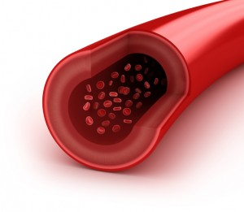
Blood Vessels
Arteries
Blood vessels that carry oxygenated blood away from the heart
Have thick muscular walls
Have small passageways for blood (internal lumen)
Contain blood under high pressure

Slide 21
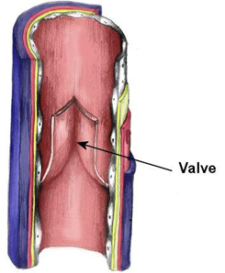
Blood Vessels
Veins
Carry deoxygenated blood to the heart
Have thin walls
Have larger internal lumen
Contain blood under low pressure
Have valves to prevent blood flowing backwards

Slide 22
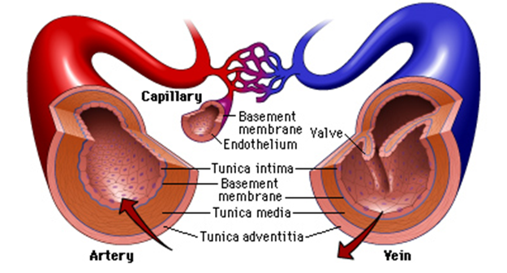
Blood Vessels
Capillaries
Connects arteries with veins
Microscopic – one cell thick
Very low blood pressure
Site of gas exchange - oxygen passes through the capillary wall and into the tissues, carbon dioxide passes from the tissues into the blood. Cell wastes diffuse through the capillary back into the blood.

Slide 23
Difference between Artery and Vein
Artery | Vein
Carry oxygenated blood (except pulmonary artery). | Carry deoxygenated blood (except pulmonary vein)
Carry blood away from the heart | Carry blood to the heart
Thick and elastic muscular wall. | Thin and slightly muscular wall.
Blood under high pressure. | Blood under low pressure.
Contain no valves | Contain valves

Slide 24
Blood
Components in blood
1. Plasma
Fluid part of blood
Carries carbon dioxide, hormones and waste
2. Red blood cells
Contain haemoglobin which carries oxygen
3. White blood cells
An important part of the immune system, they produce antibodies and destroy harmful microorganisms
4. Platelets
Clump together to form clots
Protect the body by stopping bleeding
https://www.youtube.com/watch?v=R-sKZWqsUpw

Slide 25
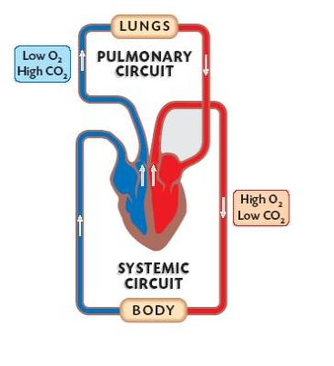
Pathway of blood
Pulmonary Circulation
The pulmonary circuit carries blood from the heart to the lungs and then back to the heart.
In the lungs, carbon dioxide is removed from the blood, and oxygen is added.
Systemic Circulation
The systemic circuit carries blood from heart to rest of the body and back to the heart.
Delivers the oxygen to the body and returns de-oxygenated blood to the heart. Blood also carries nutrients and waste.
https://www.youtube.com/watch?v=0jznS5psypI

Slide 26
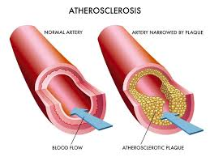
Disorders
Atherosclerosis
Deposits inside arteries (plaques)
Develop in inner wall of the arteries, narrowing their channel
increase blood pressure
increase risk of heart attack, stroke

Slide 27
Disorders
Heart Attack
Also called acute myocardial infarction
Interruption of oxygen supply to the heart
Causes death of the heart muscle
https://www.youtube.com/watch?v=gGY2CsFsiAk
Stroke
Blood clot blocks a vessel leading to the brain
Brain cells are starved of oxygen and nutrients
Loss of function may occur
Can cause paralysis, loss of ability to speak or death.
https://www.youtube.com/watch?v=SQq_1oSBei0

Slide 28
How can heart disease be avoided:
Cutting down on fried food
Eating less red meat
Eating more fresh fruit and vegetables
No smoking
Exercising regularly
Avoiding stress

Slide 29
Lungs and gas exchange
The primary function of the lungs is to provide oxygen to the tissues and remove carbon dioxide to outside.
Respiration includes two phases
(i) inspiration (ii) expiration
Inspiration means supply of oxygen from the atmosphere to the tissue space through respiratory tract and blood.
Expiration means transport of carbon dioxide from the tissue space to atmosphere through respiratory tract and blood.
The respiratory system is made of
(i) Lungs: gas exchanging organ
(ii) Chest wall & respiratory muscle→ increase & decrease the size of the thoracic cavity
(iii) Areas in the brain → control the muscles

Slide 30
How tissue gets oxygen and release carbon dioxide
How Red Cells carry oxygen :

Slide 31
Gas exchange in lungs
Air enters through nasal cavity
Pharynx
Larynx
Trachea
Left of right bronchi
Bronchioles
Alveoli

Slide 32
The Human Respiratory or Gas Exchange System
The upper respiratory tract consists of
(1) the nose or nasal cavity
(2) the pharynx, or throat.
The lower respiratory tract includes
(3) the larynx, or voice box;
(4) the trachea, or windpipe, which splits into two main branches called left and right bronchi the serves left and right lungs
(5) The lungs contain tiny branches of the bronchi called bronchioles; the bronchioles divide further to form tiny sacs called alveoli

Slide 34
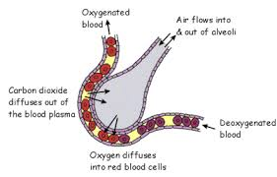
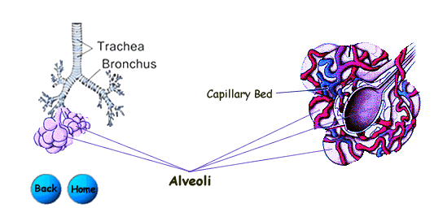
Lower Respiratory Tract
Alveoli
Alveloli are tiny air sacs that are surrounded by blood capillaries
Site of gas exchange with blood

Slide 35
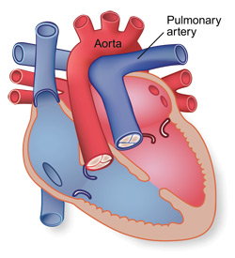
Gas Exchange in Lungs
Deoxygenated blood poor in oxygen and rich in carbon dioxide is pumped by the heart into the capillary surrounding the airspace of an alveolus.
Since inside of the alveolus has lower concentration of carbon dioxide, it diffuses into the airspace and is exhaled out.
Fresh inhaled air in the airspace contains about 21% oxygen.
This is a very high concentration compared to what is in the blood in the capillaries.

Slide 36
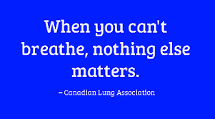
- End of lecture -

