Slide 1
Experiment 1: Preparation of (i) Tris-EDTA buffer and (ii) Phosphate-buffered saline
CHE203.L

Slide 2
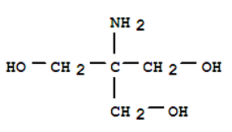
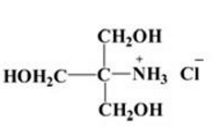
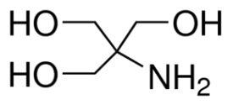
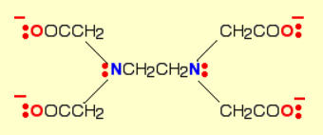
TE (Tris-EDTA) buffer
TE buffer is a commonly used buffer solution in molecular biology, especially in procedures involving DNA, cDNA or RNA. "TE" is derived from its components: Tris, a common pH buffer, and EDTA, a molecule that chelates cations like Mg²⁺.
Tris-HCl is a solution containing a tris base mixed with hydrocholoric acid. Tris-HCl is used to buffer solutions from large changes in pH level. It is designed to keep solutions within a pH range of 7.0 to 9.0.
Tris
Tris-HCl
Tris(hydroxymethyl)aminomethane
EDTA
(acidic
form)
EDTA
(basic
form)
Disodium
EDTA
http://wolfson.huji.ac.il/purification/PDF/Buffers/CALBIOCHEM_Buffers.pdf

Slide 3
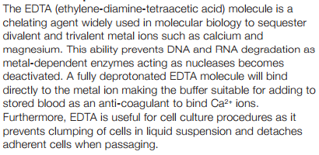
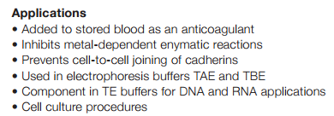
Solubility of Tris
Solubility (Tris Base): Soluble in water (550 mg/ml), ethylene glycol (79.1 mg/ml), methanol (26 mg/ml), anhydrous ethanol (14.6 mg/ml), 95% ethanol (22.0 mg/ml), DMF (14 mg/ml), acetone (2 mg/ml), ethyl acetate (0.5 mg/ml), olive oil (0.4 mg/ml), and chloroform (0.05 mg/ml)
Solubility of EDTA
The carboxyl groups of EDTA are not dissociated at low pH. Undissociated carboxyls (COOH) have no charge because the hydrogen is covalently bound and therefore acid EDTA is almost insoluble in water. You may use Na-EDTA, which is soluble salt. Or you make it by adding NaOH to EDTA - when the pH rises more carboxyls become dissociated (COO⁻) releasing protons (H⁺) to the solution (which is the principle of its pH buffering ability).
http://wolfson.huji.ac.il/purification/PDF/Buffers/CALBIOCHEM_Buffers.pdf

Slide 4
Usefulness of TE (Tris-EDTA) buffer
The purpose of TE buffer is to protect the nucleic acids from degradation.
TE buffer is often used to store DNA and RNA. EDTA in TE chelates Mg²⁺ and other divalent metals ions necessary for most causes of DNA and RNA degradation, suppressing these processes. Tris is a buffering agent to keep the solution at a defined pH.

Slide 5
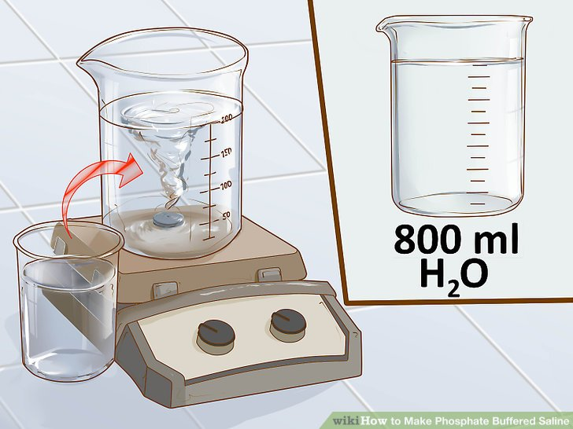
Phosphate-buffered saline (PBS)
Phosphate-buffered saline (abbreviated PBS) is a buffer solution commonly used in biological research. It is a water-based salt solution containing disodium hydrogen phosphate, sodium chloride and, in some formulations, potassium chloride and potassium dihydrogen phosphate.
Solutions containing the same concentration of particles and thus exerting equal osmotic pressures are called iso-osmotic. A 0.9% solution of NaCl (Normal Saline) is iso-osmotic with blood and tears. The term isotonic, meaning equal tone, is sometimes used interchangeably with the term iso-osmotic.

Slide 6
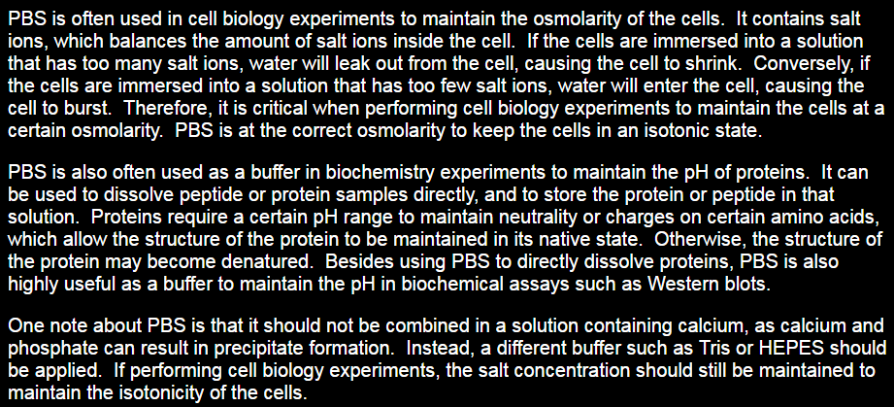
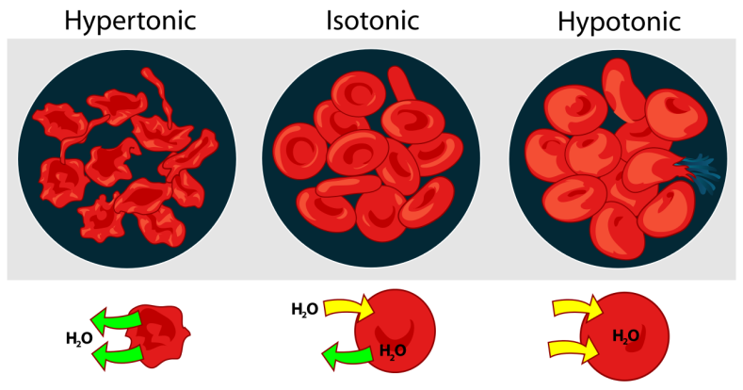
Usefulness of PBS
Phosphate buffered saline (PBS) is a non-toxic solution used in many biological laboratories. Unlike water, PBS prevents cells rupturing or shriveling up due to osmosis.

Slide 7
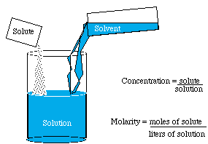
Molarity

Slide 8
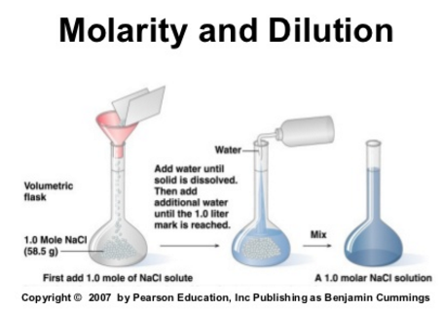
Molarity

Slide 9
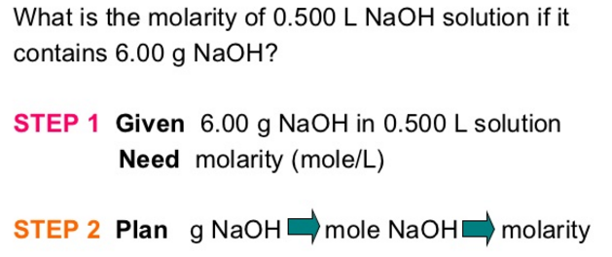
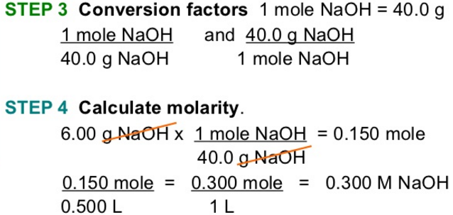
Molarity

Slide 10
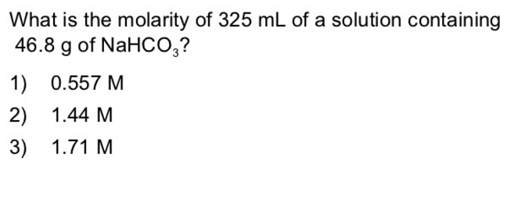
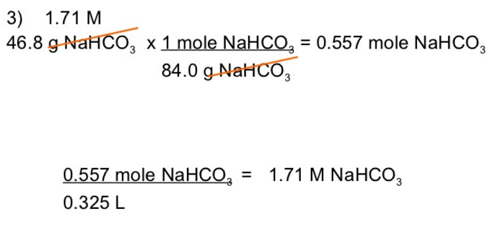
Molarity

Slide 11
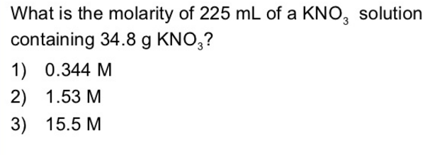
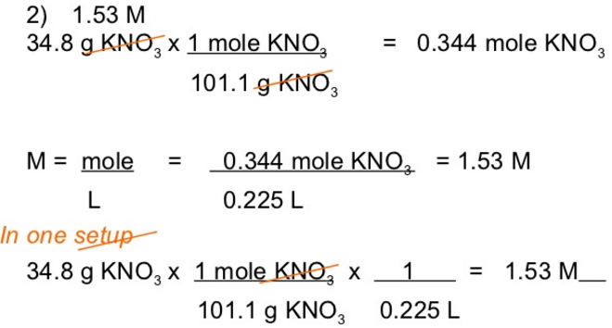
Molarity

Slide 12
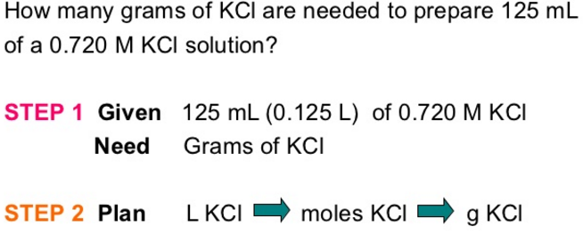
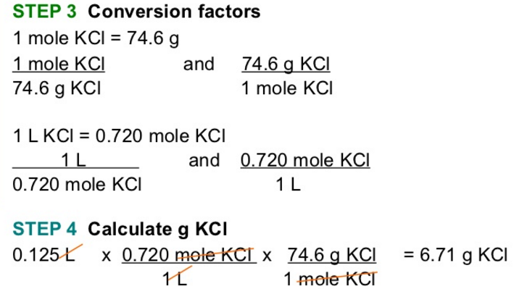
Molarity

Slide 13
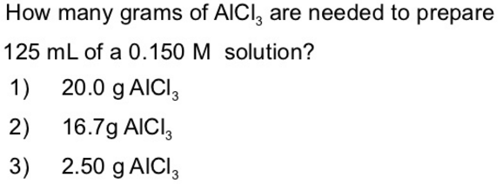
Molarity
http://biologicalworld.com/pbs.htm

Slide 14
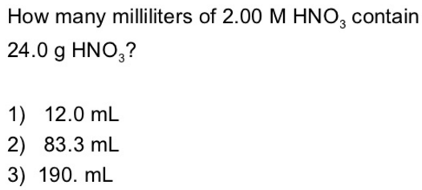
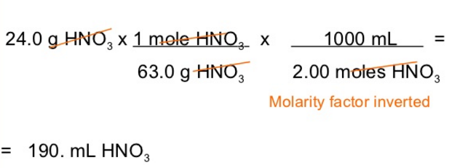
Molarity
http://biologicalworld.com/pbs.htm

Slide 15
Molarity

Slide 16
Molarity
https://www.slideshare.net/pscad123/molarity-and-dilution

Slide 17
Molarity

Slide 18
Molarity

Slide 19
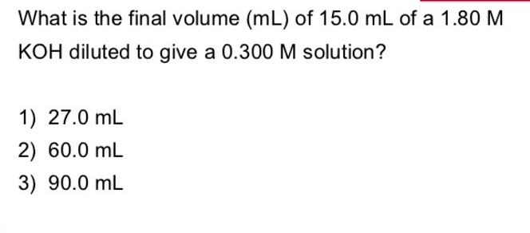
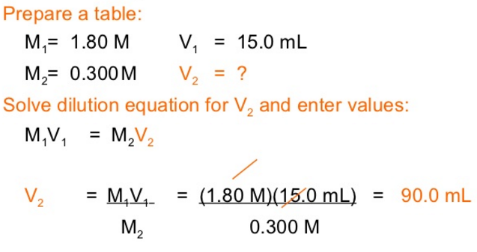
Molarity

Slide 20
Buffers
(the following ppt slides
are only for understanding of buffers:
No question in the lab final exam from
the following slides)

