Slide 1

Bond
Chemical Bond!!

Slide 2
Interactions of matter:
Atoms interact through the process of chemical bonding.
  Process is determined by the number of electrons found in the outermost energy level of an atom.
  Involves the transfer & sharing of electrons between atoms.

Slide 3
Chemical Bonds
When a Chemical Reaction occurs atoms gain, lose or share electrons.
Atoms always want to have their outer energy level “full” of electrons
When an atom has a different number of protons & electrons it is called an Ion.
  If an ion has more protons than electrons - it is Positively Charged
  If an atom has more electrons than protons it is Negatively Charged.
  Atoms of opposite charge are attracted to each other.
There are three types of chemical bonds. Ionic bonds, Covalent Bonds, & Metallic Bonds.

Slide 4
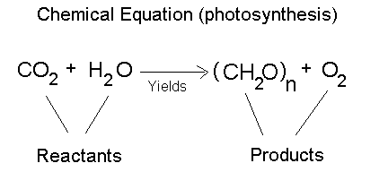
Chemical Reactions:
A Chemical Reaction = whenever a chemical bond is formed or broken.
2 types (sometimes 3) of chemical reactants
  Reactants = Substances existing before the reaction
  Products = Substances existing after the reaction
  Catalysts = Substances which speed up the rate of a reaction
Chemical Equations are a shorthand way of showing chemical reactions.
  Separates Products and reactants.
  Usually follow flow of energy.
Rx’s naturally occur when they release energy
Can however occur when energy is added.

Slide 5
Structural and Chemical Formulas:
Chemical formulas show the number of and types of atoms in a molecule
Structural Formulas are used to graphically represent a chemical formula
Useful in visualizing how chemicals react and form new ones.
When drawing them use the following rules:
The Periodic table abbreviation is used to represent the atoms.
A single strait line (---) represents a single bond
Two parallel strait lines (==) represent double bonds

Slide 6

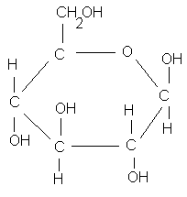

Example Formulas:
Chemical Name | Chemical Formula | Structural Formula
Water | H₂O
Carbon Dioxide | CO₂
Methane | CH₄
Glucose | C₆H₁₂O₆

Slide 7
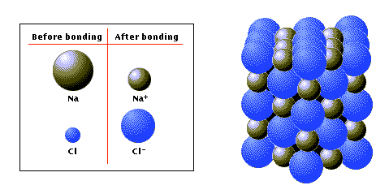
Ionic Bonds:
Ionic bonds form when 1 atom “gives” one or more electrons to another atom to complete their outer energy levels.
  This results in 1 positively charged ion & 1 negatively charged ion
  Since opposite charges attract, they come together and bond.

Slide 8
IONIC BOND bond formed between two ions by the transfer of electrons

Slide 9
Formation of Ions from Metals
Ionic compounds result when metals react with nonmetals
Metals lose electrons to match the number of valence electrons of their nearest noble gas
Positive ions form when the number of electrons are less than the number of protons
Group 1 metals ⎯→ ion ¹⁺
Group 2 metals ⎯→ ion ²⁺
Group 13 metals ⎯→ ion ³⁺

Slide 10
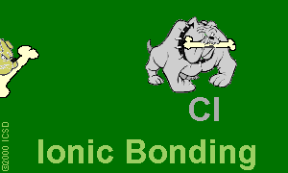
Ionic Bonds: One Big Greedy Thief Dog!

Slide 11
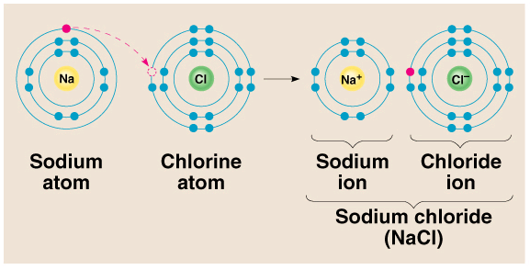
1). Ionic bond – electron from Na is transferred to Cl, this causes a charge imbalance in each atom. The Na becomes (Na+) and the Cl becomes (Cl-), charged particles or ions.

Slide 12
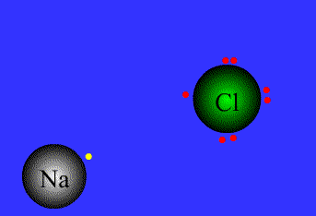

Slide 13
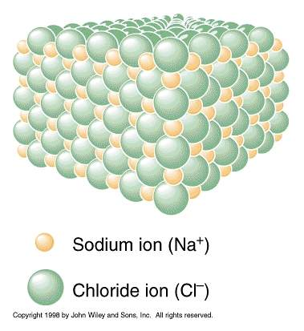
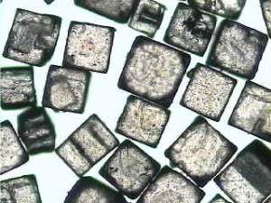

Slide 14
Formation of Sodium Ion
Sodium atom Sodium ion
Na • – e⁻ ⎯⎯→ Na ⁺
2-8-1 2-8 ( = Ne)
11 p⁺ 11 p⁺
11 e⁻ 10 e⁻
0 1⁺

Slide 15
Formation of Magnesium Ion
Magnesium atom Magnesium ion
•
Mg • – 2e⁻ ⎯→ Mg²⁺
2-8-2 2-8 (=Ne)
12 p⁺ 12 p⁺
12 e- 10 e⁻
0 2⁺

Slide 16
Learning Check
A. Number of valence electrons in aluminum
1) 1 e⁻ 2) 2 e⁻ 3) 3 e⁻
B. Change in electrons for octet
1) lose 3e⁻ 2) gain 3 e⁻ 3) gain 5 e⁻
C. Ionic charge of aluminum
1) 3- 2) 5- 3) 3⁺

Slide 17
Solution
A. Number of valence electrons in aluminum
3) 3 e⁻
B. Change in electrons for octet
1) lose 3e⁻
C. Ionic charge of aluminum
3) 3⁺

Slide 18
Learning Check
Give the ionic charge for each of the following:
A. 12 p⁺ and 10 e⁻
1) 0 2) 2+ 3) 2-
B. 50p⁺ and 46 e-
1) 2+ 2) 4+ 3) 4-
C. 15 p⁺ and 18e-
2) 3+ 2) 3- 3) 5-

Slide 19
Ionic Bond
Between atoms of metals and nonmetals with very different electronegativity
Bond formed by transfer of electrons
Produce charged ions all states. Conductors and have high melting point.
Examples; NaCl, CaCl₂, K₂O

Slide 20
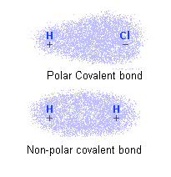
Covalent Bonds:
Covalent bonds form when 2 atoms “share” one or more electrons between them.
There are 2 types of covalent bonds:
  Non-Polar Covalent bonds form when two atoms share electrons equally
  Polar Covalent bonds form when two atoms share electrons unequally.
Atoms can share more than 1 electron between them forming double and triple bonds
A Molecule is a group of 2 or more atoms held together by covalent bonds.

Slide 21
COVALENT BOND bond formed by the sharing of electrons

Slide 22
Covalent Bond
Between nonmetallic elements of similar electronegativity.
Formed by sharing electron pairs
Stable non-ionizing particles, they are not conductors at any state
Examples; O₂, CO₂, C₂H₆, H₂O, SiC

Slide 23
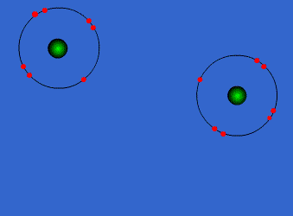
Covalent Bonds

Slide 24
Bonds in all the polyatomic ions and diatomics are all covalent bonds

Slide 25
when electrons are shared equally
NONPOLAR
COVALENT BONDS
H₂ or Cl₂

Slide 26
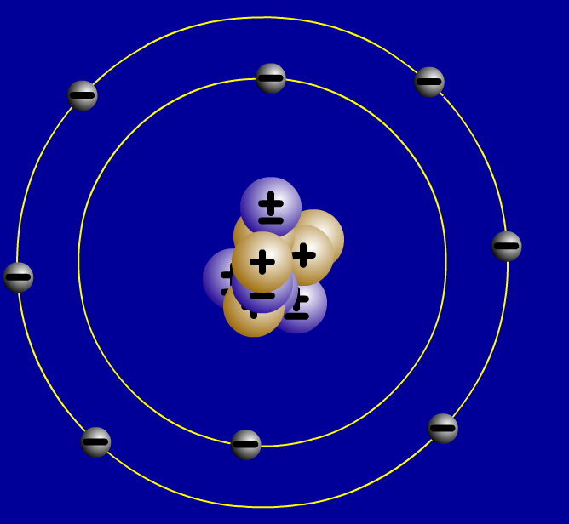
2. Covalent bonds- Two atoms share one or more pairs of outer-shell electrons.
Oxygen Atom
Oxygen Atom
Oxygen Molecule (O₂)

Slide 27
when electrons are shared but shared unequally
POLAR COVALENT BONDS
H₂O

Slide 28
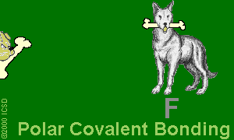
Polar Covalent Bonds: Unevenly matched, but willing to share.

Slide 29
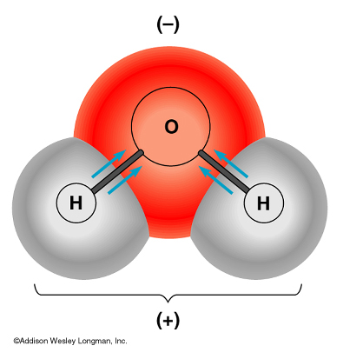
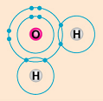
- water is a polar molecule because oxygen is more electronegative than hydrogen, and therefore electrons are pulled closer to oxygen.

Slide 30
METALLIC BOND bond found in metals; holds metal atoms together very strongly

Slide 31
Metallic Bond
Formed between atoms of metallic elements
Electron cloud around atoms
Good conductors at all states, lustrous, very high melting points
Examples; Na, Fe, Al, Au, Co

Slide 32
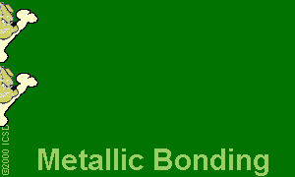
Metallic Bonds: Mellow dogs with plenty of bones to go around.

Slide 33
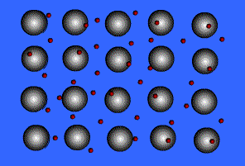
Ionic Bond, A Sea of Electrons

Slide 34

Metals Form Alloys
Metals do not combine with metals. They form
Alloys which is a solution of a metal in a metal.
Examples are steel, brass, bronze and pewter.

Slide 35
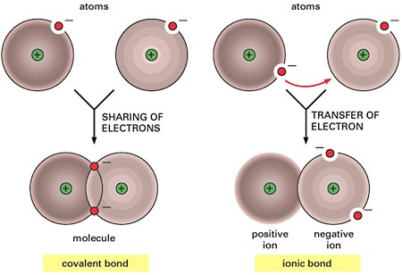
Summary of Ionic & Covalent Bonds

Slide 36
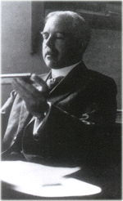
Lewis Theory
G.N. Lewis (1875-1946) recognized
valence (outmost) electrons fundamental to bonding
electron transfer resulting in ionic bonds
sharing electrons resulting in covalent bonds
atoms tend to acquire a noble-gas electronic configurations
The attraction between electrons of one atom to the nucleus of another atom contribute to what is known as chemical bonds.

Slide 37
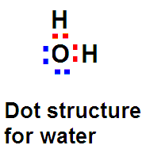
Lewis Dot Structures
Lewis Dot structures are used to represent the valence electrons of atoms in covalent molecules
Dots are used to represent only the valence electrons.
Dots are written between symbols to represent bonding electrons
37

Slide 38
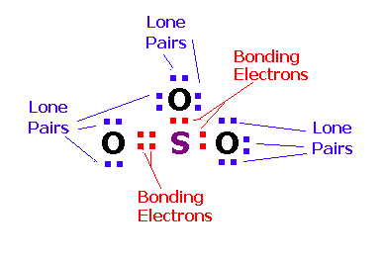
Lewis Dot Structure for SO₃
The diagram below shows the dot structure for sulfur trioxide. The bonding electrons are in shown in red and lone pairs are shown in blue.
38

Slide 39
Writing Lewis Dot Structures
Show all valence electrons.
Each bond represents two electrons.
All electrons are paired, usually (exceptions).
Each atom acquires 8 valence electrons, usually (exceptions).
Multiple bonds are needed sometimes.

Slide 40
Writing Lewis Structures
Draw skeletal structure of compound showing what atoms are bonded to each other. Put least electronegative element in the center.
Count total number of valence e⁻. Add 1 for each negative charge. Subtract 1 for each positive charge.
Complete an octet for all atoms except hydrogen.
If structure contains too many electrons, form double and triple bonds on central atom as needed.

Slide 41
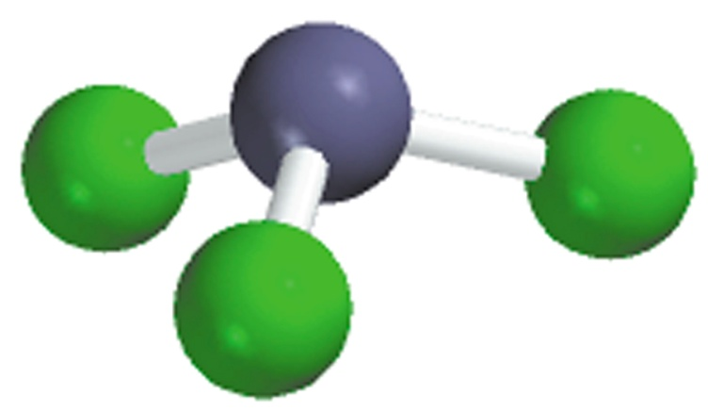
Write the Lewis structure of nitrogen trifluoride (NF₃).
Step 1 – N is less electronegative than F, put N in center
Step 2 – Count valence electrons N - 5 (2s²2p³) and F - 7 (2s²2p⁵)
5 + (3 x 7) = 26 valence electrons
Step 3 – Draw single bonds between N and F atoms and complete
octets on N and F atoms.
Step 4 - Check, are # of e⁻ in structure equal to number of valence e⁻ ?
3 single bonds (3x2) + 10 lone pairs (10x2) = 26 valence electrons
F
N
F
F

Slide 42
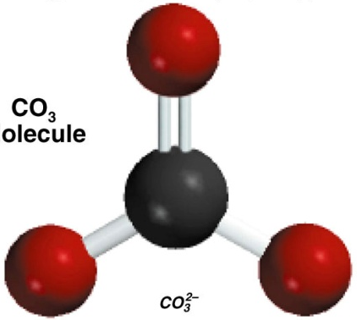
Write the Lewis structure of the carbonate ion (CO₃²⁻).
Step 1 – C is less electronegative than O, put C in center
Step 2 – Count valence electrons C - 4 (2s²2p²) and O - 6 (2s²2p⁴)
    -2 charge – 2e⁻
4 + (3 x 6) + 2 = 24 valence electrons
Step 3 – Draw single bonds between C and O atoms and complete
octet on C and O atoms.
Step 4 - Check, are # of e⁻ in structure equal to number of valence e⁻ ?
3 single bonds (3x2) + 10 lone pairs (10x2) = 26 valence electrons
Step 5 - Too many electrons, form double bond and re-check # of e⁻
2 single bonds (2x2) = 4
O
C
O
1 double bond = 4
8 lone pairs (8x2) = 16
Total = 24
O

Slide 43
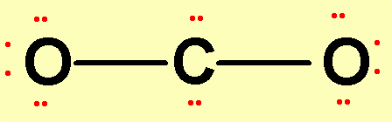
Example -- Carbon Dioxide CO₂
1. Central atom =
2. Valence electrons =
3. Form bonds.
C 4 e⁻
O 6 e⁻ x 2 O’s = 12 e⁻
Total: 16 valence electrons
This leaves 12 electrons (6 pair).
4. Place lone pairs on outer atoms.
Check to see that all atoms have 8 electrons around it
except for H, which can have 2.

Slide 44
Carbon Dioxide, CO₂
C 4 e-
O 6 e- X 2 O’s = 12 e-
Total: 16 valence electrons
How many are in the drawing?
There are too many electrons in our drawing. We must form DOUBLE BONDS between C and O. Instead of sharing only 1 pair, a double bond shares 2 pairs. So one pair is taken away from each oxygen atom and replaced with another bond.

Slide 45
Formal Charge
The formal charge on any atom in a Lewis structure is a number assigned to it according to the number of valence electrons of the atom and the number of electrons around it.
The formal charge of an atom is equal to the number of valence electrons, N_{v.e.} subtract the number of unshared electrons, N_{us.e.} and subtract half of the bonding electrons, ½ N_{b.e.}.
Formal charge = N_{v.e.} - N_{us.e.} - ½ N_{b.e.}
Stability rules:
Formulas with the lowest magnitude of formal charges are more stable.
More electronegative atoms should have negative formal charges.
Adjacent atoms should have opposite formal charges.

Slide 46
-1
+1
C – 4 e⁻
2 single bonds (2x2) = 4
H
C
O
H
O – 6 e⁻
1 double bond = 4
2H – 2x1 e⁻
2 lone pairs (2x2) = 4
12 e⁻
Total = 12
formal charge on an atom in a Lewis structure
total number of valence electrons in the free atom
total number of nonbonding electrons
(
total number of bonding electrons
1
)
=
-
-
2
formal charge on C
= 4 -
2 -
½ x 6 = -1
formal charge on O
= 6 -
2 -
½ x 6 = +1

Slide 47
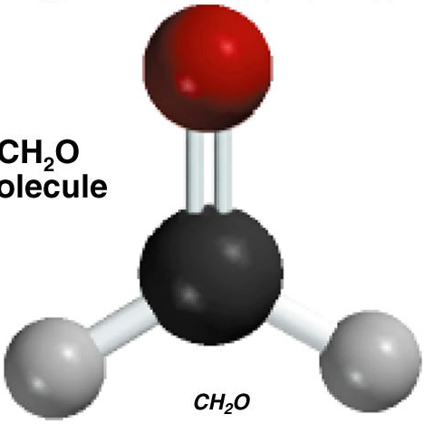
0
0
C – 4 e⁻
2 single bonds (2x2) = 4
H
C
O
O – 6 e⁻
1 double bond = 4
H
2H – 2x1 e⁻
2 lone pairs (2x2) = 4
12 e⁻
Total = 12
formal charge on an atom in a Lewis structure
total number of valence electrons in the free atom
total number of nonbonding electrons
(
total number of bonding electrons
1
)
=
-
-
2
formal charge on C
= 4 -
0 -
½ x 8 = 0
formal charge on O
= 6 -
4 -
½ x 4 = 0

Slide 48

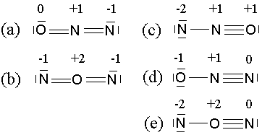

Find Formal Charge
SO₄^{2–}
Find FC in these structures
Confirm these FCs

Slide 49
Resonance
When several structures with different electron distributions among the bonds are possible, all structures contribute to the electronic structure of the molecule. These structures are called resonance structures.
When two or more plausible Lewis structures can be written but the “correct” structure cannot be written is called resonance. For example:
. . . . . .
O O O
:O: :O : :O: :O: :O: :O :
Please complete the dot structure and find the formal charge for the above structures.

Slide 50
Draw Resonance Structures
Draw resonance structures for these:
CO₂ :O::C::O: (plus two more dots for each of O)
NO₂ .NO₂ (bent molecule due to the odd electron)
NO₂⁻ :NO₂⁻ (same number of valence electron as O₃ & SO₂)
HCO₂⁻ H-CO₂– ( ditto)
O₃ ozone
SO₃ consider O-SO₂, and the resonance structures
NO₃– flat same number of valence electron as CO₃²⁻
Draw all resonance structures of all these

Slide 51
Bond Properties
Bond length distance between the nuclei of bonded atoms
bond angle angles for any two bonds around an atom
bond energy/ energy required to break the bond
bond-dissociation energy
length energy
Compound Bond (pm) (kJ/mol)
H₂ H – H 74 436 HF F – H 92 565 H₂O O – H 96 464
NH₃ N – H 101 389 CH₄ C – H 109 414
Bond Length Energy
C – C 154 348
C = C 134 614
C ≅ C 120 839
O – O 148 145
O = O 121 498

Slide 52
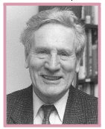
Valence Shell Electron Pair Repulsion VSEPR
The familiar VSEPR (Valence Shell Electron Pair Repulsion) approach to molecular structure was developed by Ronald Gillespie.
The basic idea is that lone pairs of electrons occupy space around a central atom in much the same way as do atoms that are bonded to the central atom.
The lone pairs and bonded atoms then assume that geometry that minimizes electrostatic repulsion
between them.
Ronald Gillespie.

Slide 53
Valence Shell Electron Pair Repulsion
Valence Shell Electron Pair Repulsion (VSEPR) theory can be used to predict the geometric shapes of molecules.
VSEPR is revolves around the principle that electrons repel each other.
One can predict the shape of a molecule by finding a pattern where electron pairs are as far from each other as possible.
53

Slide 54
The Shapes of Molecules
The shape of a molecule has an important bearing on its reactivity and behavior.
The shape of a molecule depends a number of factors. These include:
Atoms forming the bonds
Bond distance
Bond angles
54

Slide 55
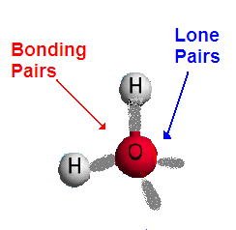
Bonding Electrons and Lone Pairs
In a molecule some of the valence electrons are shared between atoms to form covalent bonds. These are called bonding electrons.
Other valence electrons may not be shared with other atoms. These are called non-bonding electrons or they are often referred to as lone pairs.
55

Slide 56
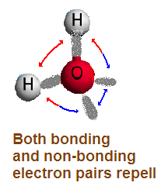
VSEPR
In all covalent molecules electrons will tend to stay as far away from each other as possible
The shape of a molecule therefore depends on:
  the number of regions of electron density it has on its central atom,
  whether these are bonding or non-bonding electrons.
56

Slide 57
VSEPR Predicting Shapes

Slide 58
VSEPR: Predicting the shape
Once the Lewis dot structure has been established, the shape of the molecule will follow one of basic shapes depending on:
  The number of regions of electron density around the central atom
  The number of regions of electron density that are occupied by bonding electrons
58

Slide 59
VSEPR: Predicting the shape
The number of regions of electron density around the central atom determines the electron skeleton
The number of regions of electron density that are occupied by bonding electrons and hence other atoms determines the actual shape
59

Slide 60
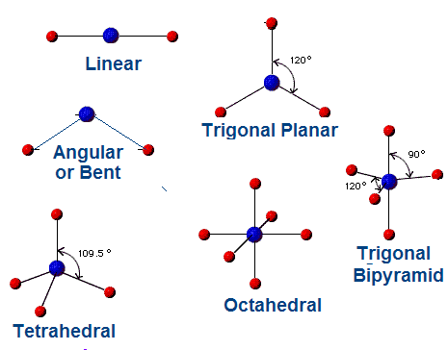
Basic Molecular shapes
The most common shapes of molecules are shown at the right
60

Slide 61
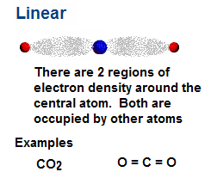
Linear Molecules
Linear molecules have only two regions of electron density.
61

Slide 62
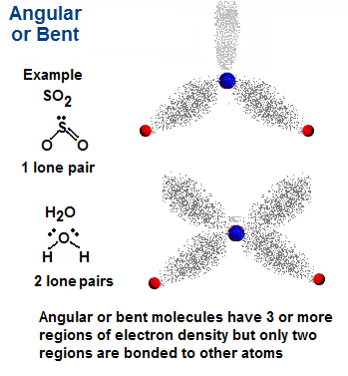
Angular or Bent
Angular or bent molecules have at least 3 regions of electron density, but only two are occupied
62

Slide 63
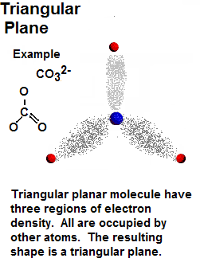
Triangular Plane
Triangular planar molecules have three regions of electron density.
All are occupied by other atoms
63

Slide 64
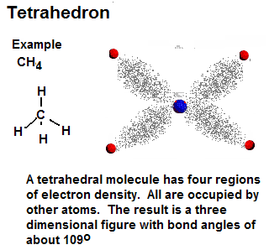
Tetrahedron
Tetrahedral molecules have four regions of electron density.
All are occupied by other atoms
64

Slide 65
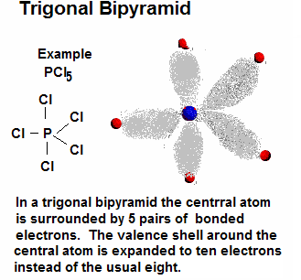
Trigonal Bipyramid
A few molecules have expanded valence shells around the central atom. Hence there are five pairs of valence electrons. The structure of such molecules with five pairs around one is called trigonal bipyramid.
65

Slide 66
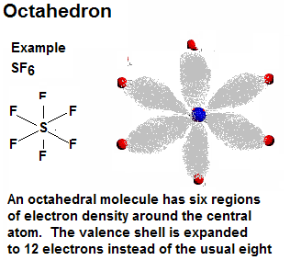
Octahedron
A few molecules have valence shells around the central atom that are expanded to as many as six pairs or twelve electrons. These shapes are known as octahedrons
66

Slide 67
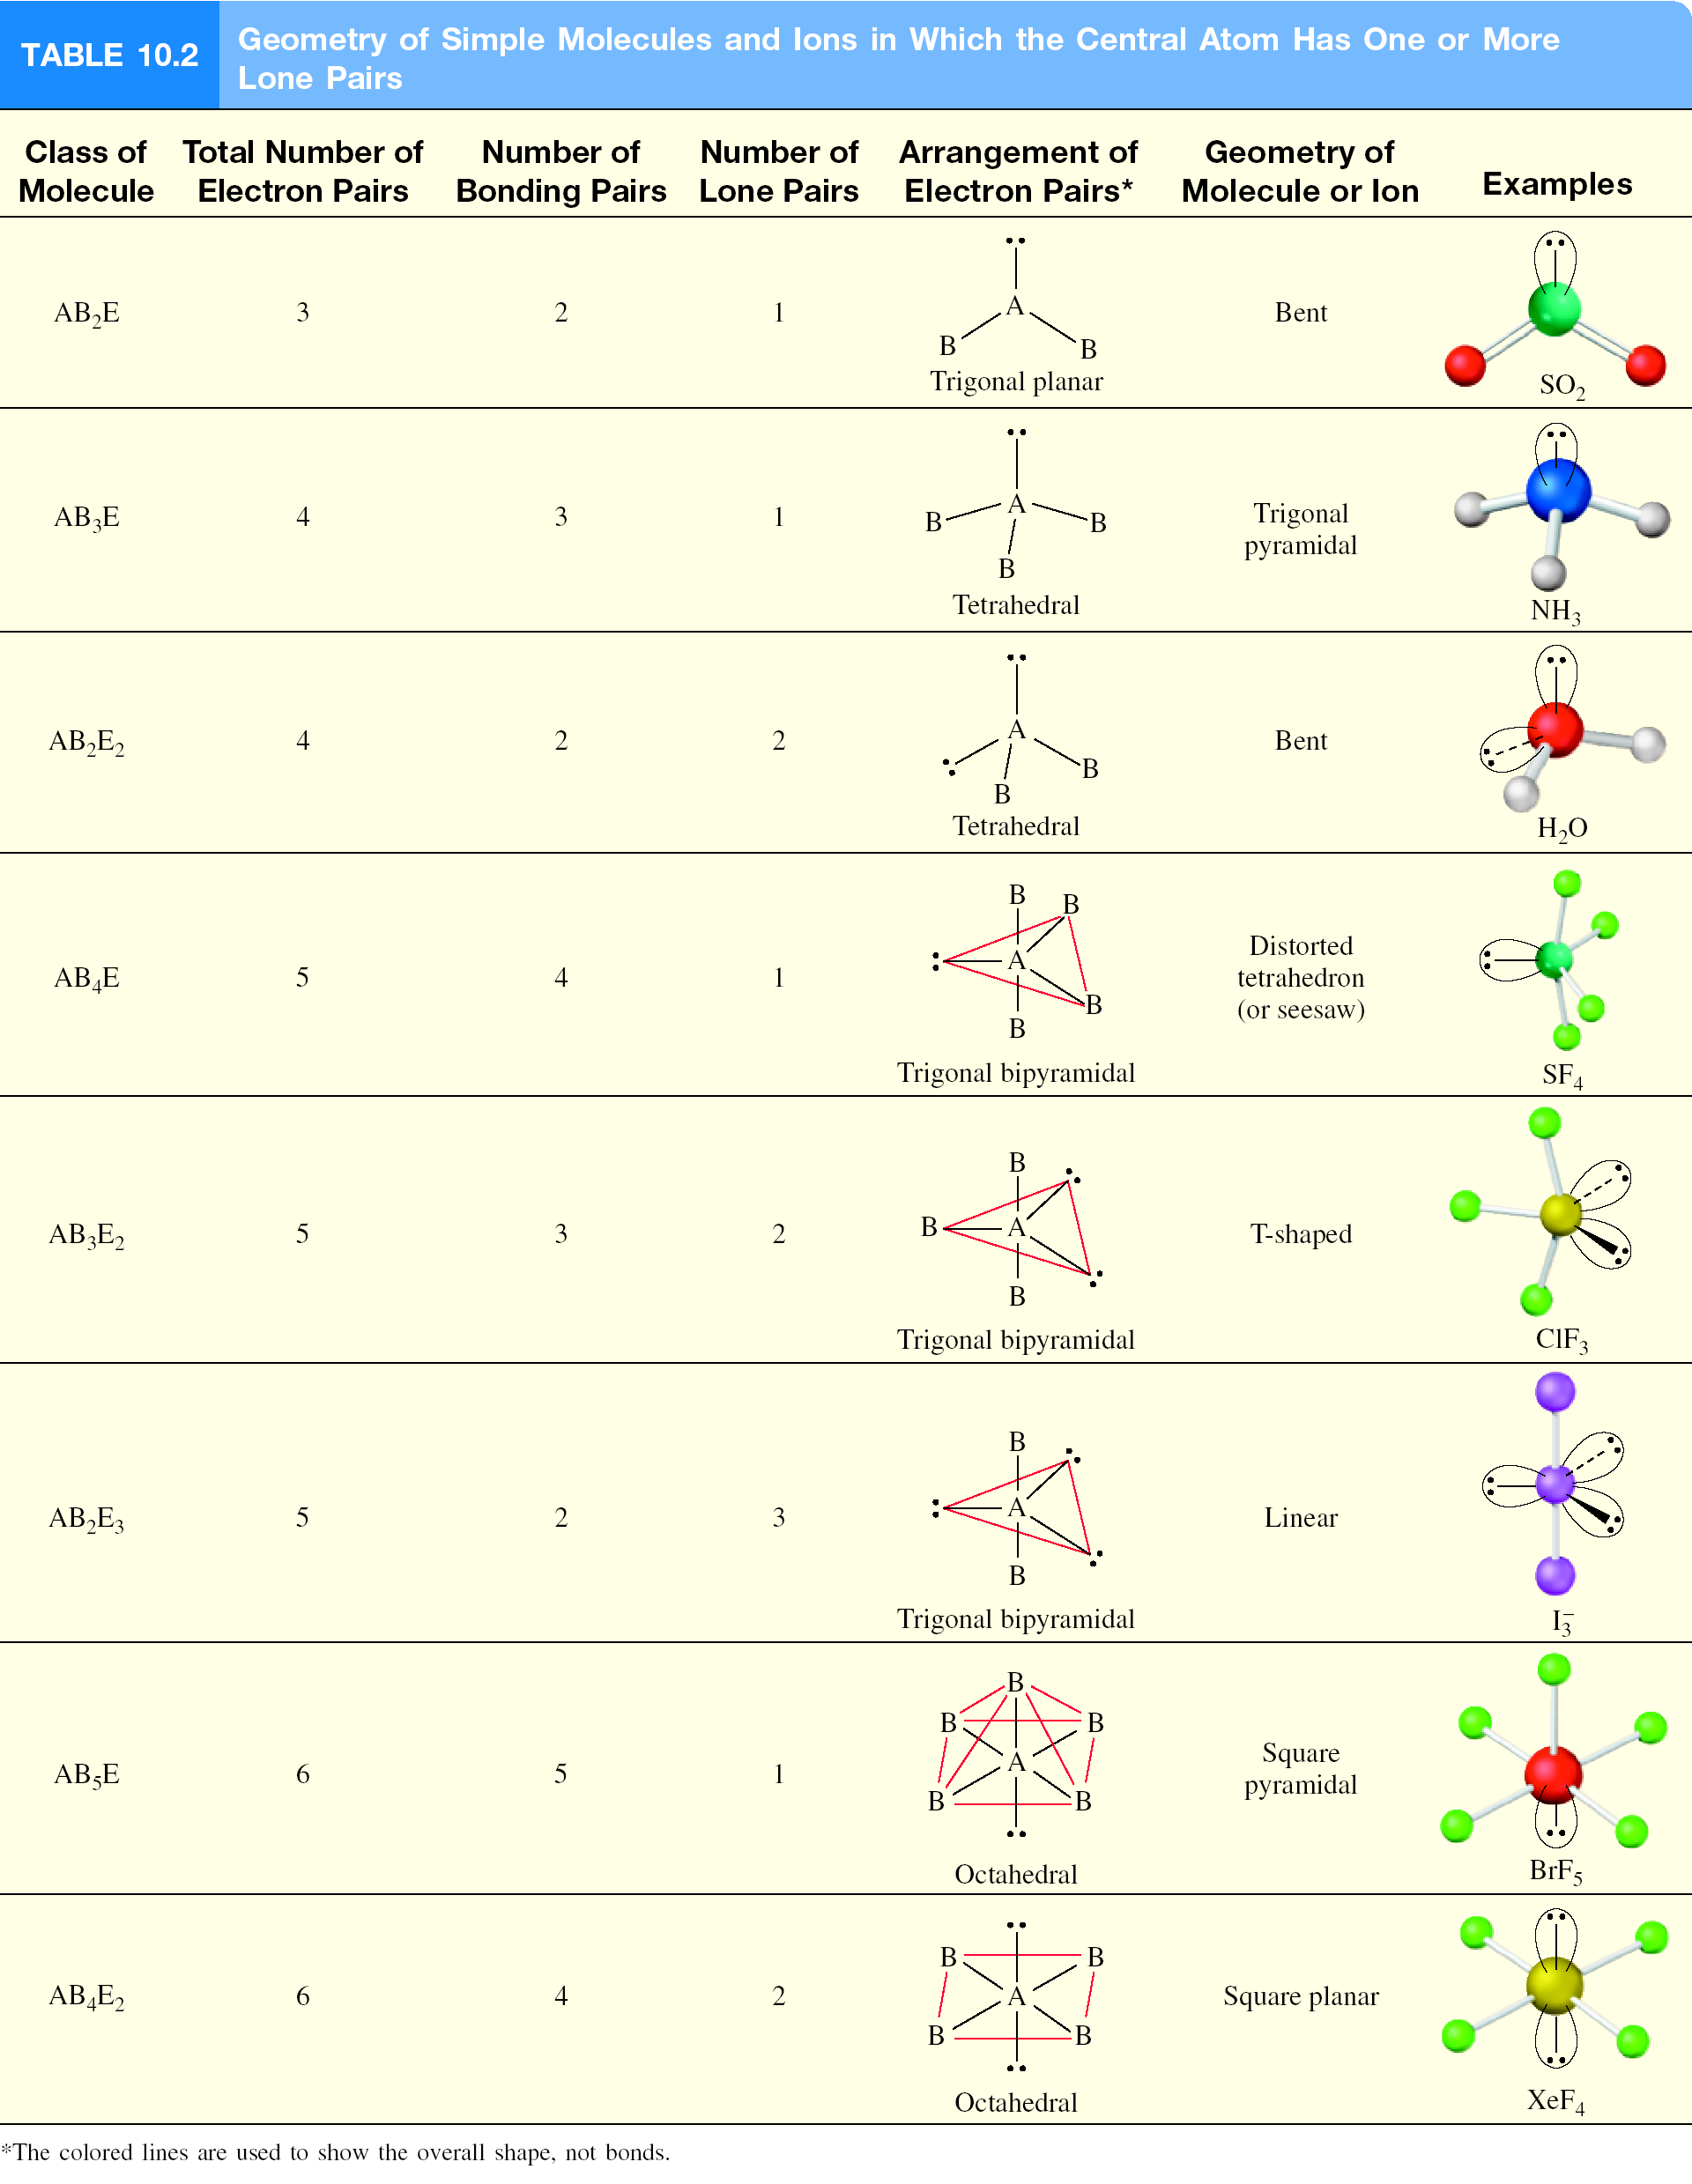

Slide 68
Molecular Polarity
Molecular Polarity depends on:
the relative electronegativities of the atoms in the molecule
The shape of the molecule
Molecules that have symmetrical charge distributions are usually non-polar
68

Slide 69
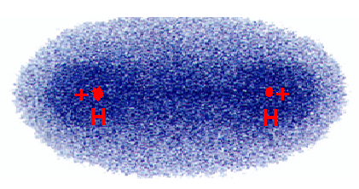
Non-polar Molecules
The electron density plot for H₂.
Two identical atoms do not have an electronegativity difference The charge distribution is symmetrical.
The molecule is non-polar.
69

Slide 70
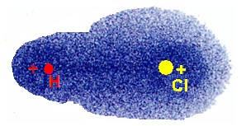
Polar Molecules
The electron density plot for HCl
Chlorine is more electronegative than Hydrogen
The electron cloud is distorted toward Chlorine
The unsymmetrical cloud has a dipole moment
HCl is a polar molecule.
70

Slide 71
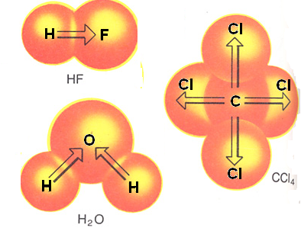
Molecular Polarity
To be polar a molecule must:
have polar bonds
have the polar bonds arranged in such a way that their polarity is not cancelled out
When the charge distribution is non-symmetrical, the electrons are pulled to one side of the molecule
The molecule is said to have a dipole moment.
HF and H₂O are both polar molecules. CCl₄ is non-polar
71

Slide 72
Valence bond theory –
the basic idea
Two half-filled orbitals overlap to form a covalent bond. The electrons in this new probability density are then shared by both atoms (equally attracted to both nuclei). Arrange themselves to have maximum overlap of their half filled orbitals, producing a bonding orbital of lowest energy!

Slide 73
– all form covalent bonds
- all overlapping orbitals must be half-filled
- the new probability distribution formed can only have a max of two electrons
Overlaps

Slide 74
Types of covalent bonds
Orbitals can overlap in two main ways creating two different types of covalent bonds
Sigma bonds & Pi bonds

Slide 75
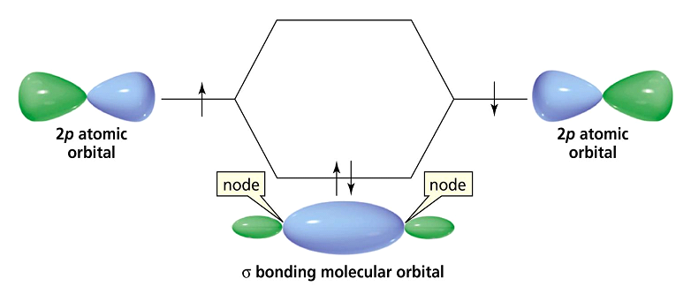
The σ bond
Electron density is between the nuclei of the overlapping atoms

Slide 76

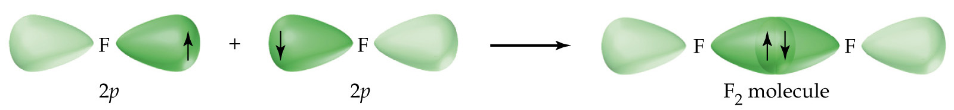
Single bonds σ bonds

Slide 77
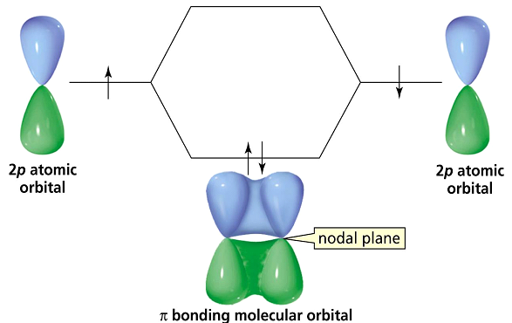
The π bond
Electron densities are above and below the nuclei of the bonding atoms

Slide 78
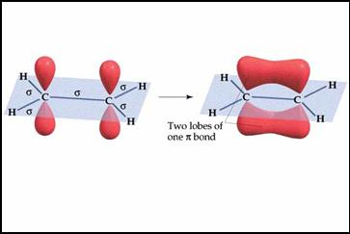
Double Bond one π bond & one σ bond

Slide 79
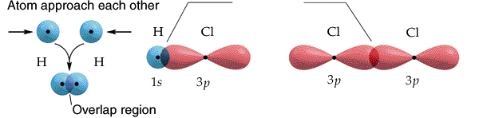
Multiple Bonds
Everything we have talked about so far has only dealt with what we call sigma bonds
Sigma bond (σ) → A bond where the line of electron density is concentrated symmetrically along the line connecting the two atoms.

Slide 80
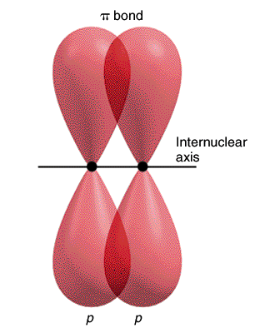
Pi bond (π) → A bond where the overlapping regions exist above and below the internuclear axis (with a nodal plane along the internuclear axis).

Slide 81
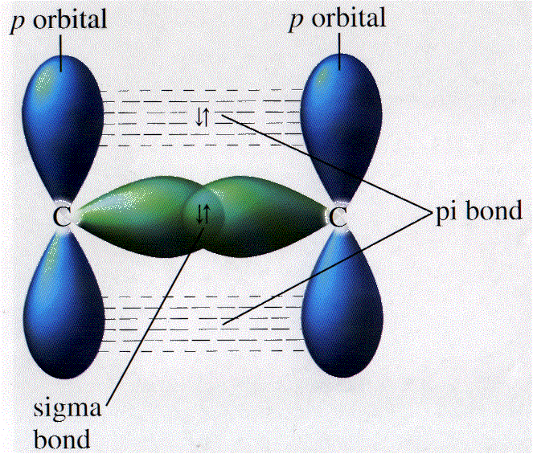

Slide 82
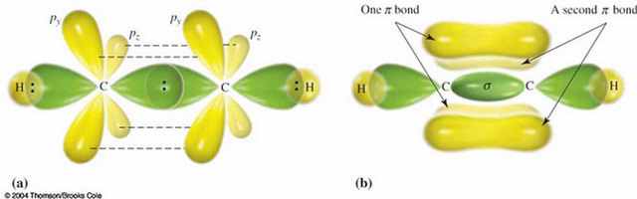
Triple bond two π bond & one σ bond

Slide 83
Promotion & Hybridization
Certain atoms can change their electron configuration in order to bond and form a wide variety of compounds
This “change” in electron configuration takes place in two steps: Promotion of an electron to a higher energy orbital & hybridization or blending of orbitals creating a new type of orbital for bonding

Slide 84
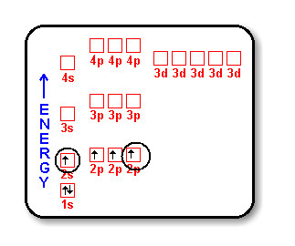
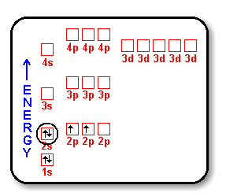
Promotion
Most of the time atoms exist in their “ground state” but, in certain cases the instant before bonding promotion takes place allowing more bonding spaces:

Slide 85
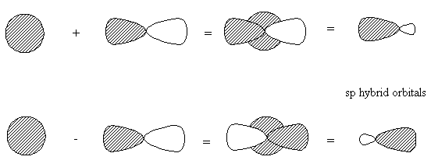
Hybridization
The merging of orbitals
Merging orbitals must all be half filled
No orbitals are “lost” due to merging – if you blend one s orbital and one p orbital you will end up with TWO hybrid orbitals!

Slide 86
Hybridization
Continued
Mix at least 2 nonequivalent atomic orbitals (eg. s and p). Hybrid orbitals have different shapes from original atomic orbitals
Covalent bonds are formed by:
  Overlap of hybrid orbitals with atomic orbitals
  Overlap of hybrid orbitals with other hybrid orbitals

Slide 87

Formation of sp hybrid orbitals
The combination of an s orbital and a p orbital produces 2 new orbitals called sp orbitals.
2s
These new orbitals are called hybrid orbitals
The process is called hybridization
What this means is that both the s and one p orbital are involved in bonding to the connecting atoms

Slide 88

Example: Hybridization in carbon to form methane (CH₄)

Slide 89

sp³-Hybridized N Atom in NH₃
N – 1s²2s²2p³
3 H – 1s¹
Predict
correct
bond angle
sp³

Slide 90

Formation of Covalent Bonds in CH₄
C – 1s²2s²2p²
4 H – 1s¹
sp³

Slide 91



Hybridization in Molecules Containing
Double and Triple Bonds
sp² Hybridization of Carbon

Slide 92

Unhybridized 2p_{z} orbital (grey), which is perpendicular to the plane of the hybrid (green) orbitals.

Slide 93



Bonding in Ethylene, C₂H₄
Sigma bond (σ) – electron density between the 2 atoms
Pi bond (π) – electron density above and below plane of nuclei of the bonding atoms

Slide 94



sp Hybridization of Carbon

Slide 95
How do I predict the hybridization of the central atom?
Draw the Lewis structure of the molecule.
Count the number of lone pairs AND the number of atoms bonded to the central atom
# of Lone Pairs
+
# of Bonded Atoms
Hybridization
Examples
2
sp
BeCl₂
3
sp²
BF₃
4
sp³
CH₄, NH₃, H₂O
5
sp³d
PCl₅
6
sp³d²
SF₆

Slide 96


Slide 97
Sigma (σ) and Pi Bonds (π)
Single bond
1 sigma bond
Double bond
1 sigma bond and 1 pi bond
Triple bond
1 sigma bond and 2 pi bonds
How many σ and π bonds are in the acetic acid (vinegar) molecule CH₃COOH?
H
O
σ bonds = 6
+ 1 = 7
H
C
C
O
H
π bonds = 1
H

Slide 98
The End
Thank you

