Slide 1
Basic Chemistry
ACh

Slide 2
Chemistry is the study of:
matter,
its properties,
the changes that matter undergoes,
and the energy associated with these changes.

Slide 3
What is matter?
Anything that:
has mass
and
occupies space (volume).

Slide 4
The 5 Branches of Chemistry
Inorganic
Organic
Analytical
Physical
Biochemistry

Slide 5
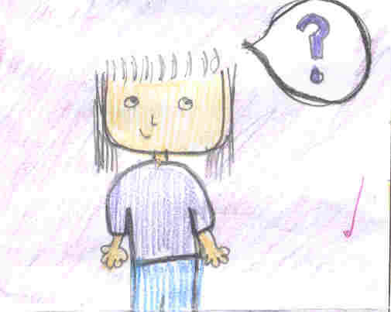
Science
What?
Why?
How?
When?

Slide 6
Theory
A well tested explanation for a broad set of observations.
May use models.
May allow predictions.
Theories may change to explain new observations.

Slide 7
Microscopic- Macroscopic
Micro –(small)
Microscopic- objects can be seen with a microscope.
Macro-(from afar)
Macroscopic- objects are seen without a microscope.

Slide 8
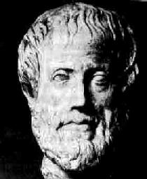
Aristotle (Greece, 4th Century BC)
Philosopher who believed that:
There are 4 elements:
earth, water, air, fire.
Matter is perpetually divisible.

Slide 9
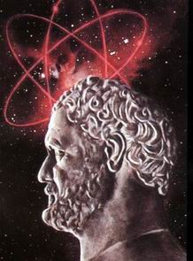
Democritus (Greece, 4th Century BC)
First atomic theory
Atom (indivisible).

Slide 10
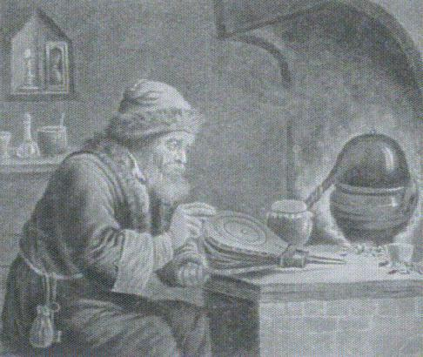
Alchemists (~300BC-1650 AD) China, India, Arabia, Europe, Egypt
Aiming to:
Change common metals to gold.
Develop medicines.
Developed lab equipment.
Mystical.

Slide 11
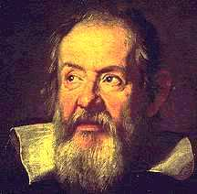
Galileo Galilei (Italy 1564 AD)
Father of the
scientific method
(along with the Englishman Francis Bacon 1500’s).

Slide 12
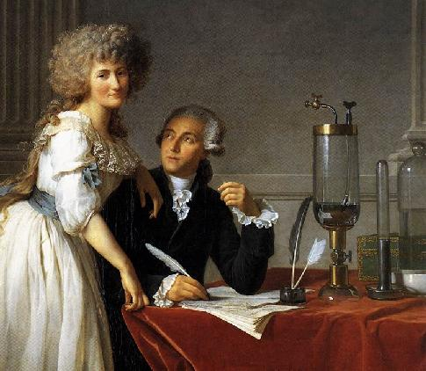
Antoine Lavoisier (France 1743-1794)
Regarded as the Father of Chemistry.
Designed equipment.
Used observations
and measurements.
Discovered nitrogen.

Slide 13
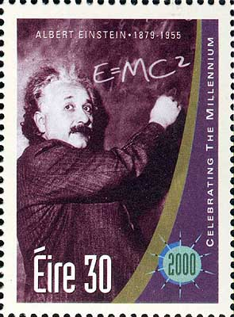
“No number of experiments can prove me right;
a single experiment can prove me wrong.”
Albert Einstein

Slide 14
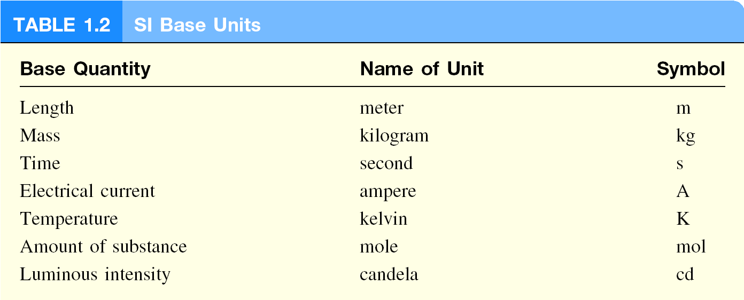
International System of Units (SI)

Slide 15
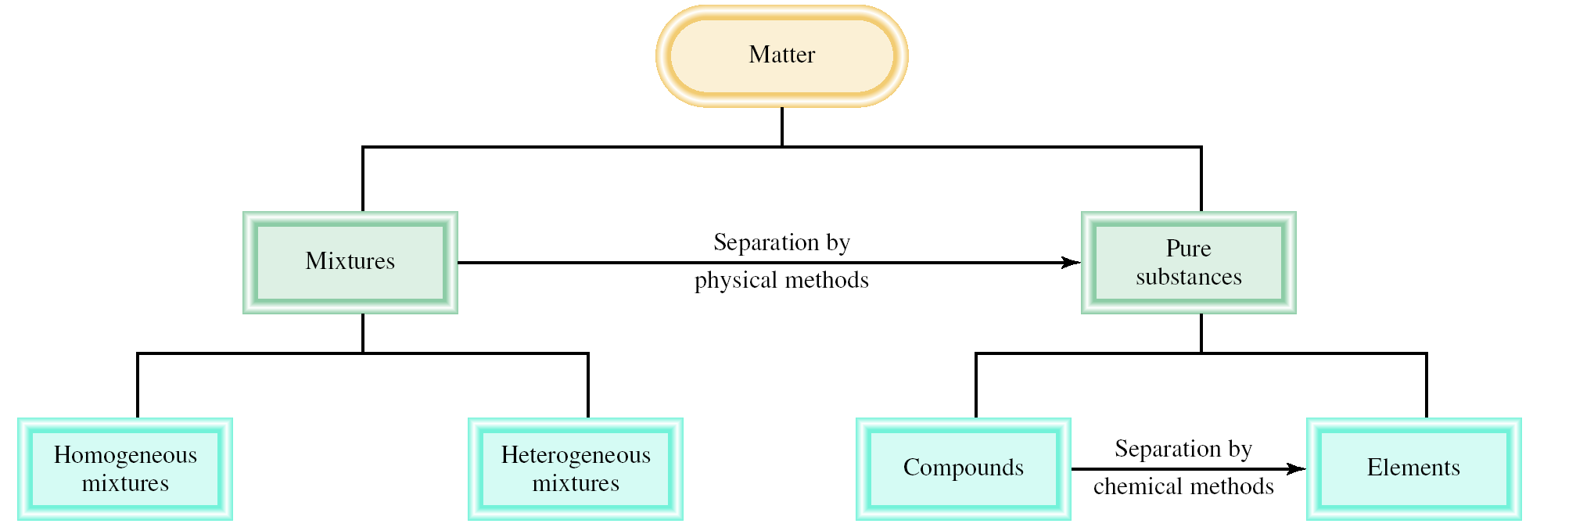
Classifications of Matter

Slide 16
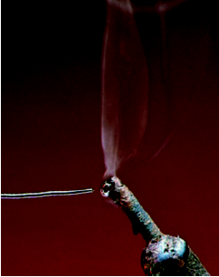
A mixture is a combination of two or more substances in which the substances retain their distinct identities.
Homogenous mixture – composition of the mixture is the same throughout.
soft drink, milk, solder
Heterogeneous mixture – composition is not uniform throughout.
cement,
iron filings in sand

Slide 17
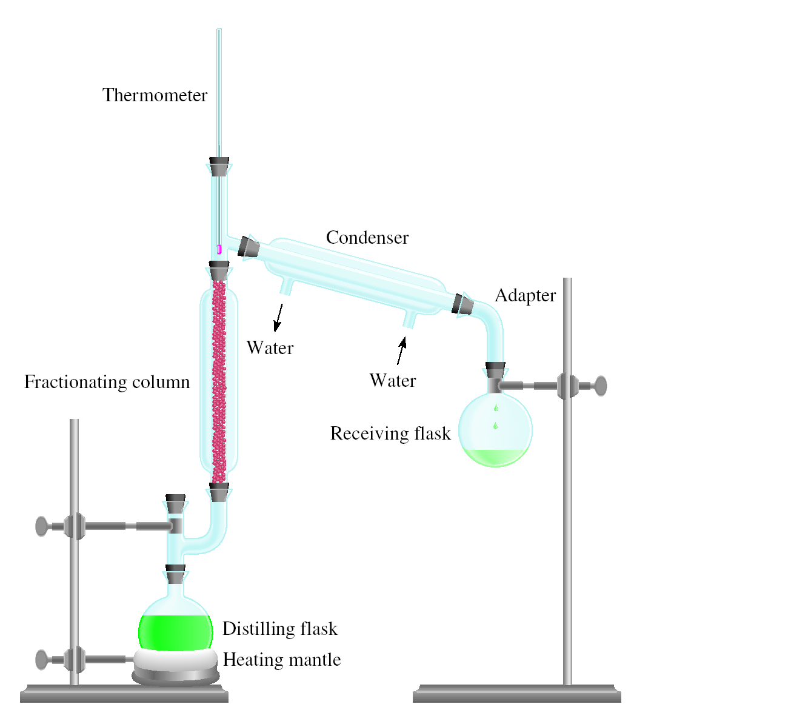
Physical means can be used to separate a mixture into its pure components.
magnet
distillation

Slide 18
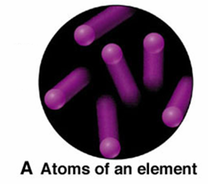
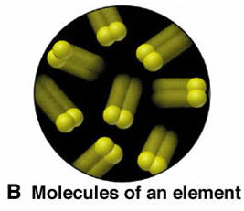
Element - The simplest type of substance with unique physical and chemical properties. An element consists of only one type of atom.
Molecule - A structure that consists of two or more atoms that are chemically bound together and thus behaves as an independent unit.

Slide 19
Compound – A substance composed of two or more elements that are chemically combined.
Mixture – A group of two or more elements and/or compounds that are physically intermingled.

Slide 20
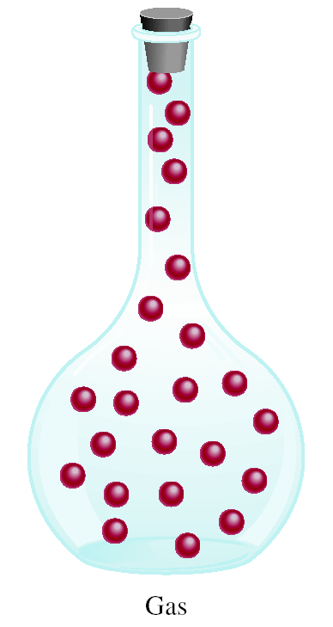
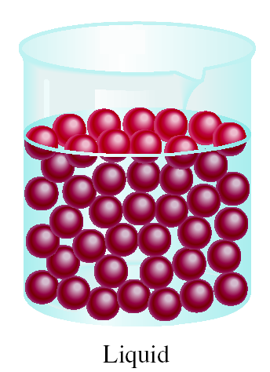
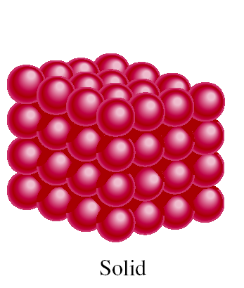
A Comparison: The Three States of Matter

Slide 21
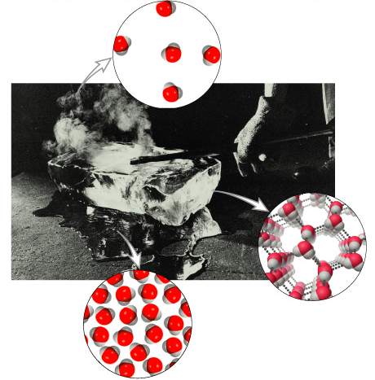
The Three States of Matter: Effect of a Hot Poker on a Block of Ice
gas
liquid
solid

Slide 23
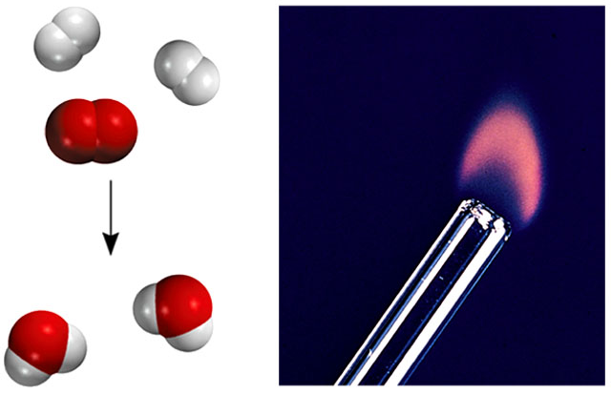
Types of Changes
A physical change does not alter the composition or identity of a substance.
sugar dissolving
in water
ice melting
A chemical change alters the composition or identity of the substance(s) involved.
hydrogen burns in air to form water

Slide 24
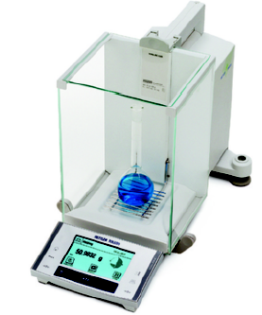
Extensive and Intensive Properties
An extensive property of a material depends upon how much matter is being considered.
mass
length
volume
An intensive property of a material does not depend upon how much matter is being considered.
density
temperature
color

Slide 25
Measurements
Measurement – quantitative observation consisting of two parts:
Number
Scale (unit)
Examples:
20 grams
6.63 × 10⁻³⁴ joule·seconds

Slide 26
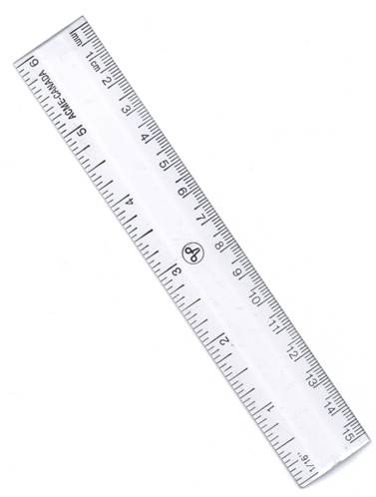
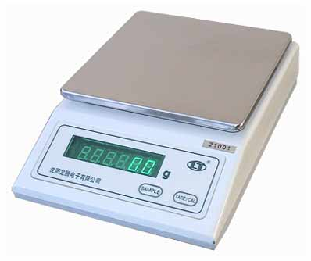
Common Types of Laboratory Equipment Used to Measure Mass & Length

Slide 27
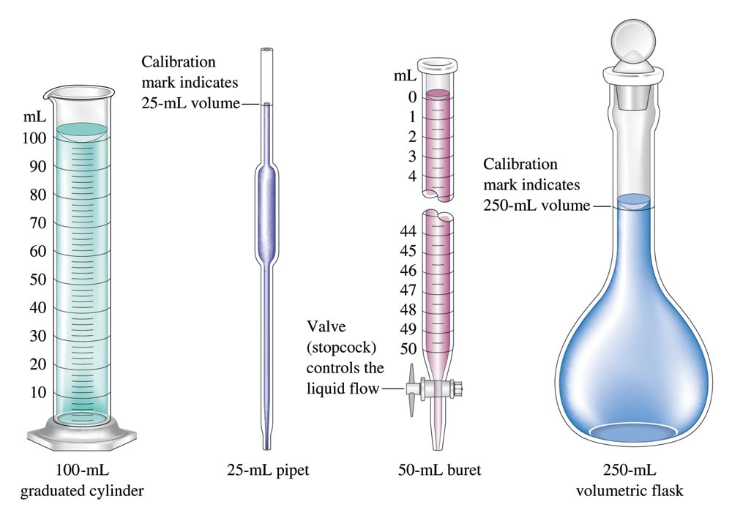
Common Types of Laboratory Equipment Used to Measure Liquid Volume

Slide 28
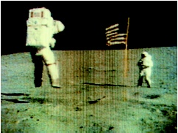
Matter - anything that occupies space and has mass.
mass – measure of the quantity of matter
SI unit of mass is the kilogram (kg)
1 kg = 1000 g = 1 x 10³ g
weight – force that gravity exerts on an object
weight = g x mass
A 1 kg bar will weigh
on earth, g = 9.81 m s⁻²
1 kg on earth
on moon, g is ∼1/6 of earth
0.17 kg on moon

Slide 29
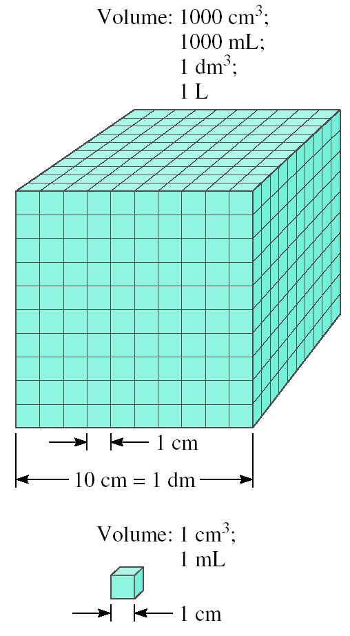
Volume – SI derived unit for volume is cubic meter (m³)
1 cm³ = (1 x 10⁻² m)³ = 1 x 10⁻⁶ m³
1 dm³ = (1 x 10⁻¹ m)³ = 1 x 10⁻³ m³
1 L = 1000 mL = 1000 cm³ = 1 dm³
1 mL = 1 cm³

Slide 30
Density – SI derived unit for density is kg/m³
1 g/cm³ = 1 g/mL = 1000 kg/m³
mass
m
density =
d =
volume
V
A piece of platinum metal with a density of 21.5 g/cm³ has a volume of 4.49 cm³. What is its mass?
m
d =
V
m = d x V
= 21.5 g/cm³ x 4.49 cm³ = 96.5 g

Slide 31
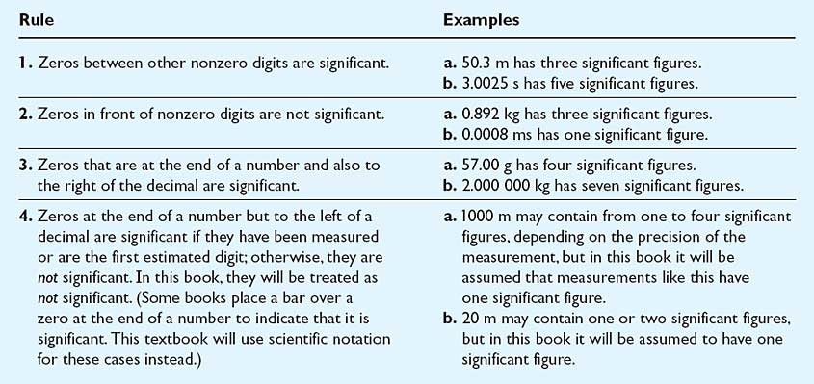
Rules for Significant Figures

Slide 32
Easier??

Slide 33
Rules for Calculating with Significant Figures

Slide 34
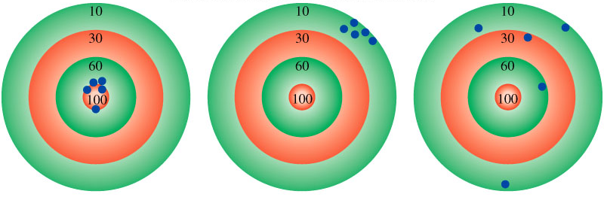
Accuracy – how close a measurement is to the true value
Precision – how close a set of measurements are to each other
accurate
&
precise
precise
but
not accurate
not accurate
&
not precise

Slide 35
