Slide 1
Identification of Bacteria BBT201 Ach

Slide 2
Importance of Bacteria identification 1. Determining the clinical significance of bacteria and its particular pathogen. 2. Determining the antimicrobial resistance of the bacteria. 3. Determining the appropriate clinical approaches and therapy against bacteria. 4. Determining whether infectious organisms are risk for patients.

Slide 3
Identification methods of bacteria There are three processes for the identification of bacteria. 1.Phenotypic method 2. Immunochemical method 3. Molecular method

Slide 4
Molecular analysis
Genotypic methods of microbe identification includes;
Nucleic acid probes
PCR
Nucleic acid sequence analysis
16s rRna analysis

Slide 5
DNA Extraction and sequencing method

Slide 6
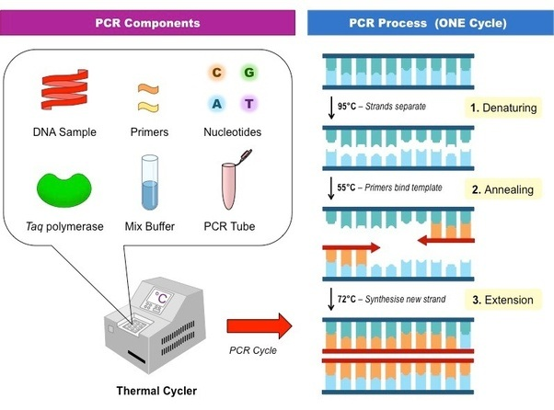
PCR- Polymerase Chain Reaction --------------------amplification for bacterial identification
PCR master mix solution needed for pcr amplification.
You have to set up the positive control reaction.

Slide 7
Run pcr
Load all reaction tubes into thermocycler/Pcr machine.
Automatic process of Dna starts.
The temperature control is set up as follows:
Initial incubation step: 95°C for 10 minutes
30 cycles of the following sequence of steps:
Melt: 95°C 30 seconds
Anneal: 60°C 30 seconds
Extend: 72°C 45 seconds
Final extension step: 72°C 10 minutes
Final step: 4°C store at this temperature

Slide 8
Significance of PCR steps
During each cycle, the first step (melt) is to separate the two DNA chains in the double helix by heating the vial containing the PCR reaction mixture to 95°C for 30 seconds. The primers cannot bind to the DNA strands at such a high temperature, so the vial is cooled to 60°C. At this temperature, the primers bind (anneal) to the single-stranded DNA. (The reason the two separated strands of DNA do not reanneal is that there is a large excess of primers in the solution; therefore, it's more likely for the DNA strands to bind to the primers instead of to each other.) The final step (Extend) is to allow the DNA polymerase to extend the copy DNA strand by raising the temperature to 70°C for 45 seconds. The three steps—the separation of the strands, annealing the primer to the template, and the synthesis of new strands—take less than two minutes. Each is carried out in the same vial. At the end of a cycle, each piece of DNA in the vial has been duplicated. The cycle can be repeated 30 or more times, and each newly synthesized DNA piece acts as a new template. After 30 cycles, 1 million copies of the initial DNA piece can be produced.

Slide 11
Sequence analysis
After the sequence information has been gathered from all the reaction tubes, the computer builds the actual sequence by matching together different pieces. You now have the 16S rDNA sequence for this bacterial species, which can be compared with all other known 16S rDNA sequences for identification. There are many sequence databases in existence. Some databases are sold commercially as part of an identification kit. In this example, we will use the GenBank public database available through the National Library of Medicine. The matching algorithm is known as BLAST (Basic Local Alignment Search Tool). A direct match of the DNA sequence determines the exact bacterial species you have found. When the DNA sequence is not an exact match but a close match to another found in the sequence database, you need to assess whether it is a new species or a variation of an existing one.

Slide 12
Summery of DNA Extraction and sequencing method

