Slide 1
Atoms, Molecules, and Ions
ACh

Slide 2
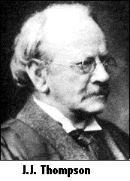
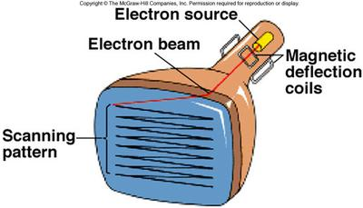
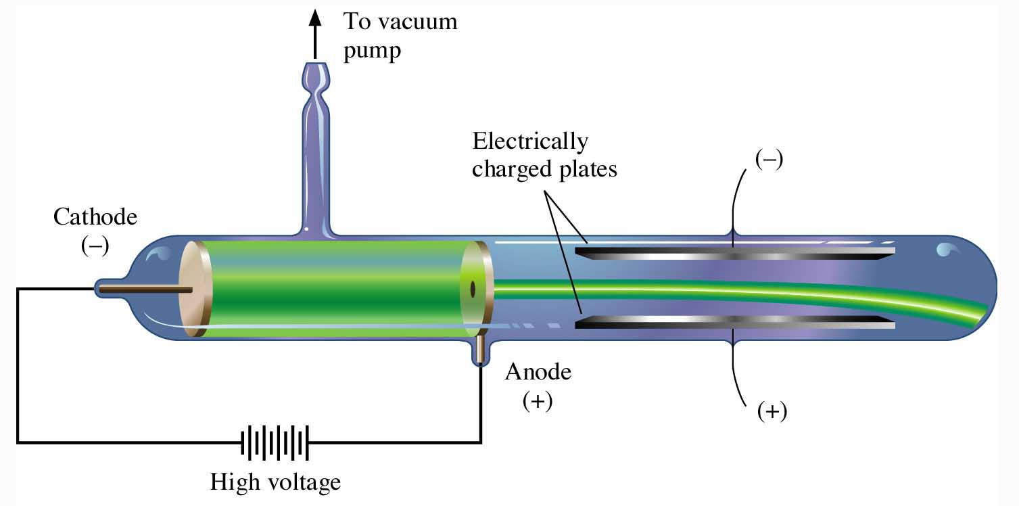
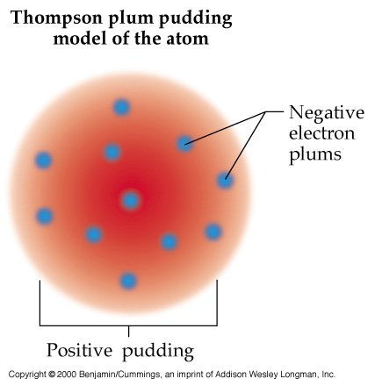
Atomic Theory of Matter
Particle Structure of the Atom
Electron – Discovered in 1898 by J.J. Thompson
Electron : A very light negatively charged subatomic particle.
-
e-
+
Another view of the Thompson Experiment
Notes:
2

Slide 3
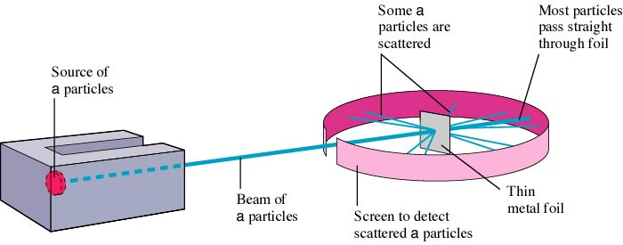
Rutherford’s Experiment on α−particle Bombardment of Metal Foil

Slide 4
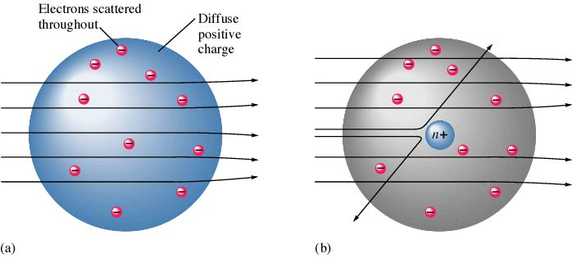
Expected and Actual Results of Rutherford’s Experiment

Slide 5
Rutherford Atomic Model (1911)
An atom with a dense center of positive charge (the nucleus) with electrons moving around the nucleus at a distance that is large relative to the nuclear radius. Nucleus is very small compared with the overall size of the atom. Nucleus is extremely dense, accounts for almost all of the atom’s mass.

Slide 6
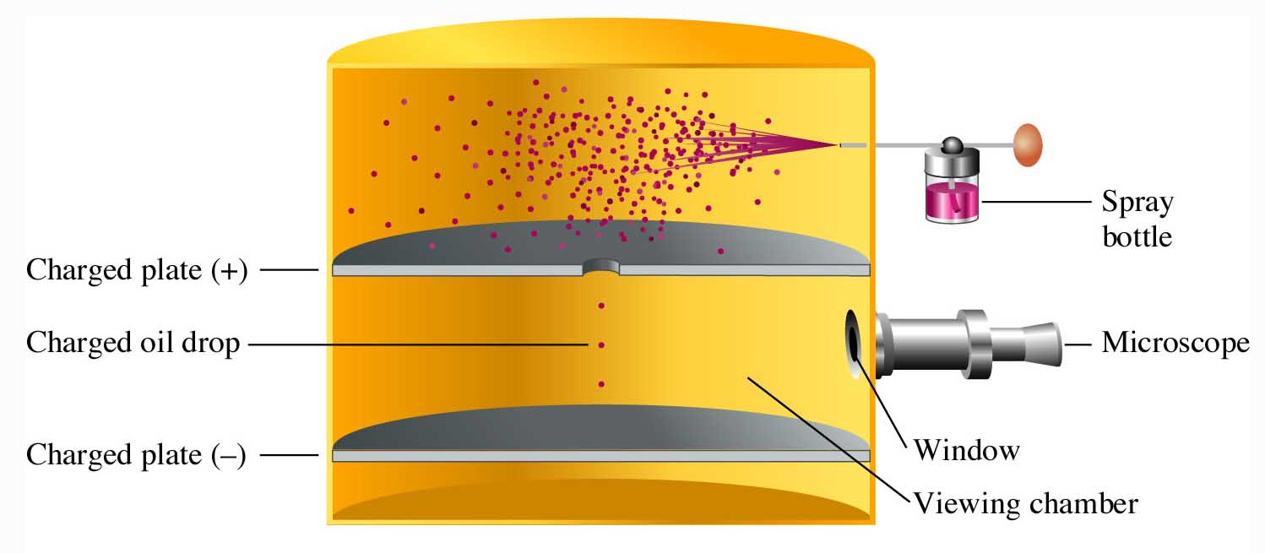
Atomic Theory of Matter
In 1909, U.S. physicist, Robert Millikan had obtained the charge on the electron. The electron’s mass was calculated to be 9.109 x 10-31 kg, which is more than 1800 times smaller than the mass of the lightest atom (hydrogen).
Notes:
2

Slide 7
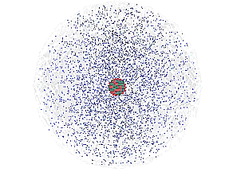
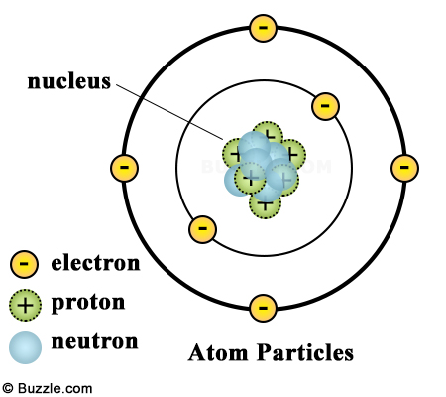
The Atom
An atom consists of a
nucleus
  (of protons and neutrons)
electrons in space about the nucleus.
Electron cloud
Nucleus

Slide 8
Copper atoms on silica surface.
An _____ is the smallest particle of an element that has the chemical properties of the element.
Distance across = 1.8 nanometer (1.8 x 10⁻⁹ m)

Slide 9
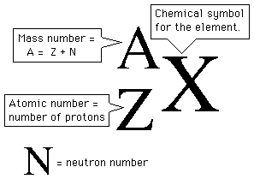

Atomic Theory of Matter
Protons Neutrons Electrons
6 6 6
6 7 6
6 8 6
Notes:
2

Slide 10
²³Na₁₁
Proton No./ Elctron NO./ Atomic No: 11
Nucleon No./ Relative atomic Mass No./ Mass No. : 23
Neutron NO: Mass #- Proton # = 12
Electronic Configuration: 2,8,1
Valence Electron: 1
Valency : +1
Period # , Group # : 3, 2
Accept/ Donate/ Share: Donate
Charge : +1

Slide 11
The Modern View of Atomic Structure
The atom contains:
  Electrons: move around the nucleus (mass: 9.11 X 10⁻³¹ kg, Charge 1⁻)
  Protons: found in the nucleus, they have a positive charge equal in magnitude to the electron’s negative charge (mass: 1.67 X 10⁻²⁷ kg, charge 1⁺)
  Neutrons: found in the nucleus, virtually same mass as a proton but no charge. (mass: 1.67 X 10⁻²⁷ kg, charge: 0)

Slide 12
Counting Protons, Neutrons, and Electrons
Protons: Atomic Number (from periodic table)
Neutrons: Mass Number minus the number of protons (mass number is protons and neutrons because the mass of electrons is negligible)
Electrons:
  If it’s an atom, the protons and electrons must be the SAME so that it is has a net charge of zero (equal numbers of + and -)
  If it does NOT have an equal number of electrons, it is not an atom, it is an ION. For each negative charge, add an extra electron. For each positive charge, subtract an electron (Don’t add a proton!!! That changes the element!)

Slide 13

Learning Check – Counting
¹²C ¹³C ¹⁴C
6 6 6
#p⁺ 6 6 6
#nº 6 7 8
#e⁻ 6 6 6

Slide 14
ELEMENTS
  pure substances that cannot be decomposed by ordinary means to other substances.
Aluminum
Bromine
Sodium

Slide 15
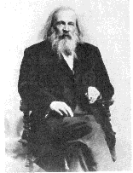
PERIODIC TABLE
The elements, their names, and symbols are given on the PERIODIC TABLE

Slide 16
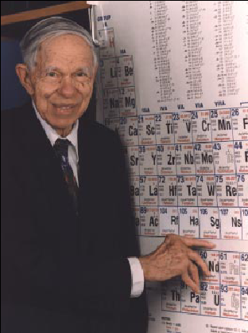
Glenn Seaborg
(1912-1999 )
Discovered 8 new elements.
Only living person for whom an element was named.

Slide 17
The red compound is composed of
• nickel (Ni) (silver)
• carbon (C) (black)
• hydrogen (H) (white)
• oxygen (O) (red)
• nitrogen (N) (blue)
CHEMICAL COMPOUNDS are composed of atoms and so can be decomposed to those atoms.

Slide 18
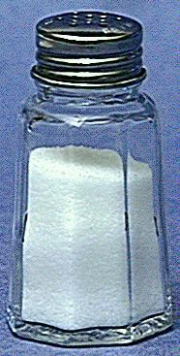
Compounds
  composed of 2 or more elements in a fixed ratio
  properties differ from those of individual elements
  EX: table salt (NaCl)

Slide 19
Atoms, Elements, Compounds, and Ions
Atom
  basic building block of all matter
Element
  Substance that consists of only one type of atom.
  Molecule has two different atoms.
Compound
  substance that consists of more than one type of
  element.
Ion
  substance that has a positive or negative charge

Slide 20
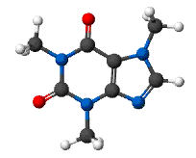
A MOLECULE is the smallest unit of a compound that retains the chemical characteristics of the compound.
Molecule: A collection of covalently-bonded atoms. H₂, O₂
Composition of molecules is given by a MOLECULAR FORMULA
H₂O
C₈H₁₀N₄O₂ - caffeine

Slide 21
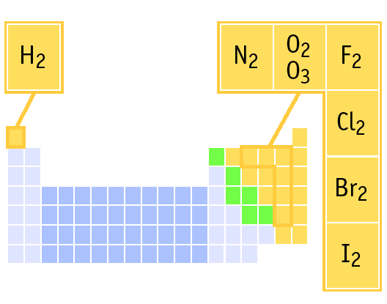
ELEMENTS THAT EXIST AS DIATOMIC MOLECULES
Remember:
BrINClHOF
These elements only exist as PAIRS. Note that when they combine to make compounds, they are no longer elements so they are no longer in pairs!

Slide 22
Radioactivity
Spontaneous emission of radiation
  Gamma (γ) rays: high energy light
  Beta (β) particles: high speed electron
  Alpha (α) particles (He²⁺): 2⁺ charge, charge twice that of electron and with opposite sign. The mass of an α -particle is 7300 times that of the electron

Slide 23
Isotopes
Atoms of the same element same number of protons & electron (same Z) but different neutron number hence mass number (A).
Boron-10 (¹⁰B) has 5 p and 5 n
Boron-11 (¹¹B) has 5 p and 6 n
¹¹B
¹⁰B

Slide 24
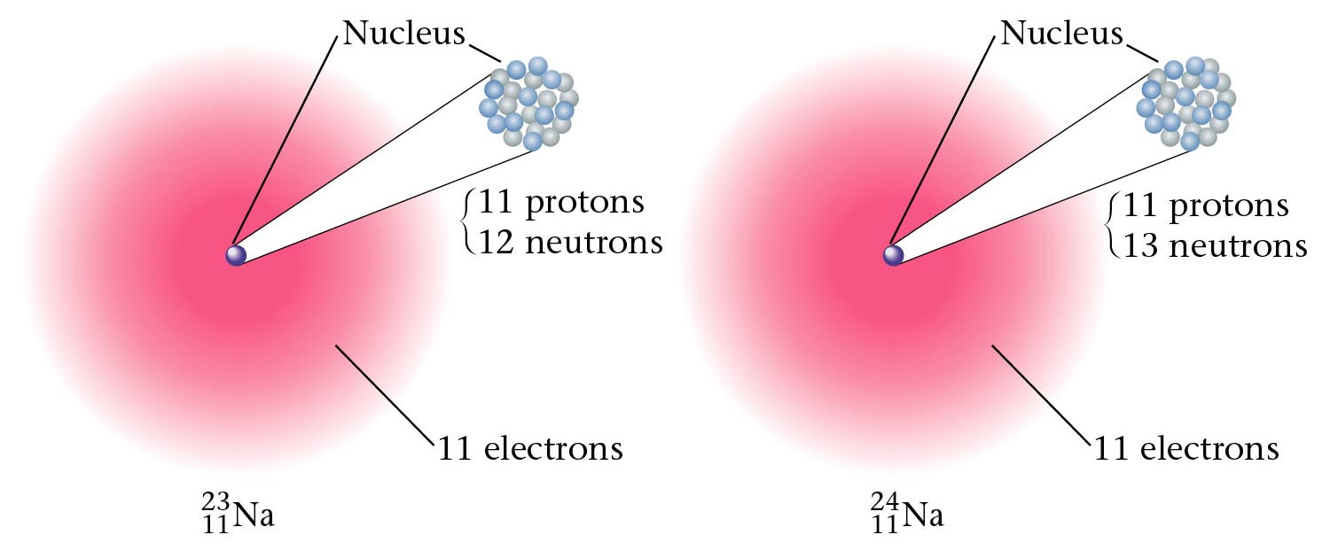
Two isotopes of sodium.

Slide 25
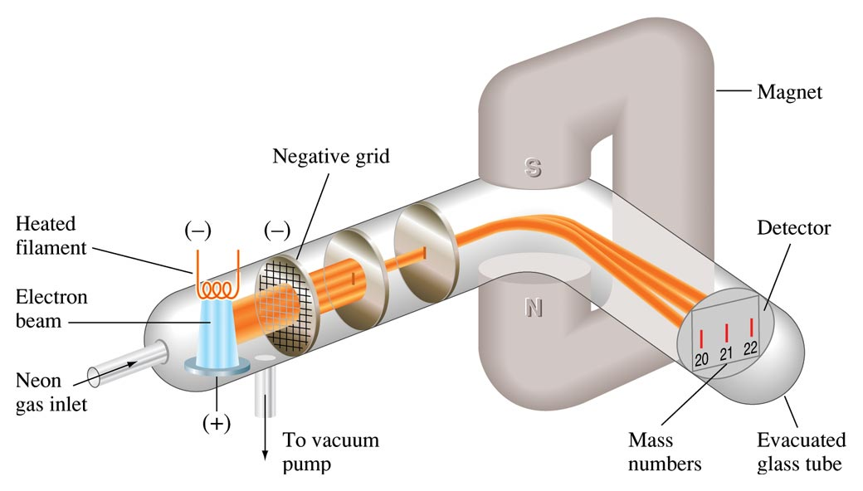
Diagram of a Simple Mass Spectrometer, Showing the Separation of Neon Isotopes

Slide 26
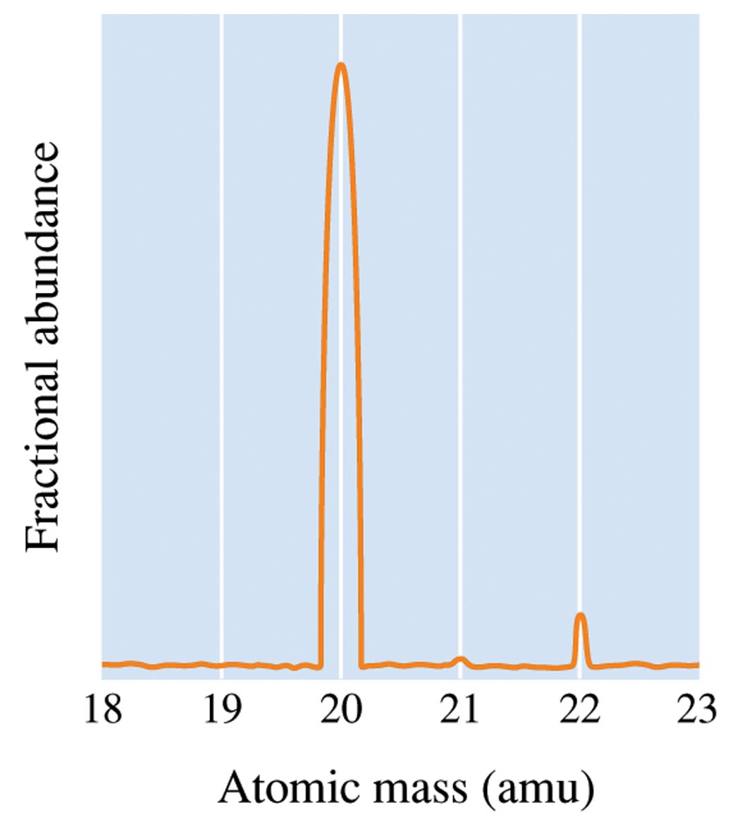
Atomic Theory of Matter
The fractional abundance is the fraction of a sample of atoms that is composed of a particular isotope. Another name is the weighted average of the atomic mass.
Notes:
2

Slide 27
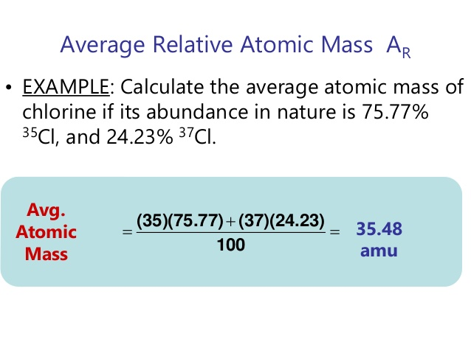
Isotopes & Average Atomic Mass
Because of the existence of isotopes, the mass of a collection of atoms has an average value.

Slide 28
Find out
⁶Li = 7.5% abundant and ⁷Li = 92.5%
  Avg. Atomic mass of Li = ______________
²⁸Si = 92.23%, ²⁹Si = 4.67%, ³⁰Si = 3.10%
  Avg. Atomic mass of Si = ______________

Slide 29


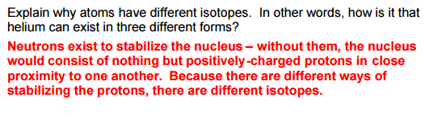
Extra

Slide 30
