Slide 1
Determination of the enzyme ALT (SGPT) & AST activity in serum by enzymatic method using Biophotometer

Slide 2
ALT
Alanine aminotransferase (glutamate pyruvate transaminase) belongs to the group of transaminases,
Catalyses the conversion of amino acid to the corresponding α-keto acids by the transfer of amino groups;
Although higher activities exist in the liver, minor activity can also be detected in the kidneys, heart, skeletal muscle, pancreas, spleen and lungs.
Elevated serum ALT is found in hepatitis, cirrhosis, obstructive jaundice, carcinoma of the liver and chronic alcohol abuse.
ALT is only slightly elevated in patients who have an uncomplicated myocardial infarction.
Although, both serum aspartate aminotransferase (AST) and ALT found to be elevated whenever disease processes affect liver cell integrity,
ALT is more liver specific enzyme. Moreover, elevations of ALT persist longer than elevations of AST activity.

Slide 3
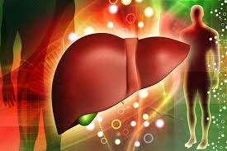

Slide 4
Principle
Alanine aminotransferase (glutamate pyruvate transaminase) catalyses the reversible transfer of an amino group from alanine to α-ketoglutarate forming glutamate and pyruvate.
The pyruvate produced is reduced to lactate by lactate dehydrogenase (LDH) and NADH.
The rate of decrease in concentration of NADH measured photometrically at 340nm is proportional to the catalytic concentration of ALT present in the sample.
R1 (buffer) | Tris pH 7.8 | 100mmol/l
 | L-Alanine | 500mmol/l
 | Lactate dehydrogenase (LDH) | 1200U/l
R2(substrate) | NADH | 0.18mmol/l
 | α-ketoglutarate | 15mmol/l

Slide 5
AST
Aspartate aminotransferase (glutamate oxaloacetate transaminase) belongs to the group of transaminases,
Catalyse the conversion of amino acids to the corresponding α-keto acids via the transfer of amino groups; they also catalyze the reverse process.
AST is commonly found in human tissue. Although heart muscle is found to have the most activity of the enzyme, significant activity has also been seen in the brain, liver, gastric mucosa ,adipose tissue, skeletal muscle, and kidneys.
AST is present in both cytoplasm and mitochondria of cells. In cases with mild tissue injury, the predominant form of AST is that from the cytoplasm, with a smaller amount coming from the mitochondria.
Severe tissue damage results in more of the mitochondrial enzyme being released.
Elevated levels of transaminases are indicative of myocardial infarction, hepatopathies, muscular dystrophy and damage to the internal organs.
Increased levels of AST however are generally a result of viral or toxic hepatitis and obstructive jaundice. Following a myocardial infarction, serum levels of AST are elevated and reach a peak 48-60 hours after onset.

Slide 6
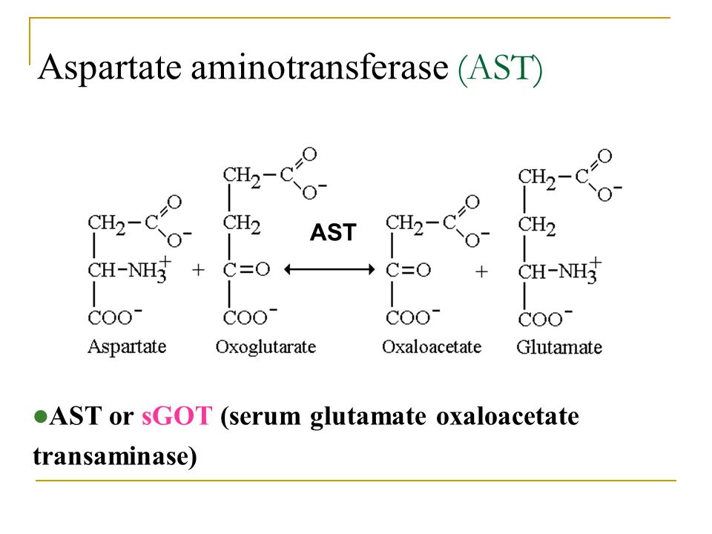

Slide 7
Significance
The blood test for aspartate aminotransferase (AST) is usually used to detect liver damage. It is often ordered in conjunction with another liver enzyme, alanine aminotransferase (ALT)
AST and ALT are considered to be two of the most important tests to detect liver injury, although ALT is more specific for the liver than is AST and is more commonly increased than is AST.
Sometimes AST is compared directly to ALT and an AST/ALT ratio is calculated.
This ratio may be used to distinguish between different causes of liver damage and to distinguish liver injury from damage to heart or muscle.

Slide 8
Ratio of AST and ALT can be useful in differential
ALT is more specific for liver damage than AST
AST: ALT =1
Associated with ischaemia (CCF and ischaemic necrosis and hepatitis)
AST: ALT >2.5
Associated with Alcoholic hepatitis
Alcohol induced deficiency of pyridoxal phosphate
AST: ALT <1
High rise in ALT specific for Hepatocellular damage
Paracetamol OD with hepatocellular necrosis
Viral hepatitis, ischaemic necrosis, toxic hepatitis
Ischaemia: an Inadequate blood supply to an organ or part of the body, especially the heart muscles.

